Slide 1
MITOCHONDRIAL NETWORK EVIDENCE
Phase 12 KDA and Phase 13 modifier analysis
How the figures were generated, what they show, and where the conclusions stop
Phase 12: cross-network KDA ranking, stratified support, and topology Phase 13: donor-aware respiratory modifier tests across the complete prespecified family
Prepared from validated project outputs • 10 August 2026

Slide 2
DECK MAP
One story, three levels of evidence
The figures answer related—but not interchangeable—questions.
1
2
3
Rank & localize
Connect & synthesize
Formally test modifiers
Which candidate drivers recur, and in which sex/APOE and cell-network contexts?
How do selected drivers connect to mitochondrial and Complex V genes across directed networks?
Do donor-level respiratory module effects differ by sex or APOE after complete-family correction?
Phase 12 overview + heatmap
Four network figures
Phase 13 landscape
Interpretive rule
Network enrichment generates mechanistic hypotheses; Phase 13 provides the donor-aware interaction test.
2

Slide 3
SHARED SETUP
Phase 12 KDA: common analytical foundation
All Phase 12 figures use eligible primary directional KDA runs and preserve the full candidate matrix.
1
Directional signatures
2
Directed neighborhoods
AD-up and AD-down mitochondrial DEG signatures are evaluated separately; pooled and combined-direction signatures are excluded.
KDA asks whether a signature is enriched downstream of a candidate in a broad-cell-type Bayesian network.
3
Complete test matrix
4
Two evidence summaries
Nonsignificant and zero-overlap tests remain. A truly untested candidate stays missing, preventing significance-only ranking bias.
Mean −log10(P) ranks candidates; within-run BH-adjusted P≤0.05 counts recurrence. Neither is a causal effect estimate.
Key boundary: KDA significance means a candidate’s downstream neighborhood is enriched for the query signature. It does not prove a direct gene-to-gene effect or causality.
Sources: Phase 12 design documents; prepare_phase12_kda_figure_data.R
3

Slide 4
FIGURE 1 SETUP
Reduced circular overview: setup and generation
A deliberately reduced view ranks each network independently and shows only cross-network recurrence.
7
3
21
295
broad networks with eligible KDA runs
top drivers retained per network
network–driver sectors plotted
eligible primary directional runs reconciled
Ranking statistic
Visual encoding
Outer color band = broad network
Sn,g = mean across eligible runs of −log10(PKDA)
Radial bar = standardized MeanOfLog
Standardized to the maximum within each broad network; coverage is explicit and used in deterministic tie-breaking.
Center link = same gene selected in >1 network
Gray label marker = mtDNA-encoded sentinel
CAMs and T cells had no eligible KDA runs and therefore receive no empty sector; absence is not a negative KDA result.
Source: reduced_circular_figure_design.md; visualize_phase12_kda_reduced_circular.R
4

Slide 5
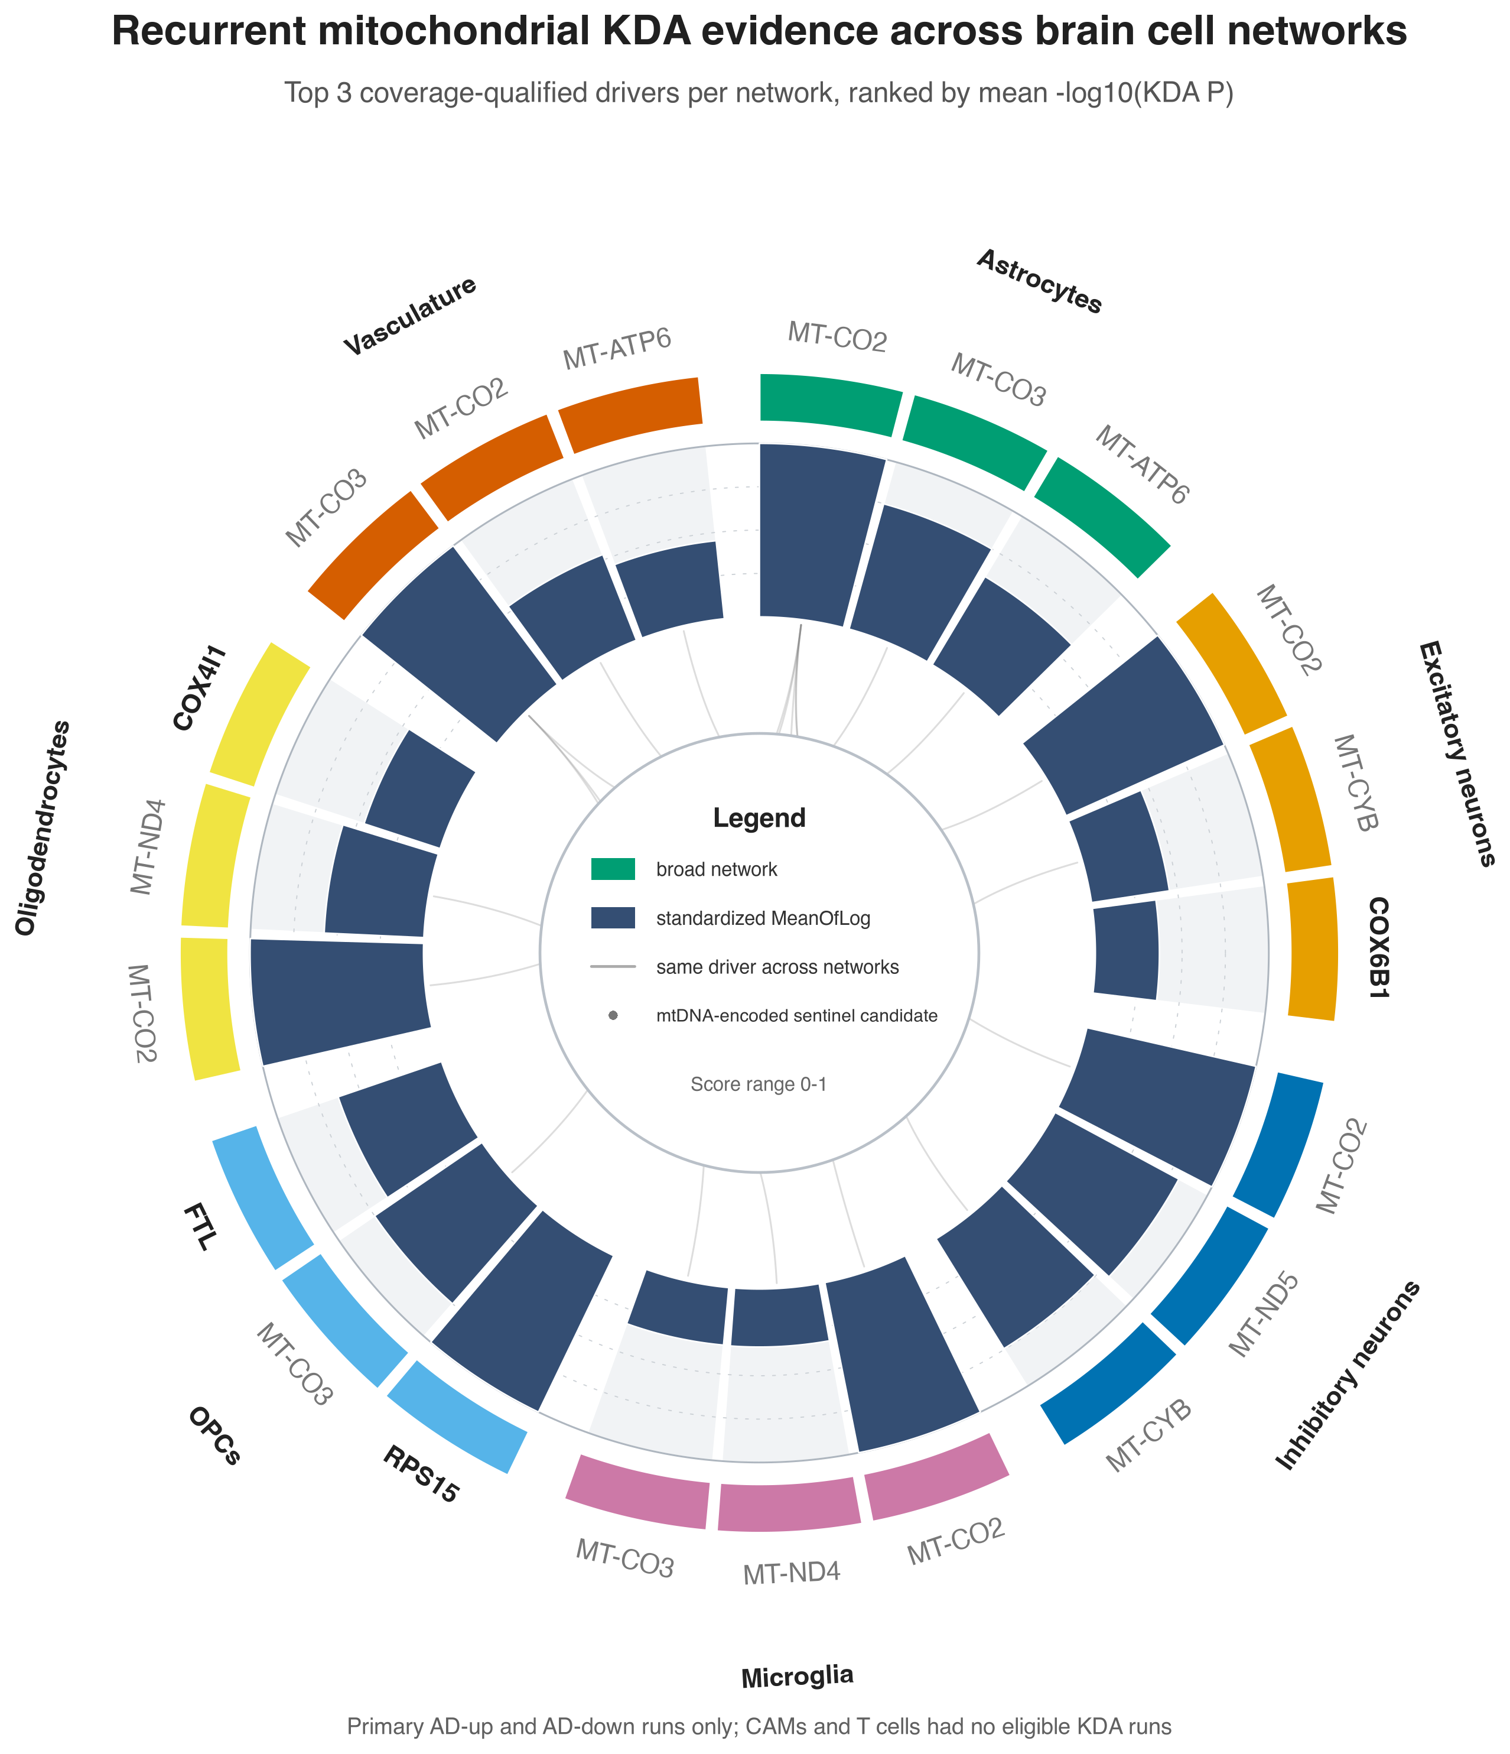
FIGURE 1 • RECURRENT MITOCHONDRIAL KDA EVIDENCE ACROSS NETWORKS
Source: phase12_kda_reduced_circular.png
5

Slide 6
FIGURE 1 CONCLUSIONS
Circular overview: findings
The overview is dominated by recurrent respiratory-chain sentinels, with a small number of nuclear candidates.
10
17/21
6
100%
unique drivers among 21 sectors
selected sectors are mtDNA-encoded
networks select MT-CO2 in the top three
ranking coverage for all displayed rows
What the figure supports
What the figure does not establish
MT-CO2 is the dominant recurrent candidate across broad networks.
High rank is not proof that an mtDNA gene is an upstream causal regulator.
MT-CO3, MT-ATP6, MT-CYB, and MT-ND4 also recur across network top-three lists.
Center links show repeated selection—not Bayesian-network edges.
OPCs elevate nuclear candidates RPS15 and FTL; excitatory and oligodendrocyte lists include COX6B1 and COX4I1.
The overview is a sentinel map; mechanistically tractable nuclear candidates are evaluated in the next panels.
Source: phase12_kda_reduced_circular_plotted_data.tsv
6

Slide 7
FIGURE 2 SETUP
Sex/APOE evidence map: setup and generation
A conservative candidate screen focuses the display on nuclear, query-independent driver hypotheses.
1
Select candidate rows
2
Aggregate within each stratum
Primary directional result; non-mtDNA; driver outside the query; overlap ≥2; signature size ≥10; sufficient ranking coverage.
For each row × sex/APOE × direction cell, summarize every tested run—not only significant rows.
3
Encode strength and recurrence
4
Keep missingness visible
Color = mean −log10(P); area = fraction of tested runs significant after within-run BH correction.
Outlined dot = tested, none significant. Gray × = no eligible/tested run. Right bar = within-network overall rank.
16
192
45
19
prioritized network–driver rows
direction × sex/APOE display cells
cells with ≥1 significant run
cells with no eligible/tested run
The shared color cap is the prespecified 95th percentile (≈5.00); uncapped values remain in the TSV.
Sources: sex_apoe_dot_heatmap_design.md; visualize_phase12_kda_sex_apoe.R
7

Slide 8
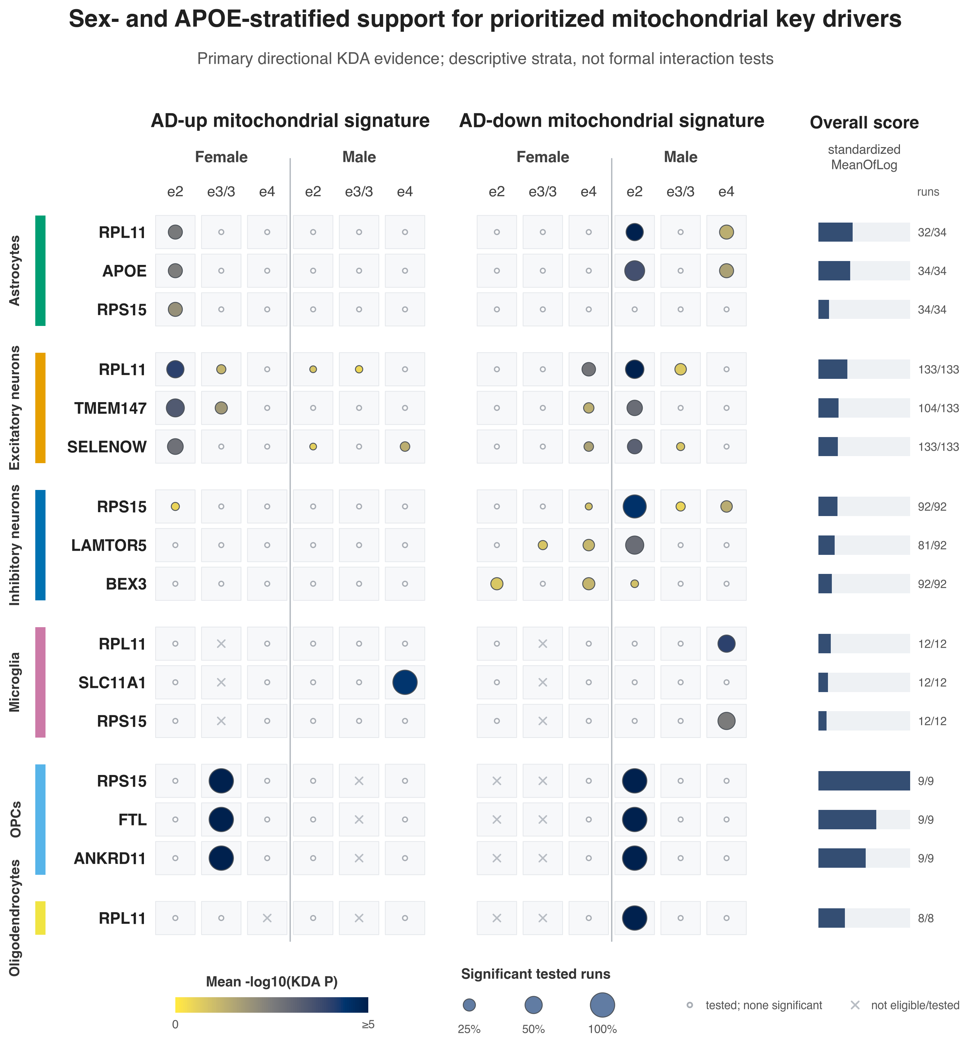
FIGURE 2 • SEX- AND APOE-STRATIFIED SUPPORT FOR PRIORITIZED DRIVERS
Source: phase12_kda_sex_apoe.png
8

Slide 9
FIGURE 2 CONCLUSIONS
Sex/APOE map: findings
Two ε2-associated directional patterns are broadest; other signals are more localized and often sparsely replicated.
Male ε2 • AD-down
Female ε2 • AD-up
Broadest recurring pattern
Complementary recurring pattern
Excitatory RPL11: 8/14 significant runs
Excitatory RPL11: 6/12; TMEM147: 6/11
Inhibitory RPS15: 9/10; LAMTOR5: 5/9
Excitatory SELENOW: 5/12
Astrocytic APOE: 2/3; excitatory TMEM147: 4/10
Astrocytic RPL11, APOE, and RPS15: each 1/3
OPC and oligodendrocyte signals are 1/1 and therefore strong but minimally replicated
Additional female ε4 AD-down and male ε4 signals are network-specific
Conclusion: the strata generate hypotheses for donor-aware interaction tests; visual differences are not formal sex/APOE interactions.
Source: sex_apoe_explanation.md; phase12_kda_sex_apoe_plotted_data.tsv
9

Slide 10
SHARED NETWORK SETUP
Network figures: shared inputs and visual language
The same validated production bundle, network backgrounds, degree mapping, and Complex V definition are reused across all four figures.
Inputs
Visual grammar
Reproducibility
Phase 12 run-level KDA and complete candidate tests
key driver
Deterministic layouts and path tie-breaking
Broad-cell-type directed Bayesian networks
black ring = KDA overlap
Auditable node, edge, path, and plotted-point TSVs
Matched Phase 08 AD vs NCI log fold-change
purple ring = Complex V
Input/output SHA-256 hashes and UTC generation log
Run-specific effective backgrounds and selected layers
dark = highlighted path
10 automated tests passed
Fixed 26-gene MitoCarta Complex V definition
pale = neighborhood context
300-dpi-scale PNG plus SVG/PDF vectors
Node fill: blue = lower in AD; orange = higher in AD
Sources: network_figures_creation_plan.md; phase12_kda_network_figure_common.py
10

Slide 11
FIGURE 3 SETUP
Wang-style neighborhoods: setup and generation
Three prespecified representative runs illustrate directed routes from nominated drivers to mitochondrial targets.
Panel | Driver / context | Selected run | Neighborhood | Why selected
A | APOE / astrocyte | Ast GRM3 • male ε2 • AD-down | L2 • n=19 • overlap=5 | Mechanistic ATP/TUFM example
B | LAMTOR5 / excitatory | Exc L3-4 RORB CUX2 • male ε2 • AD-down | L3 • n=27 • overlap=8 | Smallest LAMTOR5 q
C | GABARAPL2 / excitatory | Exc L4-5 RORB GABRG1 • male ε2 • AD-down | L3 • n=45 • overlap=9 | Smallest GABARAPL2 q
How the panels were built
Selection boundary
Reconstruct the exact directed KDA neighborhood inside the run-specific effective background.
These are illustrative runs, not the only supporting runs. Cross-run recurrence is evaluated separately in the convergence figure.
Truncate at the result’s selected layer; preserve all neighborhood edges.
Highlight prespecified shortest routes to Complex V, translation, and stress-control genes.
Label only focal drivers, overlaps, targets, and path intermediates to keep 19–45-node panels readable.
Sources: wang_subnetworks_explanation.md; plot_phase12_kda_wang_subnetworks.py
11

Slide 12
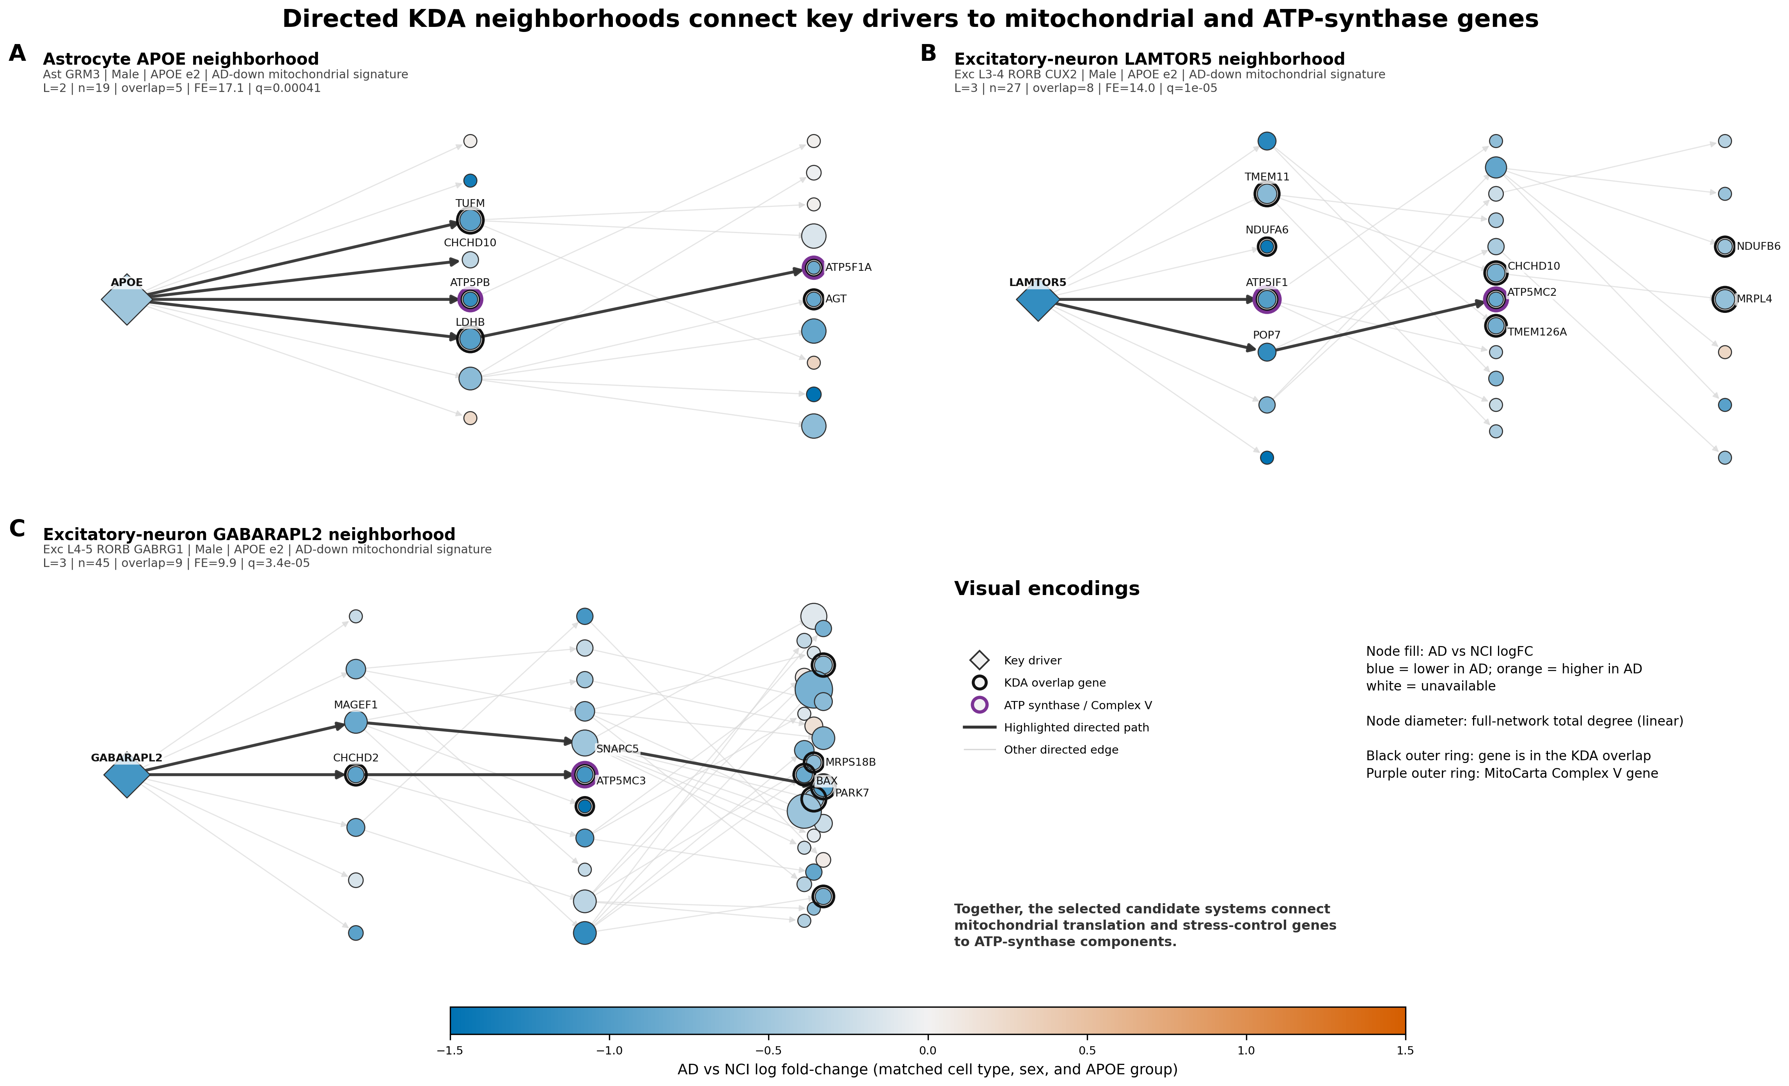
FIGURE 3 • DIRECTED KDA NEIGHBORHOODS CONNECT DRIVERS TO MITOCHONDRIAL GENES
Source: phase12_kda_wang_subnetworks.png
12

Slide 13
FIGURE 3 CONCLUSIONS
Wang-style neighborhoods: findings
All three selected driver systems contain directed routes to mitochondrial and ATP-synthase genes.
APOE • astrocyte
LAMTOR5 • excitatory
GABARAPL2 • excitatory
APOE → TUFM; APOE → ATP5PB; APOE → LDHB → ATP5F1A
LAMTOR5 → ATP5IF1; LAMTOR5 → POP7 → ATP5MC2
GABARAPL2 → CHCHD2 → ATP5MC3; route through MAGEF1/SNAPC5 to PARK7
FE 17.1 • q=0.00041
FE 14.0 • q≈1×10⁻⁵
FE 9.9 • q≈3.4×10⁻⁵
Conclusion: the selected candidate systems connect mitochondrial translation and stress-control genes to Complex V components—within directed model neighborhoods, not as experimentally proven regulatory chains.
Source: network_figures_explained.md; path TSVs
13

Slide 14
FIGURE 4 SETUP
Sex-reversal networks: setup and generation
Female ε2 AD-up and male ε2 AD-down neighborhoods are aligned to separate topology, membership, and expression color.
Female ε2
Male ε2
AD-up mitochondrial signature
AD-down mitochondrial signature
Condition-specific neighborhood reconstructed for APOE, LAMTOR5, and GABARAPL2
The same three driver systems and matched cell contexts
Matched Phase 08 AD-vs-NCI logFC colors the active nodes
The row’s union graph is computed once and uses identical coordinates
KDA overlap rings are condition-specific
Elements absent in one condition are faded rather than removed
Shared coordinates make orange-to-blue expression reversals directly visible; they do not test whether network topology differs by sex.
Sources: sex_reversal_networks_explanation.md; plot_phase12_kda_sex_reversal_networks.py
14

Slide 15
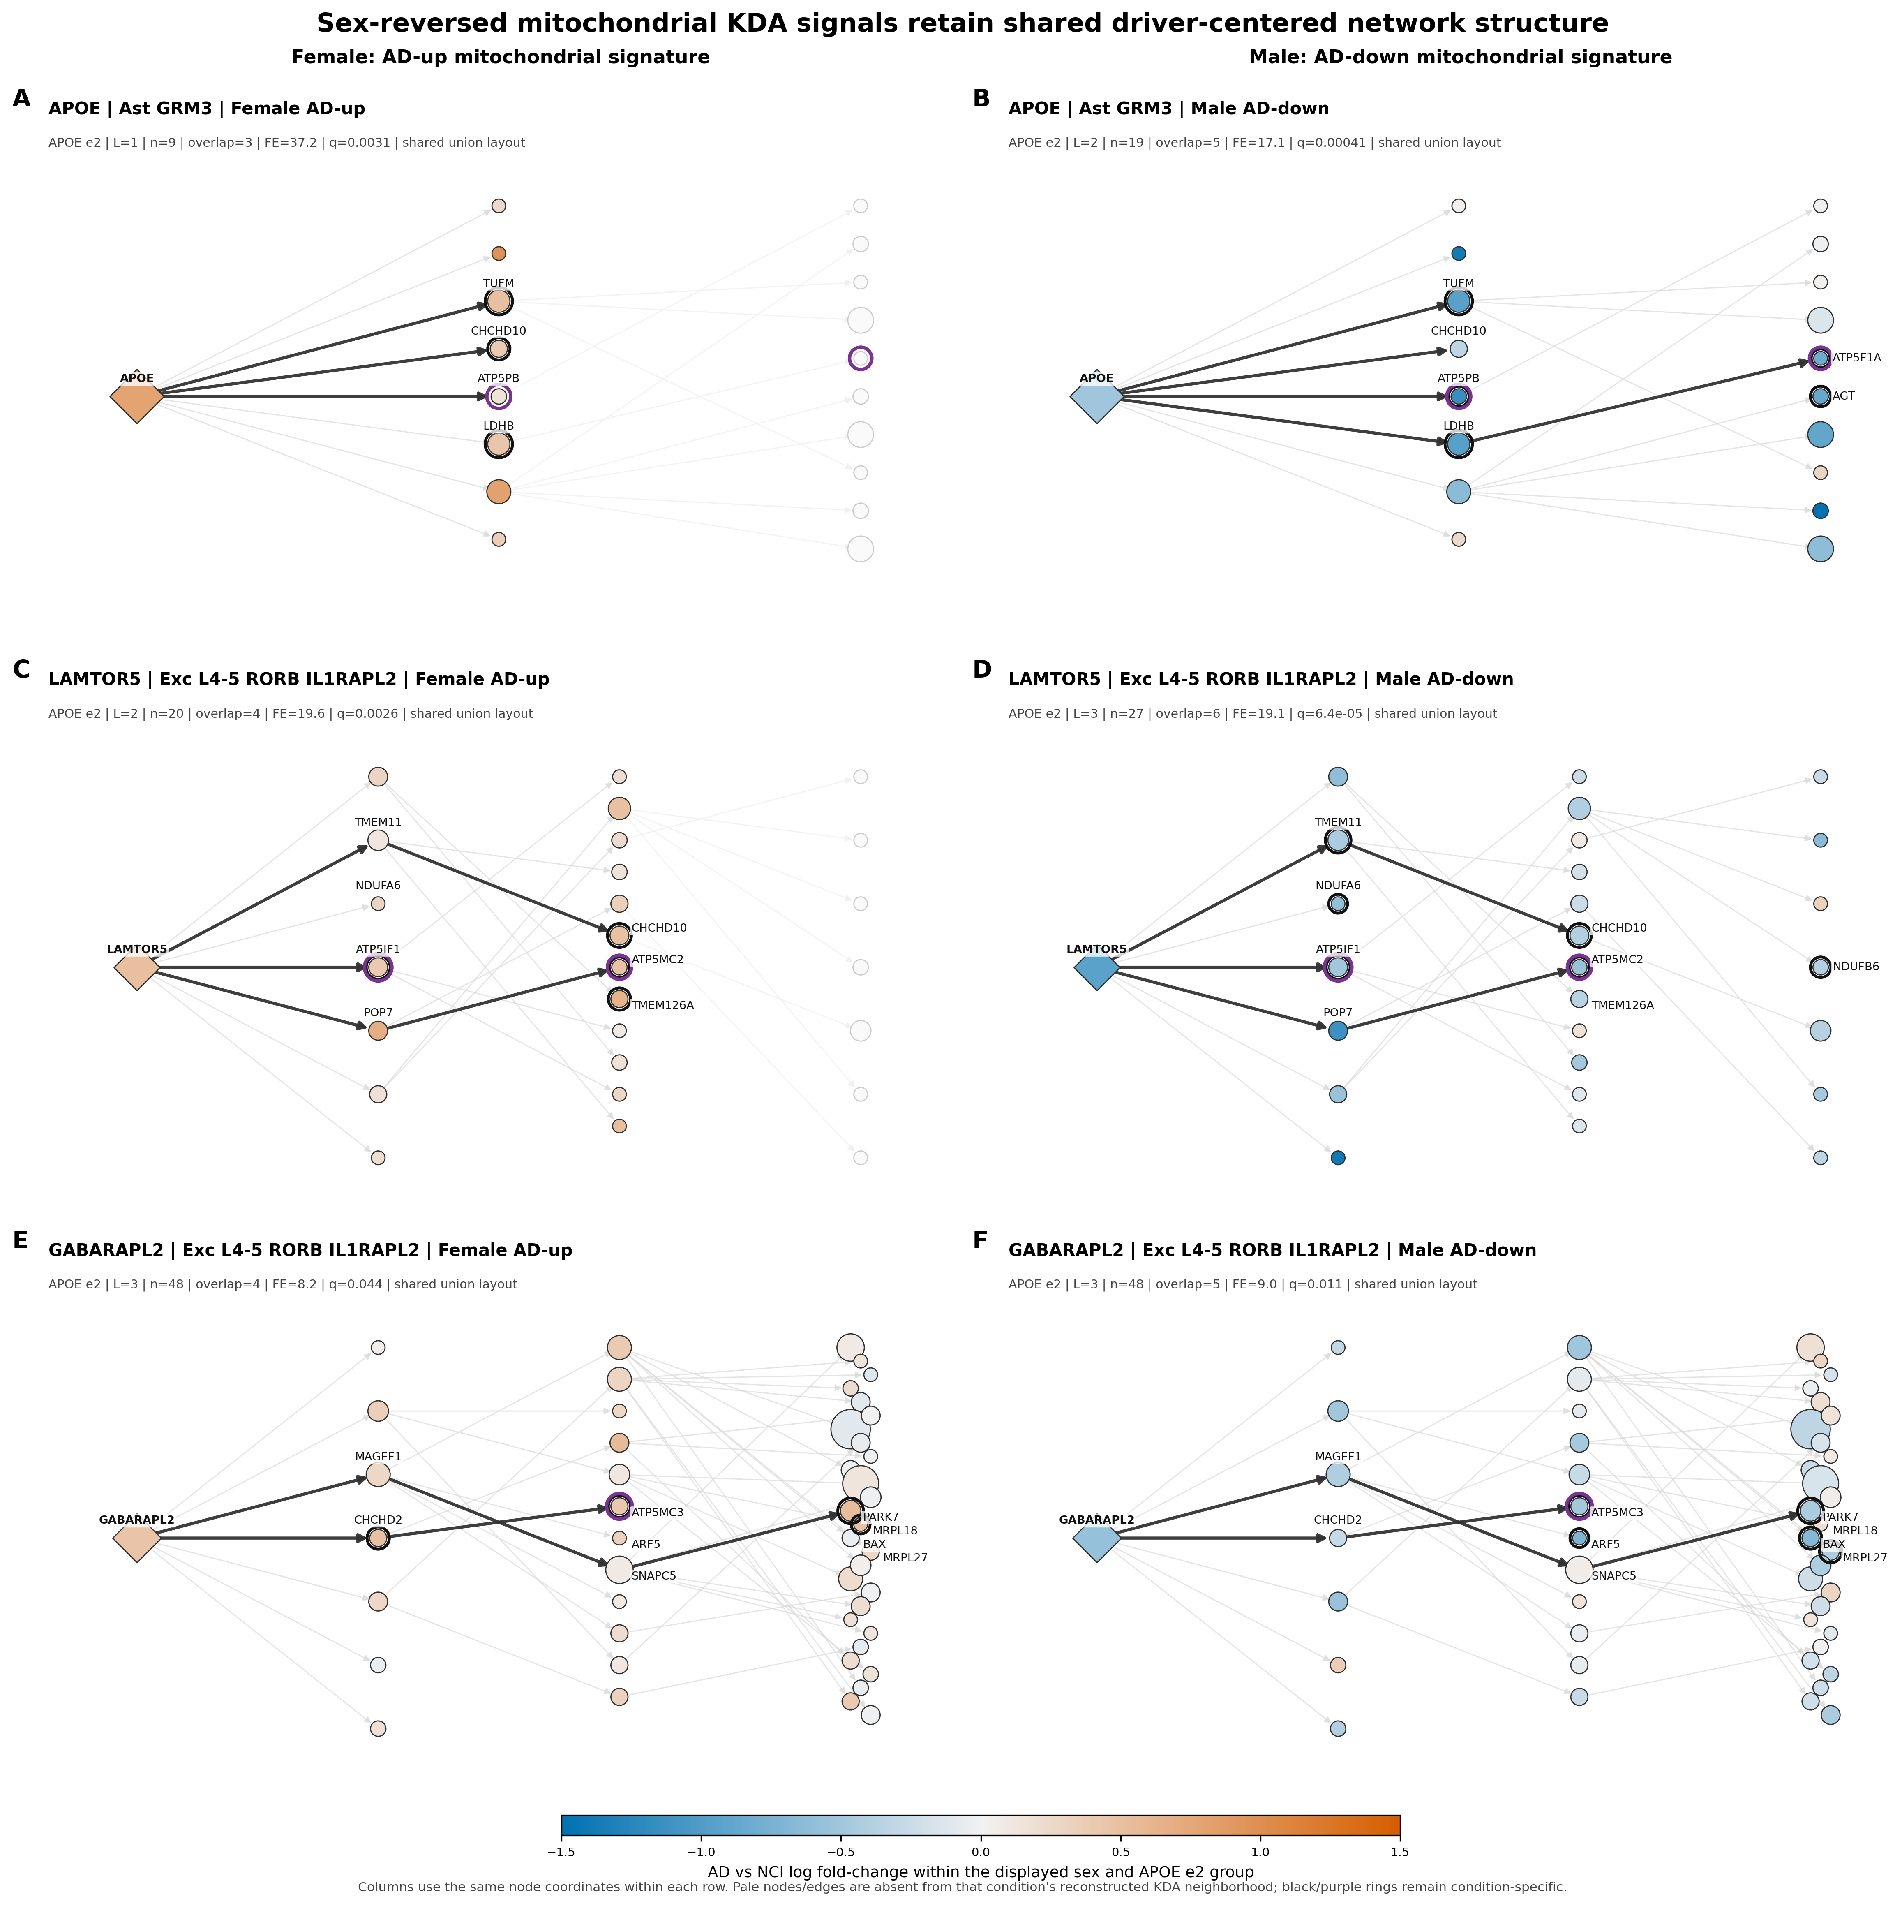
FIGURE 4 • SEX-REVERSED KDA SIGNALS RETAIN SHARED DRIVER-CENTERED STRUCTURE
Source: phase12_kda_sex_reversal_networks.png
15

Slide 16
FIGURE 4 CONCLUSIONS
Sex-reversal networks: findings
The same driver-centered framework accompanies opposite descriptive expression directions in ε2 female and male strata.
System / gene | Female ε2 AD-up logFC | Male ε2 AD-down logFC
Astrocyte APOE | +0.785 | −0.506
TUFM | +0.506 | −0.939
ATP5PB | +0.153 | −1.151
Excitatory LAMTOR5 | +0.505 | −0.928
ATP5IF1 | +0.420 | −0.497
Excitatory GABARAPL2 | +0.463 | −0.573
ATP5MC3 | +0.430 | −0.491
Supported interpretation
APOE, LAMTOR5, and GABARAPL2 remain linked to mitochondrial/Complex V genes in both ε2 strata, while matched AD effects reverse direction.
Required caution
No formal AD×sex or AD×APOE interaction was fitted here. Networks are reused across sex, donor groups are small/unequal, and the two strata are not independent replications.
Source: sex_reversal_networks_explanation.md; node TSV
16

Slide 17
FIGURE 5 SETUP
ATP convergence map: setup and generation
Unlike the selected neighborhoods, this bipartite map synthesizes qualifying primary directional calls across runs.
Qualifying-call filter
Encoding
Primary AD-up or AD-down KDA run
Left nodes: selected driver × broad network; color = network
Driver is nuclear and outside its overlap
Driver size: full-network degree using the shared Wang mapping
Overall overlap ≥2 genes
Right nodes: Complex V genes; area = total supporting calls
Mitochondrial signature ≥10 genes
Edge width: number of qualifying runs
At least one overlap gene in fixed 26-gene Complex V set
Line style: directed distance 1, 2, or 3
Deduplicate by KDA run ID for each network–driver–target
27
93
focused driver–target relationships
complete qualifying combinations
Sources: atp_convergence_explanation.md; plot_phase12_kda_atp_convergence.py
17

Slide 18
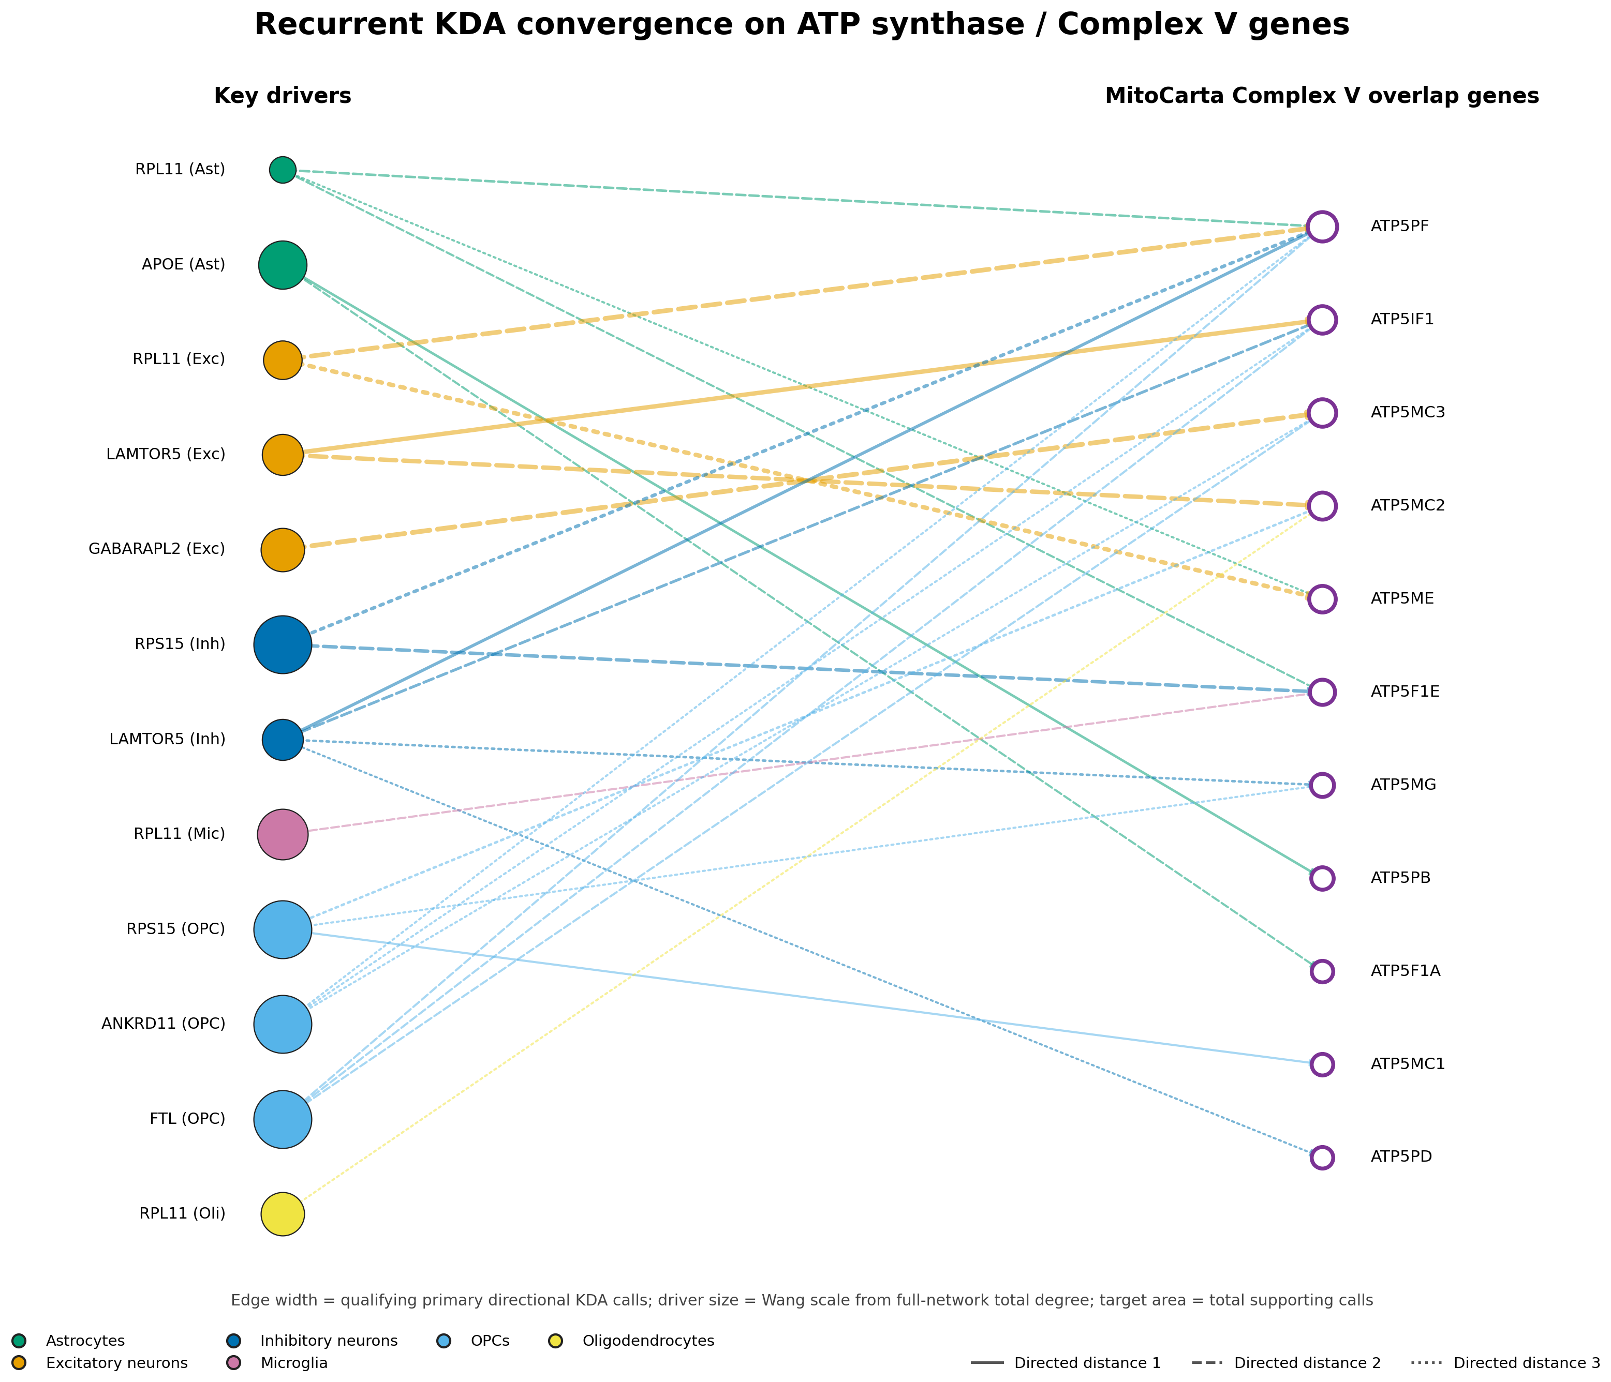
FIGURE 5 • RECURRENT CONVERGENCE ON ATP SYNTHASE / COMPLEX V GENES
Source: phase12_kda_atp_convergence.png
18

Slide 19
FIGURE 5 CONCLUSIONS
ATP convergence map: findings
Complex V convergence recurs across fine-cell-type, sex, and APOE contexts—especially in neuronal networks.
Driver / network | Complex V target | Qualifying calls | Direction mix | Distance
GABARAPL2 / excitatory | ATP5MC3 | 15 | 4 up / 11 down | 2
RPL11 / excitatory | ATP5PF | 14 | 4 up / 10 down | 2
LAMTOR5 / excitatory | ATP5IF1 | 12 | 4 up / 8 down | 1
LAMTOR5 / excitatory | ATP5MC2 | 12 | 4 up / 8 down | 2
RPL11 / excitatory | ATP5ME | 12 | 1 up / 11 down | 3
RPS15 / inhibitory | ATP5F1E | 6 | 1 up / 5 down | 2
Takeaway
The ATP finding is not confined to one illustrative run.
Several driver–Complex V relationships recur across analysis contexts. Edge width pools AD-up and AD-down calls, so recurrence does not imply one universal disease direction.
Strongest family: excitatory GABARAPL2 → ATP5MC3 (15 calls)
Source: phase12_kda_atp_convergence_pairs.tsv
19

Slide 20
FIGURE 6 SETUP
Connectivity diagnostic: setup and generation
The question is whether aggregate KDA evidence rises with full-network connectivity—and how strongly that varies by network.
One plotted record
Panel A
Panel B
candidate gene × broad network
x = total-degree percentile within network
Separate Spearman correlation within each network
50,165
y = standardized MeanOfLog KDA evidence
Rank-based; no linearity or normality assumption
records with ≥1 ranking test
area = significant primary directional calls
Effect magnitude (rho) matters more than tiny P values at n≈5k–10k
A gene can appear in multiple networks because degree and KDA ranking are network-specific.
color = broad network
Raw-degree facets retained as diagnostic supplement
labels = prespecified candidates
Sources: connectivity_evidence_explanation.md; plot_phase12_kda_connectivity_evidence.py
20

Slide 21
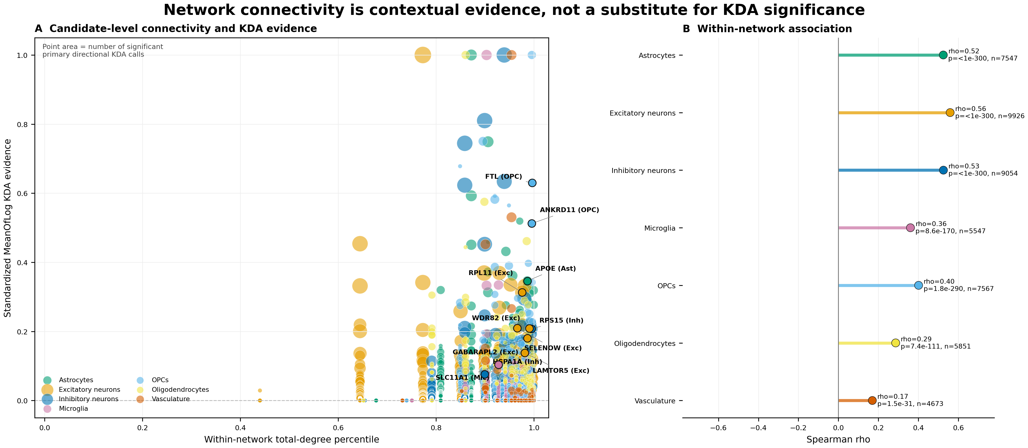
FIGURE 6 • NETWORK CONNECTIVITY IS CONTEXTUAL EVIDENCE
Source: phase12_kda_connectivity_evidence.png
21

Slide 22
FIGURE 6 CONCLUSIONS
Connectivity diagnostic: findings
Connectivity and aggregate KDA evidence are positively associated in every network, but connectivity is not determinative.
Network | Candidate records | Spearman ρ
Astrocytes | 7,547 | 0.525
Excitatory neurons | 9,926 | 0.559
Inhibitory neurons | 9,054 | 0.525
Microglia | 5,547 | 0.360
OPCs | 7,567 | 0.401
Oligodendrocytes | 5,851 | 0.286
Vasculature | 4,673 | 0.170
Signal
Highest associations occur in excitatory neurons (ρ=0.559) and astrocyte/inhibitory networks (ρ≈0.525).
All seven correlations are positive; the weakest is vasculature (ρ=0.170).
Boundary
High-degree candidates still span a wide range of KDA scores. Connectivity can shape opportunity for overlap but does not replace KDA enrichment, recurrence, or causal validation.
Use connectivity as context—not as an independent significance test.
Source: phase12_kda_connectivity_evidence_correlations.tsv
22

Slide 23
CROSS-FIGURE SYNTHESIS
What the four network figures establish together
Selected mechanisms, aligned sex contrasts, cross-run recurrence, and a network-bias diagnostic converge on one cautious interpretation.
Selected neighborhoods
APOE, LAMTOR5, and GABARAPL2 have directed routes to Complex V and mitochondrial stress/translation genes.
Sex-reversal alignment
The same driver-centered framework accompanies female ε2 AD-up and male ε2 AD-down expression directions.
Cross-run convergence
Complex V targets recur across contexts; the strongest focused link is GABARAPL2→ATP5MC3.
Connectivity diagnostic
Hubs tend to rank more strongly, but degree explains only part of the KDA evidence and varies by network.
Integrated Phase 12 conclusion: recurrent, cell-contextual network convergence on mitochondrial/Complex V biology—plausible and auditable, but still hypothesis-generating.
Sources: Phase 12 network figure explanations and plotted-data tables
23

Slide 24
FIGURE 7 SHARED SETUP
Phase 13: donor-aware respiratory-modifier design
The formal question is whether the adjusted AD effect on a respiratory module differs between two sex/APOE groups.
Nucleus counts
Donor profiles
Module scores
Six AD effects
Modifier test
Sum within donor × cell context
TMM + logCPM using all genes
NCI-reference gene z-scores averaged
Adjusted AD−NCI per sex/APOE stratum
Difference of two AD effects
Difference-of-differences
Prespecified test family
estimate = Δ(group 1) − Δ(group 2)
7 contexts × 7 contrasts × 4 modules = 196 tests
Δ = model-adjusted AD module-score mean − NCI module-score mean
Effect unit: NCI-reference donor-level module-score SD
Sources: phase_13_workflow_explained.md; phase_13_respiratory_modifier_plan.md
24

Slide 25
FIGURE 7 SETUP
Modifier landscape: setup and generation
The renderer reads the immutable validated gate table; it does not refit models or alter q values.
mtDNA OXPHOS
Nuclear OXPHOS
Mitochondrial translation
MIB/MICOS membrane
13 genes • direct respiratory
86 structural genes • direct respiratory
155 genes • supporting program
19 genes • supporting program
Heatmap encoding
Scientific gate
Rows = 7 frozen broad cell contexts
Complete-family module-score FDR
Columns = 3 sex + 4 APOE contrasts
Independent CAMERA gene-set support
Color = signed modifier estimate (−1.5 to +1.5 SD)
Donor-count and module-coverage thresholds
Crossed gray cell = not testable, never zero
Confidence interval and meaningful-effect rule
Outlines/symbols redundantly encode frozen status
Bootstrap, leave-one-donor-out, and sensitivity stability
No significance stars; exact gate status controls the conclusion.
Sources: phase13_modifier_landscape_methods.md; plot_phase13_respiratory_modifier_figures.R
25

Slide 26
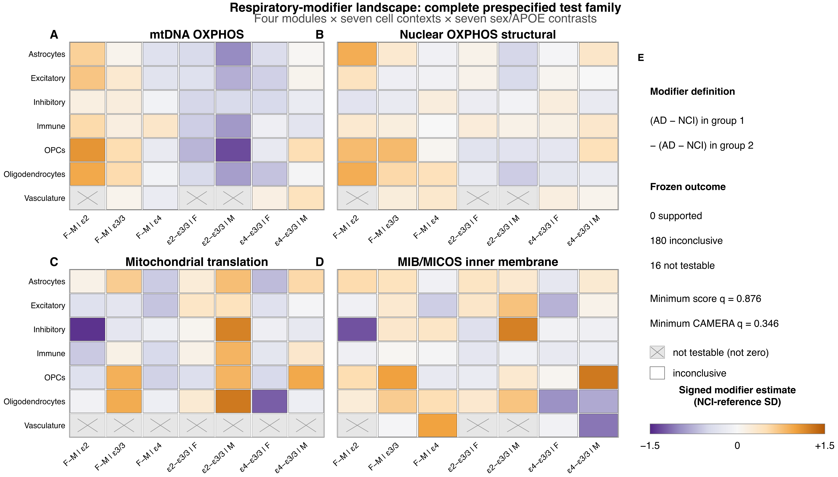
FIGURE 7 • RESPIRATORY-MODIFIER LANDSCAPE: COMPLETE PRESPECIFIED FAMILY
Source: phase13_modifier_landscape.png
26

Slide 27
FIGURE 7 CONCLUSIONS
Modifier landscape: findings
The production run is technically complete, but the complete-family scientific result is inconclusive.
196
180
16
0
prespecified tests rendered
estimable but inconclusive
not testable (all vasculature)
supported results
Complete-family evidence
Permitted conclusion
7 module-score tests had nominal P<0.05, but none passed FDR.
No respiratory module showed a supported sex/APOE modifier after the prespecified complete-family gate.
Minimum module-score q = 0.876; minimum CAMERA q = 0.346.
The direct-respiratory nominal highlight is OPC nuclear OXPHOS, female−male within ε3/3: estimate +0.815 SD, 95% CI [0.130, 1.501], P=0.0199, q=0.876.
This is evidence of unresolved uncertainty—not proof that all modifier effects are exactly zero.
Heatmap colors show effect estimates—not support status; visually strong cells can remain inconclusive.
Sources: phase13_modifier_landscape_caption.md; respiratory gate decisions
27

Slide 28
CROSS-PHASE SYNTHESIS
Integrated interpretation: Phase 12 and Phase 13
The two phases operate at different evidentiary levels and therefore answer different questions.
Dimension | Phase 12 KDA | Phase 13 modifier analysis
Unit of analysis | Directed candidate neighborhood × run | Donor-level respiratory module score
Primary question | Which candidates’ neighborhoods are enriched? | Does the AD effect differ by sex/APOE?
Strength | Localization, topology, recurrence | Formal difference-of-differences with FDR/stability gate
Result | Recurrent cell-contextual Complex V convergence | 0/196 supported; 180 inconclusive; 16 not testable
Conclusion level | Mechanistic hypotheses | No confirmed respiratory modifier in this test family
There is no contradiction: Phase 12 supports where and how mitochondrial network convergence may occur; Phase 13 did not confirm a broad donor-level sex/APOE modifier after complete-family correction.
Sources: validated Phase 12 and Phase 13 figure packages
28

Slide 29
CLOSING
Implications and next analytical steps
Preserve the mechanistic hypotheses while raising the evidentiary bar for sex/APOE claims.
1
Prioritize
2
Validate
Use APOE, LAMTOR5, GABARAPL2, RPL11, and RPS15–Complex V systems as focused hypotheses, not a validated causal ranking.
Test nominated driver→Complex V relationships with perturbation or orthogonal regulatory evidence; retain cell-network context.
3
Re-test modifiers
4
Report transparently
Use donor-aware interaction models in larger/independent cohorts, especially ε2 and vasculature strata with limited testability.
Keep full test families, not-testable states, q values, donor support, and stability checks visible in figures and text.
Bottom line: reproducible network evidence points to mitochondrial/Complex V systems; formal sex/APOE respiratory modification remains unconfirmed.
Synthesis of project-local figure methods, tables, and validation notes
29

