Slide 1
ROSMAP and SEA-AD sex/APOE key-driver analysis
Mitochondrial DEG queries with returned-only simple aggregation
PART I
PART II
ROSMAP KDA
SEA-AD validation
194 KDA calls → returned-only non-MT aggregation → 381 category units
22 SEA-AD-network KDA calls → returned-only non-MT aggregation → 44 category units
Notes:
Teaching goal: Introduce the analysis in both cohorts.
Walk through: Part I summarizes 194 ROSMAP KDA calls and 381 non-MT gene-by-category units. Part II summarizes 22 SEA-AD calls against SEA-AD-specific networks and 44 units.
Scientific boundary: Each contrast contributes at most one mitochondrial DEG query and one KDA call.
Transition: Compare the cohort and run structures before reviewing each branch.

Slide 2
Two cohorts, one aggregation rule
Each contrast contributes at most one mitochondrial DEG query; significant non-MT returns are aggregated by category.
ROSMAP FINE-CELL REAGGREGATION
SEA-AD VALIDATION
Where does a gene recur across fine-cell evidence?
Do drivers return in an independent human cohort?
324
194
381
774
22
44
planned contrasts
included KDA calls
gene × category units
planned contrasts
active KDA calls
gene × category units
Builds one core-MT DEG query within each fine-cell contrast.
Uses SEA-AD-specific Bayesian networks.
Groups returned drivers within sex/APOE × broad network.
Donor ≥3 per arm; FDR-only query; mapped n ≥3.
Final 381 units represent 228 genes in 29 categories.
20 of 22 calls are M_e33; five categories have returns.
Category = one sex/APOE group × one broad cell type (for example, M_e33 × excitatory neurons). Returned drivers from eligible fine-cell or supertype KDA calls are combined within that category.
Notes:
Teaching goal: Give a side-by-side map of the two analyses.
Walk through: Define a category before using the counts: one sex/APOE group crossed with one broad cell type, such as M_e33 excitatory neurons. Returned drivers from eligible fine-cell or supertype KDA calls are aggregated within that category. ROSMAP contributes 194 calls and 381 gene-by-category units; SEA-AD contributes 22 active calls and 44 units.
Scientific boundary: Twenty of 22 SEA-AD calls are M_e33. Categories without calls are unavailable, not negative tests.
Transition: Review the ROSMAP branch first.

Slide 3
PART 1
ROSMAP KDA reaggregation
IN THIS PART
1
Run universe
54 fine cell types define 324 contrasts; 194 calls from 43 fine types are aggregated within six groups and seven broad networks.
2
Filter funnel
3
ACAT candidates
4
Result figures
Notes:
Teaching goal: Introduce the ROSMAP fine-cell KDA branch.
Walk through: The section defines the one-query-per-contrast design, the eligibility funnel, query construction, and returned-only simple aggregation.
Scientific boundary: The analysis uses existing validated KDA results and does not pool sex/APOE groups.
Transition: Start with the four counting units.

Slide 4
Four steps: one KDA query per contrast
1
2
3
4
DEG comparison
Mitochondrial query
KDA run
Category result
fine cell type × sex/APOE
core-MT DEGs
validated completed call
gene × category
One signed AD-versus-NCI result
One query per contrast
DEG contrast valid and
Effective query n ≥ 3
Category = sex/APOE group × broad network
Notes:
Teaching goal: Separate contrast, mitochondrial query, KDA call, and category result.
Walk through: A contrast is one signed DEG result and contributes one core-MT DEG query. A mapped query of at least three genes becomes one KDA call. A category is one sex/APOE group crossed with one broad network; returned non-MT drivers from eligible fine-cell runs are aggregated within it.
Scientific boundary: A candidate driver can be a non-DEG, non-mitochondrial network gene.
Transition: Apply the definitions to the 324-contrast universe.

Slide 5
54 fine cell types create 324 planned contrasts
Each contrast contributes one mitochondrial DEG query and at most one KDA call.
54 fine cell types
324 signed results
194 call_key_drivers calls
× 6 sex/APOE groups = 324 contrasts
one query per contrast
All valid source and queries ≥3
Mutually exclusive contrast outcome
Contrasts
KDA called?
Source DEG contrast not valid
3
No
Effective query empty
95
No
Effective query 1–2
32
No
Effective query >=3
194
Yes
TOTAL
324
194 calls
Notes:
Teaching goal: Show how 324 contrasts become 194 KDA calls.
Walk through: Three source contrasts are invalid, 95 valid contrasts have an empty effective query, 32 retain one or two mapped genes, and 194 meet the three-gene floor.
Scientific boundary: Skipped contrasts have no KDA result and are not completed null tests.
Transition: Clarify the execution gate and source failures.

Slide 6
Source validity and query size decide whether KDA is called
One canonical query-size gate
What ‘source contrast not valid’ means
≥3
194
The upstream MAST comparison could not be fitted because one arm had fewer than three cells.
included KDA calls
Fine cell type
Group
AD cells
NCI cells
All 194 validated completed calls enter the aggregate.
Fib SLC4A4
M_e2
0
11
CAMs
M_e2
45
1
164 significant • 30 completed empty
Mic MKI67
M_e2
2
9
The 164 significant calls returned 1,833 rows before mitochondrial filtering.
3 unavailable comparisons = 3 unavailable KDA calls
Notes:
Teaching goal: Clarify the three-gene execution floor and the three invalid source contrasts.
Walk through: All 194 calls meeting the mapped-query floor were completed: 164 returned significant drivers and 30 returned none. The three concrete invalid MAST contrasts remain unavailable.
Scientific boundary: The minimum is an execution rule; small queries and low cell counts still require cautious interpretation.
Transition: Inspect how the mitochondrial query is constructed.

Slide 7
Mitochondrial query genes
DEG rule
2,864,117
118,297
9,262
tested gene × comparison rows
Passed DEG
core-MT query genes
Detected in ≥10% of AD or NCI nuclei.
58,112 up • 60,185 down
4,258 up • 5,004 down
Within-contrast BH FDR < 0.05.
|log₂ fold change| > log₂(1.3) ≈ 0.379.
NETWORK-BACKGROUND INTERSECTION
9,262 provisional query genes
Significant positive and negative DEGs enter the query.
− 1,329 absent from the Bayesian network
= 7,933 query genes
Query = DEG rule ∩ core_mito_protein
Membership counts can repeat genes across contrasts; each contrast contributes one query.
Notes:
Teaching goal: Explain the ROSMAP mitochondrial query.
Walk through: The DEG filters identify 4,258 positive and 5,004 negative core-MT memberships. Together these are 9,262 provisional memberships across contrasts; 7,933 remain after network-background mapping. Each contrast contributes one query and at most one KDA call.
Scientific boundary: These are repeated memberships across contrasts, not unique genes and not driver counts.
Transition: Review the returned non-MT top-five display.

Slide 8
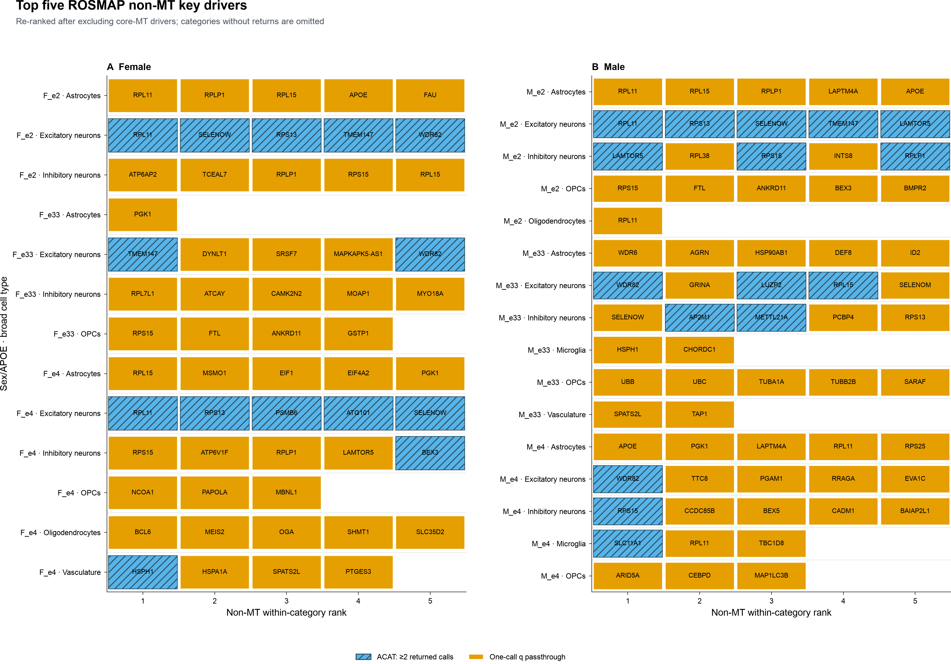
Top five: 123 non-MT entries across 29 categories
Notes:
Teaching goal: Present the ROSMAP top-five results.
Walk through: The figure displays up to five non-MT drivers in each of 29 populated categories, for 123 displayed entries. Blue hatching denotes ACAT across at least two returned calls; orange denotes one-call q passthrough.
Scientific boundary: Top five is a display cap, and returned-only scores are exploratory without final across-gene FDR control.
Transition: Summarize recurrence across categories.

Slide 9
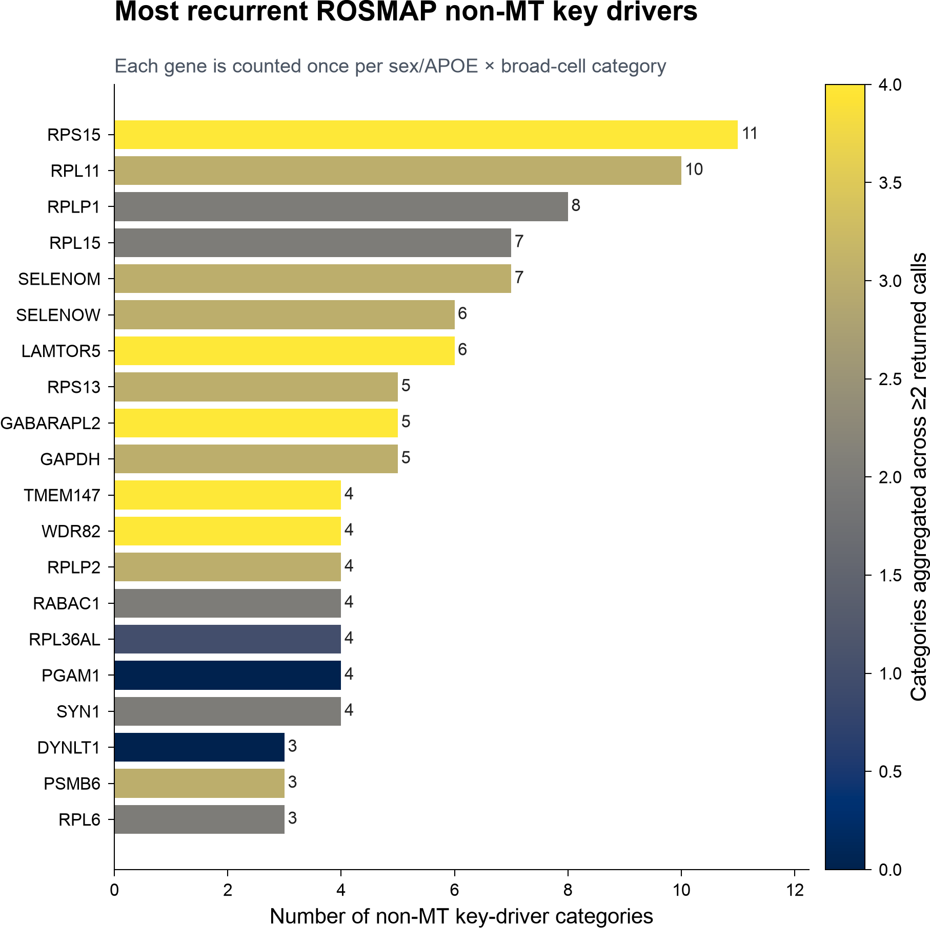
RPS15 recurs across 11 returned-only categories
Returned-only recurrence is descriptive across sex/APOE × broad-cell categories.
How to read it
Bar length = number of categories containing the gene.
Fill = categories whose score combines ≥2 returned calls (used ACAT to aggregate p value).
RPS15: 11 categories, 6 groups, 4 networks; ACAT in 4.
RPL11: 10 categories, 6 groups, 4 networks; ACAT in 3.
Notes:
Teaching goal: Interpret category recurrence.
Walk through: RPS15 occurs in 11 categories from 22 returned calls. RPL11 occurs in 10 categories from 24 calls. Color encodes how many category scores combine at least two returned calls.
Scientific boundary: Category presence is descriptive and not independent replication.
Transition: Summarize the full ROSMAP output scale.

Slide 10
Simple output: 381 non-MT category units represent 228 genes
623
381
228
29
123
non-MT returned call rows
non-MT gene × category units
distinct gene symbols
categories with non-MT returns
top-five displayed rows
Where non-MT driver units occur
Most recurrent returned-only genes
By sex/APOE group
RPS15
11
F_e4 81 • M_e33 79 • M_e2 70 F_e33 56 • F_e2 54 • M_e4 41
RPL11
10
RPLP1
8
RPL15
7
By broad network
SELENOM
7
Excitatory 153 • Inhibitory 146 • Astrocytes 32 • OPCs 21 Oligo 18 • Vasculature 6 • Microglia 5
SELENOW
6
Counts are category presence—not independent replication or call counts.
Notes:
Teaching goal: Summarize the scale and distribution of the ROSMAP output.
Walk through: The 623 retained non-MT returned rows form 381 gene-by-category units representing 228 genes across 29 categories. The lower panels show their group, network, and recurrence distributions.
Scientific boundary: Counts condition on significant within-call returns and unequal call opportunities.
Transition: Move to the SEA-AD-specific-network analysis.

Slide 11
PART 2
SEA-AD network-specific KDA
IN THIS PART
1
Run universe
129 supertypes define 774 contrasts; 22 KDA calls were run against SEA-AD-specific Bayesian networks.
2
Top-five results
3
Driver recurrence
4
Result scale
Notes:
Teaching goal: Introduce the SEA-AD-specific-network analysis.
Walk through: The section moves from 774 supertype-by-stratum contrasts to 22 executable KDA calls, then shows top-five, recurrence, and aggregate summaries.
Scientific boundary: The active calls are strongly concentrated in M_e33.
Transition: Start with the contrast-level funnel.

Slide 12
129 SEA-AD supertypes create 774 planned contrasts
One mitochondrial DEG query per supertype × sex/APOE contrast.
129 supertypes
774 signed results
22 KDA calls
× 6 groups = 774 contrasts
one query per contrast
effective mapped query n ≥ 3
Mutually exclusive contrast outcome
Contrasts
KDA called?
Source DEG contrast not estimable
393
No
Estimable source; FDR-only query = 0
348
No
Effective mapped query 1–2
11
No
Effective mapped query >=3
22
Yes
TOTAL
774
22 calls
Availability remains unbalanced: 20 M_e33 calls, one F_e33 call, and one F_e4 call.
Notes:
Teaching goal: Show how 774 SEA-AD contrasts reduce to 22 executable calls.
Walk through: There are 393 non-estimable source contrasts, 348 estimable contrasts with an empty FDR-only query, 11 with one or two mapped genes, and 22 meeting the three-gene floor.
Scientific boundary: A skipped contrast is unavailable and is not a negative validation result.
Transition: Inspect the returned non-MT candidates.

Slide 13
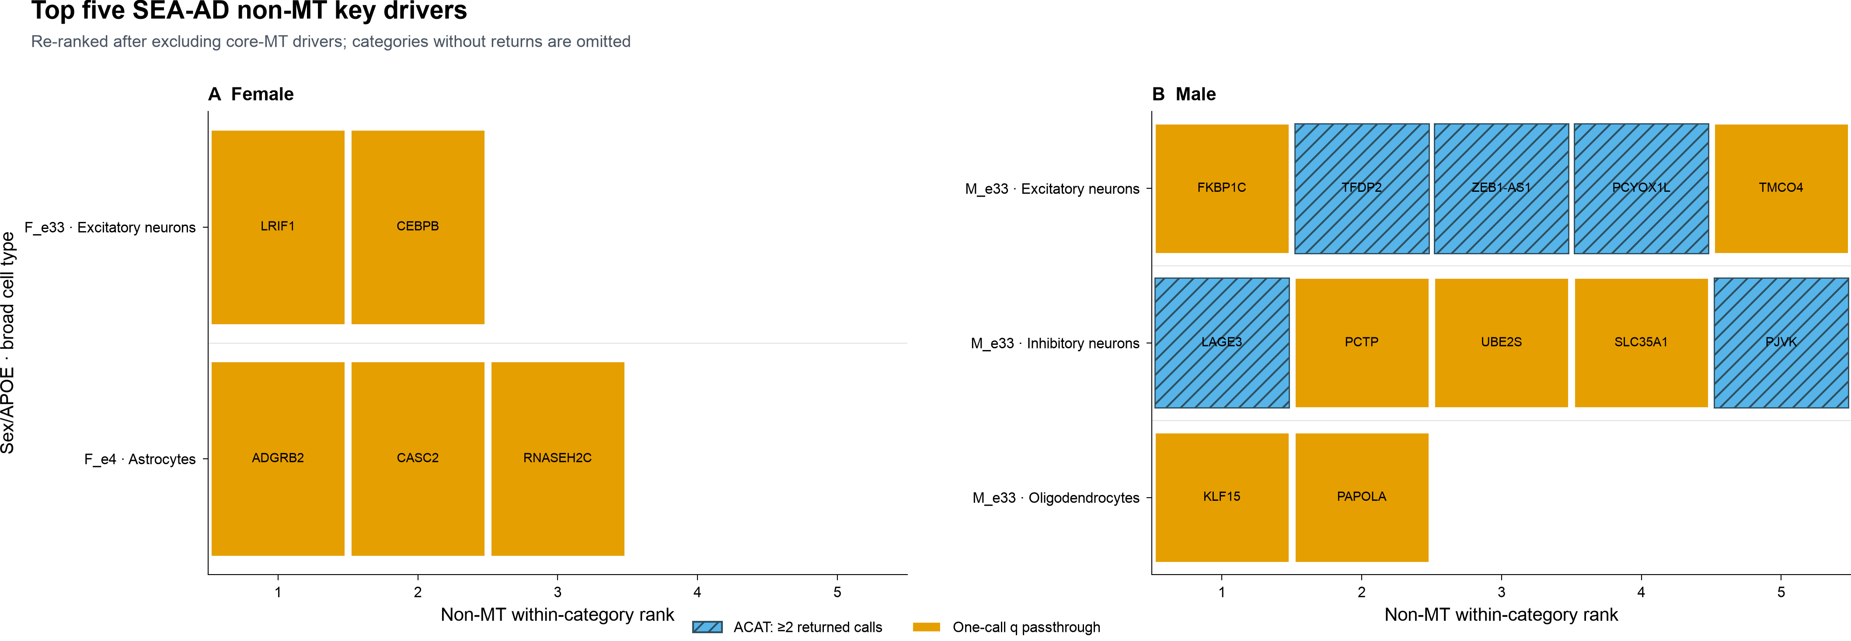
Top-five display: 17 non-MT entries across 5 categories
Blue hatching = ACAT across ≥2 returned calls; orange = one-call q passthrough.
Notes:
Teaching goal: Present leading SEA-AD non-MT candidates.
Walk through: Seventeen entries appear across F_e33 excitatory, F_e4 astrocyte, and three M_e33 categories. Blue hatching denotes ACAT across at least two calls; orange is one-call q passthrough.
Scientific boundary: Top five is a display cap and the five populated categories expose strong availability imbalance.
Transition: Review recurrence across those categories.

Slide 14
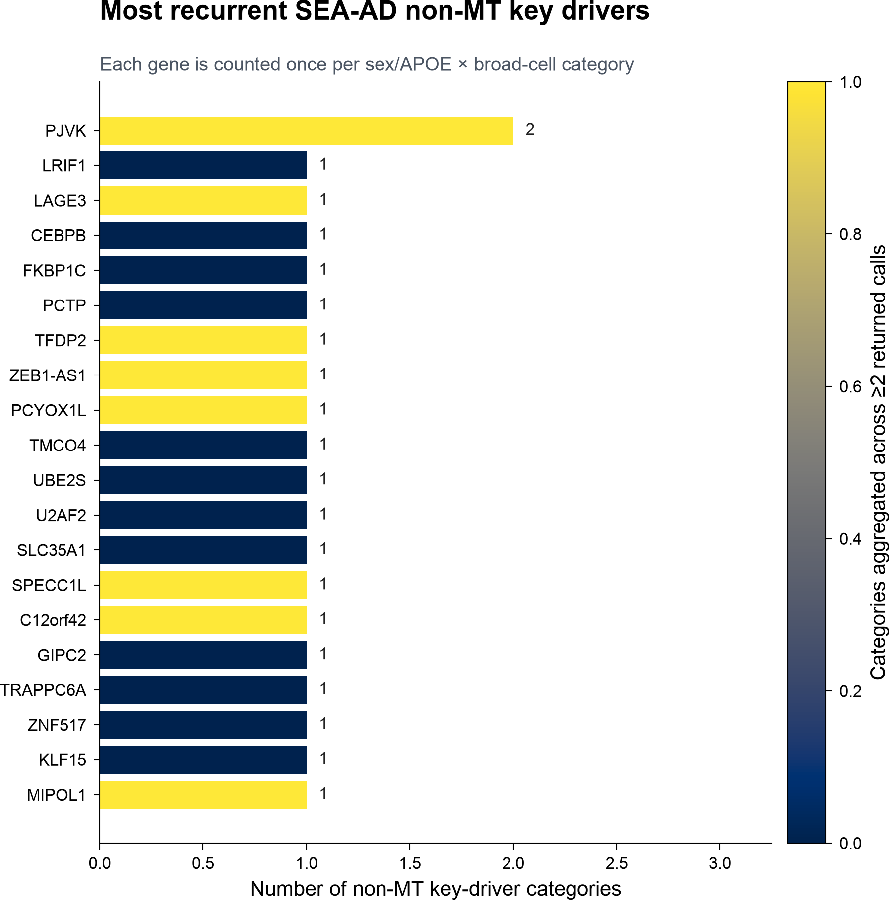
PJVK is the only gene recurring across 2 SEA-AD categories
Returned-only recurrence is descriptive across sex/APOE × broad-cell categories.
How to read it
Bar length = categories containing the gene.
Fill = category occurrences combining ≥2 returned calls.
PJVK: M_e33 excitatory + inhibitory neurons.
Its inhibitory category combines 3 returned calls by ACAT.
The remaining 19 displayed genes occur in one category.
Only 5 categories return non-MT genes.
Notes:
Teaching goal: Interpret SEA-AD category recurrence.
Walk through: PJVK is the only gene present in two categories: M_e33 excitatory and inhibitory neurons. Every other gene on the top-20 display occurs in one category.
Scientific boundary: Five return-bearing categories impose a low recurrence ceiling.
Transition: Summarize the SEA-AD output scale.

Slide 15
SEA-AD output: 44 non-MT units represent 43 genes
54
44
43
5
17
non-MT returned call rows
gene × category units
distinct gene symbols
categories with returns
top-five displayed rows
Where the 44 units occur
Execution and filtering
By sex/APOE group
20 calls with returns; 2 completed empty.
M_e33 39 • F_e4 3 • F_e33 2 • other groups 0
112 significant return rows before mitochondrial filtering.
58 core-MitoCarta rows excluded.
By broad network
Excitatory 27 • Inhibitory 12 • Astrocytes 3 • Oligo 2 Microglia, OPCs, Vasculature 0
54 non-MT rows retained for aggregation.
Returned-only ACAT scores are exploratory and not formally FDR-controlled across genes.
Notes:
Teaching goal: Summarize the SEA-AD output.
Walk through: The 54 retained rows form 44 category units representing 43 genes across five categories. Thirty-nine units and 20 of 22 active calls are M_e33.
Scientific boundary: Returned-only scores remain exploratory and are not final-FDR controlled across genes.
Transition: Compare the driver sets across cohorts.

Slide 16
PART 3
Do the same drivers appear in both cohorts?
IN THIS PART
1
Comparison design
ROSMAP and SEA-AD results are compared at gene and matched-context levels.
2
Gene overlap
3
Context overlap
4
Interpretation
Notes:
Teaching goal: Frame the cross-cohort comparison.
Walk through: Part 3 compares driver symbols, category contexts, and all six cross-cohort unit pairings formed by the shared genes.
Scientific boundary: This is a cross-cohort and cross-network comparison, not an isolated test of cohort biology.
Transition: Define gene- and category-level agreement.

Slide 17
Two ways to ask whether a driver reappears
Gene-level overlap ignores context; category-level overlap requires the same group and broad cell type.
GENE LEVEL
CATEGORY LEVEL
Does the same gene return anywhere?
Same gene, same group, same cell type?
228
43
381
44
ROSMAP driver genes
SEA-AD driver genes
ROSMAP gene × category units
SEA-AD gene × category units
Permissive overlap, but still affected by the network used to nominate drivers.
Strict context agreement; assessed within five SEA-AD return-bearing categories.
Four SEA-AD return-bearing categories also contain ROSMAP returns, yet none shares a driver.
Notes:
Teaching goal: Define gene-level and category-level agreement.
Walk through: Gene-level overlap asks whether a symbol appears anywhere among 228 ROSMAP and 43 SEA-AD genes. Category agreement also requires the same sex/APOE group and broad network among 381 and 44 units.
Scientific boundary: Availability limits context comparison; four populated categories exist in both result sets.
Transition: State the gene-level overlap.

Slide 18
3 of 43 SEA-AD drivers also return in ROSMAP
The two cohorts show limited gene overlap and no exact category match.
43
3 (7%)
0
SEA-AD driver genes
also ROSMAP drivers
exact category match
The 3 shared genes
LAGE3 • MIPOL1 • PAPOLA
None appears on both cohorts’ top-20 recurrence displays.
All three are M_e33 in SEA-AD, but their ROSMAP categories differ.
Notes:
Teaching goal: State the gene-level overlap.
Walk through: LAGE3, MIPOL1, and PAPOLA are shared: three of 43 SEA-AD genes, or seven percent. No shared gene keeps both group and broad-cell context.
Scientific boundary: Gene overlap is exploratory and influenced by cohort-specific topology and unbalanced call availability.
Transition: Inspect the three genes' contexts directly.

Slide 19
No driver-category pair matches exactly
The three shared genes reappear in different sex/APOE and/or broad-cell contexts.
Gene
SEA-AD category
ROSMAP category or categories
Preserved context
LAGE3
M_e33 · Inhibitory
F_e2, F_e4, M_e2 · Excitatory
None
MIPOL1
M_e33 · Excitatory
F_e4, M_e33 · Inhibitory
M_e33 group only
PAPOLA
M_e33 · Oligodendrocytes
F_e4 · OPCs
None
0 of 44 SEA-AD gene × category units has an exact ROSMAP match.
Notes:
Teaching goal: Show the direct context matrix for all three shared genes.
Walk through: LAGE3 and PAPOLA retain neither group nor broad cell type. MIPOL1 retains M_e33 in one ROSMAP category but switches from excitatory to inhibitory neurons.
Scientific boundary: Zero exact matches is conditional on the available returned-only units, not a negative result for unexecuted categories.
Transition: Separate gene overlap from context preservation.

Slide 20
Only MIPOL1 preserves the sex/APOE group
No shared gene preserves broad-cell context in this analysis.
LAGE3
MIPOL1
PAPOLA
SEA-AD M_e33 · Inhibitory
SEA-AD M_e33 · Excitatory
SEA-AD M_e33 · Oligodendrocytes
ROSMAP F_e2 / F_e4 / M_e2 · Excitatory
ROSMAP F_e4 / M_e33 · Inhibitory
ROSMAP F_e4 · OPCs
No matching dimension
M_e33 preserved once
No matching dimension
Notes:
Teaching goal: Summarize partial context preservation for each shared gene.
Walk through: MIPOL1 produces the only same-group pairing: SEA-AD M_e33 excitatory versus ROSMAP M_e33 inhibitory. LAGE3 and PAPOLA change both group and broad cell type.
Scientific boundary: The categories are non-independent because a gene can occupy multiple ROSMAP units.
Transition: Count all cross-cohort unit pairings.

Slide 21
Six cross-cohort unit pairings arise from three shared genes
A SEA-AD unit is paired with every ROSMAP unit carrying the same gene.
Gene
SEA-AD units
ROSMAP units
Cross-cohort pairs
Same group
Same cell type
Exact
LAGE3
1
3
3
0
0
0
MIPOL1
1
2
2
1
0
0
PAPOLA
1
1
1
0
0
0
TOTAL
3
6
6
1
0
0
Only one of six pairings preserves sex/APOE group; none preserves broad-cell type.
Notes:
Teaching goal: Make the unit-pair denominator explicit.
Walk through: LAGE3 contributes three pairings, MIPOL1 two, and PAPOLA one. Only the MIPOL1 M_e33 pairing preserves the group; no pairing preserves cell type or full context.
Scientific boundary: Pairings are descriptive and non-independent.
Transition: Summarize the corresponding percentages.

Slide 22
Context preservation is minimal across six pairings
Exact replication requires both the same sex/APOE group and the same broad-cell type.
0%
17%
0%
same broad cell type 0 of 6 pairings
same sex/APOE group 1 of 6 pairings
exact category match 0 of 6 pairings
Interpretation
The SEA-AD driver set has limited gene overlap with ROSMAP and no matched cell-type context. Cohort and network topology changed together.
Notes:
Teaching goal: Quantify context preservation across all six shared-gene pairings.
Walk through: No pairing shares broad cell type, one shares sex/APOE group, and no pairing shares both. The one same-group pairing is MIPOL1 in M_e33.
Scientific boundary: These are descriptive proportions, not formal replication probabilities.
Transition: Show the ROSMAP sex distribution of the shared genes.

Slide 23
Shared SEA-AD M_e33 genes span both ROSMAP sexes
All three shared genes are M_e33 in SEA-AD; ROSMAP sex membership is mixed.
Gene membership
ROSMAP sex distribution
Male-only (0)
None
Male-only
0
Female-only (1)
PAPOLA
Female-only
1
Both sexes
Both sexes (2)
LAGE3, MIPOL1
2
MIPOL1 and LAGE3 occur in both female and male ROSMAP categories; PAPOLA occurs only in F_e4.
Notes:
Teaching goal: Show the ROSMAP sex membership of the three shared SEA-AD M_e33 genes.
Walk through: PAPOLA is female-only in ROSMAP. LAGE3 and MIPOL1 appear in both ROSMAP sexes. None is male-only.
Scientific boundary: Observed sex membership is not a sex-interaction test and reflects unequal returned-only opportunities.
Transition: Close with supported findings and limits.

Slide 24
What the cross-cohort comparison does—and does not—show
Supported
Limits
3 of 43 SEA-AD drivers also occur in ROSMAP: LAGE3, MIPOL1, PAPOLA.
No broad-cell match occurs among the six shared-gene unit pairings.
No shared driver preserves both sex/APOE group and broad-cell type.
Only M_e33 is well represented among SEA-AD active calls (20 of 22).
MIPOL1 preserves M_e33 once but switches excitatory → inhibitory.
Cohort and network topology changed together; their effects are inseparable.
PJVK is the only SEA-AD gene recurring across two categories.
Returned-only ACAT scores are exploratory and not final-FDR controlled.
Takeaway: three genes are shared, but there are zero exact sex/APOE × broad-cell validation matches.
Notes:
Teaching goal: State the cross-cohort conclusion without overclaiming validation.
Walk through: The comparison finds three shared genes and no exact category match. MIPOL1 retains M_e33 but changes cell type; PJVK is the only within-SEA-AD recurrent gene across categories.
Scientific boundary: The comparison is descriptive, post-selected, unbalanced across strata, and confounds cohort with network topology.
Transition: Continue to the sensitivity-analysis section.

Slide 25
PART 4
Sensitivity analyses
IN THIS PART
1
Donor support
Robustness checks across sample support, profile coverage, query definition, and KDA decision rules.
2
Profile coverage
3
Query definition
Each sensitivity test is reported separately with its own evidence boundary.
4
KDA filters
Notes:
Teaching goal: Introduce the section reserved for all harmonized broad-cell KDA sensitivity analyses.
Walk through: Sensitivity checks may address donor support, nuclei-per-profile coverage, DEG query definition, and KDA filtering. The first check raises the disease-arm donor gate from three to five in both cohorts.
Scientific boundary: Each test must change one frozen decision at a time and retain its own interpretation boundary. The current test concerns donors per disease arm, not nuclei.
Transition: Begin with the cohort-level consequences of the donor-threshold test.

Slide 26
Donor-threshold sensitivity — numerical comparison
Raising minimum donors per disease arm from 3 to 5 in ROSMAP and SEA-AD.
Cohort
Minimum donors / arm
Eligible contrasts
KDA runs
Significant driver rows
Unique non-MT drivers
ROSMAP
3
42
3
39
33
ROSMAP
5
40
2
13
13
SEA-AD
3
28
5
24
18
SEA-AD
5
20
5
24
18
Driver rows count significant returned KDA rows. Unique non-MT drivers exclude MT-* genes and are deduplicated within each cohort.
Source: Phase 22 and VH14 run manifests/returns; donor-per-arm 3-vs-5 sensitivity assessment (2026-09-11).
Notes:
Teaching goal: Show the numerical impact of raising the minimum disease-arm donor count from three to five in both cohorts.
Walk through: ROSMAP falls from 42 to 40 eligible contrasts, three to two KDA runs, 39 to 13 returned rows, and 33 to 13 unique non-mitochondrial drivers. SEA-AD falls from 28 to 20 eligible contrasts, while its five KDA runs, 24 returned rows, and 18 unique non-mitochondrial drivers are unchanged.
Scientific boundary: The threshold test changes only the donor eligibility gate. It does not change retained contrast models, DEG queries, networks, or KDA settings.
Transition: Next, interpret why the two cohorts respond differently and what this means for validation.

Slide 27
Donor-threshold sensitivity — key findings
Raising minimum donors per disease arm from 3 to 5 in ROSMAP and SEA-AD.
KEY FINDINGS
ROSMAP loses the Vasculature × M_e2 4-versus-3-donor call, which alone generated 26 driver rows. This removes the low-support result dominating the ROSMAP release.
SEA-AD loses eight eligible contrasts, but all already had empty mitochondrial queries. Therefore, all five KDA runs and all returned drivers remain unchanged.
Cross-cohort validation remains zero at both thresholds.
The only exact shared executed stratum remains Astrocytes × F_e4, with no shared drivers.
The excluded contrasts are treated as unavailable comparisons—not negative validation results.
Source: Phase 22 and VH14 run manifests/returns; donor-per-arm 3-vs-5 sensitivity assessment (2026-09-11).
Notes:
Teaching goal: Summarize the cohort-specific and cross-cohort conclusions of the donor-threshold sensitivity analysis.
Walk through: ROSMAP loses the low-support Vasculature M_e2 call that generated 26 driver rows. SEA-AD loses eight eligible contrasts, but none had progressed to KDA. Cross-cohort validation remains zero under both donor thresholds; Astrocytes F_e4 is the only exact stratum executed in both cohorts, and it has no shared drivers.
Scientific boundary: Contrasts excluded by the stricter donor threshold are unavailable comparisons. They must not be counted as evidence against validation.
Transition: Continue with the next sensitivity analysis when it is available.

Slide 28
Query-size sensitivity — numerical comparison
Minimum effective genes after network mapping; donor minimum held at 3 per disease arm.
Cohort
Minimum query genes
Source-estimable contrasts
Query-passing contrasts
KDA runs
Significant KD rows
Unique non-MT KDs
ROSMAP
3
42
3
3
39
33
ROSMAP
5
42
2
2
30
24
ROSMAP
10
42
1
1
26
20
ROSMAP
20
42
1
1
26
20
ROSMAP
30
42
1
1
26
20
SEA-AD
3
28
5
5
24
18
SEA-AD
5
28
5
5
24
18
SEA-AD
10
28
3
3
8
3
SEA-AD
20
28
3
3
8
3
SEA-AD
30
28
2
2
7
3
One query is used per contrast, so query-passing contrasts and KDA runs are identical here.
Source: validated Phase 22 and VH14 run manifests and significant-return tables (2026-09-11).
Notes:
Teaching goal: Show how increasing the minimum effective query size changes KDA availability and returned drivers.
Walk through: ROSMAP contracts from three calls and 39 returned rows at three genes to one call and 26 rows at ten or more genes. SEA-AD is unchanged at five genes, contracts to three calls and eight rows at ten or twenty genes, and retains two calls and seven rows at thirty genes.
Scientific boundary: The donor minimum remains three per disease arm. This exact gating sensitivity drops existing calls; it does not refit DEG models or rerun KDA for retained calls. Significant rows are raw returns, while the final column excludes MT-* genes and deduplicates within cohort.
Transition: Next, identify the specific calls responsible for the step changes.

Slide 29
Query-size sensitivity — cohort effects
Only seven current KDA calls determine the entire threshold response.
ROSMAP
SEA-AD
Current executed query sizes: 3, 8, and 78 genes.
Current executed query sizes: 5, 9, 21, 43, and 45 genes.
Minimum 5 removes OPCs × F_e4: 9 driver rows.
Minimum 5 changes nothing.
Minimum 10 also removes Astrocytes × F_e4: 4 more rows; thresholds 20 and 30 make no further change.
Minimum 10 removes Microglia × M_e33 and Astrocytes × F_e4: 24 → 8 rows and 18 → 3 unique non-MT drivers.
At ≥10, only the low-support Vasculature × M_e2 call remains: 26 rows and 20 unique non-MT drivers.
Minimum 20 changes nothing further; minimum 30 removes Oligodendrocytes × M_e33, whose sole return is MT-*.
A higher query floor increases domination by the low-donor vasculature result.
The non-MT driver count reaches 3 at minimum 10 and stays there through 30.
Source: validated Phase 22 and VH14 run manifests and significant-return tables (2026-09-11).
Notes:
Teaching goal: Explain which KDA calls drive the query-threshold sensitivity result.
Walk through: ROSMAP loses the three-gene OPC call at five and the eight-gene astrocyte call at ten, leaving only the 78-gene low-donor vasculature call. SEA-AD is unchanged at five; at ten it loses its five-gene microglia and nine-gene astrocyte calls, and at thirty it additionally loses the 21-gene oligodendrocyte call.
Scientific boundary: Returned MT-* genes are shown only when explaining raw row changes; they are not treated as eligible key drivers.
Transition: Finish with the consequences for matched-stratum validation and the least disruptive threshold.

Slide 30
Query-size sensitivity — validation interpretation
The query floor changes assessability, but it does not create cross-cohort driver validation.
VALIDATION CONSEQUENCES
Cross-cohort non-MT driver overlap remains zero at every tested threshold.
At minimum 3 or 5, Astrocytes × F_e4 remains the only exact shared executed stratum, with no shared drivers.
At minimum 10, 20, or 30, no exact stratum is executed in both cohorts; validation is unavailable rather than negative.
Thresholds ≥10 reduce validation assessability and make ROSMAP increasingly dominated by the low-support Vasculature × M_e2 call.
Least disruptive sensitivity reference: minimum 5 effective query genes
It removes the smallest ROSMAP query while preserving every SEA-AD run and the only matched cross-cohort stratum.
Source: validated Phase 22 and VH14 run manifests and significant-return tables (2026-09-11).
Notes:
Teaching goal: State the validation impact and identify the least disruptive query-size sensitivity threshold.
Walk through: Non-mitochondrial driver overlap is zero at every threshold. The shared Astrocytes F_e4 stratum remains available at thresholds three and five but disappears from both cohorts at ten. Threshold five is the only stricter floor that preserves all SEA-AD calls and the shared stratum.
Scientific boundary: Absence of a matched executed stratum at thresholds ten or higher is an unavailable validation comparison, not negative evidence. The five-gene threshold is a sensitivity reference, not a new confirmatory rule.
Transition: Continue with the next planned sensitivity test.

