Slide 1
HUMAN VALIDATION
SEA-AD independently recovers a focused neuronal mitochondrial signal from ROSMAP
Independent SEA-AD expression evidence analyzed on a shared, frozen network/KDA scaffold
13
6
SEA-AD selected units
same-network MT matches
Focused neuronal MT rediscovery—not broad reproduction of every ROSMAP key driver
Source: validated VH10C SEA-AD selection and VH10D strict overlap outputs
Notes:
What to point at: Start with the two large numbers. SEA-AD produced 13 selected network–gene–class units, and six of those match a frozen ROSMAP unit in the same broad network and driver class.
Main takeaway: Independent SEA-AD expression evidence recovers a focused neuronal mitochondrial signal rather than the entire ROSMAP list. MT here means the frozen core-MitoCarta driver class.
Boundary / transition: A unit is a network plus gene plus driver class, so one gene may count in more than one network. Next I will show how the independent evidence and shared analysis scaffold were separated.

Slide 2
STUDY SETUP
02
SEA-AD evidence was independent; the network and KDA rules were shared
1
SEA-AD donors
2
Donor-level expression
3
Frozen KDA scaffold
4
Freeze, then compare
78 donors Dementia vs No dementia
129 supertypes × 6 groups Signed mitochondrial DEG query
Matching broad network Same KDA and selection rules
SEA-AD list fixed first ROSMAP opened for comparison
Shared: 7 broad networks • MitoCarta annotation • fKDA • selection math
Independent: donors • expression • DEG results • signed queries • frozen SEA-AD list
Source: validated VH02/VH04/VH08/VH10A–C outputs; frozen network and selector authorities
Notes:
What to point at: Follow the four boxes from SEA-AD donors to donor-level expression, signed mitochondrial DEG queries, KDA on the matching frozen network, and the post-freeze ROSMAP comparison. The SEA-AD candidate list was fixed before candidate identities were used for comparison.
Main takeaway: Donors, expression values, differential-expression results, and queries came independently from SEA-AD. The seven broad networks and the KDA and selection rules were deliberately held fixed for comparability.
Boundary / transition: This is not a new SEA-AD network reconstruction. It is independent expression evidence evaluated on a shared frozen scaffold. Next I will explain why only a small fraction of planned comparisons became KDA calls.

Slide 3
FROM DESIGN TO EXECUTED CALLS
03
Only 42 directions produced mitochondrial gene sets large enough for KDA
1,548
520
42
planned fine cell type × group × direction combinations
directions from completed DEG contrasts
mitochondrial gene sets large enough for KDA
Only three of six sex/APOE groups contributed completed fine-supertype contrasts
Female ε3/ε3 • Female ε4 • Male ε3/ε3
Independent donors determine contrast estimability; more nuclei do not add biological replicates
Source: VH08 fine_contrast_status.tsv; VH10A query_attrition.tsv
Notes:
What to point at: Read the three boxes left to right: 1,548 planned fine-cell-type by group by direction combinations, 520 directions from completed DEG contrasts, and 42 mitochondrial gene sets large enough for KDA.
Main takeaway: A planned direction is not an executed KDA call. Donor support first limited which contrasts could be fitted; then most completed directions had too few effective mitochondrial query genes.
Boundary / transition: Independent donors determine biological replication. More nuclei from the same donors improve measurement but do not add independent samples. The next two slides show the drivers selected from the 42 executed calls.
===============================
why only three sex/APOE groups contributed contrasts, what happened to the other one
Each fine-supertype contrast required at least five eligible donors in both the Dementia and No-dementia arms. A donor also needed at least 20 nuclei for that supertype.
The three groups that contributed contrasts were:
Female APOE ε3/ε3: 13 Dementia / 13 No dementia
Female APOE ε4: 9 / 5
Male APOE ε3/ε3: 9 / 10
The other groups were impossible to estimate even before considering individual supertypes:
Group
Dementia
No dementia
Reason
Female APOE ε216Dementia arm below 5
Male APOE ε214Both arms below 5
Male APOE ε443Both arms below 5
Their planned contrasts remained in the manifest but were labeled not_estimable; the donor threshold was not relaxed.
Even within the three supported groups, not every supertype passed after the ≥20-nuclei donor-profile requirement: 100 contrasts completed for female ε3/ε3, 68 for female ε4, and 92 for male ε3/ε3.
===============================
how did the number go from 1548 to 520 to 42?
There were 774 supertype×group DEG contrasts:
260 contrasts could be estimated
514 lacked sufficient donors
Because each completed contrast has two directions:
260 × 2 = 520 completed directions
42 runnable KDA calls
A completed DEG contrast did not necessarily provide enough mitochondrial query genes:
Effective query size
Directions
Outcome
0 genes 462 Empty query
1–2 genes 16 Below minimum
3–9 genes. 21 Runnable
≥10 genes. 21 Runnable and ROSMAP-sized
Therefore:
520 − 462 − 16 = 42 KDA calls

Slide 4
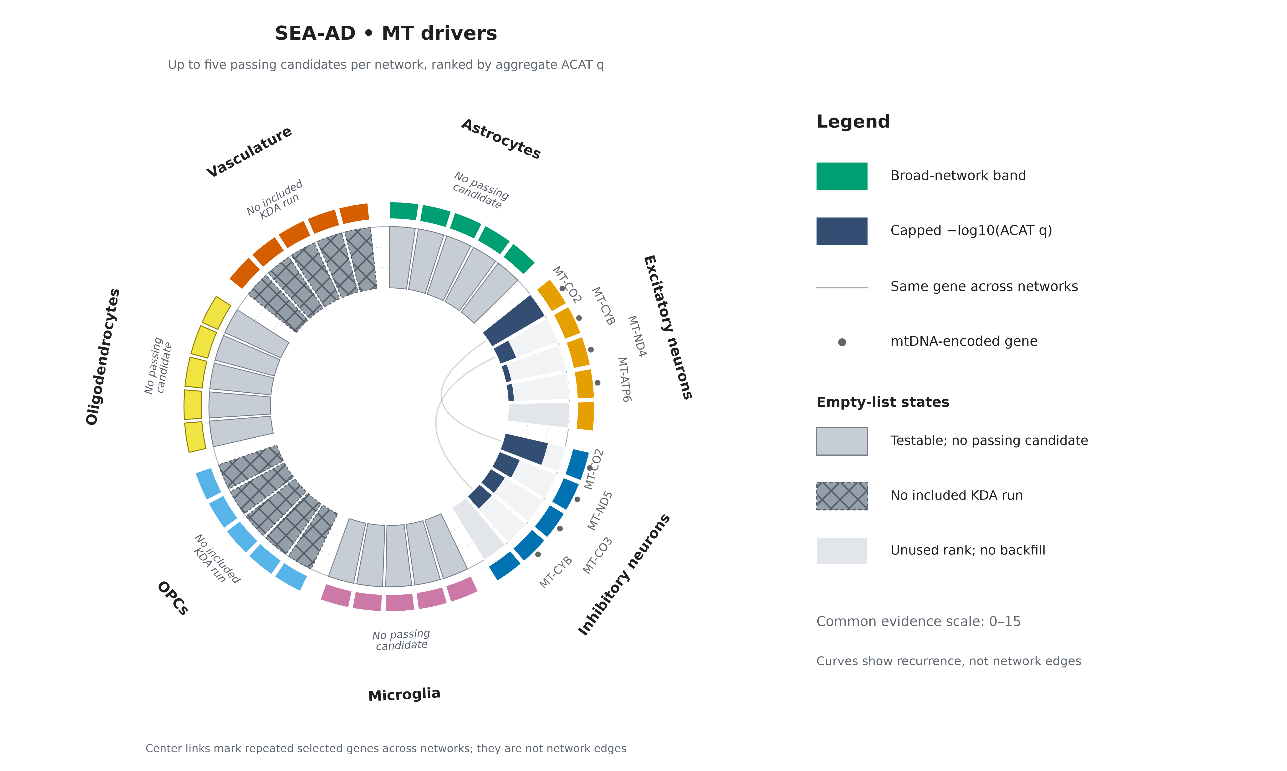
04
Source: validated VH10C selection; canonical seaad_two_case_circular figure package
Notes:
What to point at: Focus on the Excitatory and Inhibitory arcs. Eight selected MT units represent six genes. MT-CO2 and MT-CYB appear in both neuronal networks, which is why two recurrence curves cross the center.
Main takeaway: The SEA-AD MT signal is compact and neuronal rather than broadly distributed across all seven networks.
Boundary / transition: The curves indicate the same selected gene appearing in two network lists; they are not biological network edges. Gray and hatched slots distinguish testable lists with no passing driver from networks with no included run. Next we show the SEA-AD non-MT selections.

Slide 5
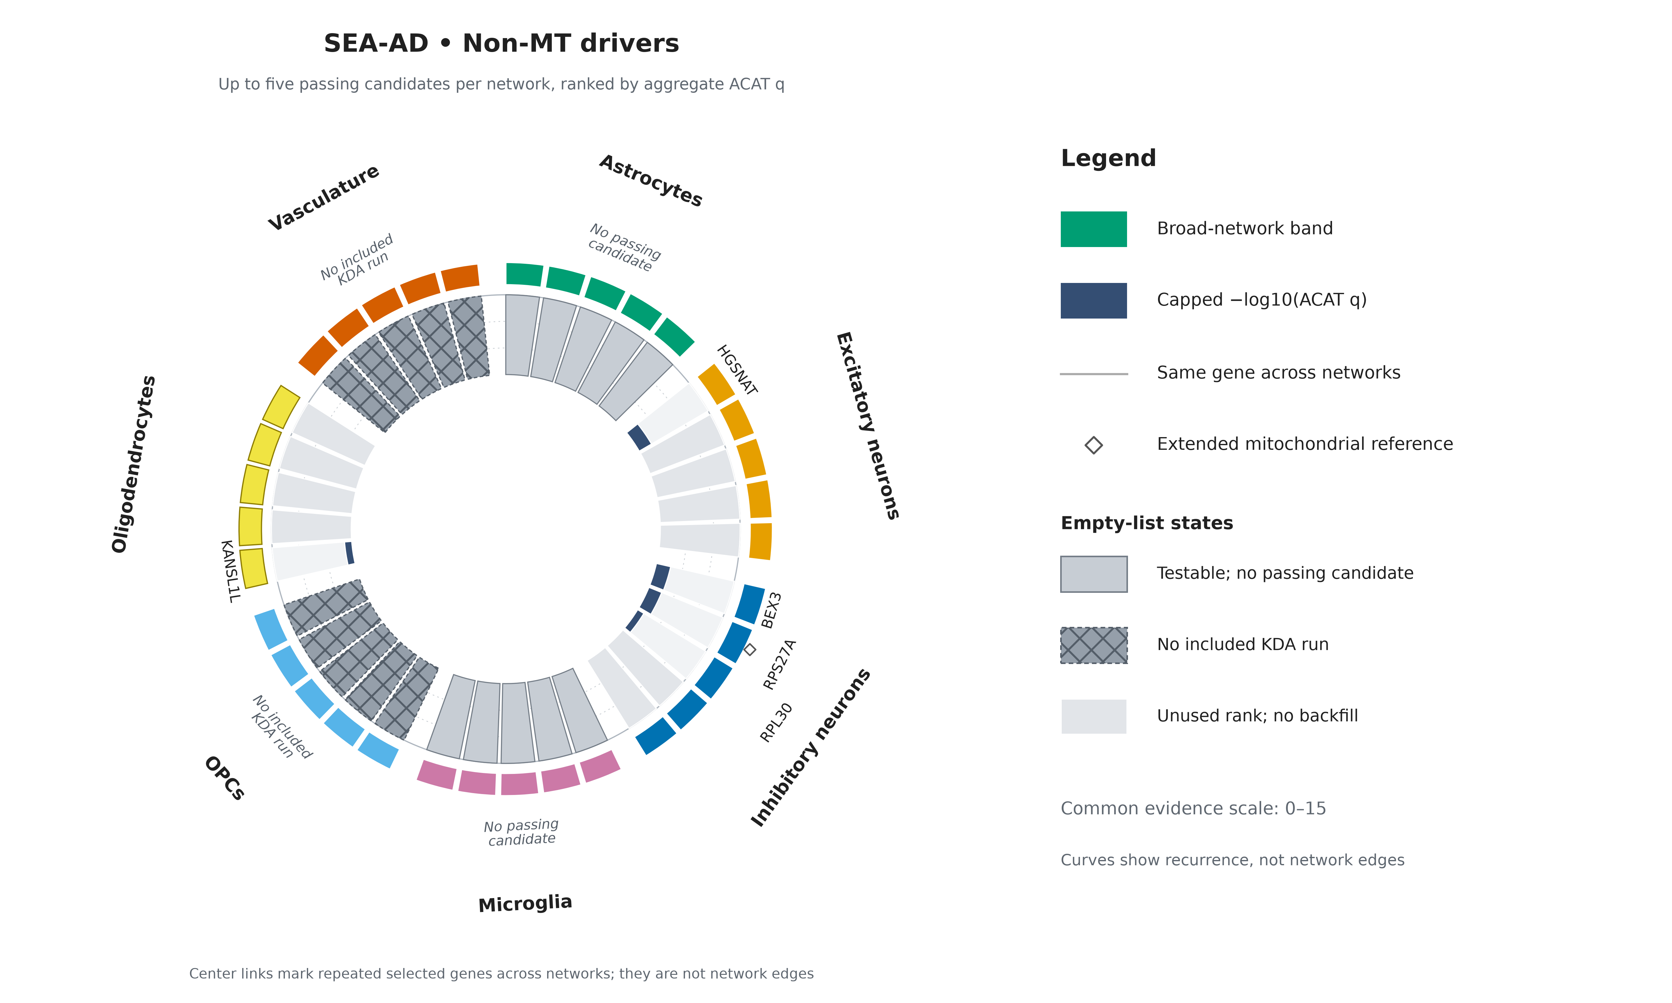
05
Source: validated VH10C selection; canonical seaad_two_case_circular figure package
Notes:
What to point at: The selected non-MT genes are HGSNAT in Excitatory neurons, BEX3, RPS27A, and RPL30 in Inhibitory neurons, and KANSL1L in Oligodendrocytes. The other list positions are deliberately not filled.
Main takeaway: SEA-AD did select non-MT drivers; the later zero overlap means these five genes differ from the final ROSMAP non-MT list, not that SEA-AD had no non-MT result.
Boundary / transition: Non-MT means outside the frozen core-MitoCarta class, not unrelated to mitochondria. OPC and Vasculature lists lacked included KDA runs and should not be treated as negative results. Next we move to the prespecified strict comparison.

Slide 6
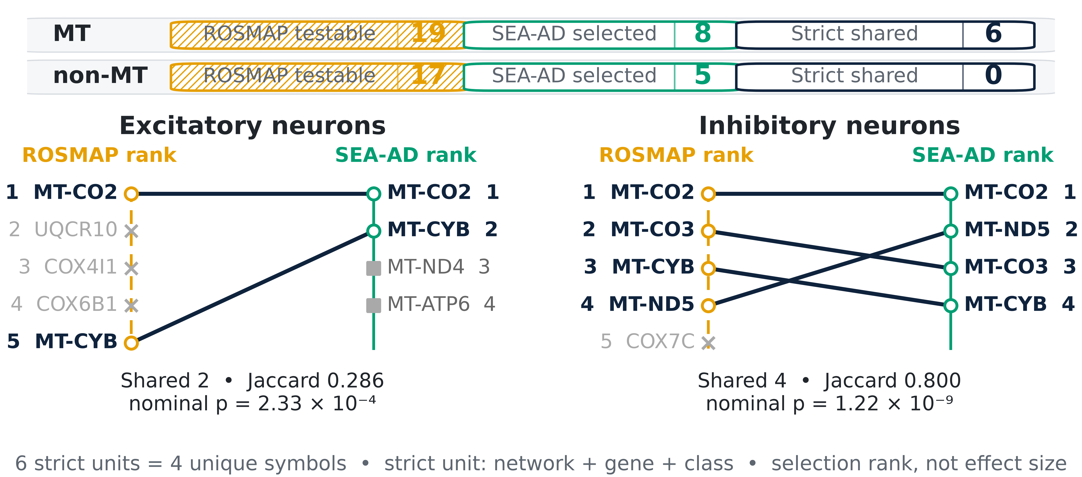
PRIMARY CROSS-COHORT ENDPOINT
06
Six ROSMAP units reappear in the same neuronal network and driver class
Source: validated VH09 frozen ROSMAP units and VH10D strict-overlap tables
Notes:
What to point at: The top bands separate MT and non-MT. Then follow the rank lines in Excitatory and Inhibitory neurons. Six same-network, same-gene, same-class units recur; because MT-CO2 and MT-CYB recur in both networks, these are four unique gene symbols.
Main takeaway: The primary cross-cohort endpoint is six strict neuronal MT matches and zero strict non-MT matches. Thirty-six of the 47 frozen ROSMAP units had a matching testable SEA-AD universe.
Boundary / transition: The printed p-values are nominal per-list overlap tests. Eleven ROSMAP units had no eligible SEA-AD run and are not negative replications. The next slide deliberately collapses network identity for a simpler gene-level view.

Slide 7
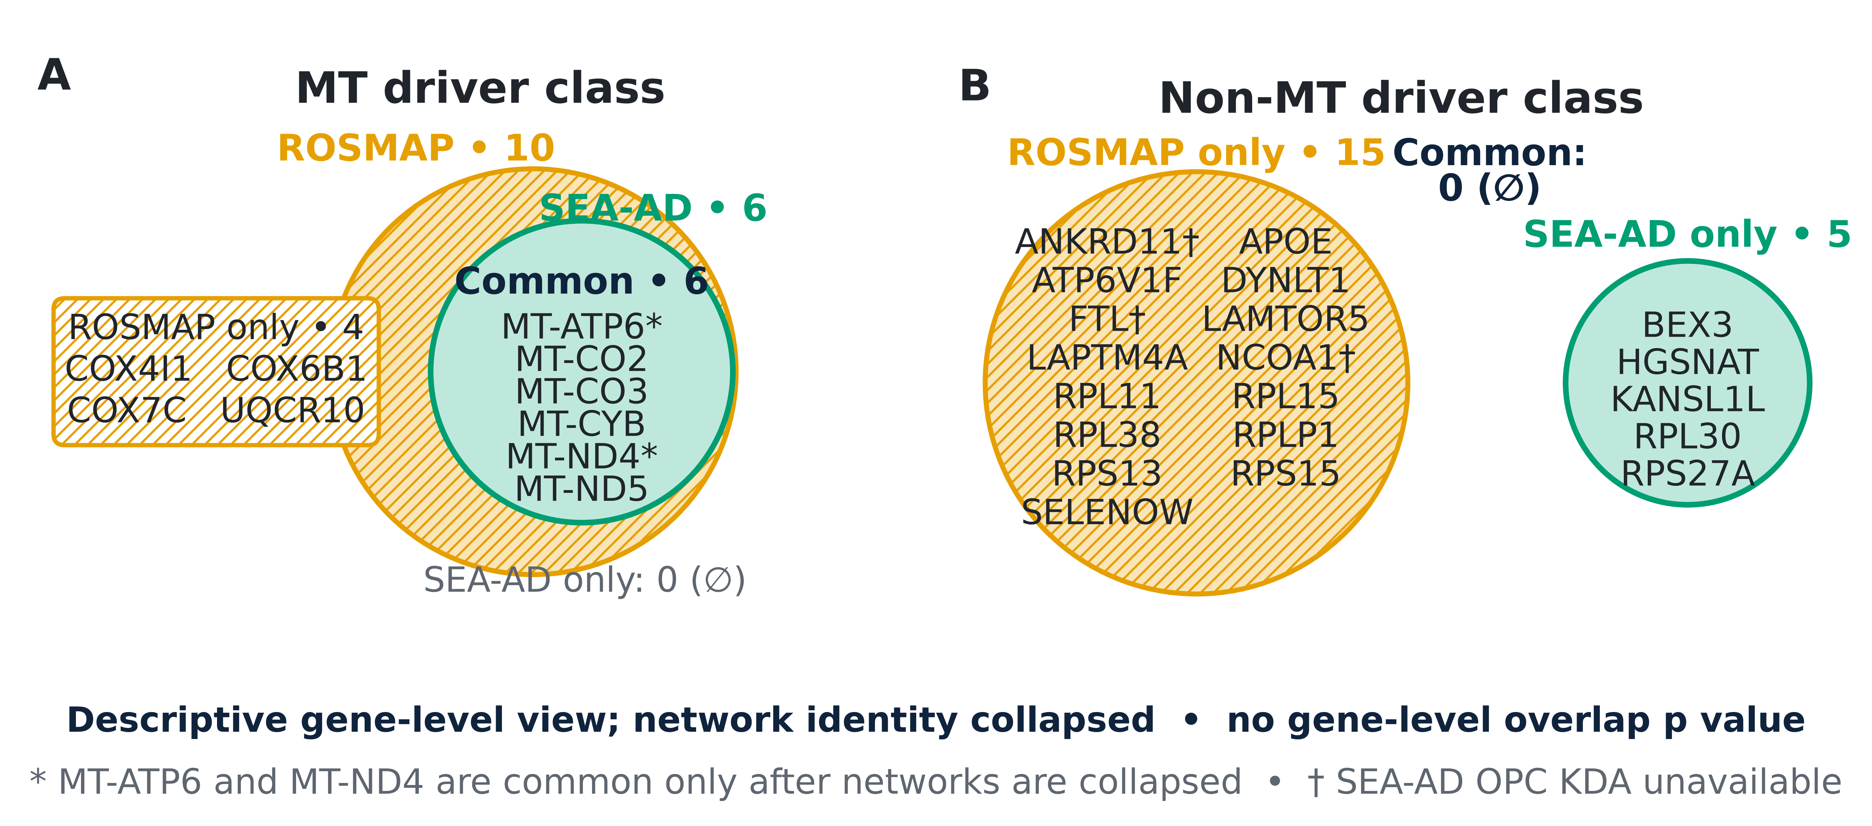
SECONDARY DESCRIPTIVE VIEW
07
Ignoring network, all six SEA-AD MT genes occur in ROSMAP; non-MT overlap is zero
Source: validated VH09/VH10C selected lists and VH10D gene-level overlap
Notes:
What to point at: In the MT panel, the SEA-AD circle is fully contained inside the ROSMAP circle: all six SEA-AD MT genes occur somewhere in ROSMAP. In the non-MT panel, the two gene sets are disjoint.
Main takeaway: The descriptive gene-level view shows six shared MT genes and no shared non-MT genes after each gene is counted once, regardless of network.
Boundary / transition: This is secondary to the strict endpoint. MT-ATP6 and MT-ND4 overlap only after networks are ignored, so the six common genes here are not the same as six strict units. No gene-level overlap p-value is claimed. Next we unpack the non-MT mismatch.

Slide 8
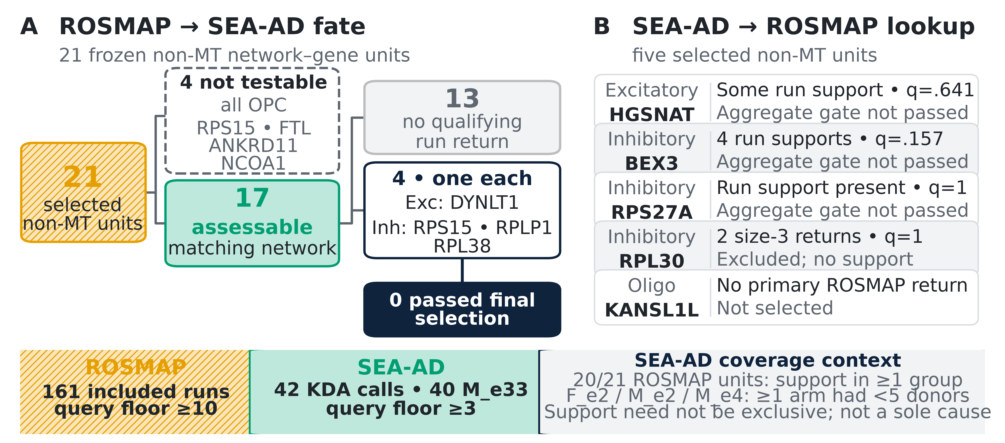
INTERPRETING THE NON-MT RESULT
08
Zero non-MT overlap does not mean the biology is absent
Source: validated VH09, VH10A/B/D outputs and frozen Phase 18 call-return authority
Notes:
Panel A starts with 21 non-MT driver units selected in ROSMAP. Four are labeled “not testable” because they all belong to the OPC network:
RPS15
FTL
ANKRD11
NCOA1
A strict comparison requires an eligible SEA-AD KDA run in the same broad network. SEA-AD produced no runnable OPC KDA calls:
36 planned OPC directions → 30 not estimable from insufficient donors → 6 completed → 5 empty queries + 1 query with only 2 genes → 0 KDA calls
The 13 were testable, but none produced a strong enough result in any matching SEA-AD KDA run.
A “qualifying run return” requires the gene to satisfy all three conditions in one run:
1. Within-run adjusted q ≤ 0.05
2. Neighborhood overlaps at least 2 mitochondrial query genes
3. Fold enrichment > 1
For these 13 ROSMAP units, no SEA-AD run in the same network passed all three conditions:
==============================================================
panel A, how it goes from 4 to 0 passed final selection. what happened to the 4 genes?
The four genes were:
DYNLT1 in Excitatory neurons
RPS15, RPLP1 and RPL38 in Inhibitory neurons
Each had exactly one SEA-AD run that met the support criteria. All four supporting runs were from the male APOE ε3/ε3, Dementia-down analysis.
They then underwent final selection across all runs in their network:
DYNLT1 was aggregated across 20 Excitatory KDA calls.
Each Inhibitory gene was aggregated across 16 calls.
Per-run raw p-values were combined using ACAT.
Results were corrected across all assessable genes in that network.
Final aggregate q had to be ≤0.05.
Each gene had adequate coverage and one supporting run, but the evidence from that single run was not strong enough after combining it with the remaining runs and correcting for multiple testing. Therefore, all four failed the aggregate q≤0.05 gate.
==============================================================
Panel B reverses the comparison:
Starting with the five non-MT drivers selected in SEA-AD (but not among the 21 ROSMAP selected genes), what evidence did ROSMAP provide for the same gene in the same network?
The q-values shown are ROSMAP final aggregate q-values.
HGSNAT, Excitatory: one ROSMAP supporting run, but aggregate q=.641. Not selected.
BEX3, Inhibitory: four supporting runs, but aggregate q=.157. Not selected.
RPS27A, Inhibitory: two supporting runs, but aggregate q=1. Not selected.
RPL30, Inhibitory: two raw returns occurred only in query-size-3 runs. ROSMAP Phase 18 required at least 10 query genes, and these returns also lacked the required overlap support. Aggregate q=1.
KANSL1L, Oligodendrocytes: no explicit primary ROSMAP KDA return. Not selected.
The key message is that three SEA-AD drivers—HGSNAT, BEX3 and RPS27A—had some supporting evidence in ROSMAP, but it was not strong enough after evidence was combined across runs and corrected for multiple testing. RPL30 had only out-of-scope weak returns, and KANSL1L had none.
“Aggregate gate not passed” means that some individual ROSMAP runs supported the gene, but the evidence was not strong enough after considering all relevant runs together.
The procedure was:
1.Collect the gene’s raw p-value from every eligible ROSMAP run in that network.
2.Combine those p-values using ACAT.
3.Correct the combined results across all assessable genes in that network using BH.
4.Require the final aggregate q-value to be ≤0.05.
The Panel B genes failed because:
HGSNAT: aggregate q=.641
BEX3: aggregate q=.157
RPS27A: aggregate q=1
All exceed 0.05.
==============================================================
“40 M_e33” means that 40 of the 42 SEA-AD KDA calls came from the male APOE ε3/ε3 group.
It does not mean 40 donors or 40 genes. Each call represents one:
fine cell type × sex/APOE group × DEG direction
The remaining two calls were:
One female APOE ε3/ε3 call
One female APOE ε4-carrier call
==============================================================
The “SEA-AD coverage context” box explains a mismatch in which sex/APOE groups were available between the cohorts.
“20/21 ROSMAP units”: 20 of the 21 selected ROSMAP non-MT network–gene units had at least one supporting ROSMAP run in F_e2, M_e2 or M_e4.
“≥1 arm had <5 donors”: SEA-AD could not analyze these groups because either the Dementia or No-dementia arm had fewer than five independent donors:
Female APOE ε2: 1 Dementia / 6 No dementia
Male APOE ε2: 1 / 4
Male APOE ε4: 4 / 3
Consequently, SEA-AD generated no KDA calls for those three groups and could not directly evaluate evidence specific to them.
“Support need not be exclusive; not a sole cause” is an important caution: some ROSMAP drivers also had support in groups that SEA-AD could analyze. Therefore, missing these groups reduced the opportunity for matching evidence, but it does not fully explain the zero non-MT overlap.
==============================================================

Slide 9
TAKE-HOME MESSAGE
09
SEA-AD supports a focused neuronal MT signal; broader validation remains incomplete
Supported
Not established
Next step
Same-network neuronal MT rediscovery
Replication of the non-MT list or untestable groups
Better donor-balanced cohorts and independently reconstructed networks
Focused cross-cohort support—not causal proof or broad validation of every driver
Source: synthesis of validated VH08–VH10 results
Notes:
What to point at: Read the three cards as supported, not established, and next step. The supported result is the same-network neuronal MT recurrence. Broad non-MT replication and untestable groups remain unresolved.
Main takeaway: SEA-AD provides focused independent support for a neuronal mitochondrial signal, while the wider ROSMAP driver list is not broadly reproduced under this design.
Boundary / transition: Shared networks and selection machinery limit how independent the full analysis is, and KDA prioritization is not causal proof. The practical next step is better donor-balanced external cohorts and, where possible, independently reconstructed networks. The appendix contains the detailed setup and audit evidence.

Slide 10
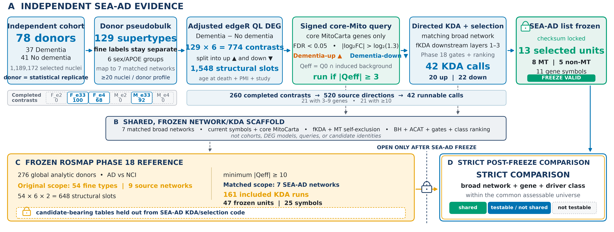
APPENDIX A1
10
Detailed validation setup
Source: validated VH02/VH04/VH08/VH09/VH10 inputs; setup figure package
Notes:
What to point at: This is the detailed version of the setup. The top lane shows independent SEA-AD evidence from donors through DEG queries and KDA selection. The lower ROSMAP lane enters only after the SEA-AD list is frozen for comparison.
Main takeaway: The compact main-deck workflow is backed by a checksum-validated, auditable implementation with explicit separation between cohort-specific evidence and shared technical assets.
Boundary / transition: The 1,548 count is a structural grid, not a run count. The original ROSMAP grid spans 54 fine types and six groups, while the SEA-AD design uses its own 129 supertypes. The next appendix slide shows where the DEG signal was concentrated.

Slide 11
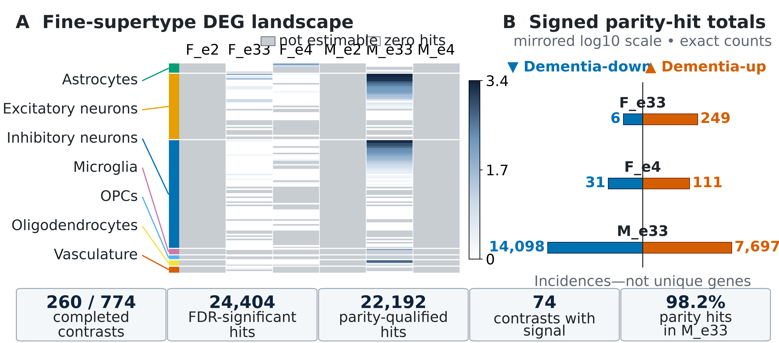
APPENDIX A2
11
Fine-supertype DEG landscape
Source: validated VH08 fine-supertype DEG summaries
Notes:
What to point at: The heatmap shows completed fine-supertype contrasts and the distribution of Phase-18-parity DEG incidences. The bottom summary makes the dominant male APOE ε3/ε3 contribution visible.
Main takeaway: Only 260 of 774 fine contrasts completed, and the usable DEG signal was strongly concentrated in a subset of neuronal contrasts, especially male APOE ε3/ε3.
Boundary / transition: Counts here are feature-by-contrast incidences, not unique genes, and they are upstream of symbol deduplication, MitoCarta filtering, and network intersection. The next slide shows what happened after runnable queries entered KDA.

Slide 12
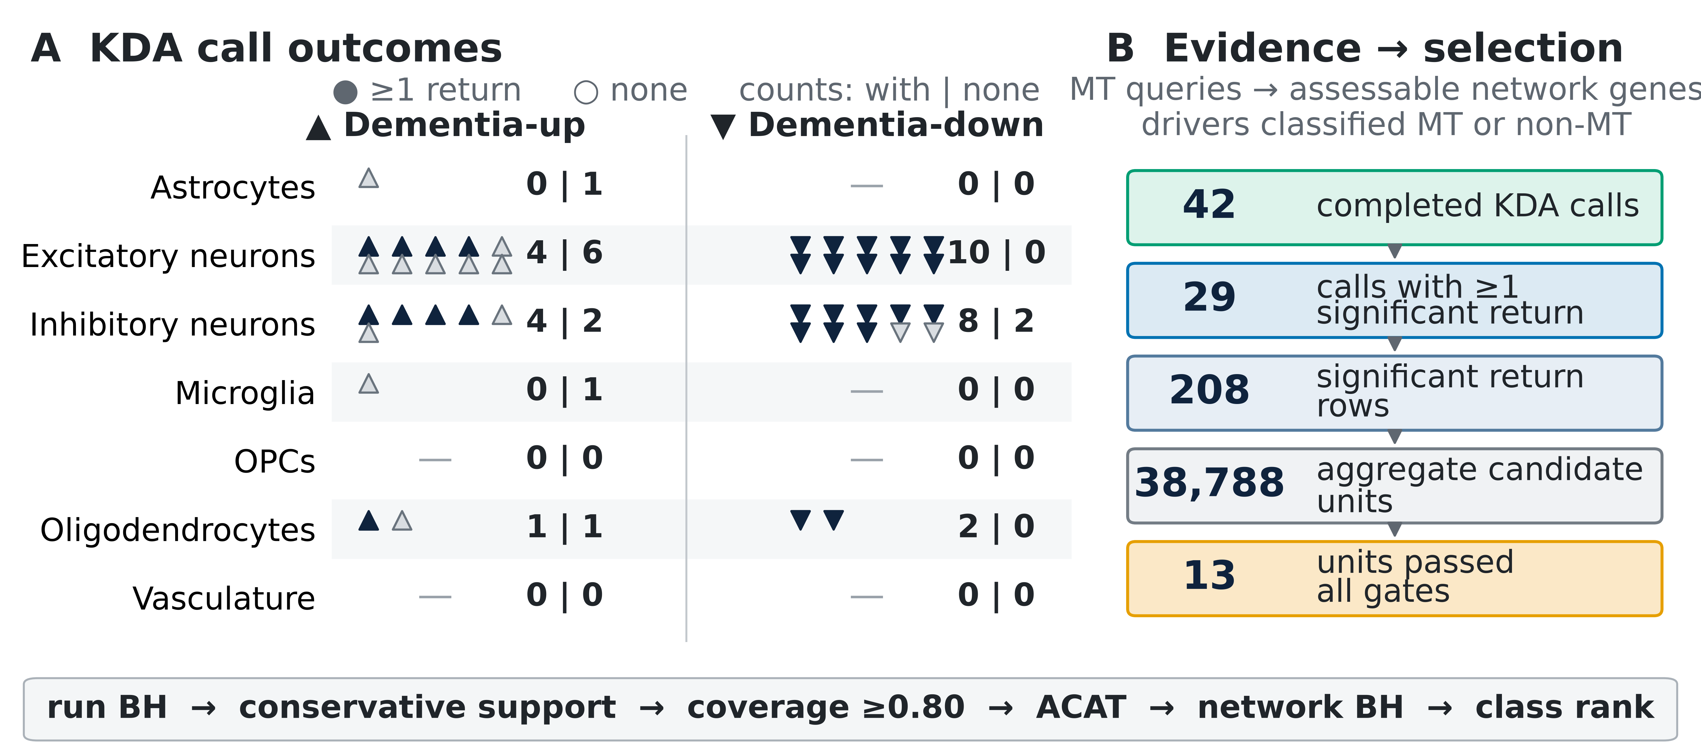
APPENDIX A3
12
KDA call outcomes
Source: validated VH10A–C KDA and selection outputs
Notes:
What to point at: Panel A separates calls with at least one significant return from calls with none. Panel B shows that 42 calls produced run-level evidence, while final across-run selection reduced the result to 13 selected units.
Main takeaway: Within-run evidence was common in the neuronal networks, but final selection across runs was intentionally much stricter.
Boundary / transition: A run-level significant return is not a final selected driver. The 208 return rows are not unique genes, and within-run q-values differ from aggregate ACAT/BH q-values. The next appendix slide summarizes the frozen rules without the implementation detail.

Slide 13
APPENDIX A4
13
Query and selection rules
1
Define query
2
Run KDA
3
Select across runs
4
Display
Signed core-MitoCarta DEG set FDR < 0.05 and |log₂FC| > log₂(1.3)
Intersect with induced-network background SEA-AD ≥3 genes; ROSMAP ≥10
Coverage ≥0.80 • ≥1 support run aggregate ACAT/BH q ≤0.05
Rank by q, p, then symbol maximum five; no backfill
Mitochondrial genes define the query; every assessable network gene can be a candidate driver
Source: frozen SEA-AD validation config and Phase 18 KDA/selection authorities
Notes:
What to point at: Read the four cards in order: define a signed core-MitoCarta DEG query, run KDA only when the effective query is large enough, aggregate evidence across runs, and display no more than five genes without backfilling.
Main takeaway: SEA-AD changed only the runnable query floor to three genes; ROSMAP used ten. Coverage, conservative support, aggregate correction, driver classes, and ranking remain aligned with the frozen Phase 18 selection logic.
Boundary / transition: The query consists of mitochondrial DEG genes, but candidate drivers can be any assessable network gene and are later classified as MT or non-MT. These rules prioritize evidence; they do not establish causality. The next appendix slide lists the selected SEA-AD units and testability summary.

Slide 14
APPENDIX A5
14
Selected drivers and ROSMAP testability
All 13 SEA-AD selected units
ROSMAP comparison
Excitatory
MT
MT-CO2 • MT-CYB • MT-ND4 • MT-ATP6
47
frozen selected units
Excitatory
non-MT
HGSNAT
36
testable in SEA-AD
Inhibitory
MT
MT-CO2 • MT-ND5 • MT-CO3 • MT-CYB
6
strict shared units
Inhibitory
non-MT
BEX3 • RPS27A • RPL30
11
no eligible SEA-AD run
Oligodendrocytes
non-MT
KANSL1L
SEA-AD list states
5 ranked • 5 tested/no passing • 4 no runs
Ranked lists are capped at five and are not backfilled.
Source: VH10C seaad_top5/list_status; VH10D candidate-overlap status
Notes:
What to point at: The left panel lists every SEA-AD selected unit by network and class. The right panel shows the ROSMAP comparison denominator and the three SEA-AD list states.
Main takeaway: All 13 SEA-AD passing units were displayed because no list exceeded the five-gene cap. Of 47 frozen ROSMAP units, 36 were testable and six were strict matches; the 11 untestable units came from networks without an eligible SEA-AD run.
Boundary / transition: Tested but not selected and not testable are different states. The table summarizes the prespecified network–gene–class endpoint, not gene-level overlap. The final appendix slide records provenance and interpretation limits.

Slide 15
APPENDIX A6
15
Provenance and interpretation limits
Reproducibility controls
Interpretation limits
• Validated source status and checksum gates • Validated color/grayscale figure packages • Embedded PNGs verified byte-for-byte • Source lines, alt text, and speaker notes • Deck inventory, checks, and SHA-256 status
• Shared broad networks and selector • Uneven independent-donor coverage • SEA-AD query floor 3 vs ROSMAP 10 • No optional sensitivity branch executed • KDA prioritization is not causal proof
VH05/VH06 QC figures are not required for the scientific claims in this deck
Source: validated input/figure manifests and deck build report
Notes:
What to point at: The left column lists the evidence controls: validated source tables, validated figure packages, byte-identical embedded images, and speaker notes. The right column lists the main boundaries.
Main takeaway: The deck is a reproducible view of the completed primary analysis. It does not rely on VH05/VH06 QC figures or an unexecuted sensitivity branch.
Boundary / transition: The shared network scaffold is not an independently reconstructed network. Uneven donor coverage limits testability, the compact transfer does not support new gene-level plots for every intermediate, and KDA is a prioritization method rather than causal proof. These points define the appropriate scope of the conclusions.

