Slide 1
GENES, NETWORKS, AND INHERITED RISK
Do genes highlighted by brain-cell networks also show inherited links to Alzheimer's disease?
A public-data study of 25 genes from 47 cell-network results
APOE had the strongest inherited DNA evidence; several other genes remain possible but unconfirmed.
STUDY DESIGN • DATASETS • EVIDENCE • INTERPRETATION
Public-data update • 21 August 2026
Notes:
This study asked whether the key-driver genes from the network analysis also have evidence from inherited DNA differences. It did not rerank the original genes.

Slide 2
EXECUTIVE OVERVIEW
02
At a glance: APOE had strong evidence; most other genes need more study
STARTING LIST
GENES TESTED
STRONG EVIDENCE
25 genes
19 nuclear
APOE
47 gene-by-cell-network combinations
6 mitochondrial genes need a different test
Linked to Alzheimer's disease and 3 spinal-fluid markers
EARLY EVIDENCE
FOLLOW-UP PRIORITY
FINAL COMPARISON
COX7C + SELENOW
RPS15
0 completed
Promising but incomplete public evidence
Strong nearby DNA signal; gene link not confirmed
Required gene-activity or reference data were missing
The genetic study adds a new layer of evidence; it does not replace the original network analysis.
Most genes need more study.
Source: consolidated genetic-support summary; formal Tier 1, recovery, and CSF status tables
Notes:
The main result is concentrated in APOE. Two genes have early evidence, and RPS15 is an important follow-up candidate, but most genes need more study.

Slide 3
PRESENTATION ROADMAP
03
The presentation moves from the study design to results and next steps
Study design and public data
Slides 04–08
01
What the two analyses ask, which public datasets were used, and how each check worked.
What the genetic evidence showed
Slides 09–13
02
The first gene screen, the APOE result, four other genes, and the reasons later tests stopped.
How to read the results and what comes next
Slides 14–18
03
What a missing result means, what this study could not test, and the most useful next steps.
Exact cutoffs, full evidence tables, and file-quality checks are kept in the appendix on slides 19–27.
Notes:
The talk first explains the question and public datasets, then shows the results, and ends with limits and next steps.

Slide 4
04
SECTION 01
01
Study design and public data
What was tested, which public resources were used, and how the evidence was checked step by step.
IN THIS SECTION
GWAS: DNA–trait links
QTL: DNA–gene activity links
CSF: spinal fluid
Notes:
This section explains which genes were tested, which public datasets were used, and how each check was performed.

Slide 5
FRAMING
05
A gene can matter in diseased cells without changing inherited Alzheimer's risk
CELL-NETWORK ANALYSIS
INHERITED-DNA ANALYSIS
Which genes are central in diseased cells?
Which genes are linked to inherited AD risk?
47 cell-network results • 25 genes
different questions
19 nuclear genes tested • 6 mitochondrial genes need a different test
The network analysis finds genes at the center of disease-related activity in cells.
The genetic analysis asks whether inherited DNA differences near a gene are linked to Alzheimer's disease or disease markers.
A gene may help drive—or respond to—disease without being where inherited risk begins.
A gene can matter in the disease process even when inherited DNA evidence is weak.
Source: genetic-support consolidated summary §1.1; call_key_driver_returns.tsv
Notes:
Network analysis and genetics answer different questions. A gene can respond to disease or help maintain a disease state without carrying inherited risk.

Slide 6
PUBLIC DATASETS
06
We combined five kinds of public data, each with a different job
Data type
Dataset / version
What it tells us
Starting gene list
Network-analysis list • GENCODE v44 • HGNC 2026-06-05
Keep the same 47 settings / 25 genes; map 19 nuclear genes and flag 6 mitochondrial genes.
Published summary lists
FunGen-xQTL snapshot f6f63fc… • six public files (~8.74 MiB)
Quickly check earlier Alzheimer's and gene-regulation results; these lists do not contain every study detail.
Alzheimer's disease study
Bellenguez 2022 • GCST90027158 • complete GRCh38 summary statistics
Look for disease-linked DNA variants within ±1 Mb (one million DNA letters) of each nuclear gene.
Brain gene-activity data
NIAGADS NG00184.v1 • eQTL Catalogue r7
Find DNA variants linked to RNA amount, RNA splicing, or protein amount in brain samples.
Spinal-fluid markers
GCST90726396 / GCST90726397 / GCST90726398 • European N=18,948 each
Test amyloid-β42, total tau, and p-tau181 across 19 genes × 3 markers = 57 checks.
Summary data = group-level results, not individual records • CSF = fluid around the brain and spinal cord.
Source: candidate, Tier 1, Tier 2, recovery, and CSF dataset registries and input inventories
Notes:
Each public dataset had one job: define the gene list, screen existing summaries, find Alzheimer-related DNA regions, study gene activity, or test spinal-fluid markers.

Slide 7
GENE-ACTIVITY DATA
07
Gene-activity datasets vary in cell type, sample size, and completeness
MICROGLIA
NEURON-LIKE CELLS
MIXED BRAIN TISSUE
BROADER BRAIN DATA
Young 2019 • 104 samples
Aygun 2021 • 73 samples
Walker 2019 • 211 samples
NG00184.v1
eQTL (RNA amount): QTD000559 sQTL (RNA splicing): QTD000563 Same cell type
eQTL (RNA amount): QTD000569 sQTL (RNA splicing): QTD000573 Related neuron samples
eQTL (RNA amount): QTD000579 sQTL (RNA splicing): QTD000583 Useful fallback—not exact-cell proof
eQTL: RNA amount sQTL: RNA splicing pQTL: protein amount Wider coverage; full files and models often missing
APOE PROTEIN FOLLOW-UP (pQTL)
RPS15 FOLLOW-UP
NG00130.v2 • 3,506 European samples • spinal-fluid protein study used after APOE passed the earlier checks; the published file list is incomplete.
Existing brain datasets were checked again; six positive setting rows came from three mixed-brain results repeated across two cell-network settings.
The full NG00184 files (~844 GB) were not downloaded; exact-cell studies were small, and matching DNA-reference data were often missing.
Source: recovery_dataset_registry.tsv; endophenotype_dataset_registry.tsv; targeted RPS15 audit
Notes:
Gene-activity studies differ in cell type, sample size, and available files. Brain-tissue results are useful fallbacks but do not prove a change in one exact cell type.

Slide 8
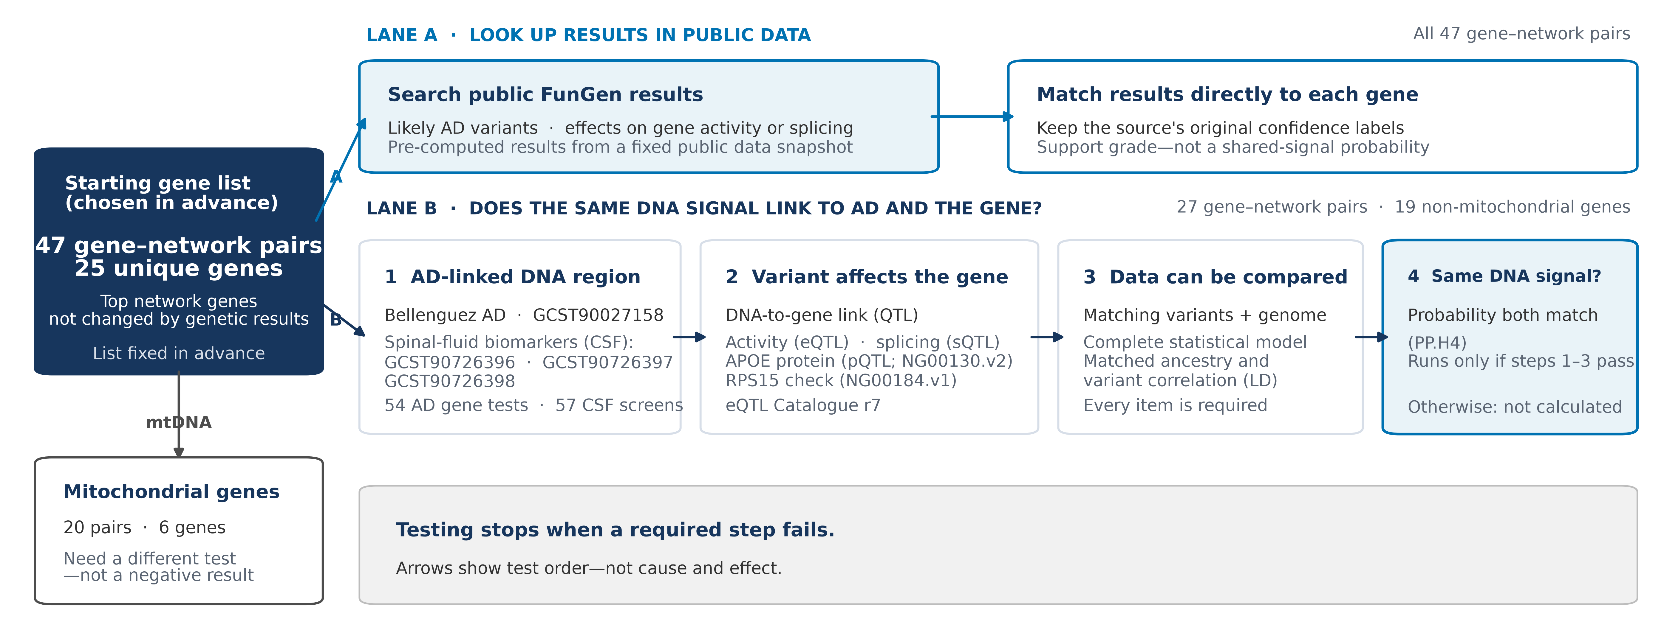
MAIN RESULT
08
A step-by-step design helps prevent overclaiming
A comparison stopped when a required signal or dataset was missing. Arrows show steps—not cause and effect.
Source: generated workflow package; analysis contracts, registries, and route manifests
Notes:
The study used a fixed order of checks. A test stopped when an earlier requirement failed or when required data were missing.

Slide 9
09
SECTION 02
02
What the genetic evidence showed
We summarize all 47 gene–network settings, then focus on APOE and the other genes.
IN THIS SECTION
All 47 settings
APOE + spinal fluid
Other genes + stopped tests
Notes:
This section shows the first gene screen, the APOE result, evidence for four other genes, and why the later comparisons stopped.

Slide 10
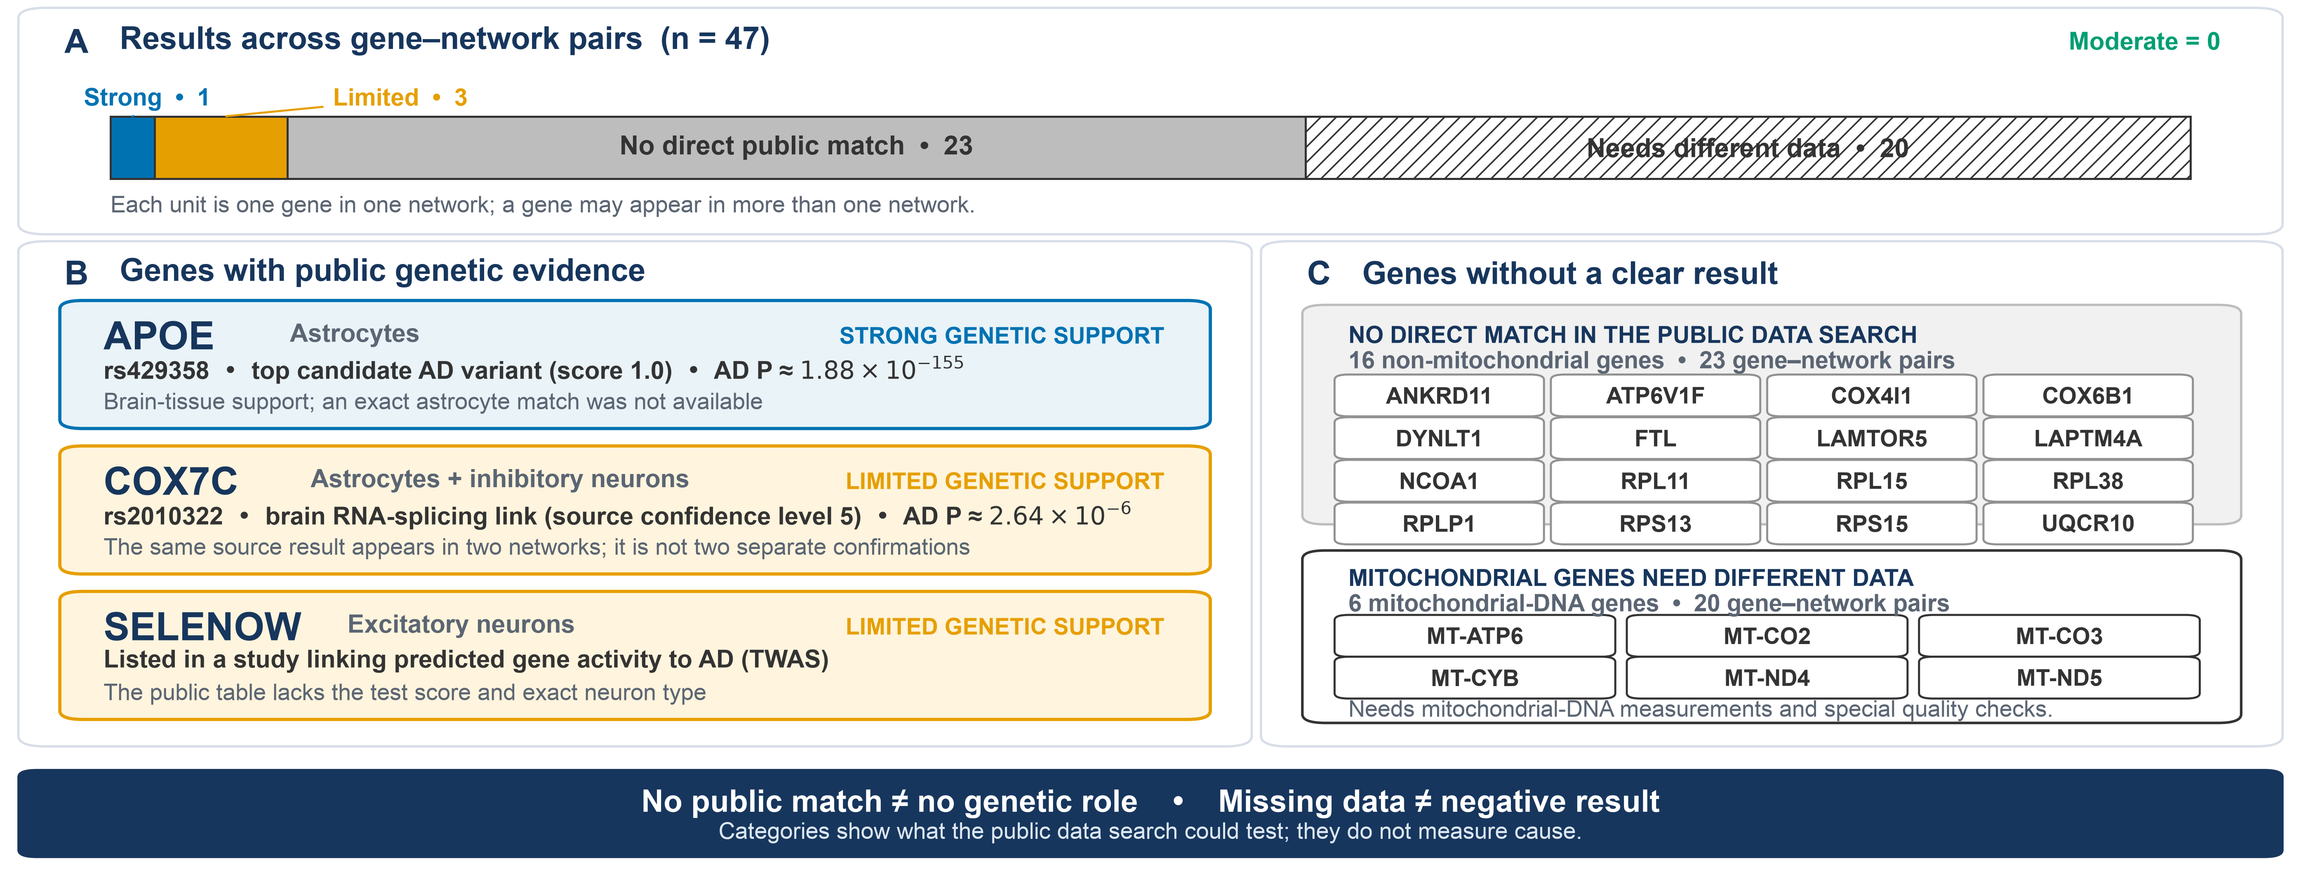
MAIN RESULT
10
Only APOE had strong evidence in the first screen
The extra RPS15 follow-up found limited evidence and was not included in these 47 first-screen results.
Source: Tier 1 genetic_support_evidence_summary.tsv and genetic_support_status.tsv
Notes:
Only APOE had strong evidence in the first screen. The two COX7C rows came from one public result, not two independent studies; the RPS15 follow-up was separate.

Slide 11
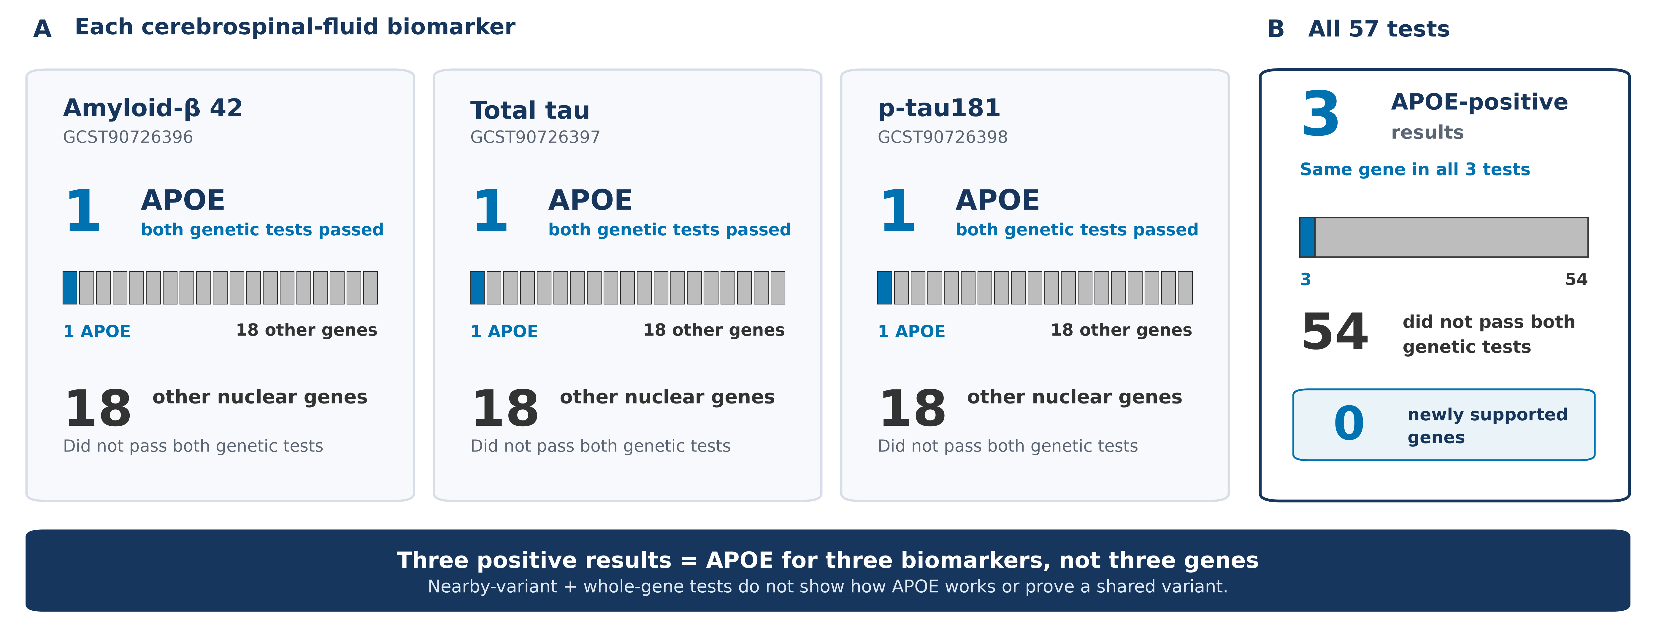
MAIN RESULT
11
APOE was linked to Alzheimer's disease and all three spinal-fluid markers
APOE's DNA signal is clear, but these data do not show exactly how APOE changes astrocytes.
Source: CSF endophenotype_gate_decisions.tsv and MAGMA candidate-gene results
Notes:
APOE is clearly linked to Alzheimer's disease and three spinal-fluid markers, but these data do not show exactly how APOE changes astrocytes.

Slide 12
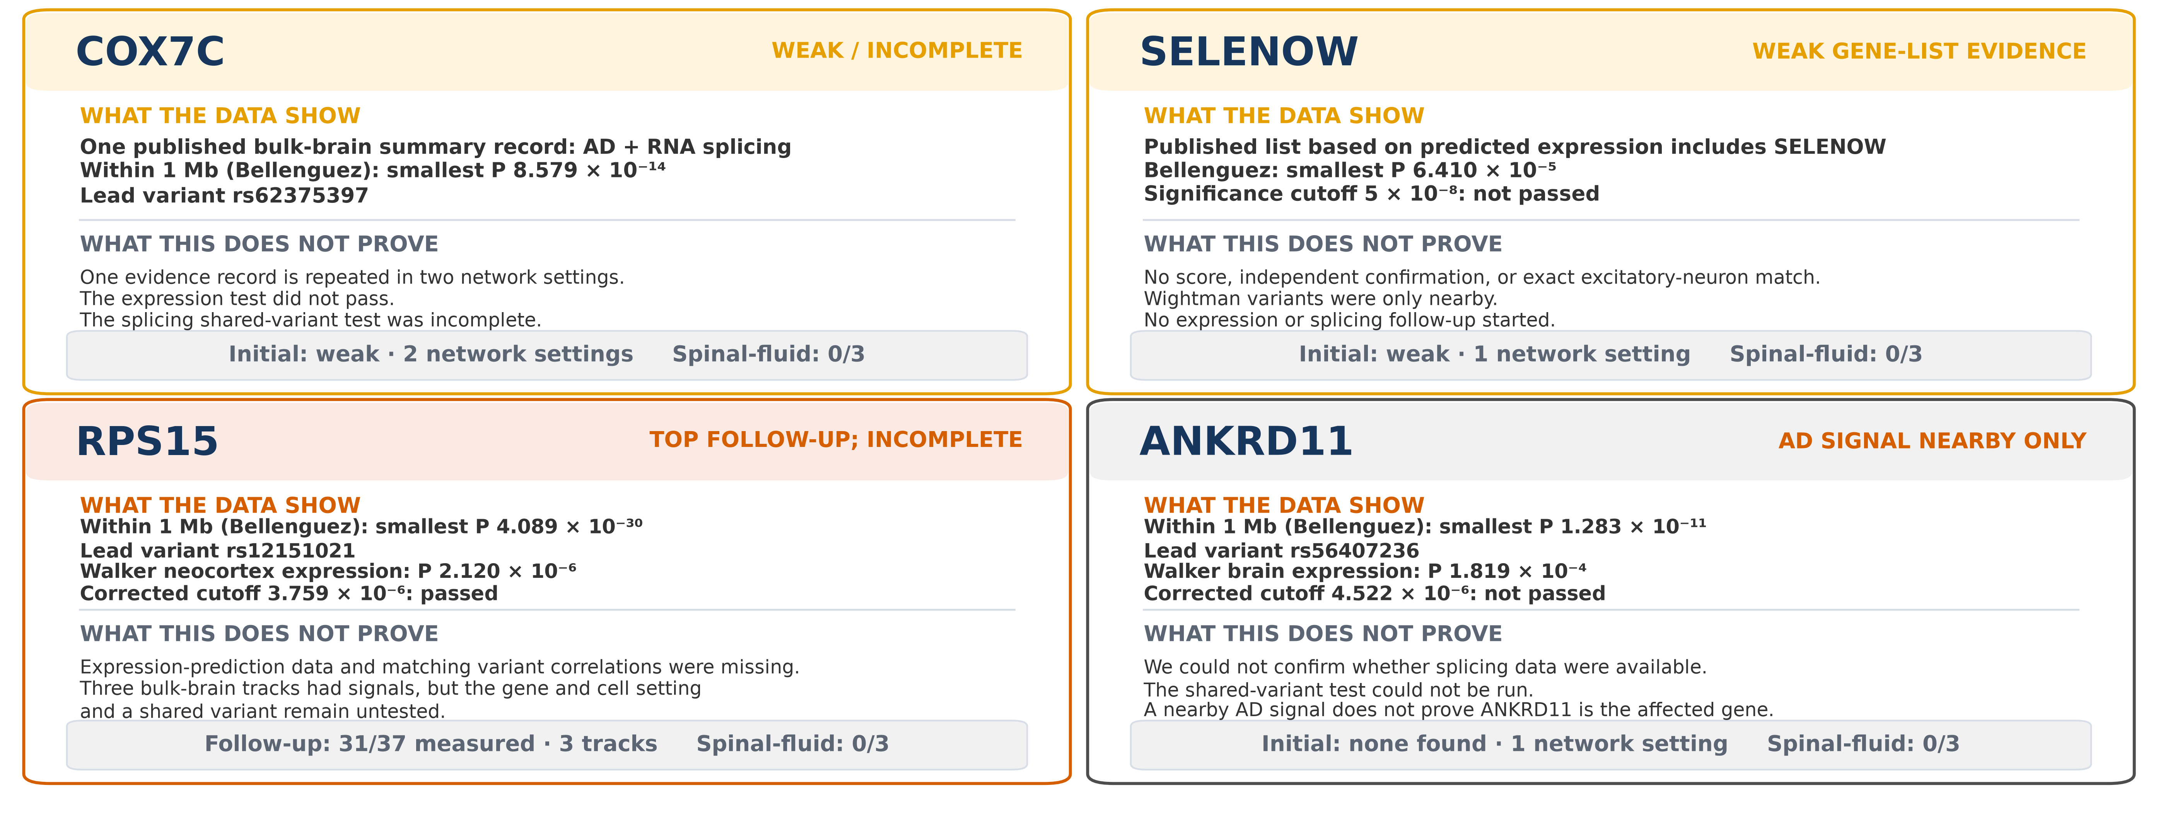
MAIN RESULT
12
Four other genes showed hints, but none could be confirmed
A strong DNA signal near a gene does not prove that the gene caused the signal.
Source: generated non-APOE plot data; Tier 1, recovery, RPS15 audit, and CSF result bundles
Notes:
A strong DNA signal near a gene does not prove that the gene caused the signal. The four non-APOE genes therefore remain promising but unconfirmed.

Slide 13
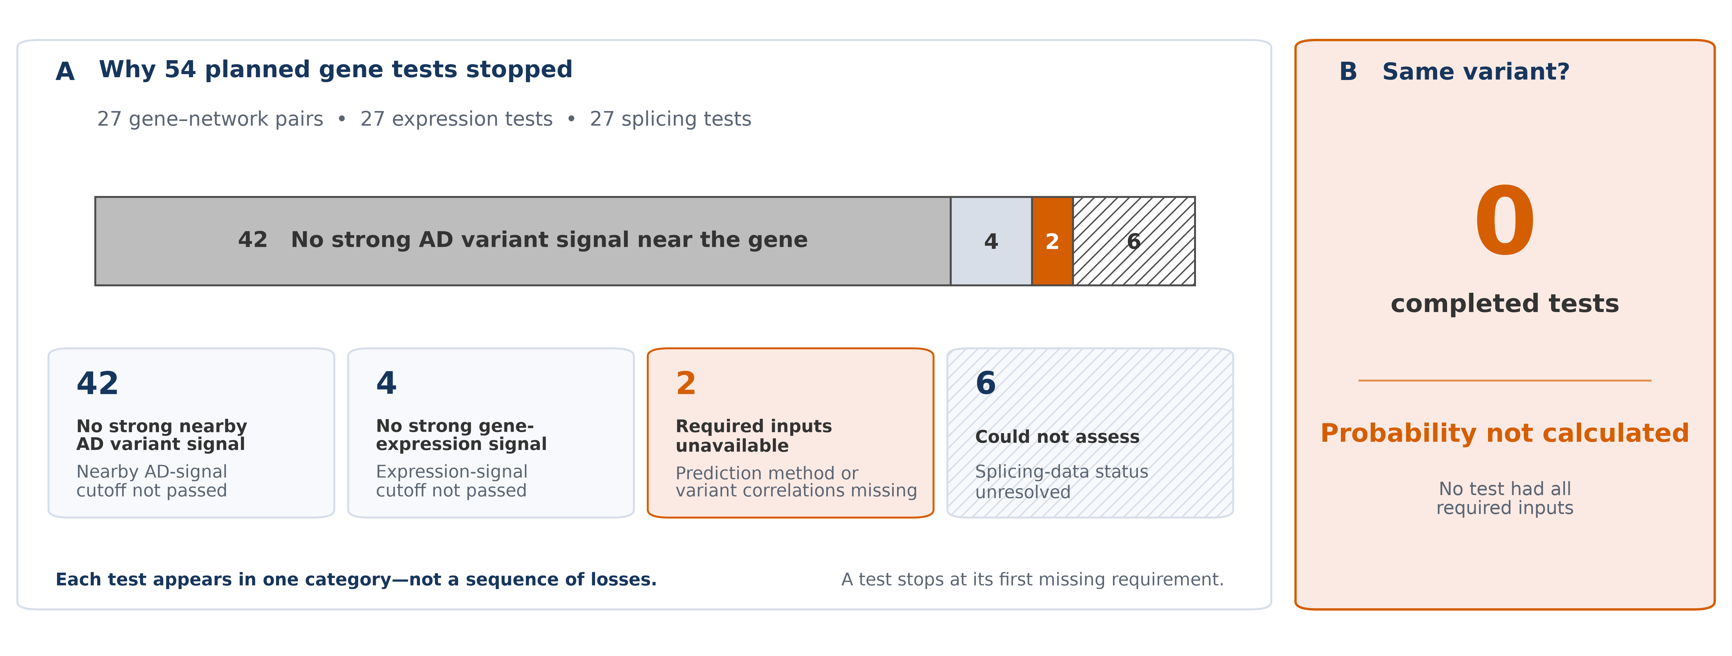
MAIN RESULT
13
None of the 54 planned gene-activity comparisons reached the final test
These numbers show why each comparison stopped; zero completed tests does not mean zero shared signals.
Source: Tier 2 recovery_route_decisions.tsv and header-only recovery_colocalization.tsv.gz
Notes:
No final shared-signal comparison was completed because earlier checks failed or required gene-activity and reference data were unavailable.

Slide 14
14
SECTION 03
03
How to interpret the results and what to do next
A missing result can mean no signal, an unfinished test, or biology that this study did not examine.
IN THIS SECTION
No strong signal
Test could not finish
Not studied here
Notes:
This section separates a true negative screen from an unfinished test or a mechanism that this study did not examine.

Slide 15
INTERPRETATION
15
A missing result can mean three different things
01
No strong signal found
02
The test could not finish
03
Not covered by this study
15 of 19 nuclear genes had no nearby Alzheimer's-linked DNA signal at P < 5×10⁻⁸. All 18 non-APOE genes failed the spinal-fluid marker checks.
Complete gene-activity files or matching DNA-reference data were missing. Data from the exact cell type were small, unavailable, or did not match.
Mitochondrial DNA, rare or large DNA changes, distant gene control, gene interactions, disease timing, and processes after RNA is made.
The six mitochondrial genes were not found negative—they need a different testing method.
Source: recovery_regional_gwas_summary.tsv; CSF gate decisions; Tier 1 mtDNA evidence states
Notes:
A missing result can mean no strong signal was found, the test could not be completed, or the mechanism was outside the study design.

Slide 16
WHAT THIS STUDY COULD NOT ANSWER
16
This study answers one focused question and leaves important gaps
01
No final signal comparison
02
Small or mixed samples
Zero final shared-signal tests were completed. Full gene-activity files and matching DNA-reference data were often unavailable.
Cell-focused gene-activity studies were small (N=73–211). Mixed brain tissue cannot prove a change in one exact cell type.
03
Limited populations
04
Other biology not tested
The main DNA studies were mostly European. Some brain data came from overlapping participants and were not fully independent.
Rare, large, mitochondrial, or distant DNA effects, gene interactions, disease timing, and laboratory experiments were outside this study.
Strongest conclusion: common inherited DNA variants located near nuclear genes in these public datasets.
Source: consolidated genetic-support summary §§5–6; route, QTL, ancestry, and provenance audits
Notes:
The study mainly tested common DNA differences near nuclear genes. It was limited by small or mismatched cell datasets, incomplete files, and limited ancestry representation.

Slide 17
NEXT STEPS
17
Next: finish the strongest open tests, then study more types of genetic effects
01
Finish APOE and RPS15
02
Test more genetic effects
03
Use separate and lab checks
Complete gene-activity datasets + matching DNA-reference data + larger studies of exact cell types
Protein- and RNA-based gene tests + rare DNA changes and interactions + more traits and populations
Dedicated mitochondrial-DNA study + repeat the network study in new data + change gene activity in lab experiments
Highest-value next step: collect the complete gene-activity and reference data needed for APOE and RPS15.
Source: genetic-support consolidated summary §6.2; bundle-repair actions are detailed in the appendix
Notes:
The highest-value next step is to finish the APOE and RPS15 comparisons with complete gene-activity data and matched reference genetics.

Slide 18
18
TAKE-HOME MESSAGE
The genetic evidence narrows the list but does not close the case
01
APOE
02
COX7C + SELENOW
Strong evidence from Alzheimer's and spinal-fluid studies.
Early evidence, but not enough for confirmation.
03
RPS15 + ANKRD11
04
No new gene confirmed
A follow-up priority and a nearby DNA-region signal, respectively.
Results included negative checks, missing data, and biology not tested here.
Status: important follow-up remains
This evidence adds to the network findings; it does not prove or reject them.
Notes:
The genetic evidence helps prioritize the list, but it neither confirms nor rejects every network-derived gene.

Slide 19
19
APPENDIX
A
Supporting details
The exact gene list, dataset versions, cutoffs, full result tables, and known file-quality issues.
IN THIS SECTION
Original gene list
Data + rules
Full results + file checks
Notes:
The appendix keeps the technical details behind the main presentation for questions and follow-up discussion.

Slide 20
APPENDIX • ORIGINAL GENE LIST
20
The original list: 25 genes in 47 gene–network settings
Cell network
Mitochondria-related group (original order)
Other driver group (original order)
Astrocytes
MT-CO2, MT-CO3, MT-ATP6, COX7C, COX4I1
RPL11, RPLP1, RPL15, APOE, LAPTM4A
Excitatory neurons
MT-CO2, UQCR10, COX4I1, COX6B1, MT-CYB
RPL11, RPS13, SELENOW, LAMTOR5, DYNLT1
Inhibitory neurons
MT-CO2, MT-CO3, MT-CYB, MT-ND5, COX7C
RPS15, LAMTOR5, RPLP1, ATP6V1F, RPL38
Microglia
MT-CO2, MT-ND4
RPL11
OPCs
MT-CO3, MT-CO2, MT-ND4
RPS15, FTL, ANKRD11, NCOA1
Oligodendrocytes
MT-CO2, MT-ND4
RPL11
Vasculature cells
MT-CO3, MT-CO2, MT-ATP6, MT-ND4
None
‘MT driver’ was a label in the original network analysis; COX7C and UQCR10 are nuclear genes. Six genes are encoded by mitochondrial DNA.
Notes:
This is the original top-five gene list from each cell network, shown in its original order.

Slide 21
APPENDIX • DATA INVENTORY
21
Dataset details: what each source was used for
Data type
Dataset / version
What it tells us
Starting gene list
Original network study • GENCODE v44 • HGNC 2026-06-05
Keep 47 settings; map gene names and DNA locations
Published summaries
FunGen-xQTL snapshot f6f63fc…
Quick screen of earlier AD and gene-regulation results
Alzheimer's disease
Bellenguez • GCST90027158
Check DNA within ±1 Mb of the 19 nuclear genes
Brain gene activity
NG00184.v1 • eQTL Catalogue r7
Check DNA links to RNA amount, RNA splicing, and protein
Spinal-fluid markers
GCST90726396 / 397 / 398 • N=18,948 each
Test amyloid-β42, total tau, and p-tau181
Focused follow-up
NG00130.v2 APOE protein QTL • local NG00184 RPS15
Study the open APOE and RPS15 questions
No individual-level genotypes or phenotypes were downloaded; Bellenguez case/control counts are omitted because published bundle fields conflict.
Notes:
This table records each public dataset, its version or accession, and the question it was used to answer.

Slide 22
APPENDIX • DECISION RULES
22
Rules decided before looking at the results
A result passed only when its P value was below the listed cutoff; a smaller P value means stronger statistical evidence.
AD / TRAIT LINK
GENE-ACTIVITY LINK
SPINAL-FLUID GENE TEST
MODEL ASSUMPTIONS
STRONG SHARED SIGNAL
P < 5×10⁻⁸
P < 0.05 / N tested
P < 8.77193×10⁻⁴
10⁻⁴ / 10⁻⁴ / 5×10⁻⁶
Estimated probability ≥ 0.80
No match in selected sources
The quick public-data screen found no direct match; this is not proof of absence.
No nearby AD signal
The full tested DNA region did not pass the Alzheimer's cutoff.
No gene-activity signal
The gene was measured but did not pass its gene-activity cutoff.
Could not test
A measurement, complete file, model, or dataset description was unavailable.
Inputs did not match
Both signals existed, but the two datasets could not be compared correctly.
Mitochondrial DNA
Mitochondrial genes need a separate testing method.
PIP, VCP, and CL are scores from the source studies. PP.H4 estimates whether the disease and gene-activity signals share a DNA variant.
Notes:
These cutoffs and result categories were decided before the gene results were reviewed.

Slide 23
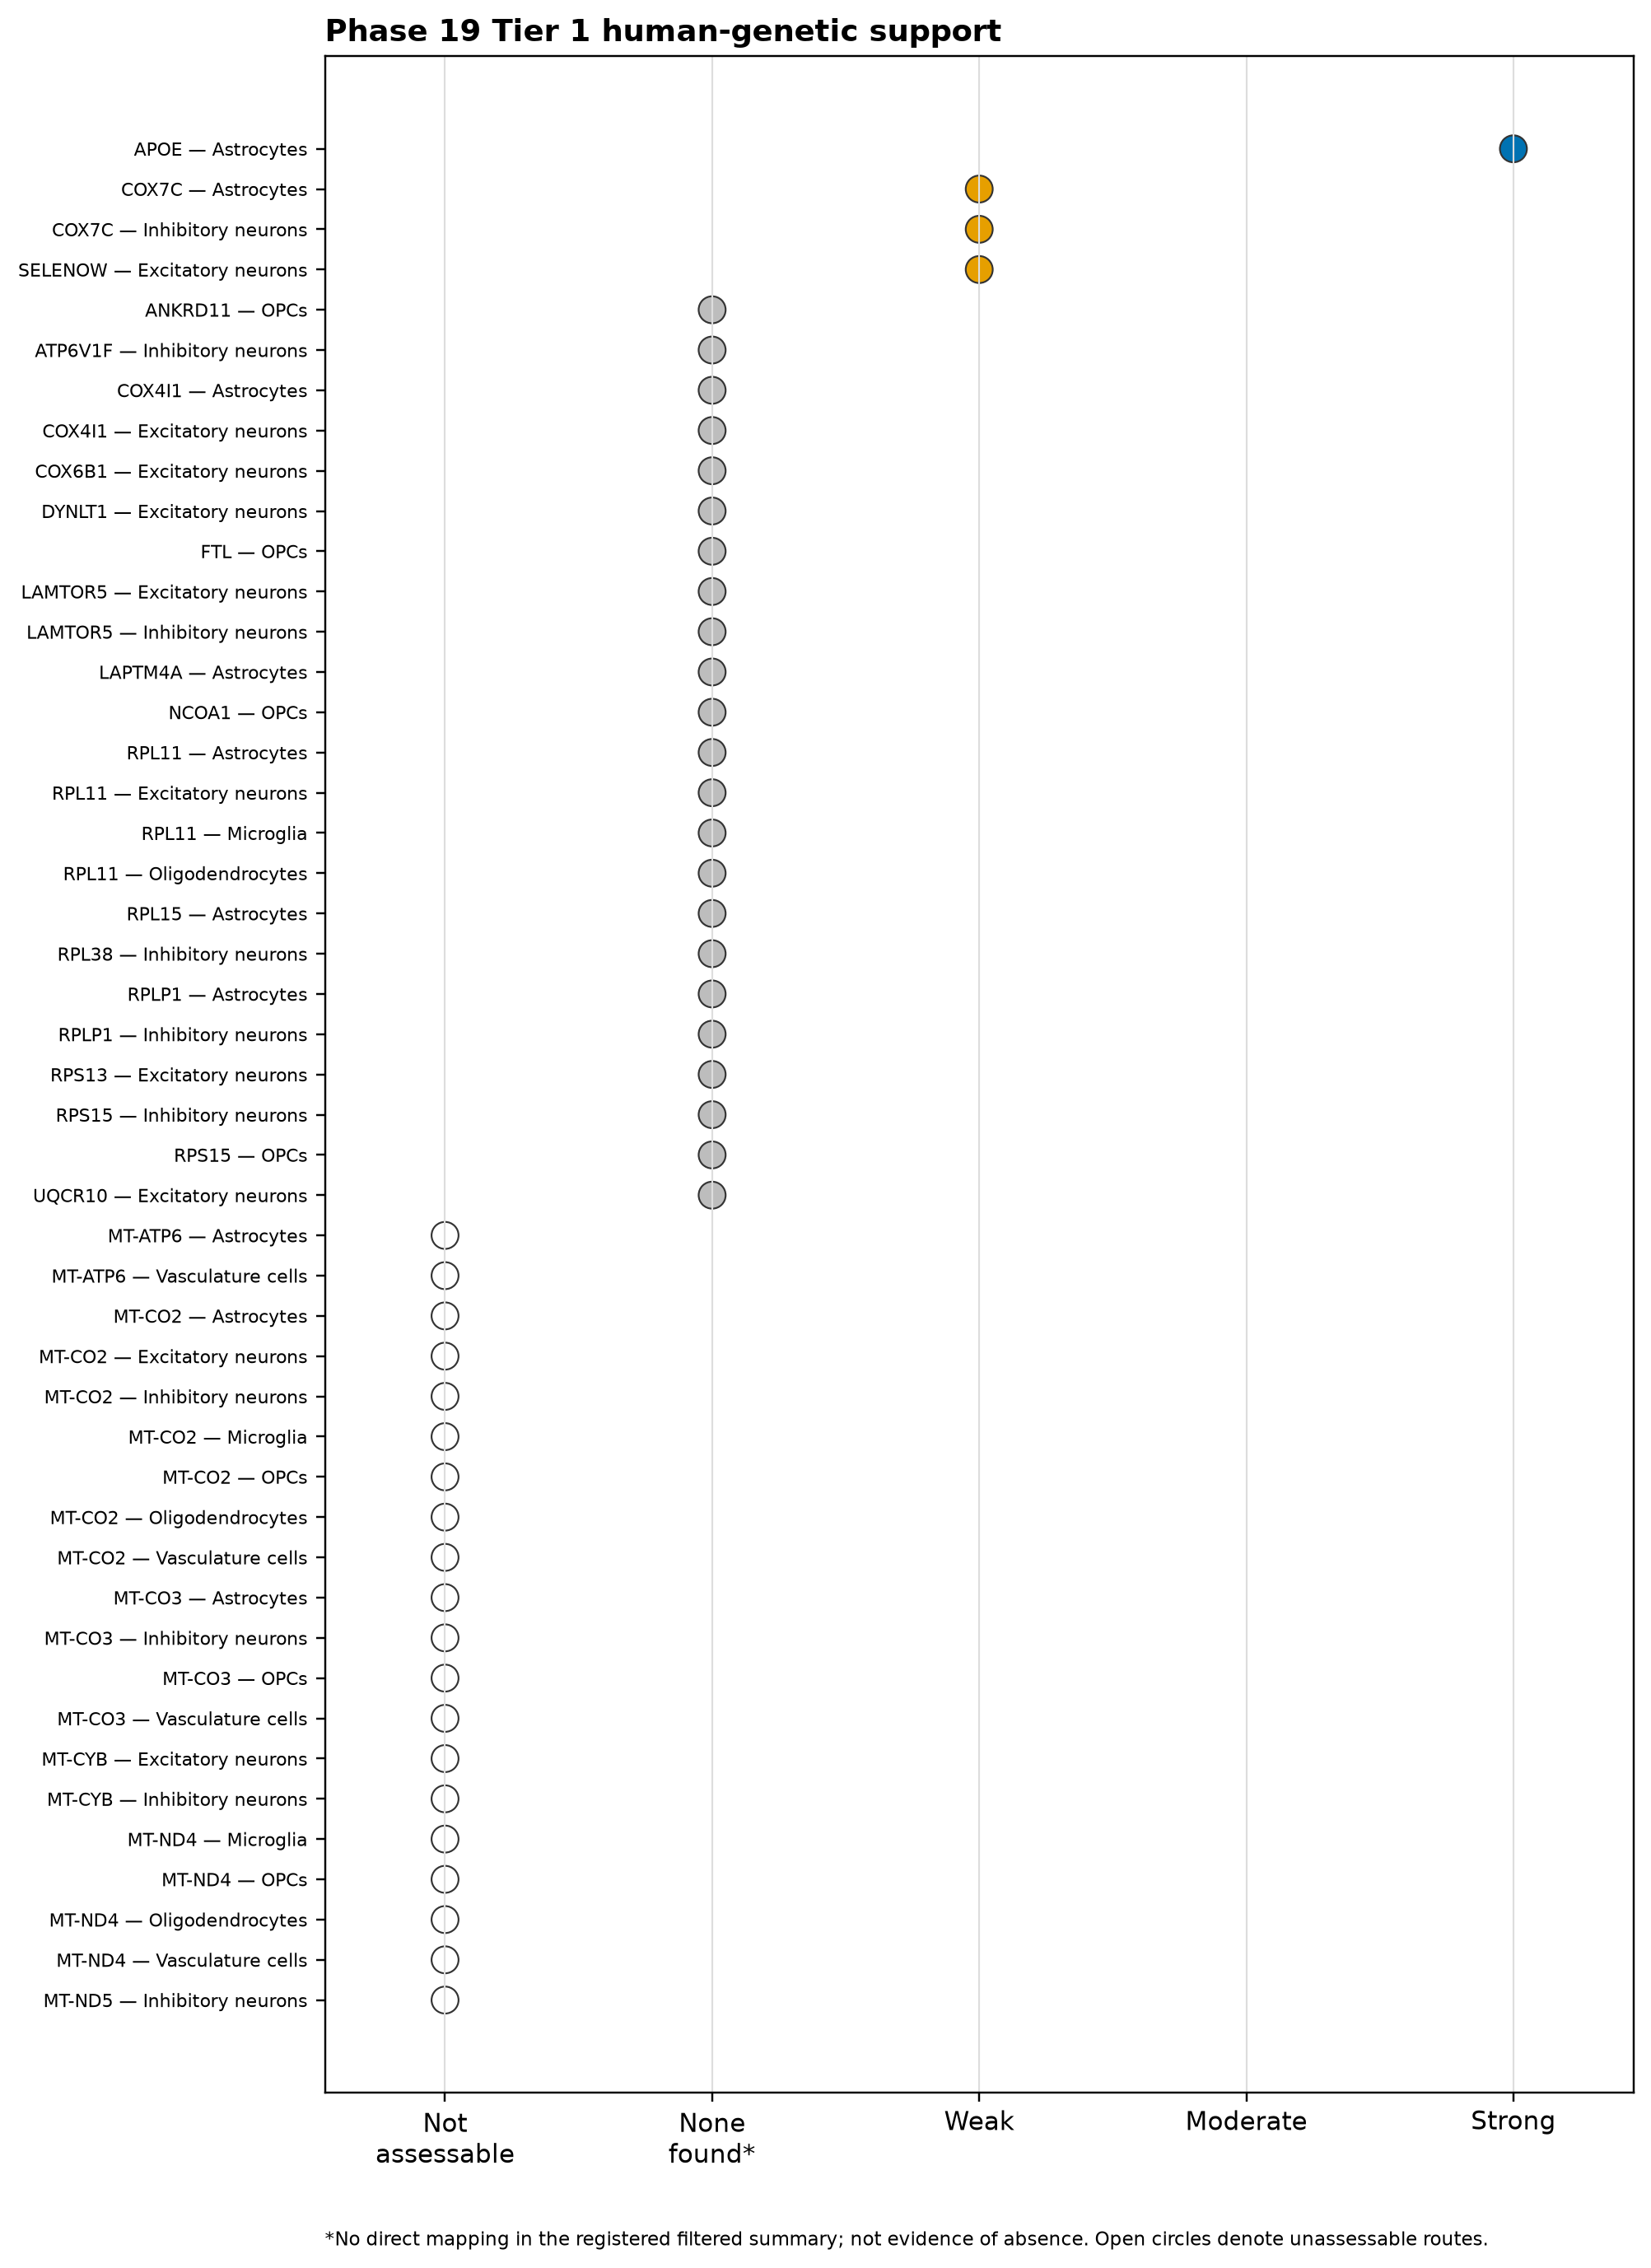
APPENDIX • FULL TIER 1 AUDIT
23
Full first-screen results for all 47 gene–network settings
First-screen matrix: 47 settings
COUNTS ACROSS 47 SETTINGS
1
Strong
0
Moderate
3
Limited
APOE
None
COX7C ×2; SELENOW ×1
23
No direct match
20
Could not test
16 nuclear genes
6 mitochondrial genes
COX7C's two limited settings come from one public result, not two independent confirmations. The extra RPS15 study is not included here.
No direct public match does not mean no genetic role • could not test is not a negative result.
Source: Tier 1 genetic_support_evidence_matrix.png and genetic_support_evidence_summary.tsv
Notes:
Appendix reference: the complete 47-row formal evidence audit, retained as a dense matrix for lookup.

Slide 24
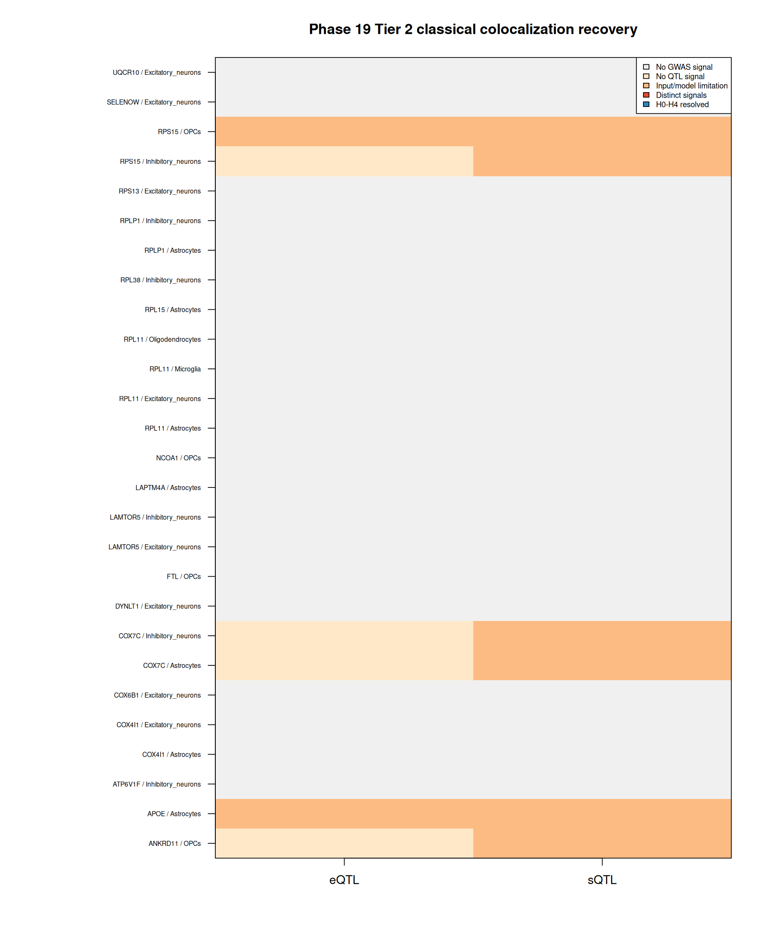
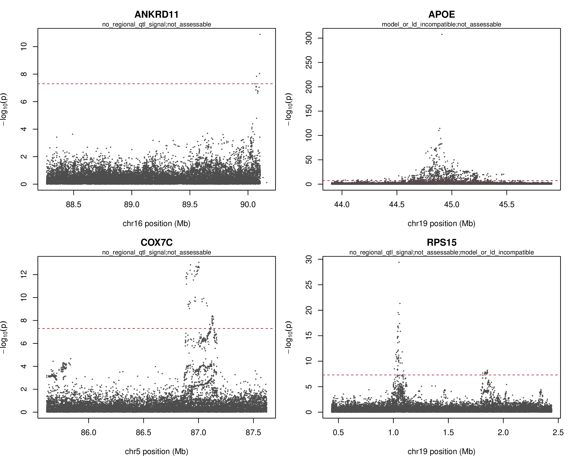
APPENDIX • TIER 2 RECOVERY DETAIL
24
Four DNA regions had AD signals, but no candidate gene was confirmed by gene-activity data
Detailed comparison outcomes
A strong nearby DNA signal identifies a region—not necessarily the named gene. No shared-signal probability was available.
Source: recovery_evidence_matrix.png; recovery_locus_plots.pdf; recovery_route_decisions.tsv
Notes:
Appendix reference: regional AD signals at four candidate windows did not resolve candidate-gene shared-signal analyses.

Slide 25
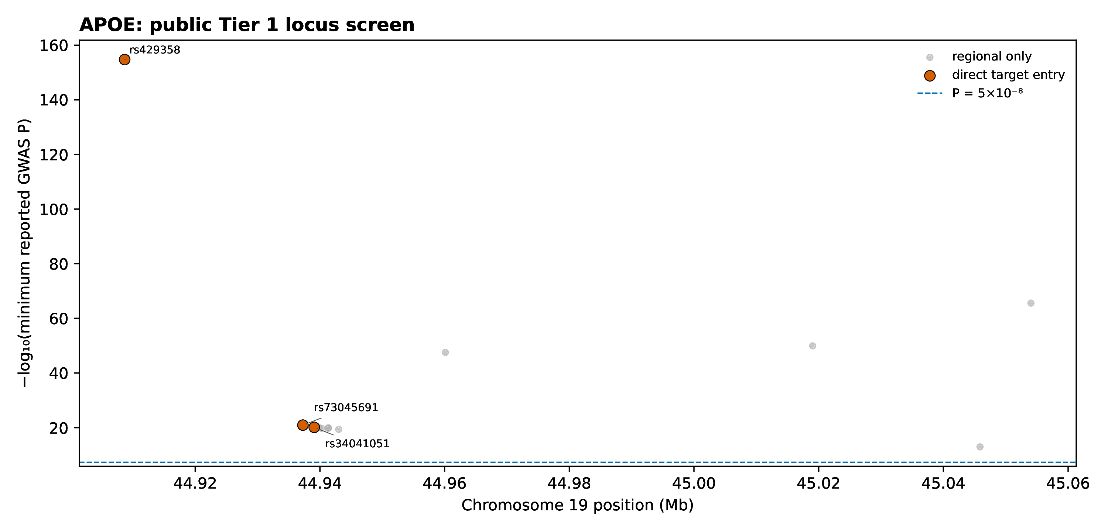
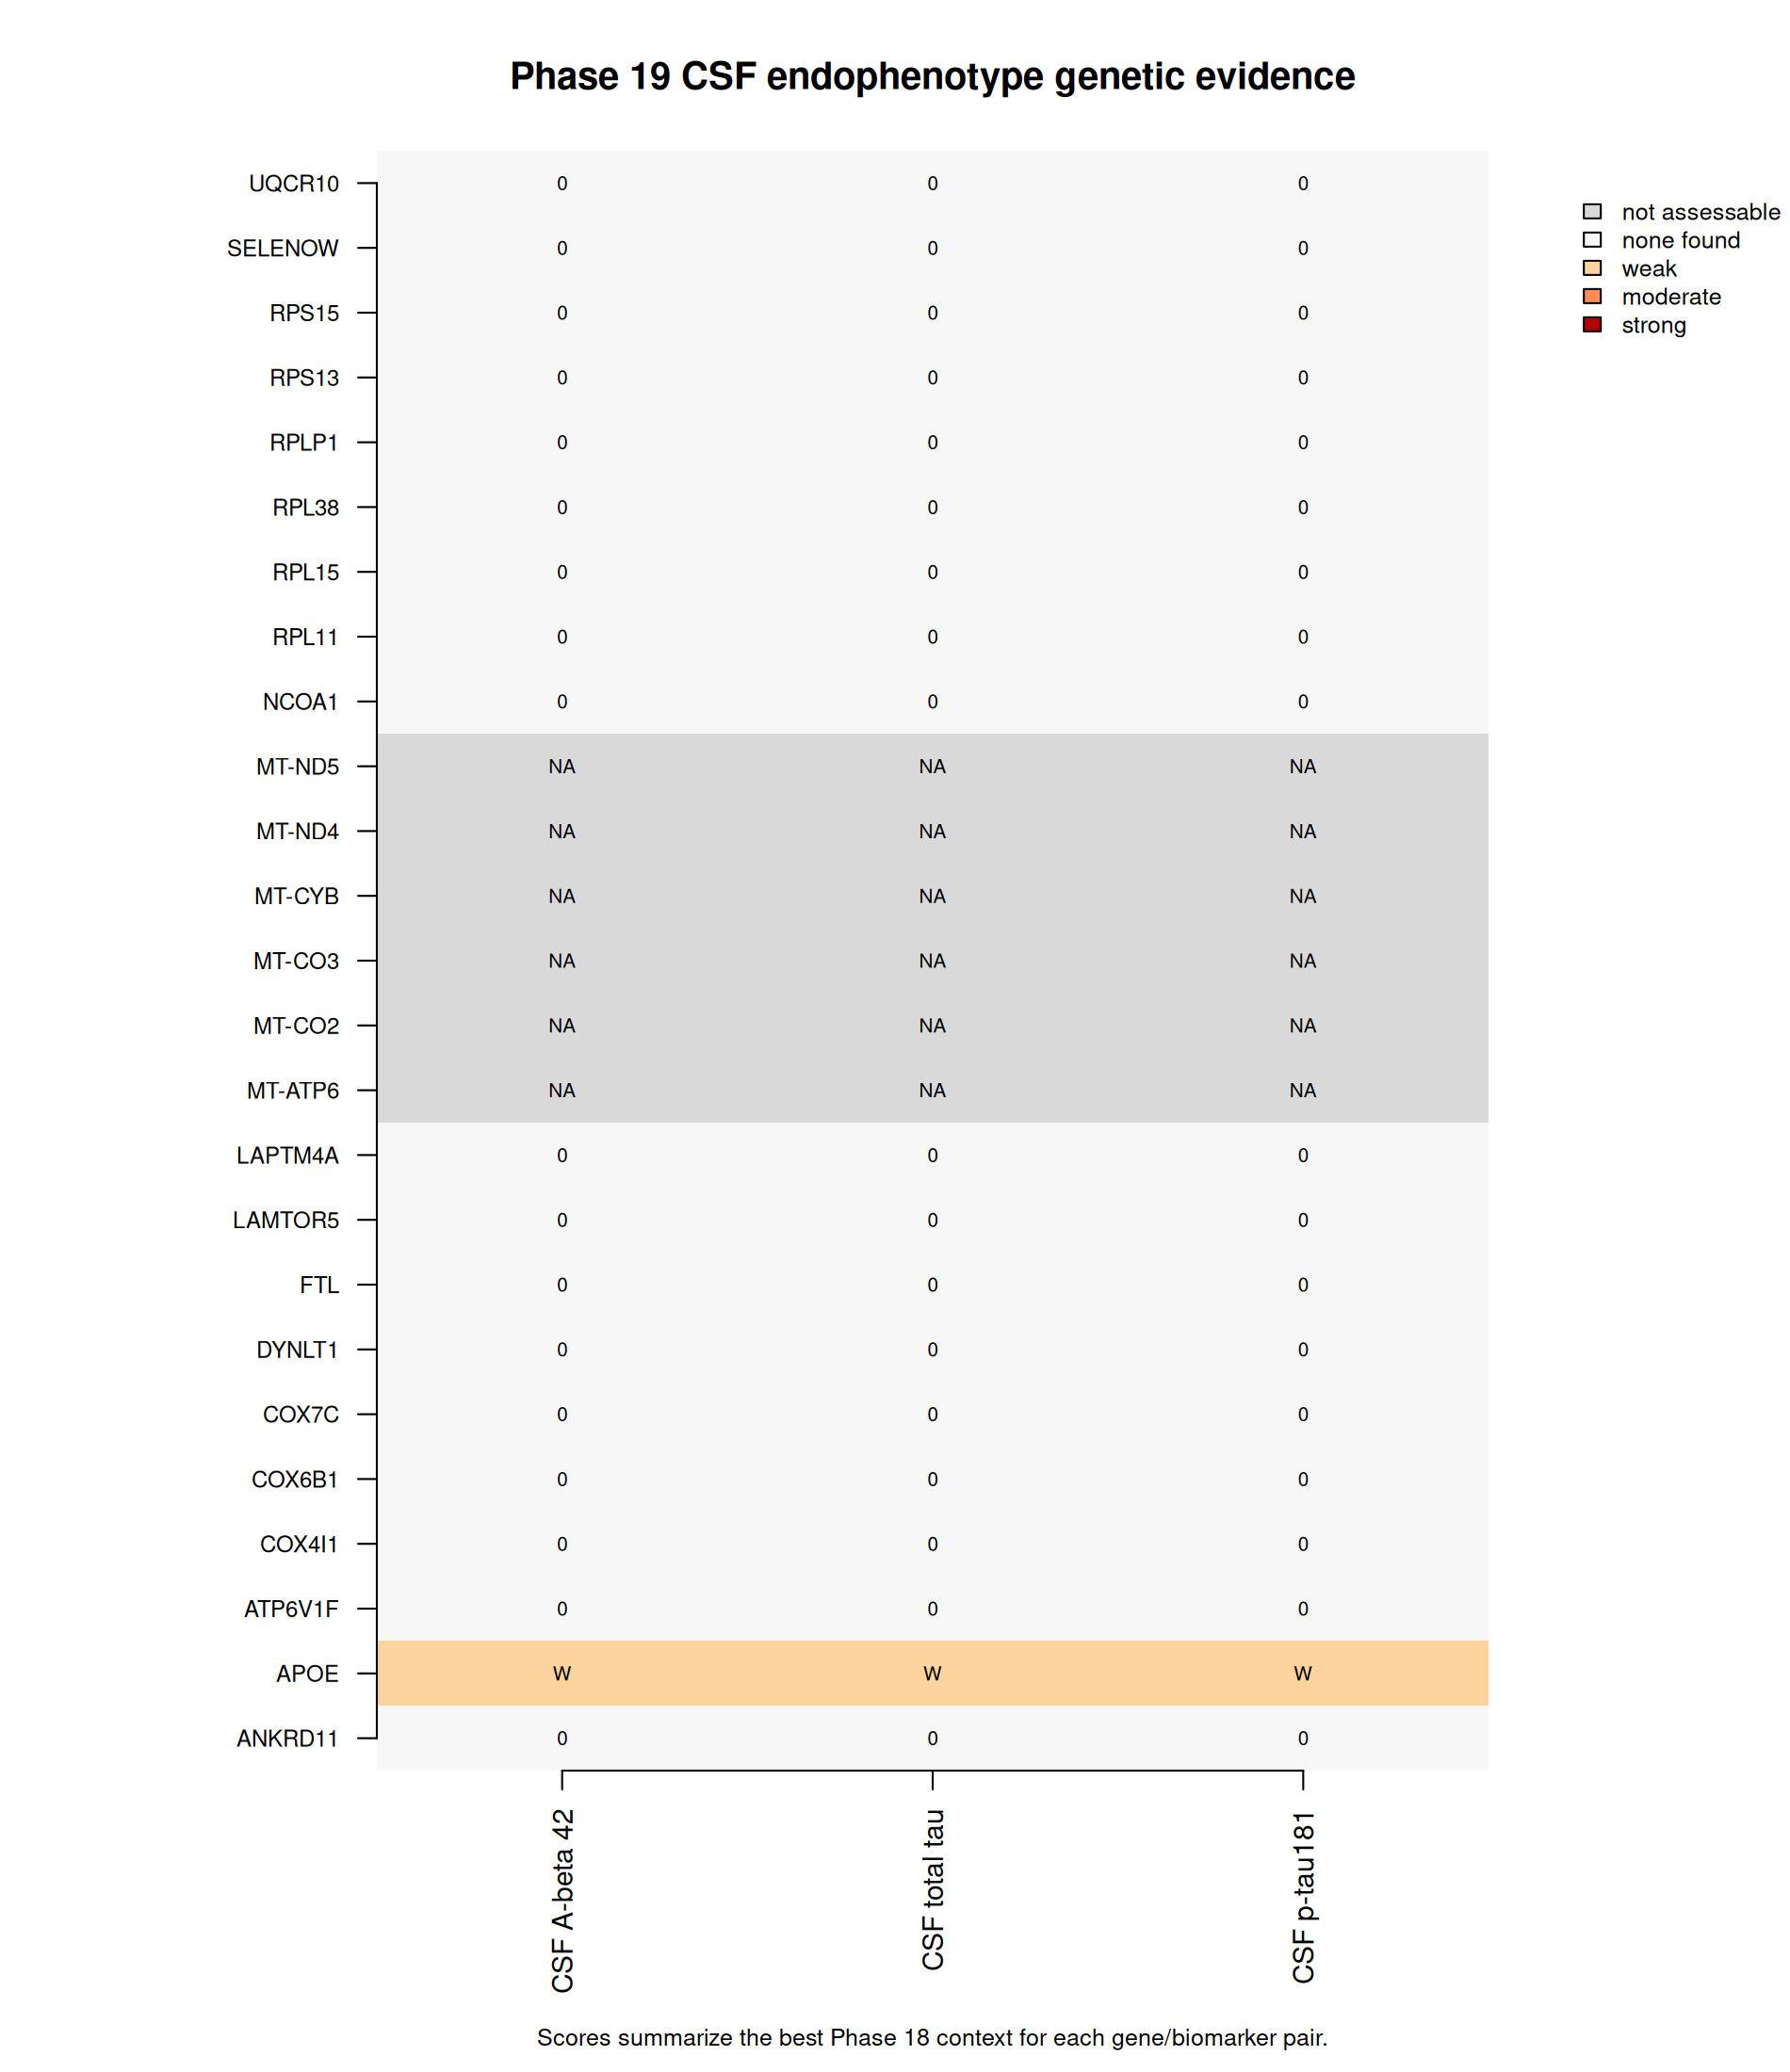
APPENDIX • APOE DETAIL
25
APOE evidence across Alzheimer's disease and three spinal-fluid markers
Spinal-fluid marker evidence
MARKER
STRONGEST NEARBY P
GENE-LEVEL P
GENE + NEARBY DNA
Amyloid-β42
stored as 0*
5.0×10⁻¹⁰
2.3037×10⁻¹⁴
Total tau
5.4×10⁻¹⁶¹
5.0×10⁻¹⁰
1.2218×10⁻¹³
p-tau181
3.27×10⁻¹⁷⁴
5.0×10⁻¹⁰
5.0×10⁻¹⁰
* The amyloid-β42 value was too small for normal storage; it does not literally mean zero, so its region plot is excluded.
Source: Tier 1 common_variant_evidence.tsv.gz and locus plot page 1; CSF gate and MAGMA result tables
Notes:
Appendix reference: APOE direct rs429358 mapping and the three CSF regional-plus-gene-based gate results. The malformed Aβ42 locus rendering is deliberately excluded.

Slide 26
APPENDIX • TARGETED PUBLIC-DATA AUDIT
26
RPS15 is promising, but the exact gene and cell setting remain uncertain
37
planned comparisons
31
comparisons measured
6
positive setting rows
3
unique mixed-brain results
0
completed shared-signal tests
MSBB BA36 RNA-amount QTL
P = 2.41403×10⁻⁷
Adjusted for many tests: 0.00209909
WHAT THIS DOES NOT SHOW
The six positive rows are the same three mixed-brain results repeated across OPC and inhibitory-neuron settings. OPC = oligodendrocyte precursor cell. The exact cell and gene link remain unconfirmed. No shared-signal probability was available.
ROSMAP DLPFC RNA-splicing QTL
P = 3.86842×10⁻³⁰
Adjusted: 1.26188×10⁻²⁶ • variant probability: 1.0
ROSMAP posterior-cingulate RNA-splicing QTL
P = 3.30886×10⁻⁷
Adjusted: 0.000858045 • variant probability: 0.910283
Follow-up result: RPS15 is promising, but the exact gene and cell setting are not confirmed.
Source: opc_rps15_evidence_summary.tsv and opc_rps15_qtl_audit.tsv
Notes:
The RPS15 follow-up measured 31 of 37 planned comparisons; three mixed-brain results repeated across two settings, and no final shared-signal test was completed.

Slide 27
APPENDIX • FILE-QUALITY CHECKS
27
Known file and documentation issues
Damaged empty-result files
Two files meant to contain zero rows are damaged even though their recorded file hashes match.
APOE protein files missing from list
The report says four NG00130.v2 files were checked, but the published file inventory does not list them.
Large raw files not in project folder
Some large inputs were streamed or stored outside the published project folder.
Old computer paths remain
The RPS15 report still includes /home/... file paths from the computer where it was run.
Sample counts disagree
Two result files report different Bellenguez case and control counts.
Nine rows have the wrong QTL label
Nine rows call a gene-expression QTL a splicing QTL; the dataset registry labels it correctly.
Repair plan: rebuild damaged files • publish complete file lists • fix labels and paths • reconcile sample counts
Status: the data package still needs repair
Source: genetic-support consolidated summary §5.3 and bundle-integrity audit
Notes:
Appendix reference: known provenance and integrity limitations that should be repaired before the bundle is considered fully complete.

