Slide 1
ROSMAP and SEAAD sex/APOE key-driver analysis
How mitochondrial DEG queries become non-core-MT network-driver candidates
PART I
PART II
ROSMAP reaggregation
SEA-AD validation
295 included runs → returned-only non-MT ACAT → 689 category units
34 active SEA-AD-network KDA calls → returned-only non-MT ACAT → 96 category units
Notes:
Teaching goal: Introduce the two cohorts and the matched returned-only aggregation rule.
Walk through: Part I summarizes the existing ROSMAP fine-cell reaggregation. Part II uses 34 newly rerun SEA-AD calls against SEA-AD-specific Bayesian networks and yields 96 non-MT gene-by-category units.
Scientific boundary: The SEA-AD rerun changes network topology as well as cohort, so differences from ROSMAP or the prior deck are not attributable to cohort biology alone.
Transition: Compare the cohort and run structures before reviewing each analysis branch.

Slide 2
Two cohorts, one aggregation rule
Both apply the same returned-only non-MT ACAT rule; the cohorts differ in run availability and balance.
ROSMAP FINE-CELL REAGGREGATION
SEA-AD VALIDATION
Where does a gene recur across fine-cell evidence?
Do drivers return in an independent human cohort?
648
295
689
1,548
34
96
planned directional slots
included KDA runs
gene × category units
planned directional slots
active KDA calls
gene × category units
Groups fine-cell runs within sex/APOE × broad network.
Applies the same returned-only non-MT ACAT rule.
Aggregates stock-significant returns only; ACAT for ≥2 calls.
Relaxed tier: donor ≥3 per arm, FDR-only query, n ≥ 3.
Final 689 units represent 433 distinct genes in 32 categories.
32 of 34 calls are M_e33; 5 categories have returns.
Notes:
Teaching goal: Give a concise side-by-side map of the ROSMAP and VH12 SEA-AD analyses.
Walk through: ROSMAP contributes 295 fine-cell runs and 689 units. The VH12 SEA-AD rerun contributes 34 active calls and 96 units from 94 genes, using the same returned-only non-MT ACAT aggregation recipe.
Scientific boundary: Thirty-two of 34 SEA-AD calls are M_e33. Categories without calls are unavailable, not completed null tests.
Transition: Review the ROSMAP branch first, then the network-specific SEA-AD rerun.

Slide 3
PART 1
ROSMAP sex/APOE KDA reaggregation
IN THIS PART
1
Run universe
54 fine cell types define the planned universe; 295 included runs from 41 fine types are aggregated within six groups and seven broad networks.
2
Filter funnel
3
ACAT candidates
4
Result figures
Notes:
Teaching goal: Introduce the fine-cell branch and its sequence from setup to results.
Walk through: The section first defines comparisons, directional slots, KDA calls, included runs, and final candidate units. It then explains DEG construction, run eligibility, complete evidence, coverage, support, ACAT, category BH, and display-only ranking.
Scientific boundary: The branch reconstructs complete evidence from the validated Phase 12 calls at effective query n ≥ 3; it does not rerun KDA or pool sex/APOE groups.
Transition: Start with the four counting units that appear in the funnel.

Slide 4
Four steps
1
2
3
4
DEG comparison
Directional slot
KDA run
Candidate unit
fine cell type × sex/APOE
+ AD-up or AD-down
validated completed call
gene × group × broad network
One signed AD-versus-NCI result
A planned query opportunity
DEG contrast valid and
Effective query n ≥ 3
One or more fine runs; either or both directions
Notes:
Teaching goal: Separate the comparison, slot, run, and candidate-unit concepts before showing counts.
Walk through: Move from left to right. A comparison is one model result. Its sign creates two planned slots. A slot becomes a KDA call when at least three effective query genes remain, and every validated completed call at that execution floor enters the cross-run aggregate. The final unit adds gene identity to group and broad network.
Scientific boundary: The word candidate does not mean mitochondrial DEG. Candidate drivers may be non-DEG, non-mitochondrial network genes.
Transition: Apply those definitions to the complete 648-slot run universe.

Slide 5
54 fine cell types create 648 planned directional slots
Up and down are two query directions from one signed DEG comparison—not two model fits.
54 fine cell types
324 signed results
295 call_key_driver calls
× 6 sex/APOE groups = 324 contrasts
× up/down = 648 directional slots
All valid source and queries ≥3
Mutually exclusive slot outcome
Slots
KDA called?
Source DEG contrast not valid
6
No
Effective query empty
246
No
Effective query 1–2
101
No
Effective query >=3
295
Yes
TOTAL
648
295 calls
Notes:
Teaching goal: Show exactly how 648 planned slots become 295 included KDA runs.
Walk through: The rows are mutually exclusive outcomes derived from the canonical source manifest. Phase 12 calls KDA when at least three effective query genes remain. All 295 completed calls enter Phase 20, including 134 calls with query size three through nine and 161 with at least ten genes.
Scientific boundary: The 6 unavailable slots come from three non-estimable source contrasts times two directions. They are unavailable models, not completed tests with null results. The effective-query-zero row combines absent directional queries and complete loss during network mapping.
Transition: Zoom out once to see how the counting unit changes through the full fine-cell funnel.

Slide 6
Source validity and query size decide whether KDA is called
One canonical query-size gate
What ‘source contrast not valid’ means
≥3
295
The upstream MAST comparison could not be fitted because one arm had fewer than three cells.
included runs with query n>=3
Fine cell type
Group
AD cells
NCI cells
All 295 validated completed calls enter the aggregate.
Fib SLC4A4
M_e2
0
11
CAMs
M_e2
45
1
That includes 295 ≥3.
Mic MKI67
M_e2
2
9
74 completed calls returned no original q≤0.05 gene; they still contribute complete evidence.
3 unavailable comparisons × 2 directions = 6 unavailable slots
Notes:
Teaching goal: Clarify the eligibility statuses and the canonical minimum of three effective query genes.
Walk through: A query of at least three genes allows the Phase 12 call and Phase 20 inclusion. The 134 calls with three through nine genes retain Phase 12's below-ten warning but are included alongside the 161 larger-query calls. The right panel gives the three concrete non-estimable comparisons and shows why they create six unavailable direction slots.
Scientific boundary: Small-query calls use the same KDA and support predicates as larger-query calls, but their smaller queries warrant cautious interpretation. Non-estimability is a data/model condition, not evidence against a biological effect.
Transition: With 295 runs fixed, inspect what one KDA call actually tests.

Slide 7
Mitochondrial query genes
DEG rule
2,864,117
118,297
9,262
tested gene × comparison rows
Passed DEG
core-MT query genes
Detected in ≥10% of AD or NCI nuclei.
58,112 up • 60,185 down
4,258 up • 5,004 down
Within-contrast BH FDR < 0.05.
|log₂ fold change| > log₂(1.3) ≈ 0.379.
NETWORK-BACKGROUND INTERSECTION
9,262 provisional query genes
Positive and negative results for AD-up and AD-down queries.
− 1,329 absent from the Bayesian network
= 7,933 query genes
Query = DEG rule ∩ core_mito_protein ∩ requested direction
Membership counts can repeat the same gene across contrasts and directions.
Notes:
Teaching goal: Explain how the mitochondrial KDA query is derived from the full fine-cell DEG analysis.
Walk through: The paper-DEG filters first act within each fine-cell by group comparison. Only passing core mitochondrial proteins in the requested sign become provisional query memberships. The matching broad network is induced on genes tested in that contrast, so out-of-background query memberships are removed before run eligibility is assessed.
Scientific boundary: These are membership counts, not unique-gene counts. A query membership also does not mean the gene will be a candidate driver.
Transition: Next distinguish source failure, an empty effective query, a one- or two-gene query, and the canonical three-gene execution floor.

Slide 8
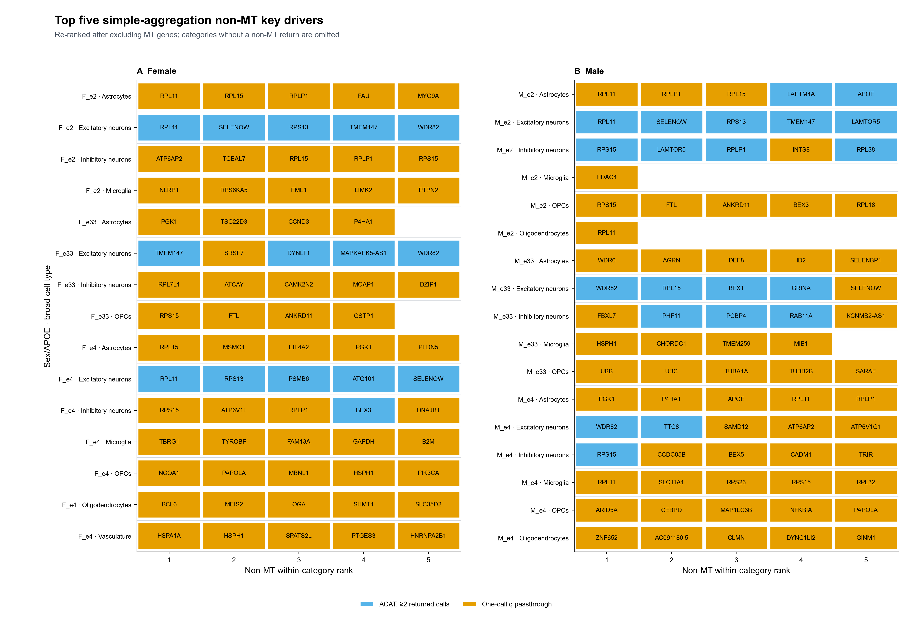
Top-five: 149 non-MT entries across 32 categories
Notes:
Teaching goal: Interpret the non-MT top-five display after excluding mitochondrial candidate drivers and recalculating display ranks.
Walk through: The figure contains 149 tiles across 32 categories. Blue means ACAT across at least two returned calls; orange means a one-call within-run BH q passthrough. Color identifies the calculation route, not an evidence tier.
Scientific boundary: Top five is a display cap, not a significance threshold. The returned-only score is post-selected and has no final across-gene BH adjustment; categories without a non-MT return are omitted.
Transition: The summary slide translates the displayed results into returned-row, category-unit, distinct-gene, and recurrence counts.

Slide 9
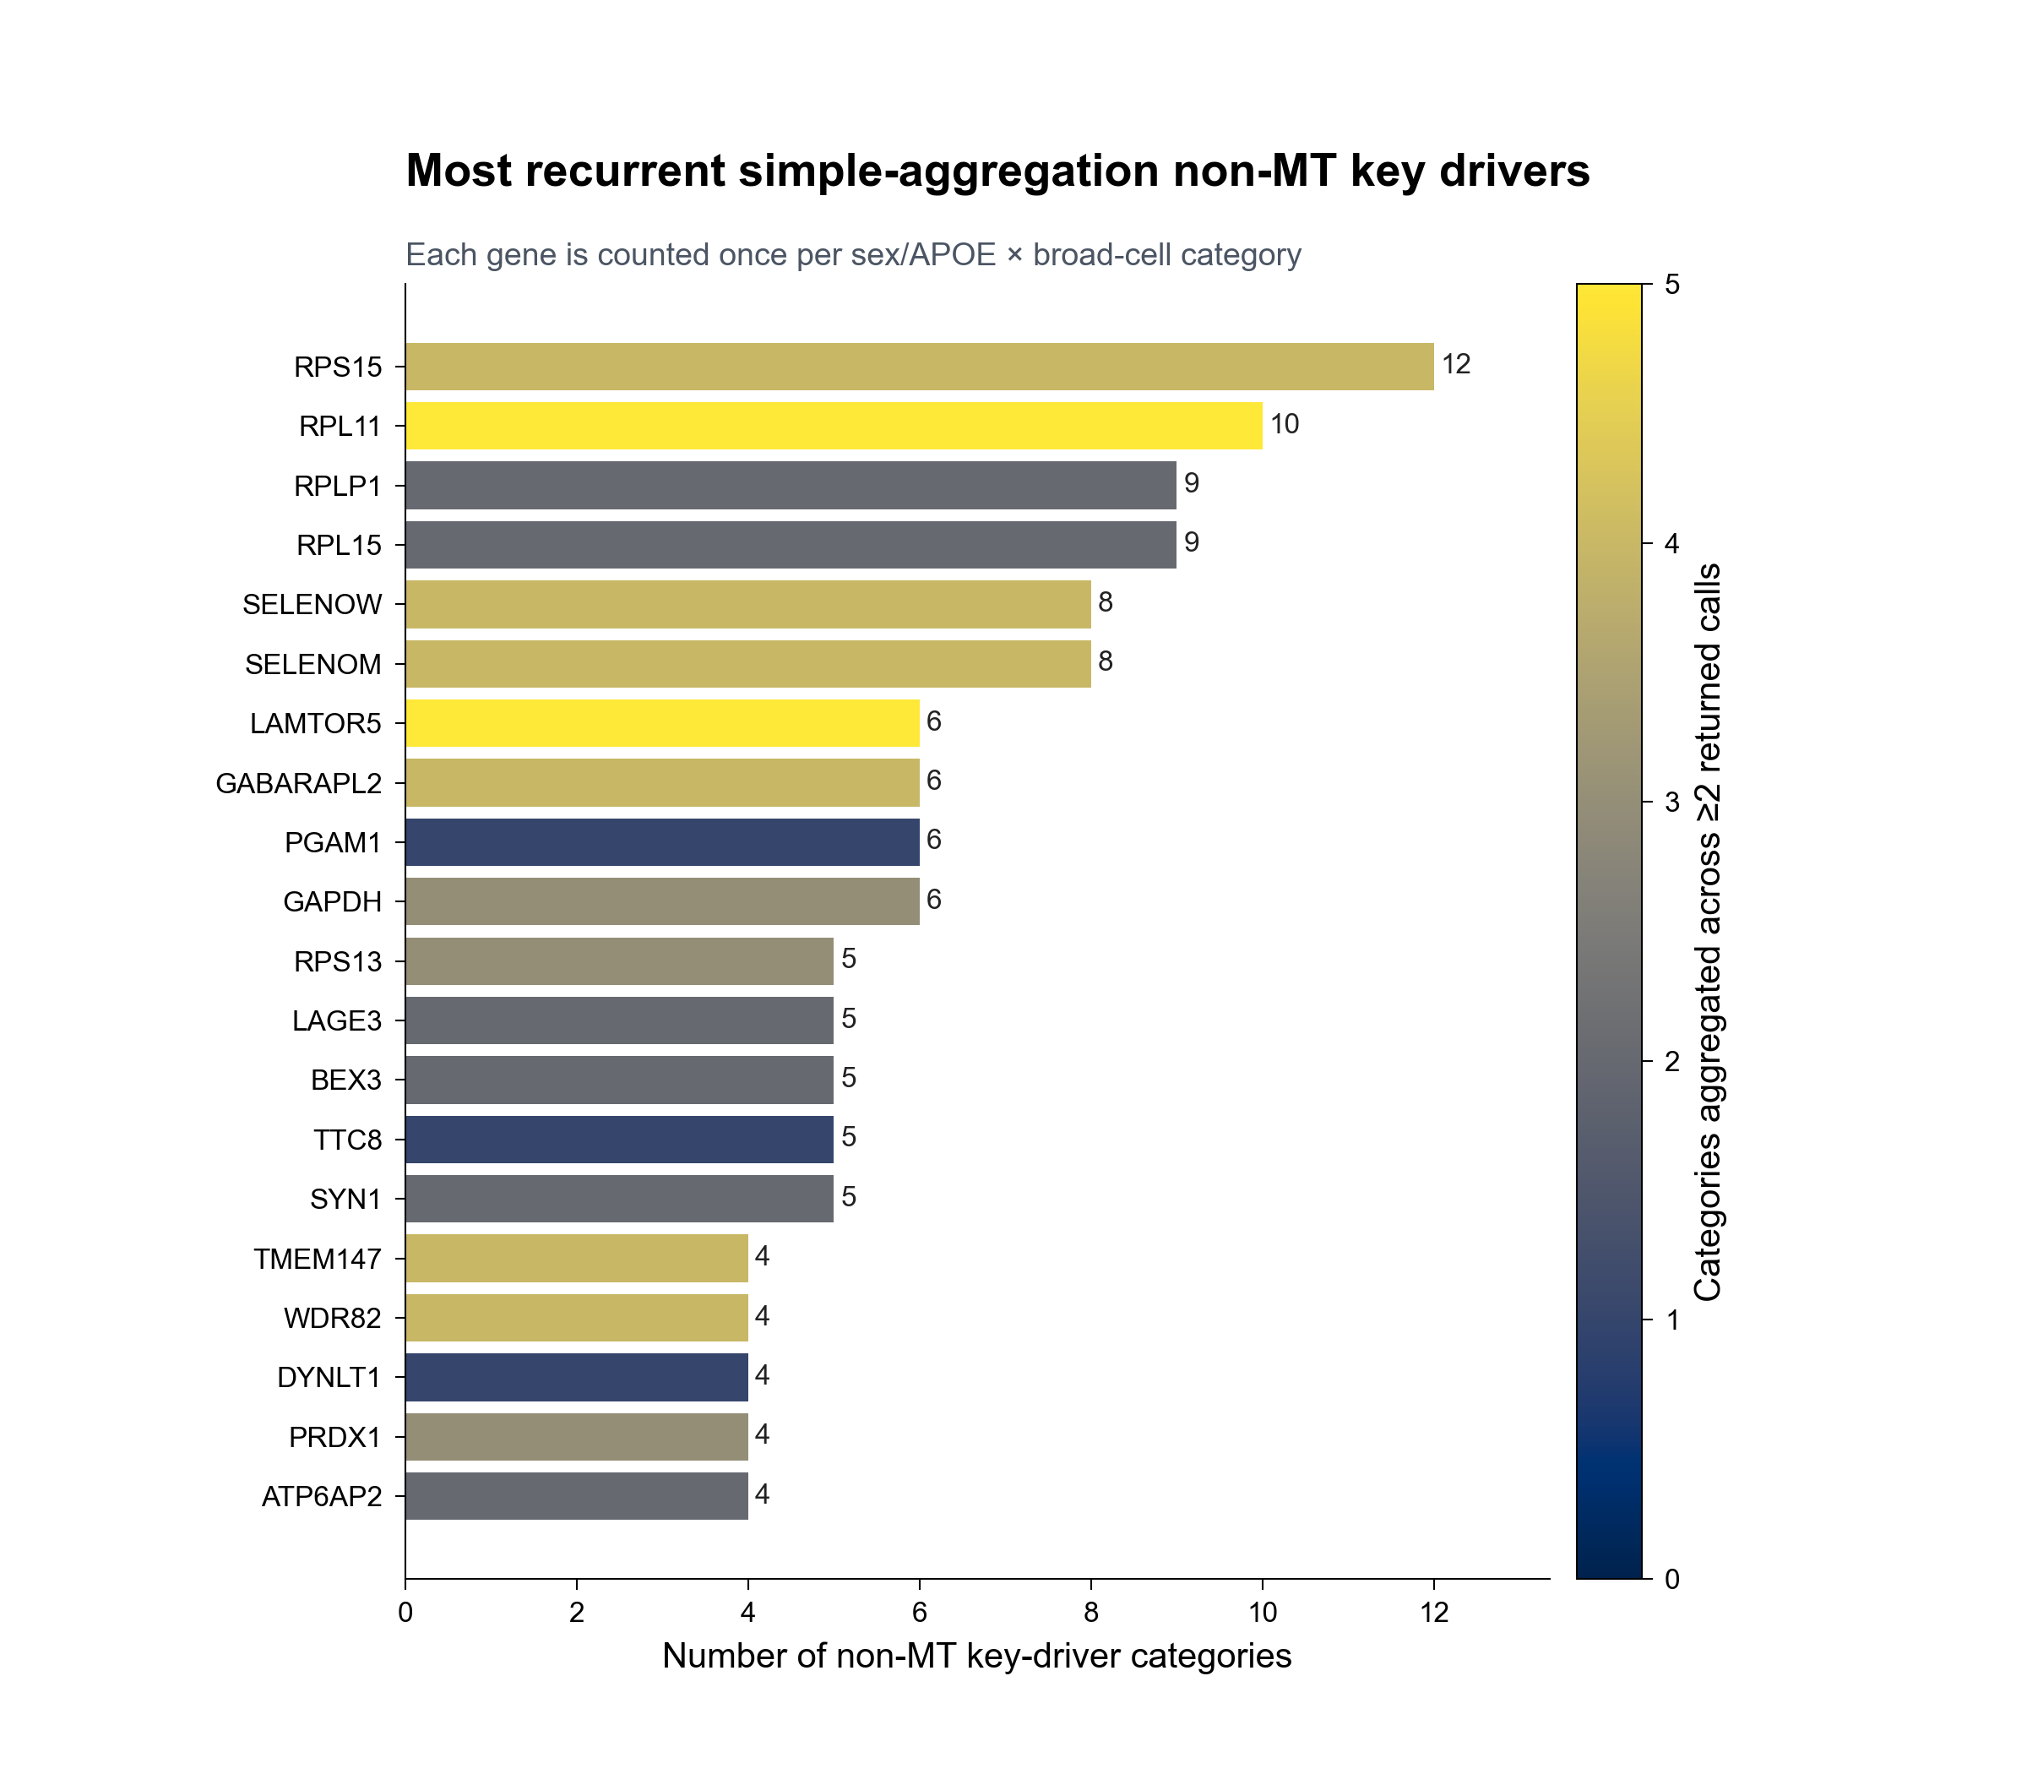
RPS15 recurs across 12 returned-only categories
Returned-only recurrence is descriptive across sex/APOE × broad-cell categories.
How to read it
Bar length = number of categories containing the gene.
Fill = categories whose score combines ≥2 returned calls (used ACAT to aggregate p value).
RPS15: 12 categories, 6 groups, 5 networks; ACAT in 4.
RPL11: 10 categories, 6 groups, 4 networks; ACAT in 5.
Notes:
Teaching goal: Interpret returned-only category recurrence without confusing category breadth, call count, and score construction.
Walk through: Bar length counts each sex/APOE by broad-cell category once. Fill counts the subset whose score combines at least two returned calls. RPS15 appears in 12 categories and RPL11 in 10; their total returned-call counts are 28 and 29, respectively.
Scientific boundary: Inputs were preselected stock-significant within-call q values. Fill shows the calculation route, not evidence strength. Recurrence is descriptive, not an independent replication or FDR-controlled significance test.
Transition: The next slide shows which non-MT genes rank in the top five within each populated category.

Slide 10
Simple output: 689 non-MT category units represent 433 genes
1,033
689
433
32
149
non-MT returned call rows
non-MT gene × category units
distinct gene symbols
categories with non-MT returns
top-five displayed rows
Where non-MT driver units occur
Most recurrent returned-only genes
By sex/APOE group
RPS15
12
M_e2 139 • F_e4 133 • M_e4 127 • F_e2 101 • M_e33 97 • F_e33 92
RPL11
10
RPLP1
9
RPL15
9
By broad network
SELENOW
8
Excitatory 363 • Inhibitory 175 • Astrocytes 63 • OPCs 33 Oligo 27 • Microglia 23 • Vasculature 5
SELENOM
8
Counts are category presence—not independent replication or call counts.
Notes:
Teaching goal: Summarize the scale and distribution of the simple returned-only non-MT result set.
Walk through: The 1,033 non-MT returned call rows form 689 gene-by-category units representing 433 genes across 32 populated categories. The lower panels show where those units occur and the genes with the broadest category presence.
Scientific boundary: These descriptive counts condition on stock-significant returns and differ across categories with unequal opportunities. They do not use nonreturns, coverage, support gates, or a final FDR-controlled cross-gene family.
Transition: Part II now returns to the direct broad-cell branch, where each eligible direction remains a separate KDA result.

Slide 11
PART 2
SEA-AD network-specific KDA rerun
IN THIS PART
1
Run universe
129 supertypes define the planned universe; 34 calls were rerun against SEA-AD-specific Bayesian networks.
2
Top-five results
3
Driver recurrence
4
Result scale
Notes:
Teaching goal: Introduce the VH12 SEA-AD-specific-network rerun.
Walk through: The section moves from the full supertype-by-stratum universe to the 34 executable KDA calls, then shows the top-five, recurrence, and aggregate summaries.
Scientific boundary: The aggregation is exploratory and returned-only; the underlying KDA calls were rerun rather than borrowed from the prior network release.
Transition: Start with how 1,548 planned directional slots become 34 active calls.

Slide 12
129 SEA-AD supertypes create 1,548 planned directional slots
Supertype × sex/APOE contrast × AD-up/AD-down mitochondrial query; network mapping determines executable calls.
129 supertypes
774 contrasts
34 KDA calls
× 6 groups = 774 contrasts
× up/down = 1,548 slots
effective mapped query n ≥ 3
Mutually exclusive slot outcome
Slots
KDA called?
Source DEG contrast not estimable
786
No
Estimable source; FDR-only query = 0
708
No
Effective mapped query 1–2
20
No
Effective mapped query >=3
34
Yes
TOTAL
1,548
34 calls
Availability remains unbalanced: 32 M_e33 calls, one F_e33 call, and one F_e4 call.
Notes:
Teaching goal: Show exactly how the planned SEA-AD universe reduces to 34 executable calls.
Walk through: Of 1,548 planned slots, 786 have a non-estimable source contrast, 708 have no FDR-only mitochondrial query, and 20 retain only one or two mapped genes. Fifteen calls have 3–9 genes and 19 have at least 10.
Scientific boundary: A skipped slot has no KDA result and is not a completed null. Network-specific mapping changes which DEG queries meet the minimum size.
Transition: Inspect the returned non-mitochondrial candidates from the completed calls.

Slide 13
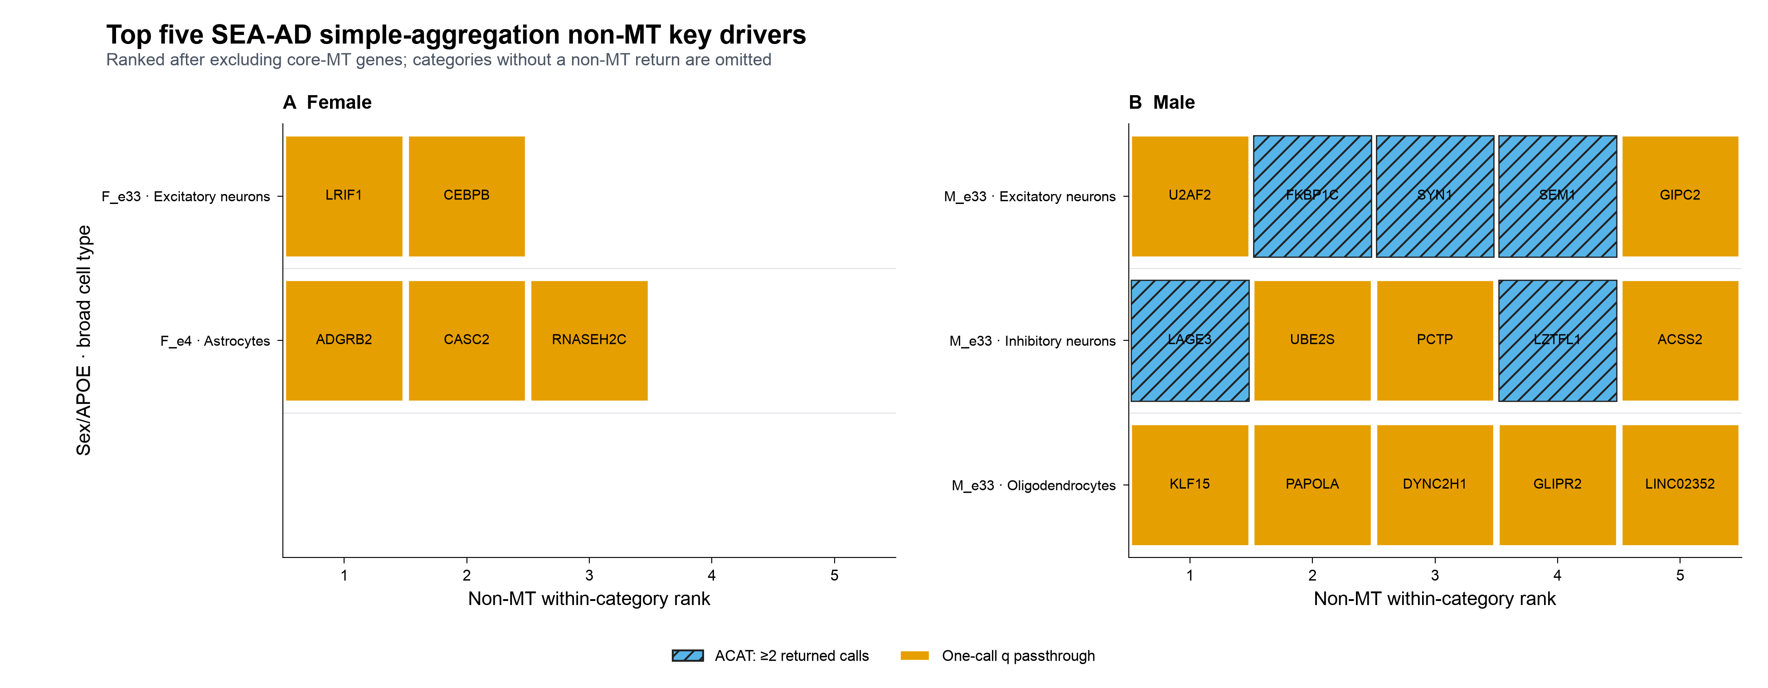
Top-five display: 20 non-MT entries across 5 categories
Blue hatching = ACAT across ≥2 returned calls; orange = one-call q passthrough.
Notes:
Teaching goal: Present the leading VH12 non-mitochondrial candidates without hiding category sparsity.
Walk through: The display contains 20 entries across five populated categories: F_e33 excitatory, F_e4 astrocytes, and M_e33 excitatory, inhibitory, and oligodendrocytes.
Scientific boundary: Top five is a display cap, not a significance threshold. Colors and hatching identify the aggregation route, not an evidence tier.
Transition: Next, summarize recurrence across the five populated categories.

Slide 14
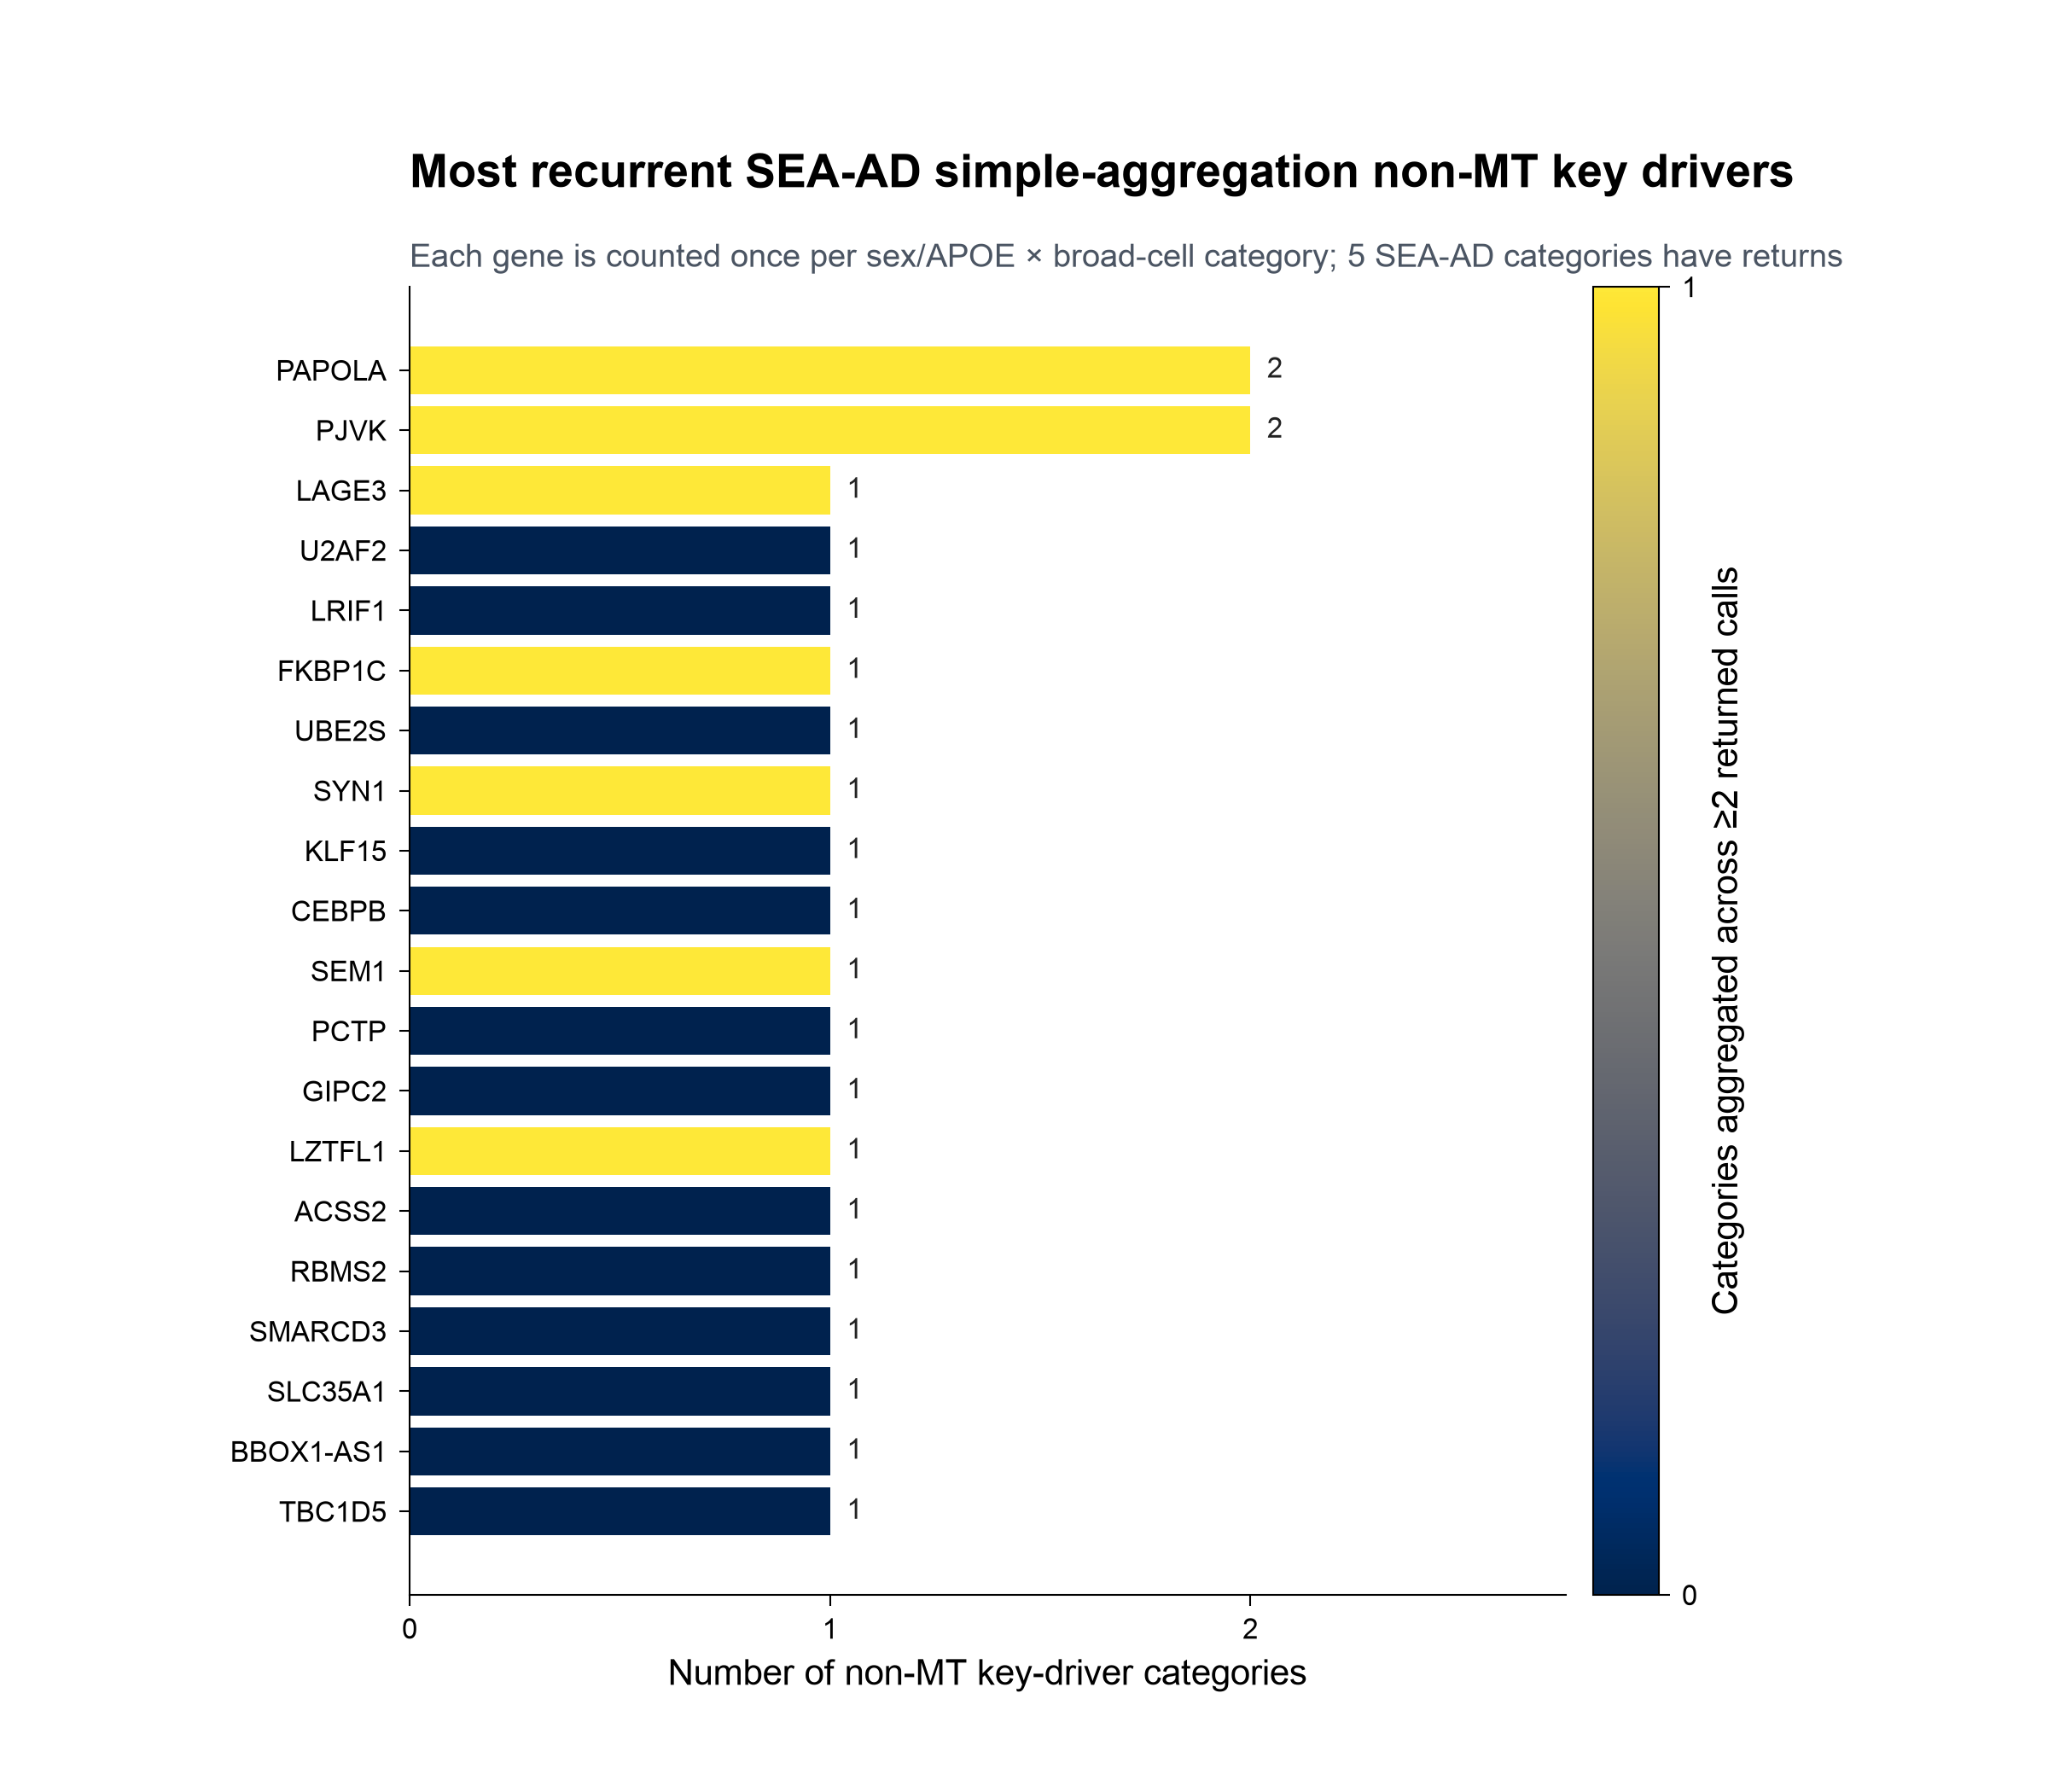
PAPOLA and PJVK each recur across 2 SEA-AD categories
Returned-only recurrence is descriptive across sex/APOE × broad-cell categories.
How to read it
Bar length = categories containing the gene.
Fill = category occurrences combining ≥2 returned calls.
PAPOLA: excitatory neurons + oligodendrocytes.
PJVK: inhibitory neurons + oligodendrocytes.
The remaining 18 displayed genes occur in one category.
Only 5 categories return non-MT genes.
Notes:
Teaching goal: Interpret recurrence under the SEA-AD-specific networks.
Walk through: PAPOLA and PJVK each appear in two M_e33 broad-cell categories. Every other gene in the top-20 recurrence display appears in one category.
Scientific boundary: Five return-bearing categories impose a low recurrence ceiling. Category recurrence is neither independent replication nor call count.
Transition: Summarize the row, unit, gene, and category counts.

Slide 15
SEA-AD output: 96 non-MT category units represent 94 genes
135
96
94
5
20
non-MT returned call rows
gene × category units
distinct gene symbols
categories with returns
top-five displayed rows
Where the 96 units occur
Execution and filtering
By sex/APOE group
29 calls with returns; 5 completed empty.
M_e33 91 • F_e4 3 • F_e33 2 • other groups 0
221 significant return rows before mitochondrial filtering.
86 core-MitoCarta rows excluded.
By broad network
Excitatory 43 • Inhibitory 27 • Oligo 23 • Astrocytes 3 Microglia, OPCs, Vasculature 0
135 non-MT rows retained for aggregation.
Returned-only ACAT scores are exploratory and not formally FDR-controlled across genes.
Notes:
Teaching goal: Summarize the scale and distribution of the VH12 result set.
Walk through: The 135 retained rows form 96 category units representing 94 genes across five categories. Most units and 32 of 34 active calls are in M_e33.
Scientific boundary: The result conditions on within-call significant returns and has no final across-gene correction. Vasculature remains encode-only exploratory and contributes no active call here.
Transition: Compare the resulting driver set with the existing ROSMAP aggregation.

Slide 16
PART 3
Do the same drivers appear in both cohorts?
IN THIS PART
1
Comparison design
ROSMAP and VH12 SEA-AD returned-only results are compared at gene and matched-context levels.
2
Gene overlap
3
Context overlap
4
Interpretation
Notes:
Teaching goal: Frame the cross-cohort comparison using the VH12 SEA-AD network rerun.
Walk through: Part 3 compares driver symbols and their sex/APOE-by-cell-type contexts, then contrasts the observed context agreement with descriptive baselines.
Scientific boundary: This is simultaneously a cross-cohort and cross-network comparison. It describes convergence but does not isolate a biological cohort effect.
Transition: Define the two agreement levels before reading the overlap counts.

Slide 17
Two ways to ask whether a driver reappears
Gene-level overlap ignores context; category-level overlap requires the same group and broad cell type.
GENE LEVEL
CATEGORY LEVEL
Does the same gene return anywhere?
Same gene, same group, same cell type?
433
94
689
96
ROSMAP driver genes
SEA-AD driver genes
ROSMAP gene × category units
SEA-AD gene × category units
Permissive overlap, but still affected by the network used to nominate drivers.
Strict context agreement; bounded by five SEA-AD return-bearing categories.
Unlike the earlier deck, VH12 uses SEA-AD-specific network topology; network choice is part of the comparison.
Notes:
Teaching goal: Define gene-level and category-level agreement for the updated analysis.
Walk through: Gene-level overlap compares symbols anywhere in each result. Category-level overlap additionally requires the same sex/APOE group and broad cell type.
Scientific boundary: ROSMAP and SEA-AD use cohort-specific network inputs in this comparison, so overlap depends on topology as well as biological replication.
Transition: First examine the permissive gene-level result.

Slide 18
10 of 94 SEA-AD drivers also return in ROSMAP
Gene-level overlap is limited after rerunning KDA with SEA-AD-specific networks.
94
10 (11%)
1
SEA-AD driver genes
also ROSMAP drivers
exact category match
The 10 shared genes
CHD3 • CTNND2 • CXXC1 • DEF8 • LAGE3 MIPOL1 • MKLN1 • PAPOLA • SECISBP2 • SYN1
LAGE3 and SYN1 also appear on both cohorts’ top-20 recurrence displays.
The earlier common-network SEA-AD result should not be mixed with this network-specific rerun.
Notes:
Teaching goal: State the updated gene-level overlap and name the shared set.
Walk through: Ten of 94 SEA-AD non-MT drivers appear among the 433 ROSMAP drivers. Only MIPOL1 also keeps the full category context.
Scientific boundary: The reduction from the earlier deck coincides with switching the SEA-AD KDA network, so it is not evidence of poorer biological replication by itself.
Transition: Inspect the sole exact category match.

Slide 19
One driver-category pair matches exactly
MIPOL1 returns in male e33 excitatory neurons in both cohorts.
Sex/APOE · cell type
Gene
SEA-AD score (rank)
ROSMAP score (rank)
M_e33 · Excitatory neurons
MIPOL1
0.0186 (#7)
0.0388 (#29)
SEA-AD
ROSMAP
Rank #7 within M_e33 excitatory neurons.
Rank #29 within M_e33 excitatory neurons.
Score 0.0186 from 3 returned calls.
Score 0.0388 from 1 returned call.
Nominated using the SEA-AD-specific excitatory network.
The only exact category overlap among 96 SEA-AD units.
Exact agreement is descriptive convergence—not a calibrated replication P value.
Notes:
Teaching goal: Show the complete exact category-level overlap.
Walk through: MIPOL1 is the only gene with the same sex/APOE group and broad cell type in both cohorts. It ranks seventh in SEA-AD and twenty-ninth in ROSMAP within M_e33 excitatory neurons.
Scientific boundary: Both scores are exploratory returned-only quantities; an exact match is not a formal replication test.
Transition: Separate exact agreement from partial context retention.

Slide 20
MIPOL1 is the sole exact context match
A few other shared genes retain either cell type or stratum—but not both.
Exact context
Same cell type
Same group
1 pair
2 additional pairs
3 additional pairs
MIPOL1 M_e33 · excitatory in both cohorts
CXXC1 · excitatory CTNND2 · inhibitory Both switch sex/APOE group
DEF8, LAGE3, SYN1 All remain M_e33 but switch broad-cell network
Notes:
Teaching goal: Distinguish exact context replication from partial context overlap.
Walk through: MIPOL1 preserves both group and cell type. CXXC1 and CTNND2 preserve broad cell type while changing stratum. DEF8, LAGE3, and SYN1 preserve M_e33 while changing broad cell type.
Scientific boundary: The listed pairs are descriptive and non-independent because genes can occupy multiple ROSMAP categories.
Transition: Quantify where the shared M_e33 genes appear across ROSMAP strata.

Slide 21
Shared genes are not concentrated in matching M_e33
Where the 10 shared SEA-AD male-e33 drivers appear within ROSMAP.
10 of 89 SEA-AD M_e33 drivers are also ROSMAP drivers. A gene may occur in more than one ROSMAP group.
ROSMAP group
Shared genes (of 10)
Note
F_e4
7
highest overlap
M_e33
4
matching group
F_e2
3
M_e4
3
F_e33
2
M_e2
1
F_e4 contains seven of the shared genes; matching M_e33 contains four.
Notes:
Teaching goal: Test descriptively whether shared SEA-AD M_e33 genes concentrate in the matching ROSMAP stratum.
Walk through: Seven of the ten shared genes appear in ROSMAP F_e4 categories, while four appear in matching M_e33 categories. Counts can exceed ten in total because a ROSMAP gene may return in multiple groups.
Scientific boundary: Unequal category sizes and repeated genes make these descriptive counts, not a calibrated enrichment test.
Transition: Compare cell-type and group retention across every matched-gene unit pairing.

Slide 22
Neither cell type nor sex/APOE context is strongly preserved
All 22 cross-cohort unit pairings of the 10 shared genes.
14%
18%
share broad cell type (3 of 22)
share sex/APOE group (4 of 22)
descriptive random-pairing expectation ≈32%
four M_e33 pairings; only MIPOL1 also matches cell type
Interpretation
The VH12 network-specific driver set shows little context transfer to ROSMAP. Network topology and cohort both changed, so the two causes cannot be separated here.
Notes:
Teaching goal: Quantify the limited context agreement in the VH12 comparison.
Walk through: Three of 22 cross-cohort unit pairings share broad cell type and four share sex/APOE group. The descriptive random-pairing expectation for cell type is about 32 percent.
Scientific boundary: Pairings are non-independent and the chance value is descriptive, not a formal null. Network and cohort effects are confounded.
Transition: Summarize the sex distribution of the shared M_e33 genes in ROSMAP.

Slide 23
Shared SEA-AD male-e33 genes span both ROSMAP sexes
ROSMAP sex context is mixed across the 10 shared M_e33 drivers.
Gene membership
ROSMAP sex distribution
Male-only (2)
CHD3, DEF8
Male-only
2
Female-only (4)
CTNND2, CXXC1, MKLN1, SECISBP2
Female-only
4
Both sexes (4)
LAGE3, MIPOL1, PAPOLA, SYN1
Both sexes
4
Only CHD3 and DEF8 are restricted to male ROSMAP categories; four shared genes appear only in female ROSMAP categories.
Notes:
Teaching goal: Show whether shared SEA-AD M_e33 genes retain a male context in ROSMAP.
Walk through: Two shared genes are male-only in ROSMAP, four are female-only, and four appear in both sexes. The full membership is shown rather than only counts.
Scientific boundary: Observed sex restriction reflects where returned-only units occur under unequal run availability; it is not a sex-interaction test.
Transition: Close with the supported findings and the interpretation limits.

Slide 24
What the SEA-AD-network rerun does—and does not—show
Supported
Not supported / limits
10 of 94 SEA-AD drivers also occur in ROSMAP.
No broad preservation of cell-type or sex/APOE context is evident.
MIPOL1 is the sole exact M_e33-excitatory context match.
Only M_e33 is well represented among SEA-AD active calls.
CXXC1 and CTNND2 retain broad cell type while switching strata.
Cohort and network topology changed together; their effects are inseparable here.
PAPOLA and PJVK each recur across two SEA-AD categories.
Returned-only ACAT scores are exploratory, post-selected, and not final-FDR controlled.
Takeaway: SEA-AD-specific topology yields a distinct driver set; MIPOL1 is the clearest matched-context candidate.
Notes:
Teaching goal: State the updated conclusion without overclaiming validation.
Walk through: The rerun finds ten shared genes, one exact context match, and weak overall context agreement. MIPOL1 is the clearest matched-context candidate, while PAPOLA and PJVK lead within-SEA-AD recurrence.
Scientific boundary: The comparison is descriptive, post-selected, unbalanced across strata, and confounds cohort with network topology. It does not establish causal regulation or formal replication.
Transition: End of deck.

Slide 25
PART 4
Sensitivity analyses
IN THIS PART
1
Donor support
Robustness checks across sample support, profile coverage, query definition, and KDA decision rules.
2
Profile coverage
3
Query definition
Each sensitivity test is reported separately with its own evidence boundary.
4
KDA filters
Notes:
Teaching goal: Introduce the section reserved for all harmonized broad-cell KDA sensitivity analyses.
Walk through: Sensitivity checks may address donor support, nuclei-per-profile coverage, DEG query definition, and KDA filtering. The first check raises the disease-arm donor gate from three to five in both cohorts.
Scientific boundary: Each test must change one frozen decision at a time and retain its own interpretation boundary. The current test concerns donors per disease arm, not nuclei.
Transition: Begin with the cohort-level consequences of the donor-threshold test.

Slide 26
Donor-threshold sensitivity — numerical comparison
Raising minimum donors per disease arm from 3 to 5 in ROSMAP and SEA-AD.
Cohort
Minimum donors / arm
Eligible contrasts
KDA runs
Significant driver rows
Unique non-MT drivers
ROSMAP
3
42
3
39
33
ROSMAP
5
40
2
13
13
SEA-AD
3
28
5
24
18
SEA-AD
5
20
5
24
18
Driver rows count significant returned KDA rows. Unique non-MT drivers exclude MT-* genes and are deduplicated within each cohort.
Source: Phase 22 and VH14 run manifests/returns; donor-per-arm 3-vs-5 sensitivity assessment (2026-09-11).
Notes:
Teaching goal: Show the numerical impact of raising the minimum disease-arm donor count from three to five in both cohorts.
Walk through: ROSMAP falls from 42 to 40 eligible contrasts, three to two KDA runs, 39 to 13 returned rows, and 33 to 13 unique non-mitochondrial drivers. SEA-AD falls from 28 to 20 eligible contrasts, while its five KDA runs, 24 returned rows, and 18 unique non-mitochondrial drivers are unchanged.
Scientific boundary: The threshold test changes only the donor eligibility gate. It does not change retained contrast models, DEG queries, networks, or KDA settings.
Transition: Next, interpret why the two cohorts respond differently and what this means for validation.

Slide 27
Donor-threshold sensitivity — key findings
Raising minimum donors per disease arm from 3 to 5 in ROSMAP and SEA-AD.
KEY FINDINGS
ROSMAP loses the Vasculature × M_e2 4-versus-3-donor call, which alone generated 26 driver rows. This removes the low-support result dominating the ROSMAP release.
SEA-AD loses eight eligible contrasts, but all already had empty mitochondrial queries. Therefore, all five KDA runs and all returned drivers remain unchanged.
Cross-cohort validation remains zero at both thresholds.
The only exact shared executed stratum remains Astrocytes × F_e4, with no shared drivers.
The excluded contrasts are treated as unavailable comparisons—not negative validation results.
Source: Phase 22 and VH14 run manifests/returns; donor-per-arm 3-vs-5 sensitivity assessment (2026-09-11).
Notes:
Teaching goal: Summarize the cohort-specific and cross-cohort conclusions of the donor-threshold sensitivity analysis.
Walk through: ROSMAP loses the low-support Vasculature M_e2 call that generated 26 driver rows. SEA-AD loses eight eligible contrasts, but none had progressed to KDA. Cross-cohort validation remains zero under both donor thresholds; Astrocytes F_e4 is the only exact stratum executed in both cohorts, and it has no shared drivers.
Scientific boundary: Contrasts excluded by the stricter donor threshold are unavailable comparisons. They must not be counted as evidence against validation.
Transition: Continue with the next sensitivity analysis when it is available.

Slide 28
Query-size sensitivity — numerical comparison
Minimum effective genes after network mapping; donor minimum held at 3 per disease arm.
Cohort
Minimum query genes
Source-estimable contrasts
Query-passing contrasts
KDA runs
Significant KD rows
Unique non-MT KDs
ROSMAP
3
42
3
3
39
33
ROSMAP
5
42
2
2
30
24
ROSMAP
10
42
1
1
26
20
ROSMAP
20
42
1
1
26
20
ROSMAP
30
42
1
1
26
20
SEA-AD
3
28
5
5
24
18
SEA-AD
5
28
5
5
24
18
SEA-AD
10
28
3
3
8
3
SEA-AD
20
28
3
3
8
3
SEA-AD
30
28
2
2
7
3
One merged up/down query is used per contrast, so query-passing contrasts and KDA runs are identical here.
Source: validated Phase 22 and VH14 run manifests and significant-return tables (2026-09-11).
Notes:
Teaching goal: Show how increasing the minimum effective query size changes KDA availability and returned drivers.
Walk through: ROSMAP contracts from three calls and 39 returned rows at three genes to one call and 26 rows at ten or more genes. SEA-AD is unchanged at five genes, contracts to three calls and eight rows at ten or twenty genes, and retains two calls and seven rows at thirty genes.
Scientific boundary: The donor minimum remains three per disease arm. This exact gating sensitivity drops existing calls; it does not refit DEG models or rerun KDA for retained calls. Significant rows are raw returns, while the final column excludes MT-* genes and deduplicates within cohort.
Transition: Next, identify the specific calls responsible for the step changes.

Slide 29
Query-size sensitivity — cohort effects
Only seven current KDA calls determine the entire threshold response.
ROSMAP
SEA-AD
Current executed query sizes: 3, 8, and 78 genes.
Current executed query sizes: 5, 9, 21, 43, and 45 genes.
Minimum 5 removes OPCs × F_e4: 9 driver rows.
Minimum 5 changes nothing.
Minimum 10 also removes Astrocytes × F_e4: 4 more rows; thresholds 20 and 30 make no further change.
Minimum 10 removes Microglia × M_e33 and Astrocytes × F_e4: 24 → 8 rows and 18 → 3 unique non-MT drivers.
At ≥10, only the low-support Vasculature × M_e2 call remains: 26 rows and 20 unique non-MT drivers.
Minimum 20 changes nothing further; minimum 30 removes Oligodendrocytes × M_e33, whose sole return is MT-*.
A higher query floor increases domination by the low-donor vasculature result.
The non-MT driver count reaches 3 at minimum 10 and stays there through 30.
Source: validated Phase 22 and VH14 run manifests and significant-return tables (2026-09-11).
Notes:
Teaching goal: Explain which KDA calls drive the query-threshold sensitivity result.
Walk through: ROSMAP loses the three-gene OPC call at five and the eight-gene astrocyte call at ten, leaving only the 78-gene low-donor vasculature call. SEA-AD is unchanged at five; at ten it loses its five-gene microglia and nine-gene astrocyte calls, and at thirty it additionally loses the 21-gene oligodendrocyte call.
Scientific boundary: Returned MT-* genes are shown only when explaining raw row changes; they are not treated as eligible key drivers.
Transition: Finish with the consequences for matched-stratum validation and the least disruptive threshold.

Slide 30
Query-size sensitivity — validation interpretation
The query floor changes assessability, but it does not create cross-cohort driver validation.
VALIDATION CONSEQUENCES
Cross-cohort non-MT driver overlap remains zero at every tested threshold.
At minimum 3 or 5, Astrocytes × F_e4 remains the only exact shared executed stratum, with no shared drivers.
At minimum 10, 20, or 30, no exact stratum is executed in both cohorts; validation is unavailable rather than negative.
Thresholds ≥10 reduce validation assessability and make ROSMAP increasingly dominated by the low-support Vasculature × M_e2 call.
Least disruptive sensitivity reference: minimum 5 effective query genes
It removes the smallest ROSMAP query while preserving every SEA-AD run and the only matched cross-cohort stratum.
Source: validated Phase 22 and VH14 run manifests and significant-return tables (2026-09-11).
Notes:
Teaching goal: State the validation impact and identify the least disruptive query-size sensitivity threshold.
Walk through: Non-mitochondrial driver overlap is zero at every threshold. The shared Astrocytes F_e4 stratum remains available at thresholds three and five but disappears from both cohorts at ten. Threshold five is the only stricter floor that preserves all SEA-AD calls and the shared stratum.
Scientific boundary: Absence of a matched executed stratum at thresholds ten or higher is an unavailable validation comparison, not negative evidence. The five-gene threshold is a sensitivity reference, not a new confirmatory rule.
Transition: Continue with the next planned sensitivity test.

