Slide 1
PROJECT OVERVIEW
ShapeMix-ATAC
A Fragment-Shape-Aware Bayesian Model
for Spatial ATAC-seq Deconvolution
Can fragment shape help us unmix
spatial chromatin data?
mixed spatial spot
Andy Zhuang • High School Science Research
1
Notes:
Most cells contain the same DNA, but different types of cells express different regions of it. This is why different types of cells, including cancer cells, can behave so differently. This is also important to the study of many diseases, where researchers try to determine the differences in DNA expression within the disease cells.

Slide 2
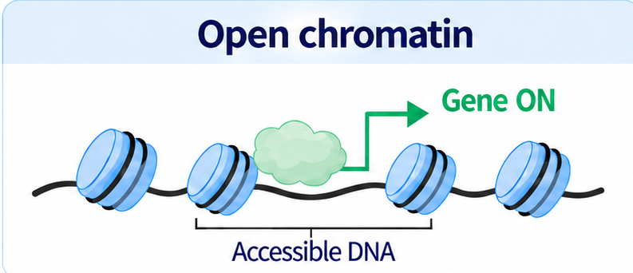
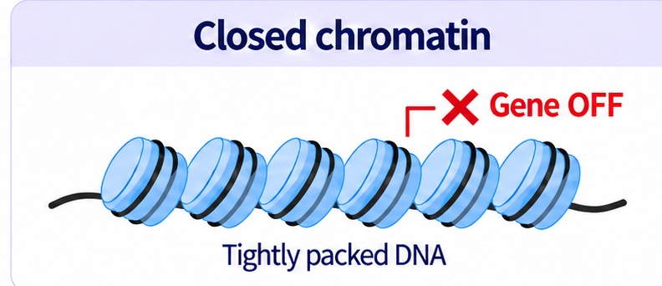


Open and Closed Chromatin
Different cells have different open regions
A
B
C
D
E
T cell
= open DNA
B cell
= closed DNA
Cancer cell
All cells contain the same DNA. Different cell types open different DNA regions.
Chromatin accessibility helps control gene expression and gene expression is linked to disease.
Notes:
ATAC-seq is a widely used technology used to identify open and closed regions. This method uses transposon enzymes to cut at special regions, building a profile of cuts (or peaks) that counts the number of cuts made to each region to identify open and closed regions. These profiles are often represented as bar graphs, where the x-axis is the region and the y-axis is the number of cuts made by the enzyme in that region.
For most cell types, the approximate cut profile is usually already known and given ahead of time.

Slide 3
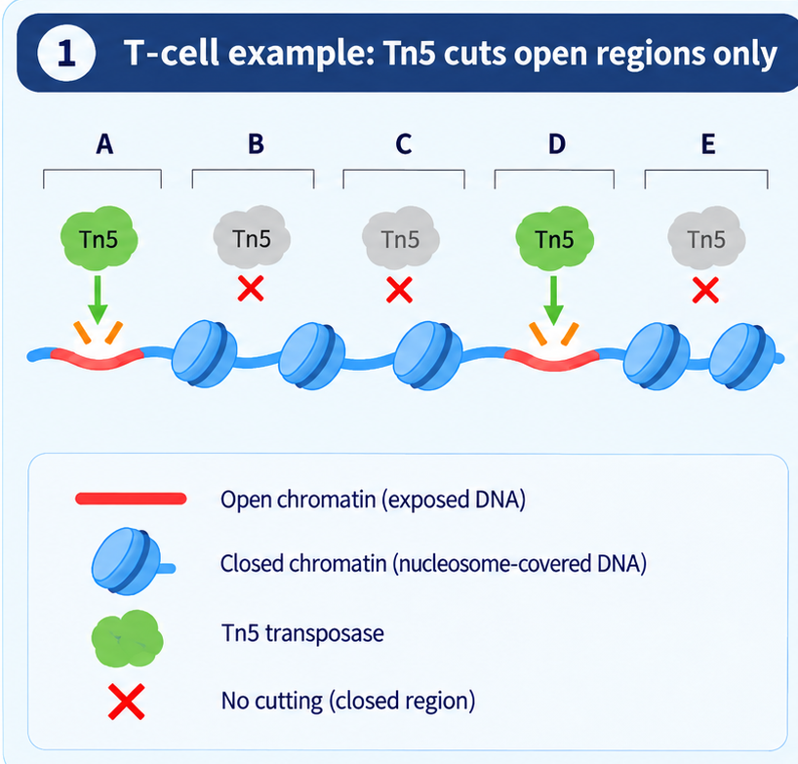
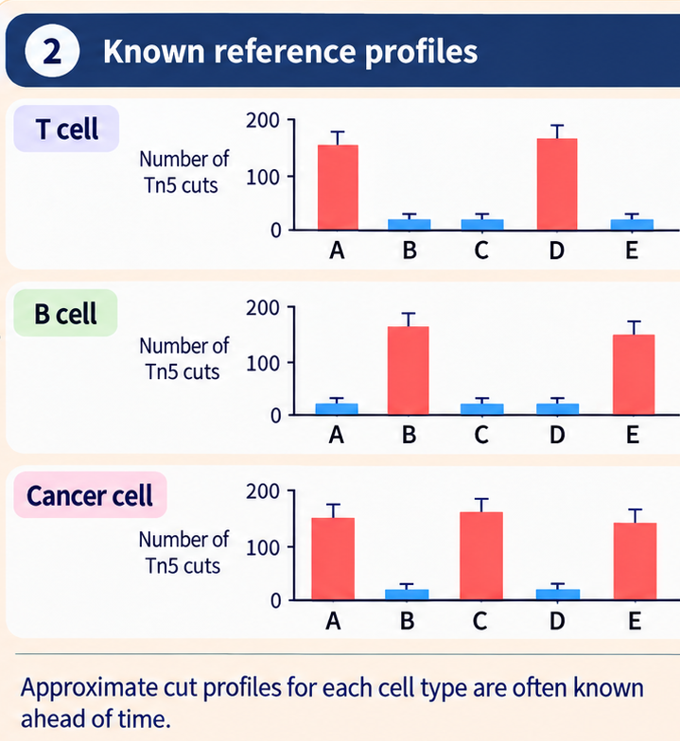
ATAC sequencing and cut profiles
Notes:
If we tie ATAC cut profiles to location information, this allows us to see exactly where different types of cells are developing and how a cell’s surorundings can affect its behavior. Spatial ATAC-seq is a method for measuring these cut profiles across multiple cells. It is a recent technology developed in 2022, and in the past few years, it has already been put to use in studying brain development, cancer, Alzheimer’s disease, and other important medical questions of today.

Slide 4
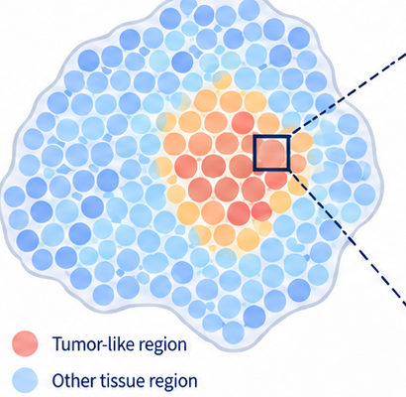
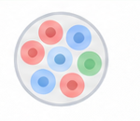
Spatial ATAC: Adding Location Information
1 What Spatial ATAC-seq measures
2 Why it matters
Key idea: ATAC cut profiles + location information
Spatial ATAC-seq was introduced in 2022 and is becoming widely used.
One spatial spot
Maps disease regions in tissue
several cells
can be mixed
Studies how nearby cells may influence a cell’s behavior
Tn5 cus
A
B
C
D
E
Connects open DNA regions with the physical structure of tissue.
Tissue section
(many spatial spots)
Spatial ATAC links chromatin accessibility with location, making it a powerful new tool for studying layout of different cells in tissue.

Slide 5

The Deconvolution Problem for Spatial ATAC
1
Spots contain many cells
2
We observe a mixed profile
3
Deconvolution unmixes it
Estimate how many cells of each type are in the spot.
Each spatial spot is much larger than one cell, so it can include multiple cell types.
The ATAC cut profile from a spot is a mixture of all cells in that spot.
Like identifying ingredients in a smoothie.
💡
Why this problem is new
Recent study (2025) adapts deconvolution method for spatial RNA-seq; methods designed specifically for spatial ATAC are still lacking.

Slide 6
Current Deconvolution for Spatial RNA-seq
1
Mixed spatial spot
2
Estimate cell-type composition
Current deconvolution matches the mixed spot
to reference gene expression profiles.
T cells
= 3
Several cells are mixed in one spot.
B cell
= 1
6
5
4
3
Cancer cells
= 3
Counts
2
1
0
A
B
C
D
E
Observed gene expression profile
Limitation
Adapts gene expression profile to cut profile.

Slide 7
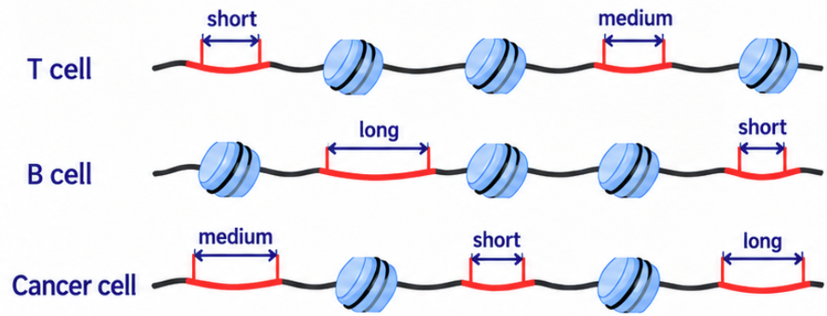
ShapeMix-ATAC: Key Idea and Hypothesis
1
ATAC cut length
2
Hypothesis
Using cut counts + cut-length signals will estimate
cell-type composition more accurately than using cut counts alone
cut length = distance between two nearby cut points
Available in spatial ATAC-seq
Not available in spatial RNA-seq

Slide 8
Experiments and Project Status
Test whether adding cut-length information improves deconvolution accuracy
1
Use public
datasets
2
Mixed spots with
known cell proportions
3
Compare two
methods
4
Evaluate
accuracy
PBMC (human
immune cells)
Human tumor /
bone marrow /
immune tissue
Cut counts
only
Cut counts +
cut length
Mouse tissues
Spatial spots
with known
composition
Compare estimates
with the known
true composition
Current status:
Implemented the Bayesian model with cut-length information
Tested on PBMC datasets; results look promising

Slide 9
