Slide 1
DEEPEYE: A Compact and Accurate Video Comprehension with Quantization and Tensorization
Cheng Yuan
cyuan328@sjtu.edu.cn
2018.07

Slide 2
Outline
Introduction
Basics of YOLO
YOLO with Quantization
RNN with Tensorization
DEEPEYE System

Slide 3
Outline
Introduction
Basics of YOLO
YOLO with Quantization
RNN with Tensorization
DEEPEYE System

Slide 4
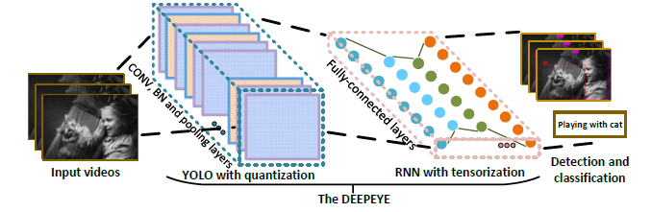
Introduction
As it requires a huge number of parameters when exposed to high dimensional inputs in video detection and classification, there is a grand challenge to develop a compact yet accurate video comprehension system.
We introduce a video comprehension (object detection and action recognition) system for terminal devices, namely DEEPEYE. Based on You Only Look Once (YOLO), we have developed an 8-bit quantization method when training YOLO; and also developed a tensorized-compression method of Recurrent Neural Network (RNN) composed of features extracted from YOLO.

Slide 5
Outline
Introduction
Basics of YOLO
YOLO with Quantization
RNN with Tensorization
DEEPEYE System

Slide 6
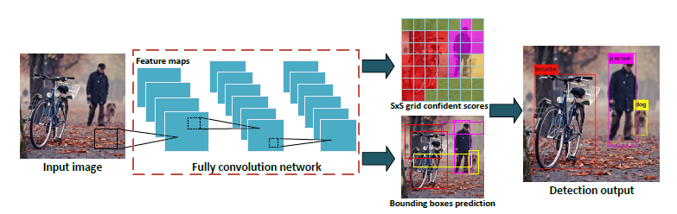
Basics of YOLO
YOLO reframes object detection as a signal regression problem, straight from image pixels of every frames to bounding box coordinates and class probabilities. A convolutional network simultaneously predicts multiple bounding boxes and class probabilities for those boxes.
YOLO has several benefits over traditional methods of object detection since it trains on full images and directly optimizes detection performance.

Slide 7
Outline
Introduction
Basics of YOLO
YOLO with Quantization
RNN with Tensorization
DEEPEYE System

Slide 8


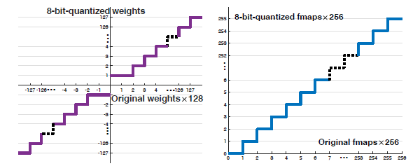
YOLO with Quantization
The direct YOLO implementation for video-scale data would require large and unnecessary resource of both software and hardware. A YOLO model (namely Q-YOLO) with 8-bit quantization is developed as followed.

Slide 9
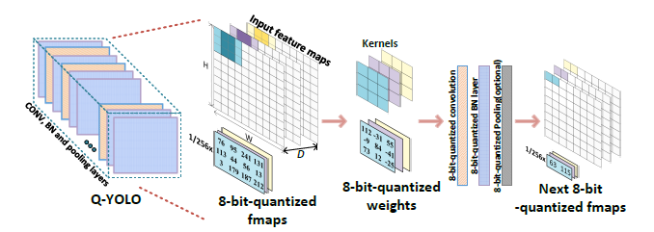
YOLO with Quantization
The overall working flow of the Q-YOLO model is presented as followed, and the network is assumed to have a feed-forward linear topology. All the expensive operations in convolutional layers are operating on 8-bit quantization.

Slide 10
Outline
Introduction
Basics of YOLO
YOLO with Quantization
RNN with Tensorization
DEEPEYE System

Slide 11


RNN with Tensorization
Previous neural network compression on RNN is performed by either precision-bit truncation or low-rank approximation, which cannot maintain good balance between network compression and network accuracy.
We developed a tensorization-based RNN during the training process. The tensor decomposition method will be first introduced, and then a tensorized RNN (namely T-RNN) will be discussed based on the extension of general neural network.

Slide 12
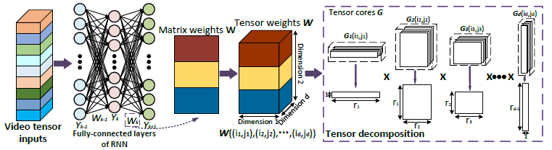
RNN with Tensorization
The whole working flow with tensorization on the hidden-to-hidden weights is shown as followed. This will be much higher compressed and more efficient since the rank r is very small compared with general matrix-vector multiplication of traditional fully-connected layers.

Slide 13
Outline
Introduction
Basics of YOLO
YOLO with Quantization
RNN with Tensorization
DEEPEYE System

Slide 14
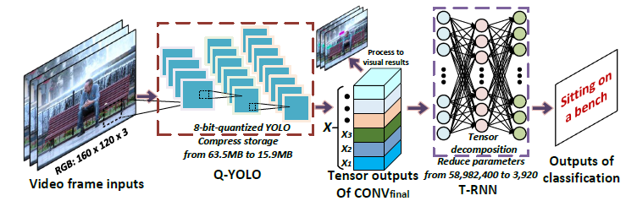
DEEPEYE System
Instead of optimizing the video detection and classification in a separated fashion, the DEEPEYE is the first approach to leverage object detection and action recognition together with remarkable optimizations. Since the whole system is highly compressed with quantization and tensorization, it benefits a lot with a much better performance in compression, speed-up as well as resource-saving, especially when applying to the video comprehension tasks.

Slide 15
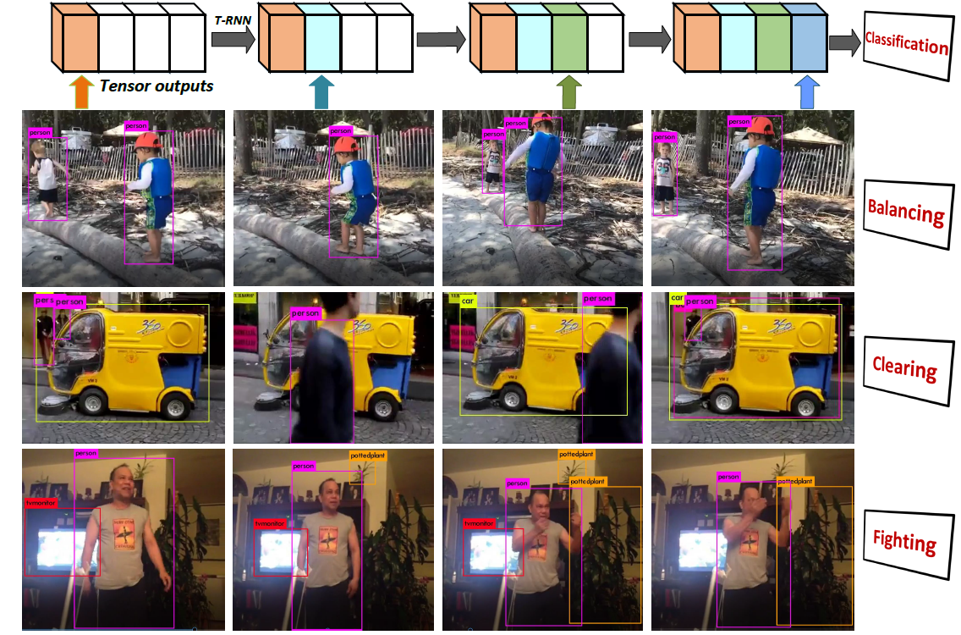
DEEPEYE System
Detection and classification result on MOMENTS dataset.

Slide 16
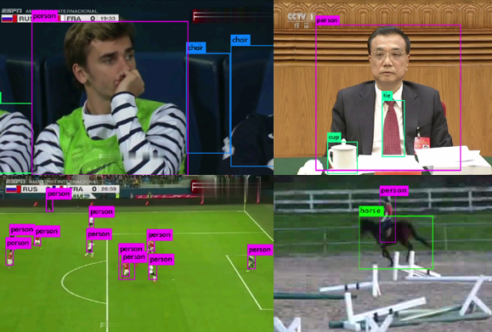
DEEPEYE System
Detection and classification results on customized dataset.

Slide 17
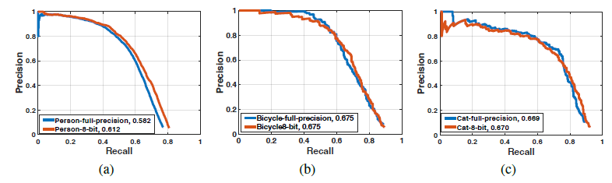
DEEPEYE System
Average precision comparison between 8-bit-quantized Q-YOLO and full-precision YOLO on classes: (a) person, (b) bicycle and (c) cat.

Slide 18
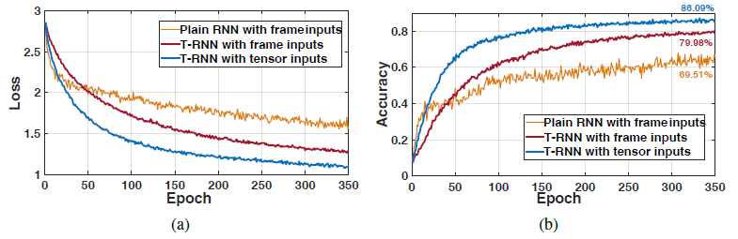
DEEPEYE System
Comparison among different RNN models on (a) loss curves and (b) accuracy curves.

Slide 19
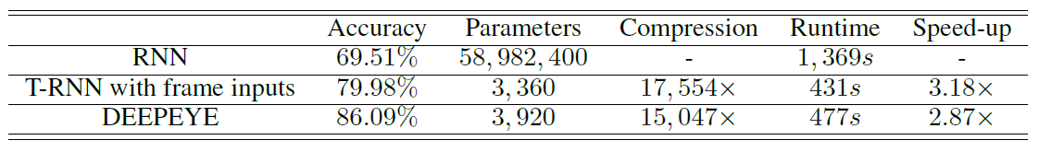
DEEPEYE System
The performance evaluation on multiple baselines: the number of parameters involved in the input-to-hidden mappings of respective baselines; and the runtime as average cost-time of each training epoch.

Slide 20
Thank You!
Cheng Yuan
(+86) 18217399602
cyuan328@sjtu.edu.cn

