Slide 1
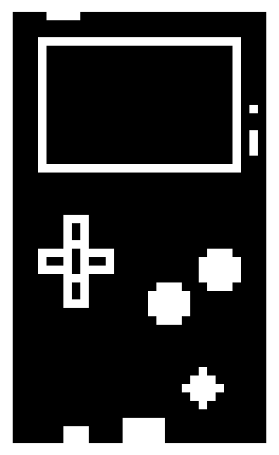
WAIT
OFF
OFF
+ON
+ON
DANCE
DO THE
CONGA!

Slide 2
WAIT
OFF
OFF
+ON
+ON
DANCE
DO THE
CONGA!

Slide 3
WAIT
OFF
OFF
+ON
+ON
DANCE
DO THE
CONGA!

Slide 4
WAIT
OFF
OFF
+ON
+ON
DANCE
DO THE
CONGA!

Slide 5
WAIT
OFF
OFF
DANCE
+ON
+ON
DO THE
CONGA!

Slide 6
WAIT
OFF
OFF
+ON
+ON
DANCE
DO THE
CONGA!

Slide 7
WAIT
OFF
OFF
+ON
+ON
DANCE
DO THE
CONGA!

Slide 8
WAIT
OFF
OFF
+ON
+ON
WAIT
DO THE
CONGA!

Slide 9
WAIT
OFF
OFF
+ON
+ON
WAIT
DO THE
CONGA!

Slide 10
WAIT
OFF
OFF
+ON
+ON
WAIT
DO THE
CONGA!

Slide 11
WAIT
OFF
OFF
WAIT
+ON
+ON
DO THE
CONGA!

Slide 12
WAIT
OFF
OFF
+ON
+ON
WAIT
DO THE
CONGA!

Slide 13
WAIT
OFF
OFF
+ON
+ON
DANCE
DO THE
CONGA!

Slide 14
WAIT
OFF
OFF
+ON
+ON
CONGA
DO THE
CONGA!

Slide 15
WAIT
OFF
OFF
+ON
+ON
CONGA
DO THE
CONGA!

Slide 16
WAIT
OFF
OFF
+ON
+ON
CONGA
DO THE
CONGA!

Slide 17
WAIT
OFF
OFF
CONGA
+ON
+ON
DO THE
CONGA!

Slide 18
WAIT
OFF
OFF
+ON
+ON
CONGA
DO THE
CONGA!

Slide 19
WAIT
OFF
OFF
+ON
+ON
CONGA
DO THE
CONGA!

Slide 20
WAIT
OFF
OFF
+ON
+ON
DO THE
CONGA!

