Slide 1
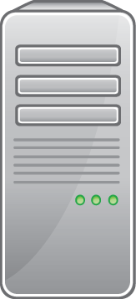

recovhub
CRM
Plans
Merchant
Account
Merchant
Account
Server
1
2
3
Facility
4
1. Facility navigates to Plans page
2. Facility selects Plan link and is routed to
Merchant Account Server (MAS)
3. MAS sends funds to CRM
4. MAS sends confirmation email / receipt to Facility

