Slide 1
Rockbuster Analysis
Eric Riesberg

Slide 2
Summary
Revenue by Genre
Statistics by MPAA Rating
Customer Value per Country
Top Countries and Cities
Top Customers
Conclusions

Slide 3
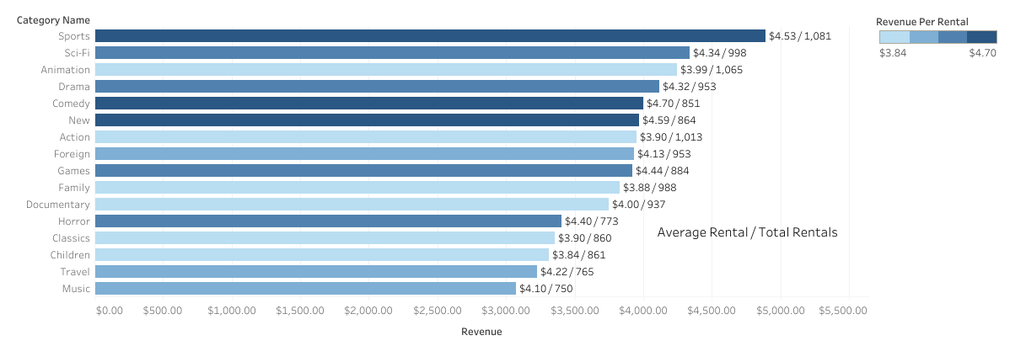
Revenue by Genre
Rockbuster makes the largest portions of revenue from Sports films.
On a per rental basis, Comedy produces the highest revenue.
Music has the least number of films as a genre.
On a per rental basis, Children produces the lowest revenue.

Slide 4
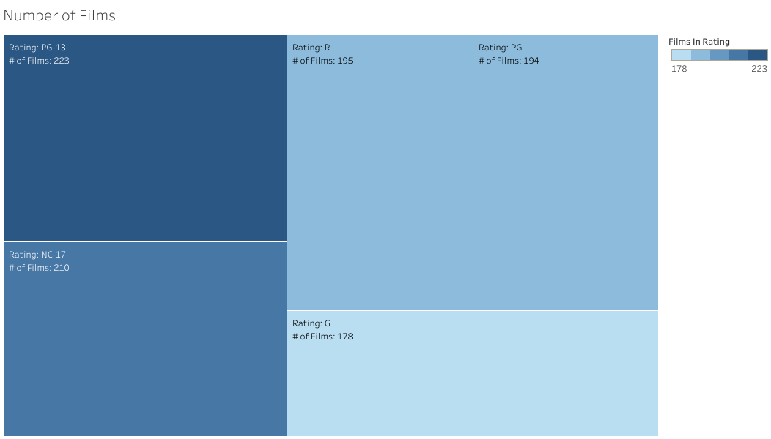
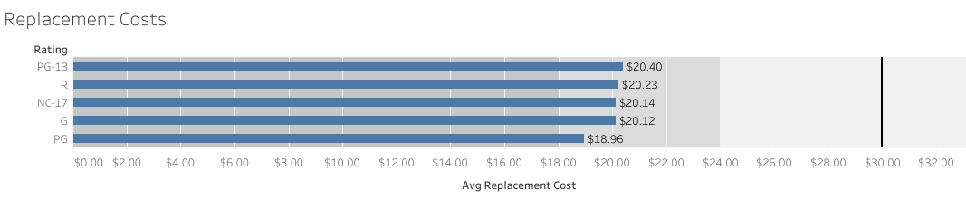
Statistics by MPAA Rating
PG-13 rated films have the highest inventory levels.
G rated films have the lowest inventory levels.
PG-13 rated films have the highest replacement costs on average.
PG rated films have the lowest replacement costs on average.

Slide 5
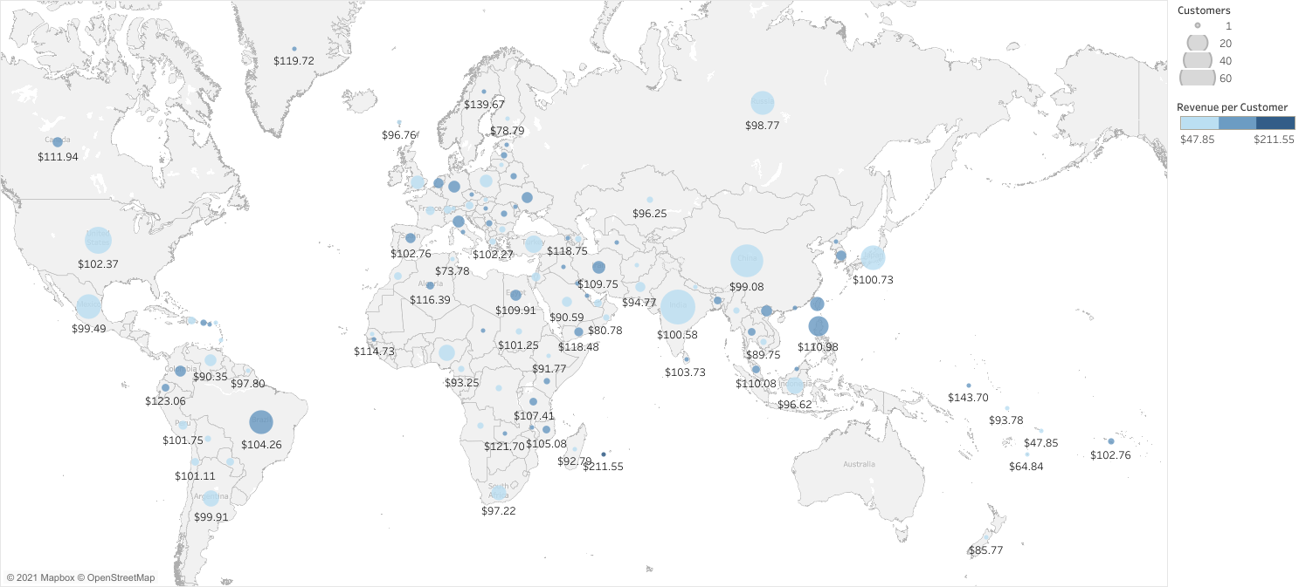
Customer Value per Country
The chart below indicates the average revenue per customer in each country, and the number of customers
Top 3 countries for revenue per customer are: Runion ($221.60), Vatican ($146.70), and Nauru ($143.70)
Bottom 3 countries for revenue per customer are: American Samoa ($47.90), Lithuania ($63.80), and Saint Vincent and the Grenadines ($64.80)

Slide 6
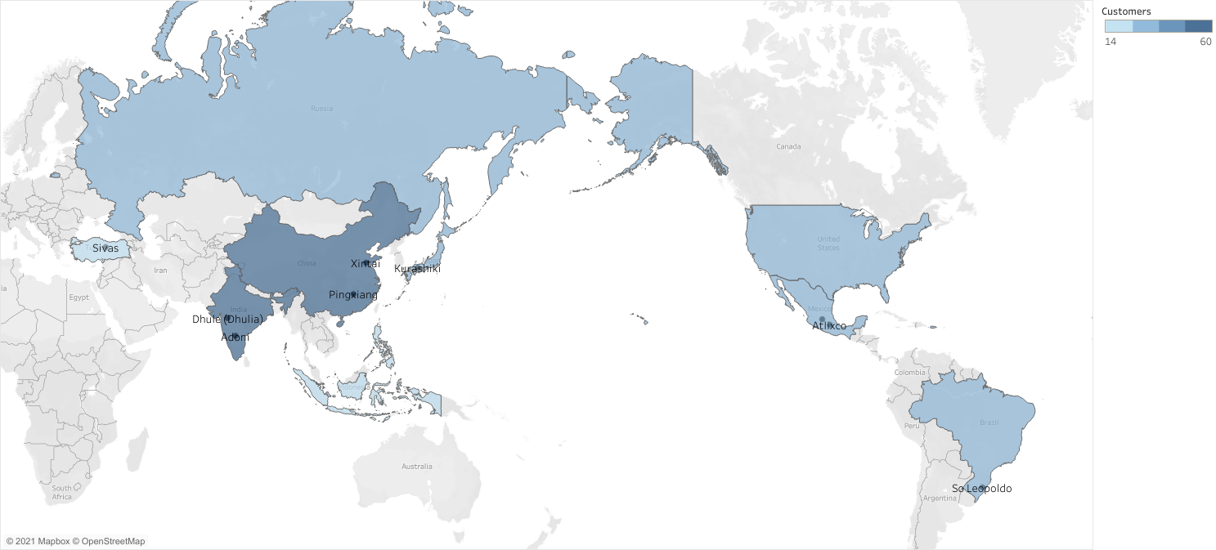
Top Countries and Cities
The chart below indicates the location of the Top 10 Countries and the Top 10 cities in terms of customers.
Top 3 countries for number of customers are: India (60), China (53), and United States (36).

Slide 7
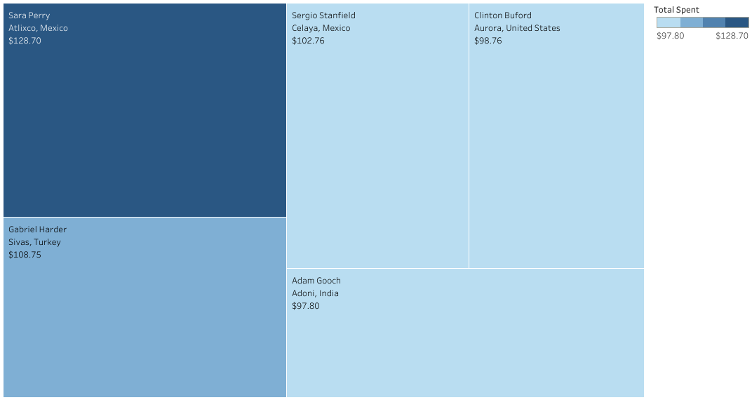
Top Customers
The chart below indicates the cumulative revenue of the top 5 customers in the top 10 cities.
In total, the top 5 customers have generated a total of $536.77 ($107.35 / customer).
Sara Perry is the top customer, with rental amounts of $128.70.

Slide 8
Conclusions
Sports and Comedy both do very well as Genres. They produce the highest amount of overall revenue, and the highest revenue per rental, respectively. Rockbuster should continue to invest in these two Genres to generate greater revenue.
PG films are both lower in inventory and replacement cost than the majority of other MPAA Ratings. This makes them intriguing for investment as the risk of loss is decreased.
Revenue per customer is relatively close across all countries, meaning focus should be given to the countries with large amounts of customers. India, China and the US should remain in focus to help boost revenues.

