Slide 1



Zero Hunger Hackathon
Empower global food security with your coding skills
May 22-24, 2024 | Free Online Event
in collaboration with

Slide 2
Our Goal
Codeappetite is a web based platform that aims to create a more efficient and effective system for connecting
surplus food with those who need it, ultimately reducing food waste and improving food security for the target audience.
Notes:
“leading organizations” - examples please.
https://docs.google.com/spreadsheets/d/1w7bpUPExBQ7TpGt6eeJFvCoEHBWxb-1-xS9iDVnvpzs/edit?usp=sharing
Participating in Hack To The Rescue empowers you to help solve nonprofits’ most pressing challenges using the most cutting edge advancements in technology, including Generative AI. In just three days, you can create a solution that will have a massive impact on the lives of millions of people.

Slide 3
Current Situation
Notes:
“leading organizations” - examples please.
https://docs.google.com/spreadsheets/d/1w7bpUPExBQ7TpGt6eeJFvCoEHBWxb-1-xS9iDVnvpzs/edit?usp=sharing
Participating in Hack To The Rescue empowers you to help solve nonprofits’ most pressing challenges using the most cutting edge advancements in technology, including Generative AI. In just three days, you can create a solution that will have a massive impact on the lives of millions of people.

Slide 4
What is the problem?
Who is your target audience?
To reduce food waste and hunger.
To build the connection by creating a web application for organizations that have surplus food and people who need.
Organizations that have surplus food.
People who need need food.

Slide 5
Solution
Notes:
“leading organizations” - examples please.
https://docs.google.com/spreadsheets/d/1w7bpUPExBQ7TpGt6eeJFvCoEHBWxb-1-xS9iDVnvpzs/edit?usp=sharing
Participating in Hack To The Rescue empowers you to help solve nonprofits’ most pressing challenges using the most cutting edge advancements in technology, including Generative AI. In just three days, you can create a solution that will have a massive impact on the lives of millions of people.

Slide 6
What are the key features our application has?
Geolocation Technology
Using AWS Location services, the app will be match surplus food with nearby users based on the location of the users.
Real-Time Notifications
When a matches come up for the user based on their location, they will receive a notification on their app using AWS SNS service.
Surplus Food and needs Listings
Using AWS DynamoDB which stores the database of surplus food from the different markets, users will be able to see list of food available.
Feedback and Rating System
We wanted to provide a feature where the users will be able to give use feedback based on the use of their app to further improve the application for future developments

Slide 7
Prototype
Notes:
“leading organizations” - examples please.
https://docs.google.com/spreadsheets/d/1w7bpUPExBQ7TpGt6eeJFvCoEHBWxb-1-xS9iDVnvpzs/edit?usp=sharing
Participating in Hack To The Rescue empowers you to help solve nonprofits’ most pressing challenges using the most cutting edge advancements in technology, including Generative AI. In just three days, you can create a solution that will have a massive impact on the lives of millions of people.

Slide 8
We want to integrate tool with:
Are there any technical requirements?
We would like to use different AWS Services such as Dynamodb, location service, SNS, AWS SDK libraries.
The web application is currently built using flask and AWS services.
www.hacktotherescue.org

Slide 9
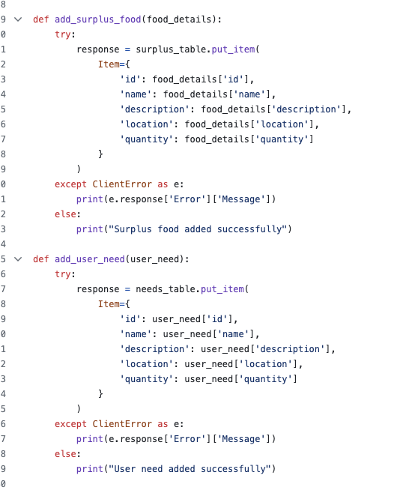
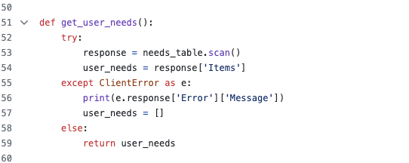
Database Service

Slide 10
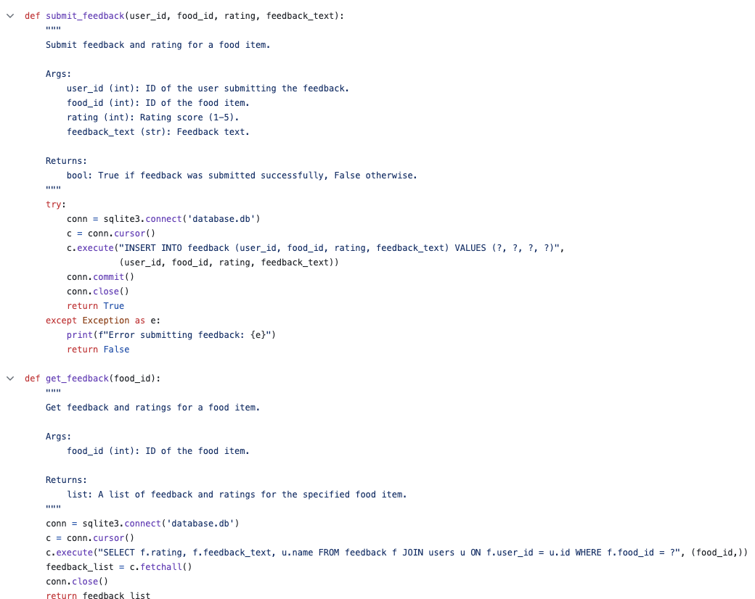
Feedback Service

Slide 11
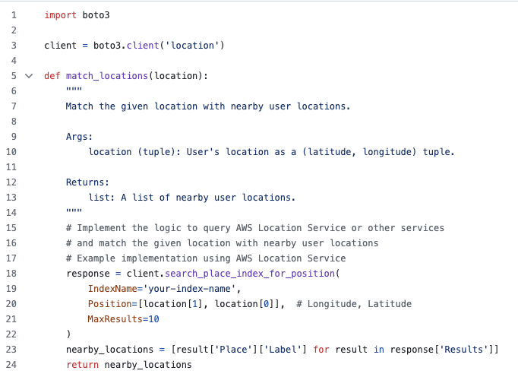
Location Service

Slide 12
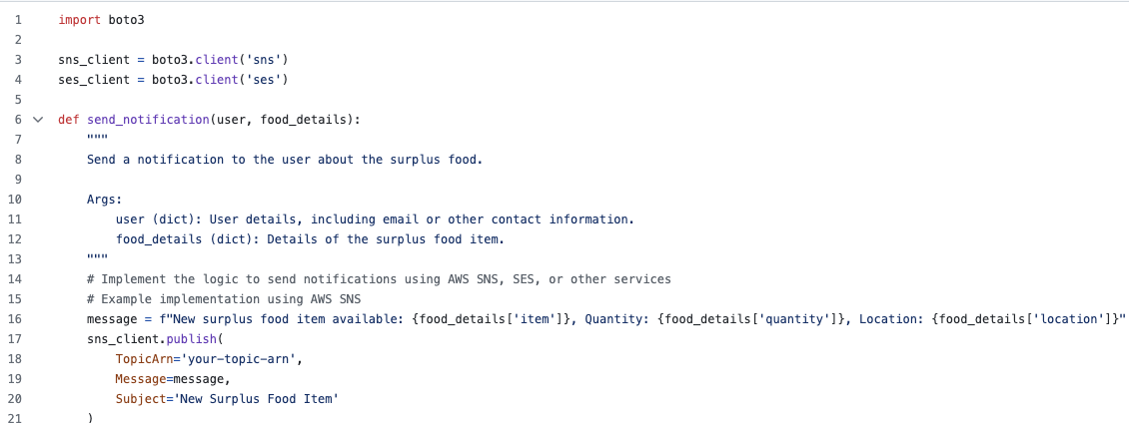
Notification Service

Slide 13
Further Developments
Notes:
“leading organizations” - examples please.
https://docs.google.com/spreadsheets/d/1w7bpUPExBQ7TpGt6eeJFvCoEHBWxb-1-xS9iDVnvpzs/edit?usp=sharing
Participating in Hack To The Rescue empowers you to help solve nonprofits’ most pressing challenges using the most cutting edge advancements in technology, including Generative AI. In just three days, you can create a solution that will have a massive impact on the lives of millions of people.

Slide 14
How would we proceed to develop this idea further?
We would implement the functionalities using AWS services to get the prototype of our idea working.
We would consider other users that can onboard to our application.
We would have the full stack working on using AWS services.

Slide 15
Thank you 💜
Notes:
“leading organizations” - examples please.
https://docs.google.com/spreadsheets/d/1w7bpUPExBQ7TpGt6eeJFvCoEHBWxb-1-xS9iDVnvpzs/edit?usp=sharing
Participating in Hack To The Rescue empowers you to help solve nonprofits’ most pressing challenges using the most cutting edge advancements in technology, including Generative AI. In just three days, you can create a solution that will have a massive impact on the lives of millions of people.

