Slide 1
Term Deposit Subscription
Eriko Funasato

Slide 2
UCI - Bank Marketing Data Set
Bank Client Data:
age, job, marital, education, default, housing, loan
Last contact / Campaign
contact, month, day_of_week, duration, campaign, pdays, previous, poutcome
Social and economics:
emp.var.rate, cons.price.idx, cons.conf.idx, euribor3m, nr.employed
Target outcome:
Y - Subscribe term deposit or not

Slide 3
The problem
Preprocessing
What features?
Prediction Model
What features are important to get customers subscribe in the term deposit.
Try to build a model to predict whether customers will subscribe for term deposit.
How to deal with missing values
How to encode categorical variables
Imbalance Target

Slide 4
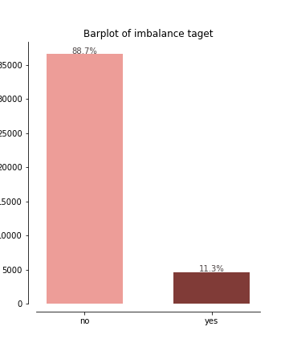
Imbalance
Target
11% to 89%
(User class_weight = “balanced”)

Slide 5
Preprocessing
Numerical
Categorical
By description, all the unknown or missing values are represented as “unknown” in all the categorical values. And since most of them are not ordinal(nominal), therefore we would like to oneHotEncode them.
There are almost no missing value in the numerical columns, but one weird columns “pdays”, which is the number of days since last reach out, indicate no call before as 999. Therefore, we need to replace 999 with 0.

Slide 6
Three Models
Logistic Regression
Random Forest
Ensemble model
Baseline
The logistic regression performance is not very well, but its simplicity make it work very well as the baseline.
RandomizedSearchCV
Using random grid search , we can search for the best hyperparameters that goes into the model.
Voting Classifier
With ensemble model of knn, decision tree, and svc, find the best combination of the model with their vote.

Slide 7
Interpretation

Slide 8
Metrics
Models
Validation score
F1 Score
Confusion Matrix
1
Logistic Regression
[[5952, 935],
[118, 758]]
0.86
0.88
What features?
Prediction Model
2
Random Forest
[[6774, 73],
[667, 209]]
0.90
0.88
3
Ensemble model
[[6631, 216],
[488, 388]]
0.91
0.90

Slide 9
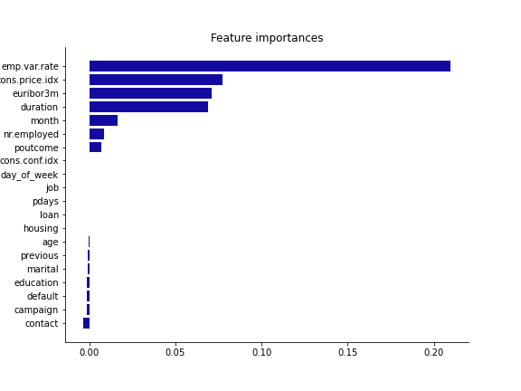
Most important features:
Employment variation rate
Consumer price index
Euribor 3 month rate
They are all social and economics related features.

Slide 10
Thank you!

