Slide 1
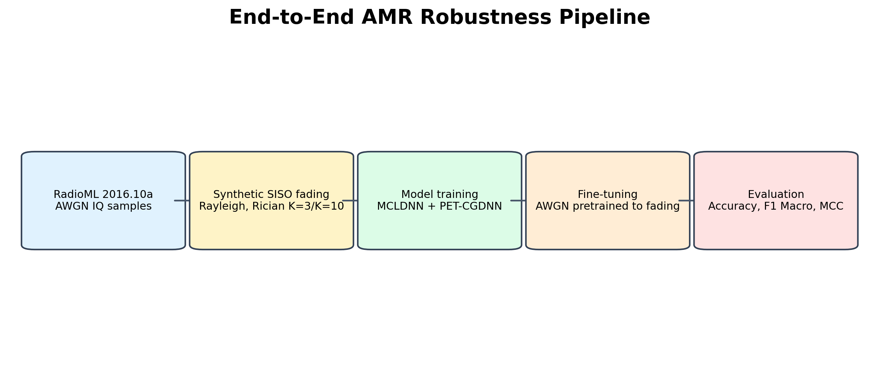
MYZ 307E Project Presentation
Deep Learning-Based Automatic Modulation Recognition under Different SISO Channel Conditions
Batuhan Gedik | Erkam Tuğ | Eren Söker | Muhammet Anıl Gülaz
Robustness evaluation for AWGN, Rayleigh, and Rician SISO channels
Slide 1/10
Notes:
Owner: Eren Target time: 0:20 We study how AMR models behave when the channel is more realistic than AWGN.

Slide 2
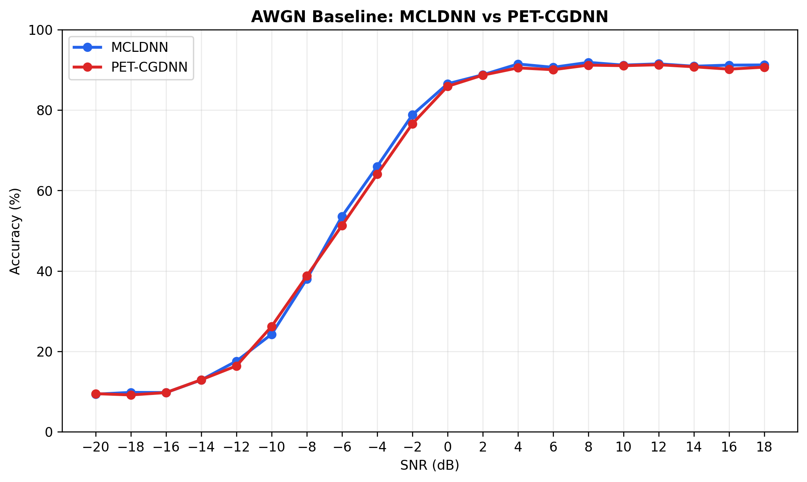
Why AWGN-Only AMR Is Not Enough
Problem: In a practical approach, the channel obtains different channel models; therefore, it can affect the efficiency of AMRs, which can lead to misconceptions for determining modulation types.
Motivation: Developing AMR (Automatic modulation recognition) for low SNR signals. And develop a more practically efficient model for different SISO channel conditions.
Slide 2/10
Notes:
Owner: Eren Target time: 0:40 The engineering problem is robustness: can AMR still classify signals when the channel changes?

Slide 3
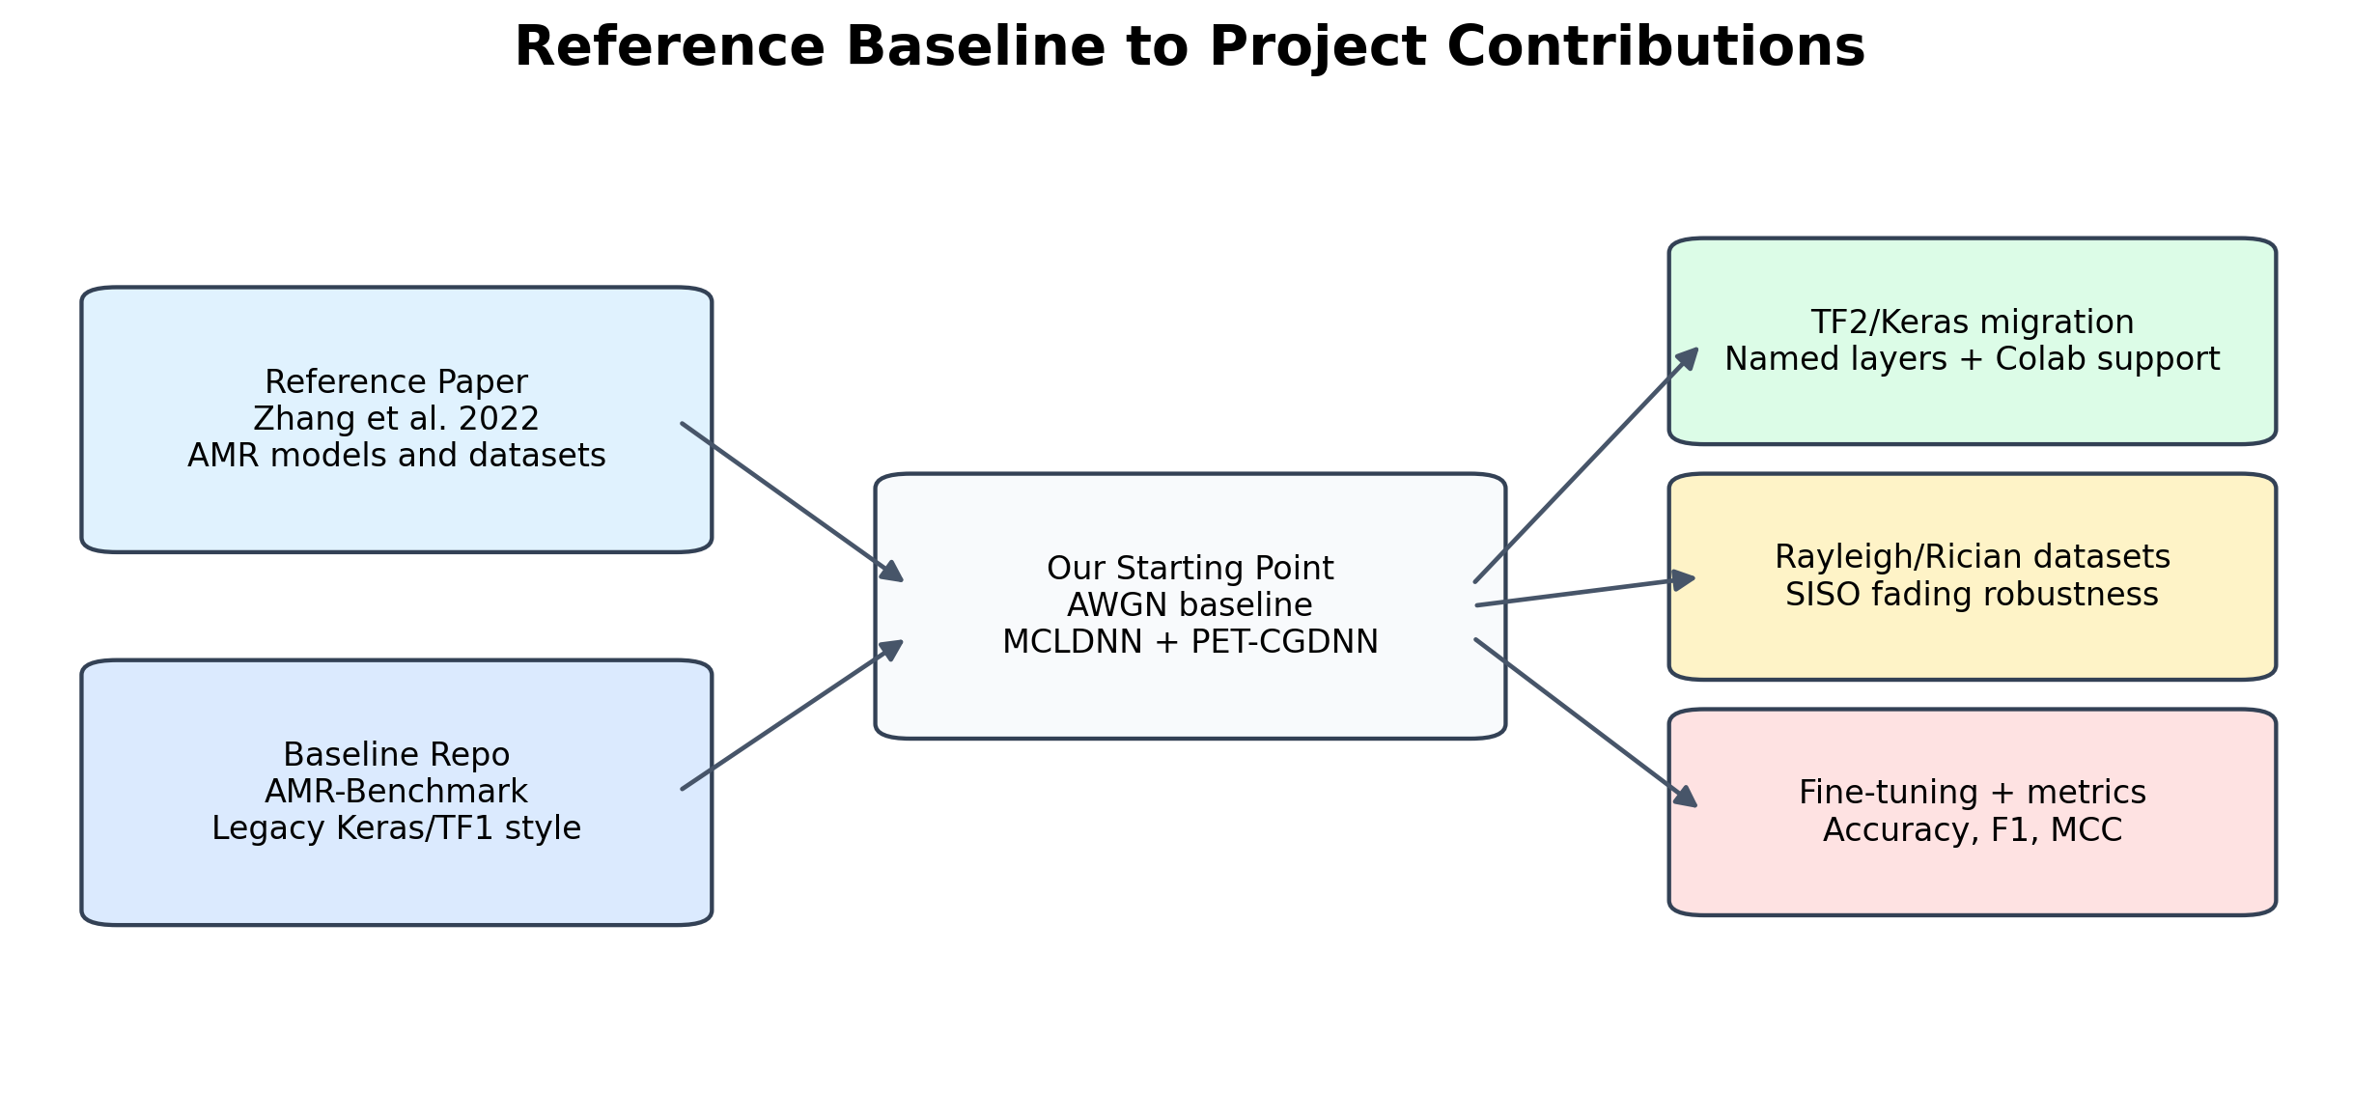
Reference Baseline and Starting Point
Reference Paper: Zhang, F., Luo, C., Xu, J., Luo, Y., & Zheng, F. (2022). Deep learning based automatic modulation recognition: Models, datasets, and challenges. Digital Signal Processing, 129, 103650. https://doi.org/10.1016/j.dsp.2022.103650
Github Repo: Richardzhangxx/AMR-Benchmark.
https://github.com/Richardzhangxx/AMR-Benchmark.
Our Github Repo: AMR-UnderDifferentNoises-DL
https://github.com/erigami-sl/AMR-UnderDifferentNoises-DL
Slide 3/10
Notes:
Owner: Muhammet Target time: 0:35 We did not build from zero; we extended a known benchmark toward more practical SISO channels.

Slide 4
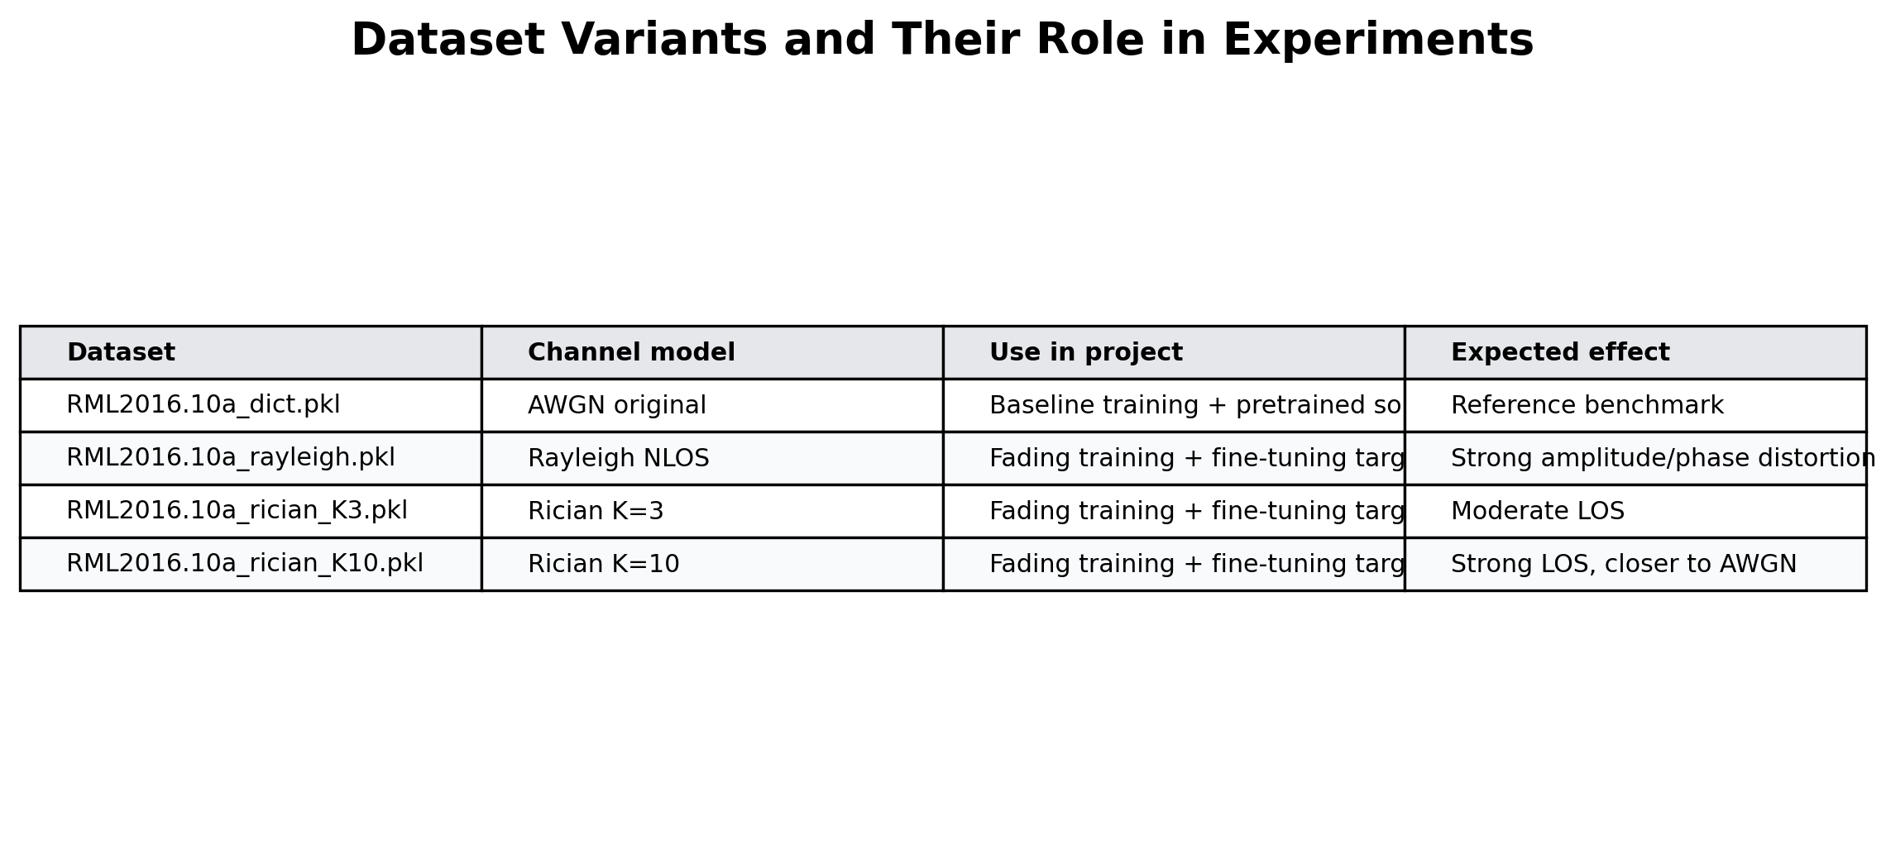
Dataset: RadioML 2016.10a
We used the RadioML 2016.10a dataset as the common AMR benchmark. The dataset contains 220,000 I/Q signal samples from 11 modulation classes across 20 SNR levels from -20 dB to +18 dB.
We kept the original benchmark setup with signal normalization and a 60/20/20 train-validation-test split.
Since the original dataset mainly represents AWGN channel conditions, we generated additional versions with Rayleigh fading and Rician fading to test robustness under more realistic SISO channels.
Slide 4/10
Notes:
Owner: Muhammet Target time: 0:40 We keep the original dataset structure so comparisons stay fair.

Slide 5
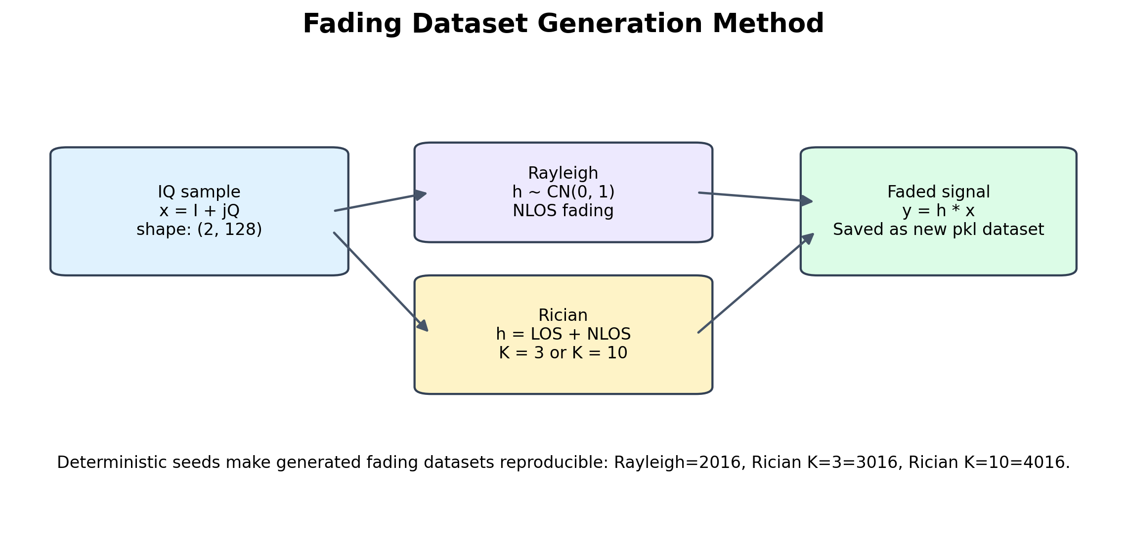
Contribution
Contribution 1: More Realistic Channel Conditions
The original benchmark mainly evaluates AMR under AWGN conditions.
We extended the dataset by adding SISO fading channel models:
Rayleigh fading for non-line-of-sight environments.
Rician fading with K=3 for moderate line-of-sight.
Rician fading with K=10 for strong line-of-sight
The generated datasets preserve the original structure:
same modulation classes
same SNR range
same 2 × 128 I/Q tensor format
This allowed fair comparison between AWGN baseline performance and fading-channel robustness.
Slide 5/10
Notes:
Owner: Erkam Target time: 0:50 The key improvement is not just training another model; it is testing AMR under controlled, realistic channel shifts.

Slide 6
Contribution
Contribution 2: Robust Training and Fine-Tuning Pipeline
We reproduced and migrated the baseline models to a modern TensorFlow/Keras pipeline.
We trained the models under multiple channel settings:
AWGN baseline
Rayleigh fading
Rician K=3
Rician K=10
We added a fine-tuning strategy:
start from AWGN-trained weights
adapt the model to fading-channel datasets
use a lower learning rate to preserve learned modulation features
Slide 6/10
Notes:
Owner: Erkam Target time: 0:55 We compare three strategies: baseline, faded training, and fine-tuning.

Slide 7
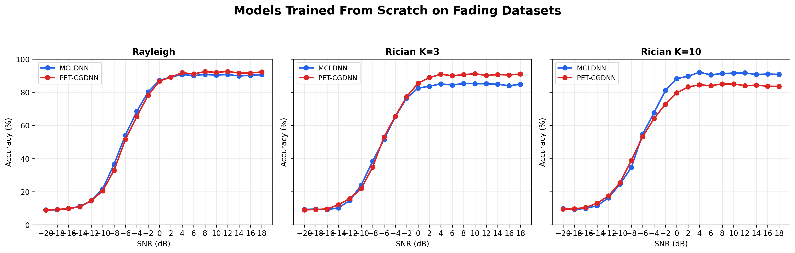
Results
Results: Accuracy vs. SNR for Baseline and Fading Datasets
Under AWGN, both MCLDNN and PET-CGDNN reach around 90% accuracy at high SNR.
Accuracy drops sharply in the low-SNR region, especially below -8 dB.
Fading-trained models also reach high accuracy, but performance depends on the channel type:
Rayleigh: both models remain close to AWGN-level high-SNR performance.
Rician K=3: PET-CGDNN performs better than MCLDNN at high SNR.
Rician K=10: MCLDNN clearly outperforms PET-CGDNN at high SNR.
In all cases, accuracy drops strongly below about -8 dB, showing that low-SNR AMR is still the hardest region.
Case | Best Model | Mean Acc. | High-SNR Acc.
AWGN baseline | MCLDNN | 61.27% | 90.53%
Rayleigh trained | MCLDNN / PET-CGDNN | 60.69% / 60.64% | 89.94% / 91.10%
Rician K=3 trained | PET-CGDNN | 60.38% | 89.90%
Rician K=10 trained | MCLDNN | 61.33% | 90.73%
Training on the new fading datasets keeps performance close to the AWGN baseline in Rayleigh and Rician K=10 for MCLDNN, while Rician K=3 favors PET-CGDNN.
Slide 7/10
Notes:
Owner: Batuhan Target time: 1:05 The result is nuanced: fading does not always improve accuracy, but some model-channel pairs remain highly robust.

Slide 8
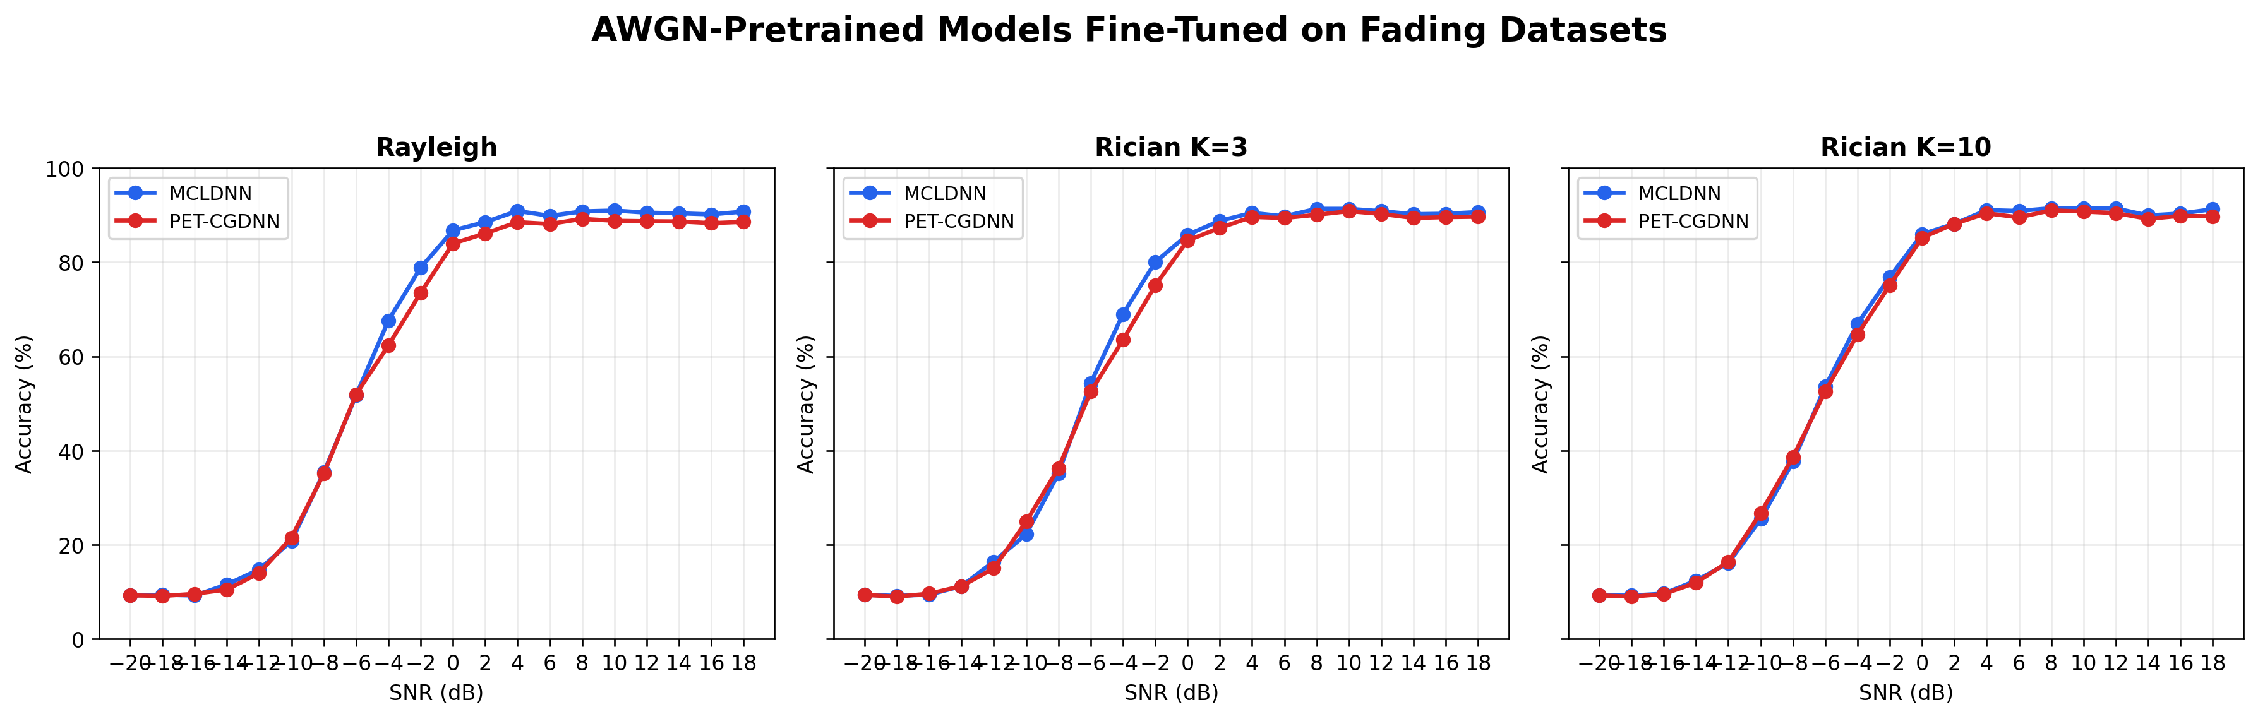
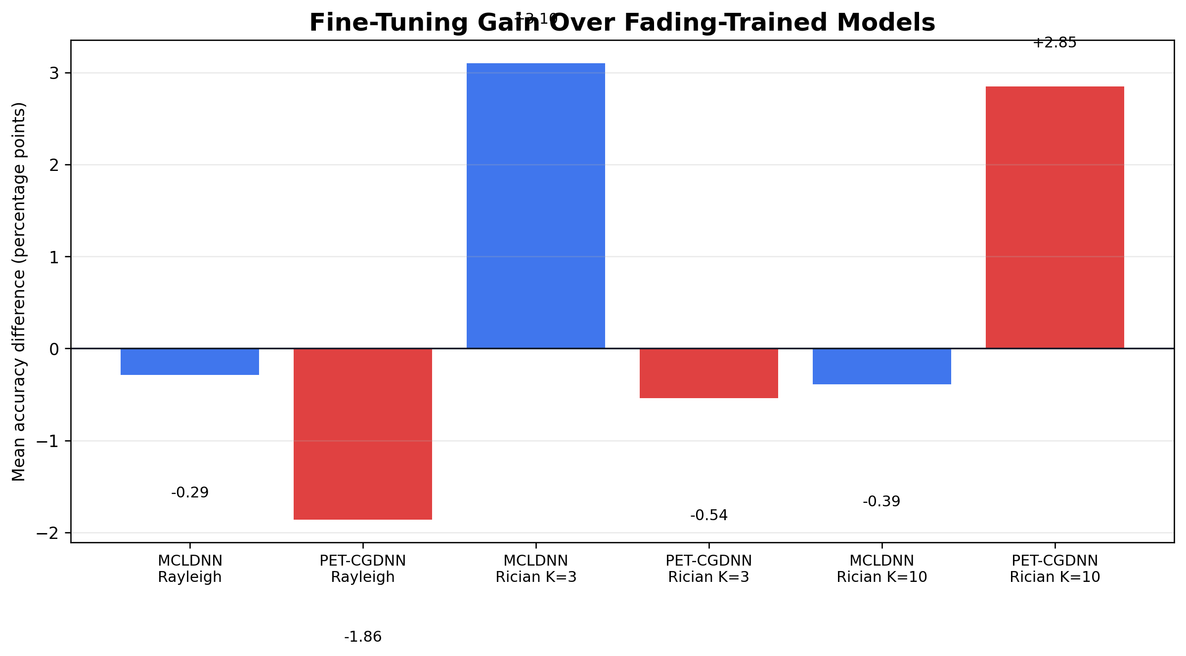
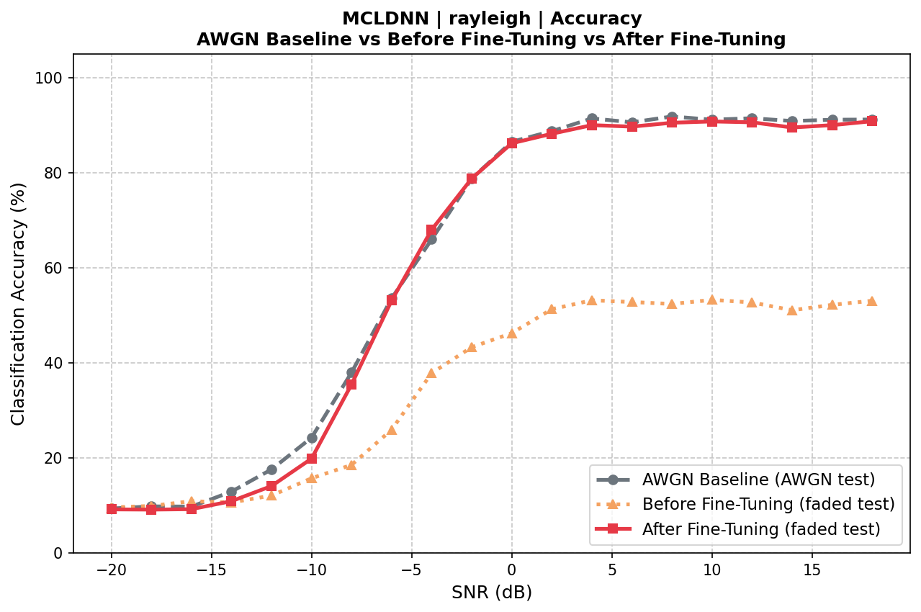
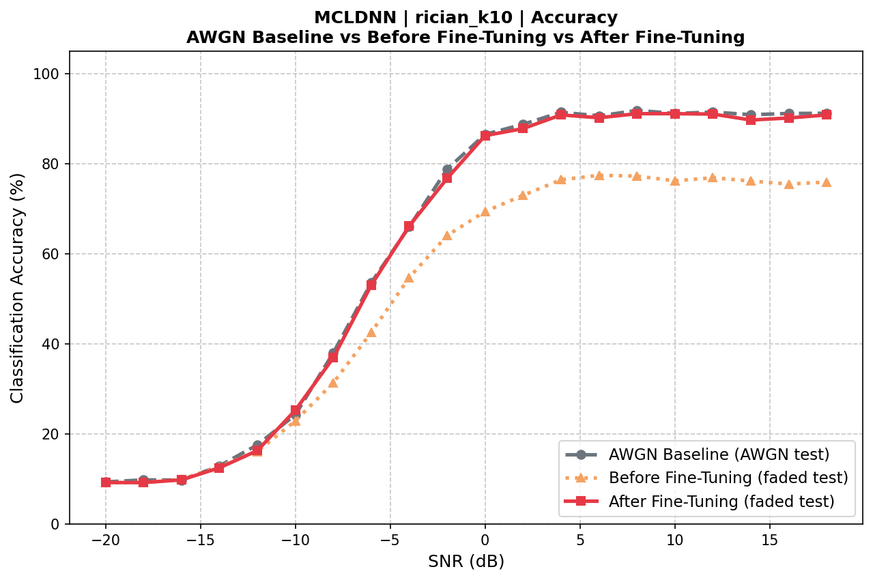
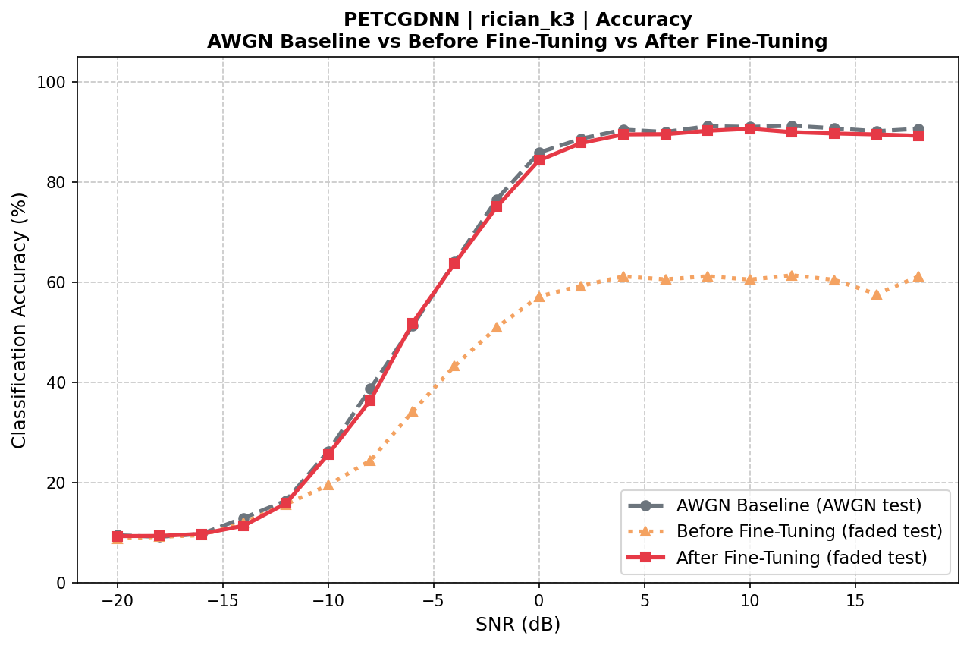
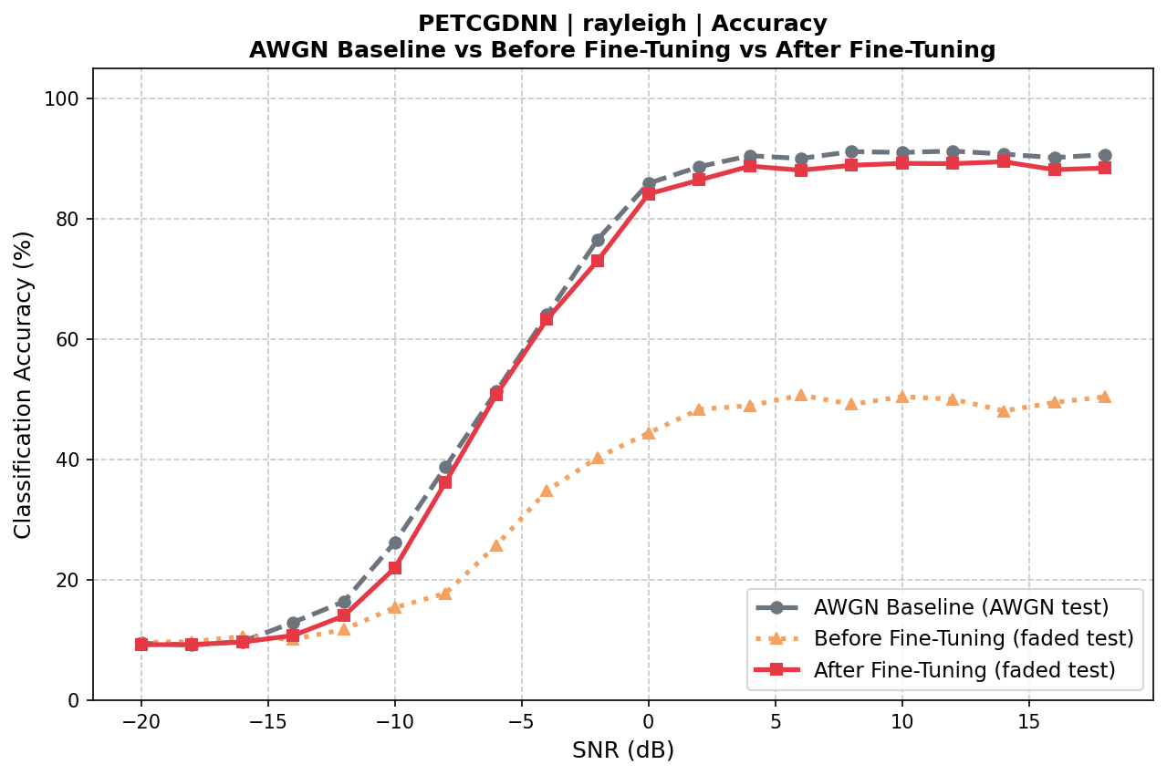
Results
Results: Effect of Fine-Tuning
Can we do better by adapting AWGN-trained models instead of training only from scratch?
Channel | Model | Fading-trained Mean Acc. | Fine-tuned Mean Acc. | Gain
Rayleigh | MCLDNN | 60.69% | 60.40% | -0.29
Rayleigh | PET-CGDNN | 60.64% | 58.78% | -1.86
Rician K=3 | MCLDNN | 57.67% | 60.78% | +3.10
Rician K=3 | PET-CGDNN | 60.38% | 59.84% | -0.54
Rician K=10 | MCLDNN | 61.33% | 60.94% | -0.39
Rician K=10 | PET-CGDNN | 57.55% | 60.40% | +2.85
We fine-tuned AWGN-pretrained models on the generated fading datasets.
Fine-tuning effect was not uniform across all channels.
The largest positive gains were observed in:
MCLDNN on Rician K=3: +3.10 percentage points
PET-CGDNN on Rician K=10: +2.85 percentage points
Some cases showed small negative gains, especially under Rayleigh.
This suggests that fine-tuning helps most when the target channel differs enough from AWGN but still preserves learnable signal structure.
Slide 8/10
Notes:
Owner: Batuhan Target time: 1:00 Fine-tuning is most useful as adaptation, but its effect depends on model and channel.

Slide 9
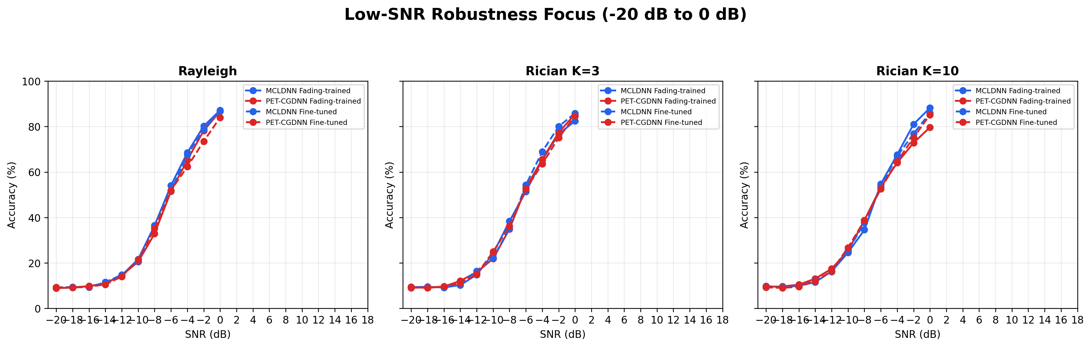
Takeaway
What the Results Show
Summary Category | Best Result | Strategy | Mean Accuracy
Best AWGN baseline | MCLDNN | AWGN baseline | 61.27%
Best on Rayleigh | MCLDNN | Fading-trained | 60.69%
Best on Rician K=3 | MCLDNN | Fine-tuned | 60.78%
Best on Rician K=10 | MCLDNN | Fading-trained | 61.33%
Best low-SNR mean | MCLDNN / Rician K=10 | Fading-trained | 37.05%
Across all experiments, accuracy drops sharply below around -8 dB. This shows that low-SNR AMR remains difficult even after training on fading-channel datasets.
Training on Rayleigh and Rician datasets helps evaluate robustness under more realistic SISO channels, but it does not completely solve the low-SNR problem.
The most useful improvements are seen in the transition region between about -8 dB and 0 dB, where the models start recovering from near-random classification to reliable recognition.
At very low SNR values, such as -20 dB to -12 dB, the models remain close to chance-level accuracy because the signal features are heavily buried in noise.
Therefore, our method improves the evaluation and adaptation pipeline, but future work should focus more directly on low-SNR-specific training strategies
Slide 9/10
Notes:
Owner: Batuhan Target time: 1:05 The main insight is channel-specific robustness, not a single best model everywhere.

Slide 10
Takeaway
Conclusion and Future Work
We extended the AMR benchmark from only AWGN evaluation to more realistic SISO fading channels.
We generated and tested additional datasets with:
Rayleigh fading
Rician K=3
Rician K=10
Results show that high-SNR performance can remain close to the AWGN baseline, but low-SNR recognition is still the main limitation.
Fine-tuning helps AWGN-pretrained models adapt to fading channels, but the best strategy depends on the model and channel type.
Overall, MCLDNN showed the most stable performance across the tested channel conditions
Future Work
--Develop training methods specifically targeting very low SNR conditions.
--Add more realistic channel effects such as Doppler shift, multipath delay, and frequency offset.
--Test on larger or real over-the-air RF datasets.
--Explore hybrid strategies: multi-channel training, data augmentation, and domain adaptation.
--Optimize the models for real-time or embedded AMR applications.
Slide 10/10
Notes:
Owner: Batuhan / Eren Target time: 0:45 Our contribution is a more realistic robustness evaluation and a clearer view of where AMR models fail or hold up.

