Slide 1
Horton’s Who Done It?
Communicating Permissions with
Responsibility Tracking
Mark Miller – Google Research
Jed Donnelley – LBNL/NERSC
Alan Karp – Hewlett Packard
Google ‘Dry Run’ for HotSec, July 31, 2007
Notes:
My name is Jed Donnelley. I’m a computer scientist in the NERSC computer center at Berkeley Lab. I’ll be giving a brief introduction for our presentation today:
Horton’s Who Done it? Communicating Permissions with Responsibility Tracking.
I’m joined by the lead author of the Horton paper, Mark Miller now from Google Research and by our co-author Alan Karp from the virus safe computing group at Hewlett Packard.
This presentation is a ‘dry run’ for our presentation that will be given at about this time next week for the HotSec workshop that’s part of the Usenix Security Symposium in Boston.
We appreciate your role as our guinea pigs…

Slide 2
Communicate Permissions to
Combine Computer Services:
Principle Of Least Authority (POLA) – Avoids excess authority (e.g. Trojan horse).
Explicit sourcing of authority – Avoids Confused Deputies.
Relieves confusion over designation and permission.
Directly supports explicit confinement.
Notes:
We’ve done this work because we believe that only by providing for communication of permissions can we effectively combine computer services.
Communicating permissions provides the benefits noted here for combining computer services:
If we’re communicating permissions, there’s no reason to communicate more permissions than needed. We naturally achieve Principle Of Least Authority sharing and avoid excess authority.
A communicated permissions come with an explicit source, so our services know where their permissions came from. We can avoid confused deputies.
Bundling a designation with a permissioin eliminates potentially confusing situations where we could have an object named without permission to access it or have permission to access it without having it named.
By using communicable permission parameters we can naturally support confinement. Namely we only need to permit communication to the services that support our communicated permissions.

Slide 3
Problems with User based permissions:
Ambient ‘user’ authority makes POLA difficult.
Separation of designation and authority leads to confusion such as confused deputies.
No effective mechanism for confinement.
No effective dynamic means to communicate permissions.
Notes:
In principle it would be possible for each active object/process to run as a separate ‘user’, but this has never proven practical for obvious reasons, particularly given the various ad hoc mechanisms for dynamically changing access by user (e.g. only “owner”s can change ACLs, etc.). In practice ACL systems exacerbate all the problems that capability systems help to solve.

Slide 4
Why Do ACL Systems Remain?
Knocks on Capabilities:
Legacy issues – well founded.
Performance concerns – ill founded.
‘Loose permissions’ - Confusion about the Communicating Conspirators problem.
Concern about the lack of support for identity based controls and tracking:
Horton
Notes:
With all of these problems, why have people stuck so stubbornly to running computer services as “users” with “control lists” on objects for access control? Some of us in the capability community (cap-talk) have spent some time studying this topic. One issue seems to be a general misunderstanding of the issue of communicating conspirators. A discussion of this topic is, however, beyond the scope of this paper. In recent years it has been shown that despite such concerns, capability systems can be as tight with access controls as is possible (communicating conspirators) and can be programmed to support control schemes such as multi level security systems.
The concerns that are the focus of this paper are those over the apparent lack of support for identity based access controls, tracking, and responsibility (e.g. logging for auditing by identity) in capability systems. These concerns are manifest in many of the documents that are critical of capabilities for access control, for example regarding the Trusted Computer Security Evaluation Criteria (TCSEC). A quick thought might suggest some relevance to such concerns. With capabilities being communicated as parameters and the communication not associated with a responsible identity, it might seem that there would be no way to effectively label capability enabled actions by identity. With Horton we demonstrate otherwise.

Slide 5

Horton – the Problem
Door Opening Responsibility Metaphor
Consider card keys labeled with personal identities:
Alice can open the door with Alice’s key
Bob can open the door with Bob’s key
Suppose Alice wants to delegate door opening responsibility to Bob.
Alice could allow Bob to use her key, but then it would appear that Alice had opened the door when it was actually Bob who’d done so.
To safely “delegate” the door opening responsibility to Bob, Alice needs an ‘escrow’-like service where Alice can use her key to generate a key labeled as Bob’s and make it available to Bob.
Horton fills this role for communicated permissions.
Notes:
Here’s a metaphorical look at what Horton provides.

Slide 6
Delegating Least Authority
b.foo(c)
Msgs are only means to cause effects
Refs control authority
Leverage oo patterns
Anonymous
A
B
foo( )
C
Notes:
Horton shows that capabilities can support identity based access controls, tracking, and responsibility (logging and auditing).
What Horton does is to provide a reference implementation for support of responsibility for access by identity (delegation, logging for auditing, and even identity based access control) over any simple object/capability system. For this reference implementation we use an identity mechanism based on Sealer(who<identity>)/Unsealer(be<identity>) pairs. This object functionality provides much the same facility as a matching pair of a Public Key and Private key provide. If a running program has access to a who<identity>, it can “seal” parameters (e.g. data, capabilities) so that they can only be extracted from the resulting object (capability) by the corresponding Unsealer (be<identity>).
<simplify the diagram for this chart?>
In this diagram we have application level objects, A, B, and C initialized and controlled by mutually suspicious parties (e.g. people), Alice, Bob, and Carol, who have access to their be<identity> capabilities. Our people trust very restricted code (in this implementation the stubs that do the delegation) under their own control with their sensitive be<identity> capabilities. Much like with public keys, the who<identity> capabilities are more freely shared.
Fundamentally what Horton provides is a mechanism to label capabilities with an identity responsible for actions permitted by that capability. Such actions can be logged and even controlled (e.g. with permission revocation). Horton also provides for safe delegation between one party and another.
If A is acting on behalf of Alice and has a capability that is labeled as Alice’s responsibility (e.g. P2 in the above) and A also has a capability to communicate directly with an application level process, B, under the control of Bob, A can send over the P2 capability directly labeled as Alice’s responsibility. Doing so would allow B to access the ‘c’ object (supported by Carol and Carol’s responsibility) with the responsibility labeled as Alice’s. There are times when such direct communication of responsibility labeled capabilities is appropriate.
However, to support effective delegation Horton needs to provide a mechanism for safely communicating a capability from A to B in such a way as to transfer the responsibility of the capability from Alice to Bob. That is to ‘delegate’ the capability to Bob in the process of communicating it from A to B. In this process of course it’s important that A never get access to the capability labeled as Bob’s responsibility and that B never get access to the capability labeled as Alice’s responsibility. It is somewhat counter intuitive that doing so is even possible. Demonstrating that simple capability systems are capable of such delegation is an important contribution of this paper – suggesting that one of the few seemingly legitimate concerns about capability systems is also ill founded and that simple object/capability systems can support identities and responsible delegation of objects (capabilities). It is also helpful that such a mechanism can be implemented in a way that is transparent to the programs involved. A need not know that it’s capability is being delegated with responsibility tracking and B need not know that it received a capability that was delegated responsibly (with responsibility tracking).
<should we say something here about Carol’s responsibility for the service?>

Slide 7
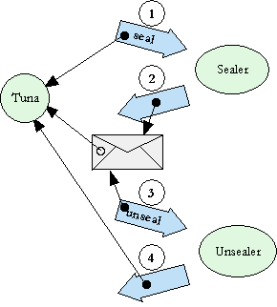
Rights Amplification
Inspired by PK
Simple oo pattern
No explicit crypto
Can represent responsible identity

Slide 8
Two-party intermediation

Slide 9
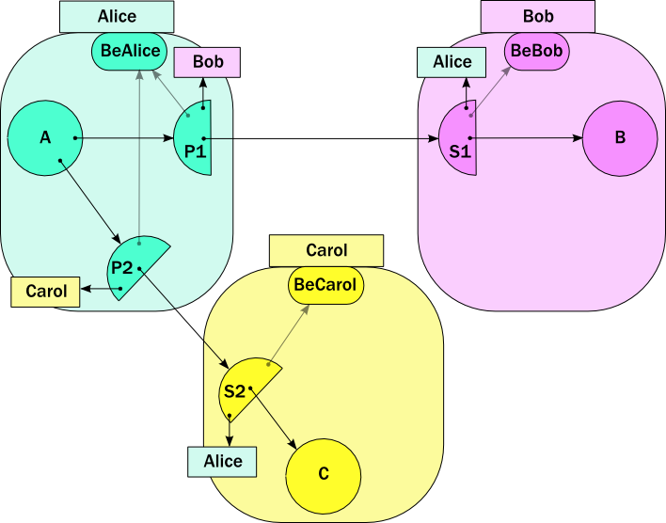

Slide 10
b.foo(c)

Slide 11


Slide 12
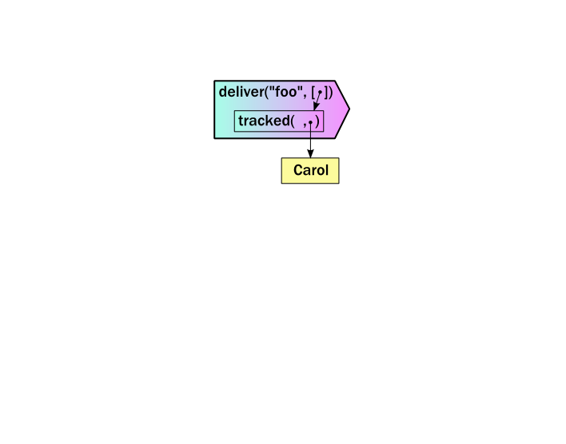
?

Slide 13
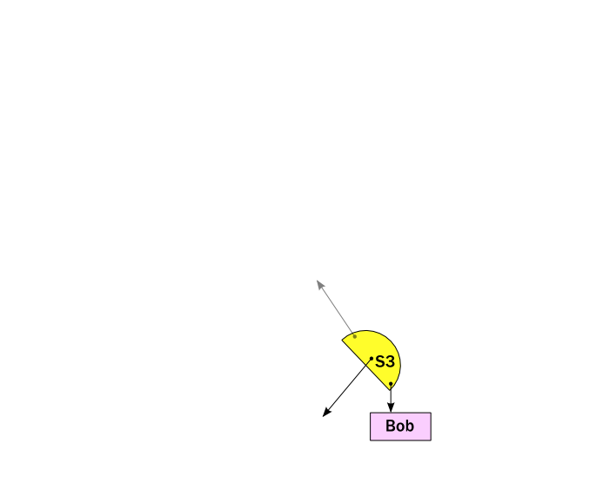
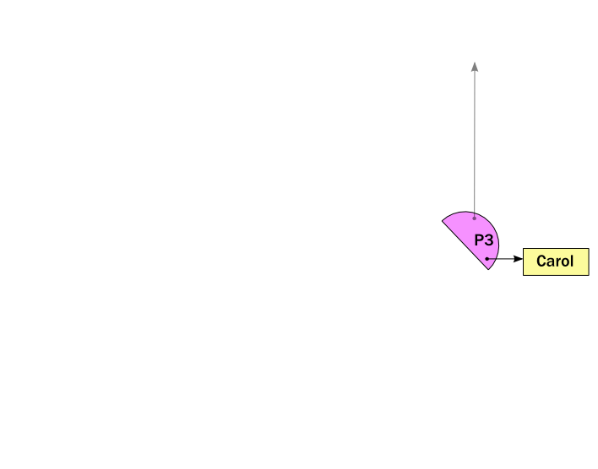

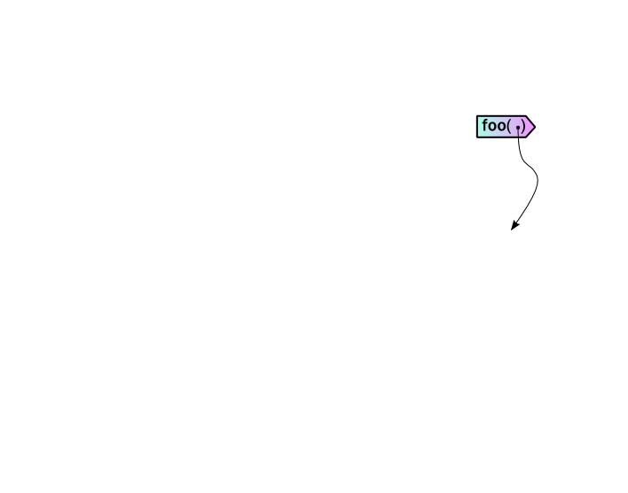

Slide 14
Three-party intermediation
with some steps skipped

Slide 16
s2.intro(..)

Slide 17
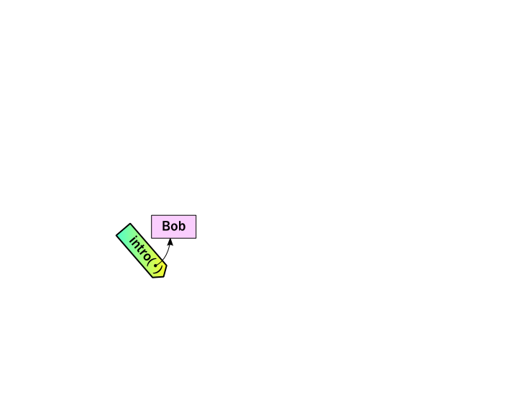
s2.intro(..)

Slide 18
s1.deliver(..)

Slide 20
makeStub(..)
return gift
wrap(s3)

Slide 21
makeStub(..)

Slide 22
wrap(s3,
whoBob,
beCarol)

Slide 23
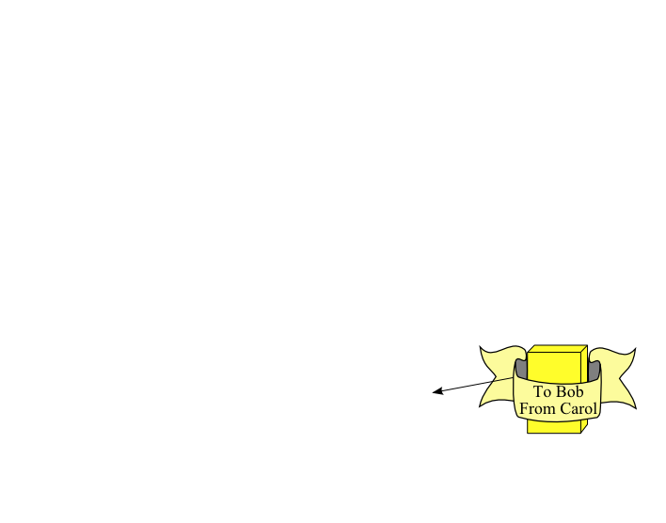
wrap(s3,
whoBob,
beCarol)

Slide 24
return gift

Slide 26
unwrap( ,
whoCarol,
beBob)

Slide 27
unwrap( ,
whoCarol,
beBob)

Slide 28
makeProxy(..)

Slide 29
makeProxy(..)

Slide 30
E.call(..)

Slide 32
The Full Story

Slide 33
wrap(s3,
whoBob,
beCarol)

Slide 34
pr
wrap(s3,
whoBob,
beCarol)

Slide 35
pr
wrap(s3,
whoBob,
beCarol)
seal( )

Slide 36
pr
wrap(s3,
whoBob,
beCarol)

Slide 37
pr
return gift

Slide 38
pr

Slide 39
unwrap( ,
whoCarol,
beBob)
pr

Slide 40
unwrap( ,
whoCarol,
beBob)
unseal( )
pr

Slide 41
unwrap( ,
whoCarol,
beBob)
pr

Slide 42
unwrap( ,
whoCarol,
beBob)
pr

Slide 43
unwrap( ,
whoCarol,
beBob)
seal( )
pr

Slide 44
unwrap( ,
whoCarol,
beBob)
pr

Slide 45
unwrap( ,
whoCarol,
beBob)
( )
pr

Slide 46
unwrap( ,
whoCarol,
beBob)
pr

Slide 47
unwrap( ,
whoCarol,
beBob)
pr

Slide 48
unwrap( ,
whoCarol,
beBob)
( )
pr

Slide 49
unwrap( ,
whoCarol,
beBob)

Slide 50
makeProxy(..)

Slide 51
makeProxy(..)

Slide 52
E.call(..)

