Slide 1
Horton’s Who Done It?
Communicating Authority with
Responsibility Tracking
Mark S. Miller Google Research¹
Jed Donnelley LBNL/NERSC
Alan H. Karp HP Labs
Usenix HotSec Workshop, August 7, 2007
¹Work done while at HP Labs
Notes:
My name is Jed Donnelley. I’m a computer scientist in the NERSC computer center at Berkeley Lab. I’ll be giving a brief introduction for our presentation today:
Horton’s Who Done it? Communicating Permissions with Responsibility Tracking.
I’m joined by the lead author of the Horton paper, Mark Miller now from Google Research and by our co-author Alan Karp from the virus safe computing group at Hewlett Packard.
This presentation is a ‘dry run’ for our presentation that will be given at about this time next week for the HotSec workshop that’s part of the Usenix Security Symposium in Boston.
We appreciate your role as our guinea pigs…

Slide 2
Communicating Object Access with Delegation
Alice
Bob
Alice
Alice
Doc Chapters:
Chapter 1
…
Chapter 1
…
Initial Conditions:
Alice has: 1. A capability to send to Bob and
2. A capability to a document with chapters.
Notes:
Horton shows that capabilities can support identity based access controls, tracking, and responsibility (logging and auditing).
What Horton does is to provide a reference implementation for support of responsibility for access by identity (delegation, logging for auditing, and even identity based access control) over any simple object/capability system. For this reference implementation we use an identity mechanism based on Sealer(who<identity>)/Unsealer(be<identity>) pairs. This object functionality provides much the same facility as a matching pair of a Public Key and Private key provide. If a running program has access to a who<identity>, it can “seal” parameters (e.g. data, capabilities) so that they can only be extracted from the resulting object (capability) by the corresponding Unsealer (be<identity>).
<simplify the diagram for this chart?>
In this diagram we have application level objects, A, B, and C initialized and controlled by mutually suspicious parties (e.g. people), Alice, Bob, and Carol, who have access to their be<identity> capabilities. Our people trust very restricted code (in this implementation the stubs that do the delegation) under their own control with their sensitive be<identity> capabilities. Much like with public keys, the who<identity> capabilities are more freely shared.
Fundamentally what Horton provides is a mechanism to label capabilities with an identity responsible for actions permitted by that capability. Such actions can be logged and even controlled (e.g. with permission revocation). Horton also provides for safe delegation between one party and another.
If A is acting on behalf of Alice and has a capability that is labeled as Alice’s responsibility (e.g. P2 in the above) and A also has a capability to communicate directly with an application level process, B, under the control of Bob, A can send over the P2 capability directly labeled as Alice’s responsibility. Doing so would allow B to access the ‘c’ object (supported by Carol and Carol’s responsibility) with the responsibility labeled as Alice’s. There are times when such direct communication of responsibility labeled capabilities is appropriate.
However, to support effective delegation Horton needs to provide a mechanism for safely communicating a capability from A to B in such a way as to transfer the responsibility of the capability from Alice to Bob. That is to ‘delegate’ the capability to Bob in the process of communicating it from A to B. In this process of course it’s important that A never get access to the capability labeled as Bob’s responsibility and that B never get access to the capability labeled as Alice’s responsibility. It is somewhat counter intuitive that doing so is even possible. Demonstrating that simple capability systems are capable of such delegation is an important contribution of this paper – suggesting that one of the few seemingly legitimate concerns about capability systems is also ill founded and that simple object/capability systems can support identities and responsible delegation of objects (capabilities). It is also helpful that such a mechanism can be implemented in a way that is transparent to the programs involved. A need not know that it’s capability is being delegated with responsibility tracking and B need not know that it received a capability that was delegated responsibly (with responsibility tracking).
<should we say something here about Carol’s responsibility for the service?>

Slide 3
Capability Communication of the Document Reference
Alice
Bob
Alice
here’s( )
Alice
Doc Chapters:
Chapter 1
…
Chapter 1
…
Alice sends a message to Bob containing
a reference to the document.
Notes:
Horton shows that capabilities can support identity based access controls, tracking, and responsibility (logging and auditing).
What Horton does is to provide a reference implementation for support of responsibility for access by identity (delegation, logging for auditing, and even identity based access control) over any simple object/capability system. For this reference implementation we use an identity mechanism based on Sealer(who<identity>)/Unsealer(be<identity>) pairs. This object functionality provides much the same facility as a matching pair of a Public Key and Private key provide. If a running program has access to a who<identity>, it can “seal” parameters (e.g. data, capabilities) so that they can only be extracted from the resulting object (capability) by the corresponding Unsealer (be<identity>).
<simplify the diagram for this chart?>
In this diagram we have application level objects, A, B, and C initialized and controlled by mutually suspicious parties (e.g. people), Alice, Bob, and Carol, who have access to their be<identity> capabilities. Our people trust very restricted code (in this implementation the stubs that do the delegation) under their own control with their sensitive be<identity> capabilities. Much like with public keys, the who<identity> capabilities are more freely shared.
Fundamentally what Horton provides is a mechanism to label capabilities with an identity responsible for actions permitted by that capability. Such actions can be logged and even controlled (e.g. with permission revocation). Horton also provides for safe delegation between one party and another.
If A is acting on behalf of Alice and has a capability that is labeled as Alice’s responsibility (e.g. P2 in the above) and A also has a capability to communicate directly with an application level process, B, under the control of Bob, A can send over the P2 capability directly labeled as Alice’s responsibility. Doing so would allow B to access the ‘c’ object (supported by Carol and Carol’s responsibility) with the responsibility labeled as Alice’s. There are times when such direct communication of responsibility labeled capabilities is appropriate.
However, to support effective delegation Horton needs to provide a mechanism for safely communicating a capability from A to B in such a way as to transfer the responsibility of the capability from Alice to Bob. That is to ‘delegate’ the capability to Bob in the process of communicating it from A to B. In this process of course it’s important that A never get access to the capability labeled as Bob’s responsibility and that B never get access to the capability labeled as Alice’s responsibility. It is somewhat counter intuitive that doing so is even possible. Demonstrating that simple capability systems are capable of such delegation is an important contribution of this paper – suggesting that one of the few seemingly legitimate concerns about capability systems is also ill founded and that simple object/capability systems can support identities and responsible delegation of objects (capabilities). It is also helpful that such a mechanism can be implemented in a way that is transparent to the programs involved. A need not know that it’s capability is being delegated with responsibility tracking and B need not know that it received a capability that was delegated responsibly (with responsibility tracking).
<should we say something here about Carol’s responsibility for the service?>

Slide 4
Horton Magic: Bob Receives a Delegated Capability
Alice
Bob
Alice
Alice
Alice->Bob
Doc Chapters:
Chapter 1
…
Chapter 1
…
Alice can’t act with Bob’s responsibility
Bob can’t act with Alice’s responsibility
Notes:
Horton shows that capabilities can support identity based access controls, tracking, and responsibility (logging and auditing).
What Horton does is to provide a reference implementation for support of responsibility for access by identity (delegation, logging for auditing, and even identity based access control) over any simple object/capability system. For this reference implementation we use an identity mechanism based on Sealer(who<identity>)/Unsealer(be<identity>) pairs. This object functionality provides much the same facility as a matching pair of a Public Key and Private key provide. If a running program has access to a who<identity>, it can “seal” parameters (e.g. data, capabilities) so that they can only be extracted from the resulting object (capability) by the corresponding Unsealer (be<identity>).
<simplify the diagram for this chart?>
In this diagram we have application level objects, A, B, and C initialized and controlled by mutually suspicious parties (e.g. people), Alice, Bob, and Carol, who have access to their be<identity> capabilities. Our people trust very restricted code (in this implementation the stubs that do the delegation) under their own control with their sensitive be<identity> capabilities. Much like with public keys, the who<identity> capabilities are more freely shared.
Fundamentally what Horton provides is a mechanism to label capabilities with an identity responsible for actions permitted by that capability. Such actions can be logged and even controlled (e.g. with permission revocation). Horton also provides for safe delegation between one party and another.
If A is acting on behalf of Alice and has a capability that is labeled as Alice’s responsibility (e.g. P2 in the above) and A also has a capability to communicate directly with an application level process, B, under the control of Bob, A can send over the P2 capability directly labeled as Alice’s responsibility. Doing so would allow B to access the ‘c’ object (supported by Carol and Carol’s responsibility) with the responsibility labeled as Alice’s. There are times when such direct communication of responsibility labeled capabilities is appropriate.
However, to support effective delegation Horton needs to provide a mechanism for safely communicating a capability from A to B in such a way as to transfer the responsibility of the capability from Alice to Bob. That is to ‘delegate’ the capability to Bob in the process of communicating it from A to B. In this process of course it’s important that A never get access to the capability labeled as Bob’s responsibility and that B never get access to the capability labeled as Alice’s responsibility. It is somewhat counter intuitive that doing so is even possible. Demonstrating that simple capability systems are capable of such delegation is an important contribution of this paper – suggesting that one of the few seemingly legitimate concerns about capability systems is also ill founded and that simple object/capability systems can support identities and responsible delegation of objects (capabilities). It is also helpful that such a mechanism can be implemented in a way that is transparent to the programs involved. A need not know that it’s capability is being delegated with responsibility tracking and B need not know that it received a capability that was delegated responsibly (with responsibility tracking).
<should we say something here about Carol’s responsibility for the service?>

Slide 5
Delegating Least Authority
A
B
C
Notes:
Horton shows that capabilities can support identity based access controls, tracking, and responsibility (logging and auditing).
What Horton does is to provide a reference implementation for support of responsibility for access by identity (delegation, logging for auditing, and even identity based access control) over any simple object/capability system. For this reference implementation we use an identity mechanism based on Sealer(who<identity>)/Unsealer(be<identity>) pairs. This object functionality provides much the same facility as a matching pair of a Public Key and Private key provide. If a running program has access to a who<identity>, it can “seal” parameters (e.g. data, capabilities) so that they can only be extracted from the resulting object (capability) by the corresponding Unsealer (be<identity>).
<simplify the diagram for this chart?>
In this diagram we have application level objects, A, B, and C initialized and controlled by mutually suspicious parties (e.g. people), Alice, Bob, and Carol, who have access to their be<identity> capabilities. Our people trust very restricted code (in this implementation the stubs that do the delegation) under their own control with their sensitive be<identity> capabilities. Much like with public keys, the who<identity> capabilities are more freely shared.
Fundamentally what Horton provides is a mechanism to label capabilities with an identity responsible for actions permitted by that capability. Such actions can be logged and even controlled (e.g. with permission revocation). Horton also provides for safe delegation between one party and another.
If A is acting on behalf of Alice and has a capability that is labeled as Alice’s responsibility (e.g. P2 in the above) and A also has a capability to communicate directly with an application level process, B, under the control of Bob, A can send over the P2 capability directly labeled as Alice’s responsibility. Doing so would allow B to access the ‘c’ object (supported by Carol and Carol’s responsibility) with the responsibility labeled as Alice’s. There are times when such direct communication of responsibility labeled capabilities is appropriate.
However, to support effective delegation Horton needs to provide a mechanism for safely communicating a capability from A to B in such a way as to transfer the responsibility of the capability from Alice to Bob. That is to ‘delegate’ the capability to Bob in the process of communicating it from A to B. In this process of course it’s important that A never get access to the capability labeled as Bob’s responsibility and that B never get access to the capability labeled as Alice’s responsibility. It is somewhat counter intuitive that doing so is even possible. Demonstrating that simple capability systems are capable of such delegation is an important contribution of this paper – suggesting that one of the few seemingly legitimate concerns about capability systems is also ill founded and that simple object/capability systems can support identities and responsible delegation of objects (capabilities). It is also helpful that such a mechanism can be implemented in a way that is transparent to the programs involved. A need not know that it’s capability is being delegated with responsibility tracking and B need not know that it received a capability that was delegated responsibly (with responsibility tracking).
<should we say something here about Carol’s responsibility for the service?>

Slide 6
Delegating Least Authority
b.foo(c)
A
B
C
Notes:
Horton shows that capabilities can support identity based access controls, tracking, and responsibility (logging and auditing).
What Horton does is to provide a reference implementation for support of responsibility for access by identity (delegation, logging for auditing, and even identity based access control) over any simple object/capability system. For this reference implementation we use an identity mechanism based on Sealer(who<identity>)/Unsealer(be<identity>) pairs. This object functionality provides much the same facility as a matching pair of a Public Key and Private key provide. If a running program has access to a who<identity>, it can “seal” parameters (e.g. data, capabilities) so that they can only be extracted from the resulting object (capability) by the corresponding Unsealer (be<identity>).
<simplify the diagram for this chart?>
In this diagram we have application level objects, A, B, and C initialized and controlled by mutually suspicious parties (e.g. people), Alice, Bob, and Carol, who have access to their be<identity> capabilities. Our people trust very restricted code (in this implementation the stubs that do the delegation) under their own control with their sensitive be<identity> capabilities. Much like with public keys, the who<identity> capabilities are more freely shared.
Fundamentally what Horton provides is a mechanism to label capabilities with an identity responsible for actions permitted by that capability. Such actions can be logged and even controlled (e.g. with permission revocation). Horton also provides for safe delegation between one party and another.
If A is acting on behalf of Alice and has a capability that is labeled as Alice’s responsibility (e.g. P2 in the above) and A also has a capability to communicate directly with an application level process, B, under the control of Bob, A can send over the P2 capability directly labeled as Alice’s responsibility. Doing so would allow B to access the ‘c’ object (supported by Carol and Carol’s responsibility) with the responsibility labeled as Alice’s. There are times when such direct communication of responsibility labeled capabilities is appropriate.
However, to support effective delegation Horton needs to provide a mechanism for safely communicating a capability from A to B in such a way as to transfer the responsibility of the capability from Alice to Bob. That is to ‘delegate’ the capability to Bob in the process of communicating it from A to B. In this process of course it’s important that A never get access to the capability labeled as Bob’s responsibility and that B never get access to the capability labeled as Alice’s responsibility. It is somewhat counter intuitive that doing so is even possible. Demonstrating that simple capability systems are capable of such delegation is an important contribution of this paper – suggesting that one of the few seemingly legitimate concerns about capability systems is also ill founded and that simple object/capability systems can support identities and responsible delegation of objects (capabilities). It is also helpful that such a mechanism can be implemented in a way that is transparent to the programs involved. A need not know that it’s capability is being delegated with responsibility tracking and B need not know that it received a capability that was delegated responsibly (with responsibility tracking).
<should we say something here about Carol’s responsibility for the service?>

Slide 7
Delegating Least Authority
A
B
foo( )
C
Notes:
Horton shows that capabilities can support identity based access controls, tracking, and responsibility (logging and auditing).
What Horton does is to provide a reference implementation for support of responsibility for access by identity (delegation, logging for auditing, and even identity based access control) over any simple object/capability system. For this reference implementation we use an identity mechanism based on Sealer(who<identity>)/Unsealer(be<identity>) pairs. This object functionality provides much the same facility as a matching pair of a Public Key and Private key provide. If a running program has access to a who<identity>, it can “seal” parameters (e.g. data, capabilities) so that they can only be extracted from the resulting object (capability) by the corresponding Unsealer (be<identity>).
<simplify the diagram for this chart?>
In this diagram we have application level objects, A, B, and C initialized and controlled by mutually suspicious parties (e.g. people), Alice, Bob, and Carol, who have access to their be<identity> capabilities. Our people trust very restricted code (in this implementation the stubs that do the delegation) under their own control with their sensitive be<identity> capabilities. Much like with public keys, the who<identity> capabilities are more freely shared.
Fundamentally what Horton provides is a mechanism to label capabilities with an identity responsible for actions permitted by that capability. Such actions can be logged and even controlled (e.g. with permission revocation). Horton also provides for safe delegation between one party and another.
If A is acting on behalf of Alice and has a capability that is labeled as Alice’s responsibility (e.g. P2 in the above) and A also has a capability to communicate directly with an application level process, B, under the control of Bob, A can send over the P2 capability directly labeled as Alice’s responsibility. Doing so would allow B to access the ‘c’ object (supported by Carol and Carol’s responsibility) with the responsibility labeled as Alice’s. There are times when such direct communication of responsibility labeled capabilities is appropriate.
However, to support effective delegation Horton needs to provide a mechanism for safely communicating a capability from A to B in such a way as to transfer the responsibility of the capability from Alice to Bob. That is to ‘delegate’ the capability to Bob in the process of communicating it from A to B. In this process of course it’s important that A never get access to the capability labeled as Bob’s responsibility and that B never get access to the capability labeled as Alice’s responsibility. It is somewhat counter intuitive that doing so is even possible. Demonstrating that simple capability systems are capable of such delegation is an important contribution of this paper – suggesting that one of the few seemingly legitimate concerns about capability systems is also ill founded and that simple object/capability systems can support identities and responsible delegation of objects (capabilities). It is also helpful that such a mechanism can be implemented in a way that is transparent to the programs involved. A need not know that it’s capability is being delegated with responsibility tracking and B need not know that it received a capability that was delegated responsibly (with responsibility tracking).
<should we say something here about Carol’s responsibility for the service?>

Slide 8
Delegating Least Authority
A
B
C
Notes:
Horton shows that capabilities can support identity based access controls, tracking, and responsibility (logging and auditing).
What Horton does is to provide a reference implementation for support of responsibility for access by identity (delegation, logging for auditing, and even identity based access control) over any simple object/capability system. For this reference implementation we use an identity mechanism based on Sealer(who<identity>)/Unsealer(be<identity>) pairs. This object functionality provides much the same facility as a matching pair of a Public Key and Private key provide. If a running program has access to a who<identity>, it can “seal” parameters (e.g. data, capabilities) so that they can only be extracted from the resulting object (capability) by the corresponding Unsealer (be<identity>).
<simplify the diagram for this chart?>
In this diagram we have application level objects, A, B, and C initialized and controlled by mutually suspicious parties (e.g. people), Alice, Bob, and Carol, who have access to their be<identity> capabilities. Our people trust very restricted code (in this implementation the stubs that do the delegation) under their own control with their sensitive be<identity> capabilities. Much like with public keys, the who<identity> capabilities are more freely shared.
Fundamentally what Horton provides is a mechanism to label capabilities with an identity responsible for actions permitted by that capability. Such actions can be logged and even controlled (e.g. with permission revocation). Horton also provides for safe delegation between one party and another.
If A is acting on behalf of Alice and has a capability that is labeled as Alice’s responsibility (e.g. P2 in the above) and A also has a capability to communicate directly with an application level process, B, under the control of Bob, A can send over the P2 capability directly labeled as Alice’s responsibility. Doing so would allow B to access the ‘c’ object (supported by Carol and Carol’s responsibility) with the responsibility labeled as Alice’s. There are times when such direct communication of responsibility labeled capabilities is appropriate.
However, to support effective delegation Horton needs to provide a mechanism for safely communicating a capability from A to B in such a way as to transfer the responsibility of the capability from Alice to Bob. That is to ‘delegate’ the capability to Bob in the process of communicating it from A to B. In this process of course it’s important that A never get access to the capability labeled as Bob’s responsibility and that B never get access to the capability labeled as Alice’s responsibility. It is somewhat counter intuitive that doing so is even possible. Demonstrating that simple capability systems are capable of such delegation is an important contribution of this paper – suggesting that one of the few seemingly legitimate concerns about capability systems is also ill founded and that simple object/capability systems can support identities and responsible delegation of objects (capabilities). It is also helpful that such a mechanism can be implemented in a way that is transparent to the programs involved. A need not know that it’s capability is being delegated with responsibility tracking and B need not know that it received a capability that was delegated responsibly (with responsibility tracking).
<should we say something here about Carol’s responsibility for the service?>

Slide 9
Delegating Least Authority
Msgs are only means to cause effects
Refs control authority
Leverage OO patterns
A
B
C
Notes:
Horton shows that capabilities can support identity based access controls, tracking, and responsibility (logging and auditing).
What Horton does is to provide a reference implementation for support of responsibility for access by identity (delegation, logging for auditing, and even identity based access control) over any simple object/capability system. For this reference implementation we use an identity mechanism based on Sealer(who<identity>)/Unsealer(be<identity>) pairs. This object functionality provides much the same facility as a matching pair of a Public Key and Private key provide. If a running program has access to a who<identity>, it can “seal” parameters (e.g. data, capabilities) so that they can only be extracted from the resulting object (capability) by the corresponding Unsealer (be<identity>).
<simplify the diagram for this chart?>
In this diagram we have application level objects, A, B, and C initialized and controlled by mutually suspicious parties (e.g. people), Alice, Bob, and Carol, who have access to their be<identity> capabilities. Our people trust very restricted code (in this implementation the stubs that do the delegation) under their own control with their sensitive be<identity> capabilities. Much like with public keys, the who<identity> capabilities are more freely shared.
Fundamentally what Horton provides is a mechanism to label capabilities with an identity responsible for actions permitted by that capability. Such actions can be logged and even controlled (e.g. with permission revocation). Horton also provides for safe delegation between one party and another.
If A is acting on behalf of Alice and has a capability that is labeled as Alice’s responsibility (e.g. P2 in the above) and A also has a capability to communicate directly with an application level process, B, under the control of Bob, A can send over the P2 capability directly labeled as Alice’s responsibility. Doing so would allow B to access the ‘c’ object (supported by Carol and Carol’s responsibility) with the responsibility labeled as Alice’s. There are times when such direct communication of responsibility labeled capabilities is appropriate.
However, to support effective delegation Horton needs to provide a mechanism for safely communicating a capability from A to B in such a way as to transfer the responsibility of the capability from Alice to Bob. That is to ‘delegate’ the capability to Bob in the process of communicating it from A to B. In this process of course it’s important that A never get access to the capability labeled as Bob’s responsibility and that B never get access to the capability labeled as Alice’s responsibility. It is somewhat counter intuitive that doing so is even possible. Demonstrating that simple capability systems are capable of such delegation is an important contribution of this paper – suggesting that one of the few seemingly legitimate concerns about capability systems is also ill founded and that simple object/capability systems can support identities and responsible delegation of objects (capabilities). It is also helpful that such a mechanism can be implemented in a way that is transparent to the programs involved. A need not know that it’s capability is being delegated with responsibility tracking and B need not know that it received a capability that was delegated responsibly (with responsibility tracking).
<should we say something here about Carol’s responsibility for the service?>

Slide 10
Delegating Least Authority
Msgs are only means to cause effects
Refs control authority
Leverage OO patterns
Anonymous
A
B
C
Notes:
Horton shows that capabilities can support identity based access controls, tracking, and responsibility (logging and auditing).
What Horton does is to provide a reference implementation for support of responsibility for access by identity (delegation, logging for auditing, and even identity based access control) over any simple object/capability system. For this reference implementation we use an identity mechanism based on Sealer(who<identity>)/Unsealer(be<identity>) pairs. This object functionality provides much the same facility as a matching pair of a Public Key and Private key provide. If a running program has access to a who<identity>, it can “seal” parameters (e.g. data, capabilities) so that they can only be extracted from the resulting object (capability) by the corresponding Unsealer (be<identity>).
<simplify the diagram for this chart?>
In this diagram we have application level objects, A, B, and C initialized and controlled by mutually suspicious parties (e.g. people), Alice, Bob, and Carol, who have access to their be<identity> capabilities. Our people trust very restricted code (in this implementation the stubs that do the delegation) under their own control with their sensitive be<identity> capabilities. Much like with public keys, the who<identity> capabilities are more freely shared.
Fundamentally what Horton provides is a mechanism to label capabilities with an identity responsible for actions permitted by that capability. Such actions can be logged and even controlled (e.g. with permission revocation). Horton also provides for safe delegation between one party and another.
If A is acting on behalf of Alice and has a capability that is labeled as Alice’s responsibility (e.g. P2 in the above) and A also has a capability to communicate directly with an application level process, B, under the control of Bob, A can send over the P2 capability directly labeled as Alice’s responsibility. Doing so would allow B to access the ‘c’ object (supported by Carol and Carol’s responsibility) with the responsibility labeled as Alice’s. There are times when such direct communication of responsibility labeled capabilities is appropriate.
However, to support effective delegation Horton needs to provide a mechanism for safely communicating a capability from A to B in such a way as to transfer the responsibility of the capability from Alice to Bob. That is to ‘delegate’ the capability to Bob in the process of communicating it from A to B. In this process of course it’s important that A never get access to the capability labeled as Bob’s responsibility and that B never get access to the capability labeled as Alice’s responsibility. It is somewhat counter intuitive that doing so is even possible. Demonstrating that simple capability systems are capable of such delegation is an important contribution of this paper – suggesting that one of the few seemingly legitimate concerns about capability systems is also ill founded and that simple object/capability systems can support identities and responsible delegation of objects (capabilities). It is also helpful that such a mechanism can be implemented in a way that is transparent to the programs involved. A need not know that it’s capability is being delegated with responsibility tracking and B need not know that it received a capability that was delegated responsibly (with responsibility tracking).
<should we say something here about Carol’s responsibility for the service?>

Slide 11
Two styles, relative strengths
Program decisions
Fine-grained
Built for safety
Least authority
Virus resistant
Authorization-based
Object-capabilities (ocaps)
Human decisions
Large-grained
Built for damage control
Most responsibility
Spam resistant
Identity-based
ACLs
?

Slide 12
Two styles, relative strengths
Program decisions
Fine-grained
Built for safety
Least authority
Virus resistant
Authorization-based
Object-capabilities (ocaps)
Human decisions
Large-grained
Built for damage control
Most responsibility
Spam resistant
Identity-based
ACLs
Polaris, Plash
Bitfrost?

Slide 13
Two styles, relative strengths
Program decisions
Fine-grained
Built for safety
Least authority
Virus resistant
Authorization-based
Object-capabilities (ocaps)
Human decisions
Large-grained
Built for damage control
Most responsibility
Spam resistant
Identity-based
ACLs
+
“Hybrid” Cap Systems (SCAP, Sys/38)

Slide 14
Two styles, relative strengths
Program decisions
Fine-grained
Built for safety
Least authority
Virus resistant
Authorization-based
Object-capabilities (ocaps)
Human decisions
Large-grained
Built for damage control
Most responsibility
Spam resistant
Identity-based
ACLs
?

Slide 15
Two styles, relative strengths
Program decisions
Fine-grained
Built for safety
Least authority
Virus resistant
Authorization-based
Object-capabilities (ocaps)
Human decisions
Large-grained
Built for damage control
Most responsibility
Spam resistant
Identity-based
ACLs
Horton

Slide 16
Alice
Can’t vet code or actions of each object.

Slide 17
Alice
Can’t vet code or actions of each object.

Slide 18
Alice
Can’t vet code or actions of each object.

Slide 19
Alice
Can’t vet code or actions of each object.

Slide 20
Alice
Can’t vet code or actions of each object.

Slide 21
Alice
Can’t vet code or actions of each object.

Slide 22
Alice
Can’t vet code or actions of each object.

Slide 23
Alice
Can’t vet code or actions of each object.

Slide 24
Alice
Can’t vet code or actions of each object.

Slide 25
Alice
Can’t vet code or actions of each object.
Aggregate into long-lived responsible identity.
A

Slide 26
Story Needs Four Characters
Alice & Bob
  Old patterns for identity-based control: identity tunnel
Alice introduces Bob & Carol
  Builds new relationships from old
Carol also hears of Bob from Dave
  Corroborates Bob’s independence from Alice

Slide 27
Two-party intermediation
A message travels through an
identity tunnel

Slide 28
Alice
Bob
Bob
Alice
A
B

Slide 29
Alice
Bob
b.foo()
Bob
Alice
A
B

Slide 30
Alice
Bob
Bob
Alice
A
B
foo()

Slide 31
Do I still use
Bob’s services?
Alice
Bob
Bob
Alice
A
B
foo()

Slide 32
Bob, deliver
to B
Alice
foo()
Bob
Bob
Alice
A
B

Slide 33
Alice
Bob
Bob
Alice
A
B
deliver(“foo”,[])

Slide 34
Do I still honor
Alice’s requests?
Alice
Bob
Bob
Alice
A
B
foo()

Slide 35
Deliver to
B for Alice
foo()
Alice
Bob
Bob
Alice
A
B

Slide 36
Alice
Bob
Bob
Alice
A
B
foo()

Slide 37
Alice
Bob
A
B

Slide 38
Three-party intermediation
Build new relationships from old

Slide 39
Alice
Bob
A
B
C
Carol

Slide 40
b.foo(c)
Alice
Bob
A
B
C
Carol

Slide 41
Alice
Bob
A
B
foo( )
C
Carol

Slide 42
Carol, please provide Bob access to C
Alice
Bob
A
B
foo( )
Bob
intro( )
C
Carol

Slide 43
Carol, please provide Bob access to C
Alice
Bob
A
B
foo( )
Alice needs
tunnel for Bob
Bob
intro( )
C
Carol

Slide 44
Carol, please provide Bob access to C
Alice
Bob
A
B
foo( )
Gift wrap it
for Bob
Bob
intro( )
C
Carol

Slide 45
Carol, please provide Bob access to C
Alice
Bob
A
B
foo( )
Gift wrap it
for Bob
Bob
intro( )
To Bob
From Carol
C
Carol

Slide 46
Carol, please provide Bob access to C
Alice
Bob
A
B
foo( )
return Bob’s
gift
Bob
intro( )
To Bob
From Carol
C
Carol

Slide 47
Bob, deliver “fo__ to B with Carol’s ( )
foo( )
Alice
Bob
A
B
To Bob
From Carol
C
Carol

Slide 48
Alice
Bob
A
B
deliver(“foo”,[[ , ]])
Carol
To Bob
From Carol
C
Carol

Slide 49
Unwrap Carol’s
gift from Alice
Alice
Bob
A
B
deliver(“foo”,[[ , ]])
Carol
To Bob
From Carol
C
Carol

Slide 50
Unwrap Carol’s
gift from Alice
Alice
Bob
A
B
foo( )
C
Carol

Slide 51
Alice
Bob
A
B
foo( )
C
Carol

Slide 52
Alice
Bob
A
B
C
Carol

Slide 53
Alice
Bob
A
B
Is Bob a pseudonym
for Alice?
C
Carol

Slide 54
Four party intermediation
Only corroborating introductions
let Alice shed blame

Slide 55
Alice
Bob
A
B
Bob
C
D
Carol
Dave

Slide 56
Better Identities than ACLs
Fully decentralized
  No global administrator or name server
Track bilateral responsibility
  For requests and for service
  Also tracks delegation chain
Sybil resistant aggregation strategy
Corroboration-driven disaggregation

Slide 57
Conclusions
Delegate authority, bound to responsibility for using that authority.
Fine-grain least authority for safety.
Large-grain identities for damage control.
Reference implementations in Java & E:
http://erights.org/download/horton/

Slide 59
Three-party intermediation
The details

Slide 60
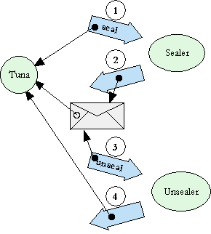
Rights Amplification
Inspired by PK
Simple oo pattern
No explicit crypto
Can represent responsible identity

Slide 61
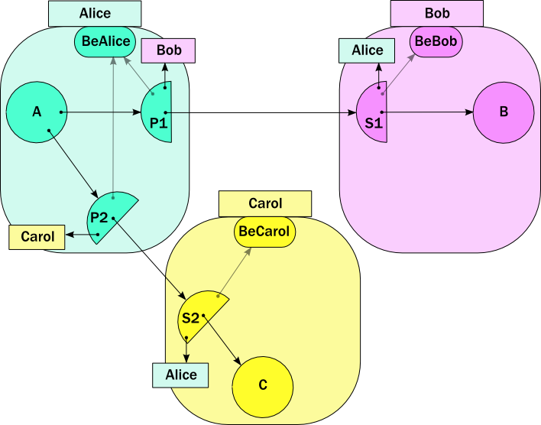

Slide 62
b.foo(c)

Slide 63


Slide 64
Carol, please provide Bob access to C

Slide 65
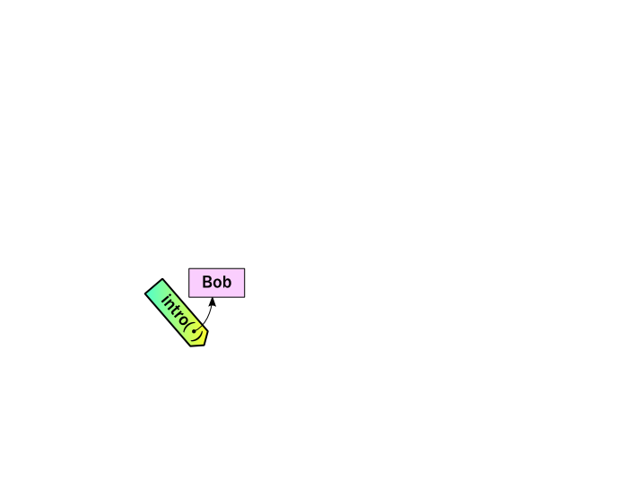
Carol, please provide Bob access to C

Slide 66
Bob, please use Carol’s C

Slide 67
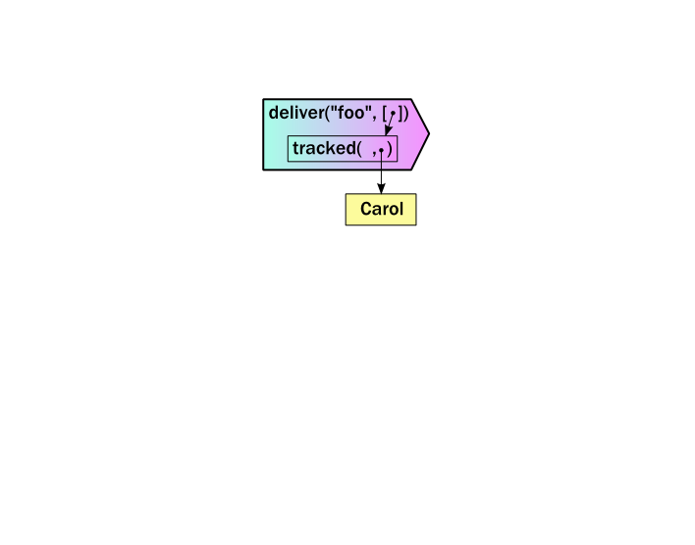

Slide 68
Make a stub for Bob’s use

Slide 69
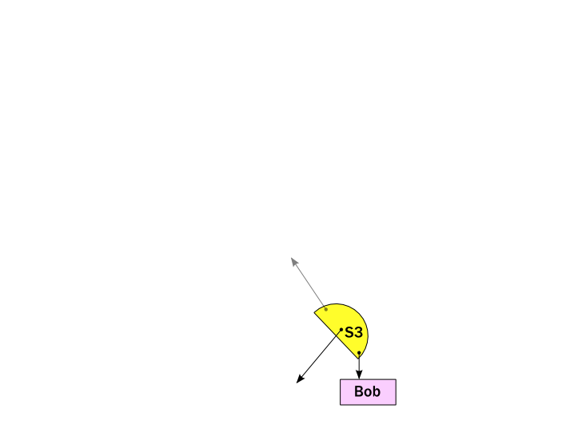
Make a stub for Bob’s use

Slide 70
Gift wrap it for Bob

Slide 71
wrap(s3,
whoBob,
beCarol)

Slide 72
pr
wrap(s3,
whoBob,
beCarol)

Slide 73
pr
wrap(s3,
whoBob,
beCarol)
seal( )

Slide 74
pr
wrap(s3,
whoBob,
beCarol)

Slide 75
pr
return gift

Slide 76
pr

Slide 77
unwrap( ,
whoCarol,
beBob)
pr

Slide 78
unwrap( ,
whoCarol,
beBob)
unseal( )
pr

Slide 79
unwrap( ,
whoCarol,
beBob)
pr

Slide 80
unwrap( ,
whoCarol,
beBob)
pr

Slide 81
unwrap( ,
whoCarol,
beBob)
seal( )
pr

Slide 82
unwrap( ,
whoCarol,
beBob)
pr

Slide 83
unwrap( ,
whoCarol,
beBob)
( )
pr

Slide 84
unwrap( ,
whoCarol,
beBob)
pr

Slide 85
unwrap( ,
whoCarol,
beBob)
pr

Slide 86
unwrap( ,
whoCarol,
beBob)
( )
pr

Slide 87

unwrap( ,
whoCarol,
beBob)

Slide 88
makeProxy(..)

Slide 89
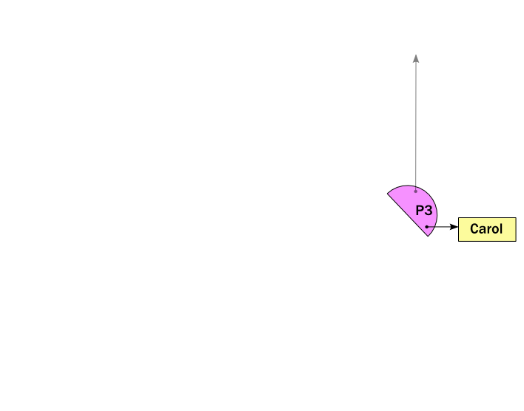
makeProxy(..)

Slide 90
E.call(..)

Slide 91
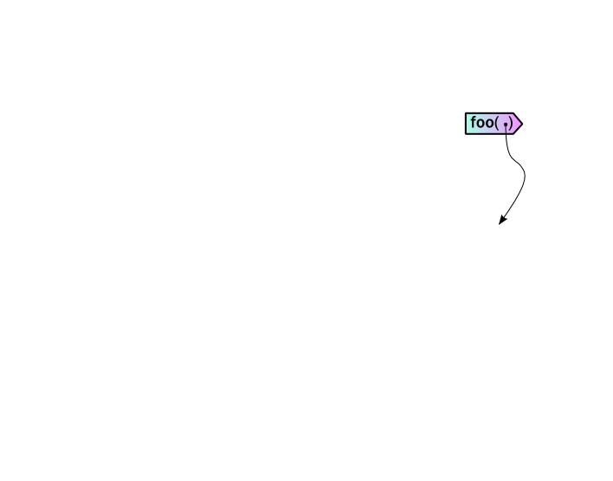

Slide 92
Alice
Bob
A
B
C
D
Carol
Dave

Slide 93
Bob
B
C
D
Carol
Dave

Slide 94
Bob
B
C
D
Carol
Dave

Slide 95
CapWiki with attribution

Slide 96
The Web: Good, Bad, and Ugly:
Good: Internet hypertext, wonderful!
Bad: Username/passwords for every site that has any sort of access control.
Ugly: Hard to share limited access to network objects. Hard to combine network objects with access restrictions.
Notes:
We’ve done this work because we believe that only by providing for communication of permissions can we effectively combine computer services.
Communicating permissions provides the benefits noted here for combining computer services:
If we’re communicating permissions, there’s no reason to communicate more permissions than needed. We naturally achieve Principle Of Least Authority sharing and avoid excess authority.
A communicated permissions come with an explicit source, so our services know where their permissions came from. We can avoid confused deputies.
Bundling a designation with a permission eliminates potentially confusing situations where we could have an object named without permission to access it or have permission to access it without having it named.
By using communicable permission parameters we can naturally support confinement. Namely we only need to permit communication to the services that support our communicated permissions.

Slide 97
Alice’s Domain
Sends:
BobSend
EveSend
IvanSend

Slide 98
Alice’s Domain
Sends:
BobSend
EveSend
IvanSend
CapWiki:
CapWiki Stuff:
Concepts
Finances
Other
Alice’s
CapWiki
Finances:
Investor
Market

Slide 99
Alice’s Domain
Bob’s Domain
Sends:
BobSend
EveSend
IvanSend
CapWiki:
CapWiki Stuff:
Concepts
Finances
Other
Receives:
AliceReceive
Sends:
AliceSend
DaveSend
Alice’s
CapWiki
Finances:
Investor
Market

Slide 100
Alice’s Domain
Bob’s Domain
Sends:
BobSend
EveSend
IvanSend
CapWiki:
CapWiki Stuff:
Concepts
Finances
Other
Receives:
*AliceReceive
Sends:
AliceSend
DaveSend
Alice’s
CapWiki
Finances:
Investor
Market

Slide 101
Alice’s Domain
Bob’s Domain
Sends:
BobSend
EveSend
IvanSend
CapWiki:
CapWiki Stuff:
Concepts
Finances
Other
Alice Bob
Receives:
AliceReceive
Sends:
AliceSend
DaveSend
Alice’s
CapWiki
Finances:
Investor
Market

Slide 102
Alice’s Domain
Bob’s Domain
Sends:
BobSend
EveSend
IvanSend
CapWiki:
CapWiki Stuff:
Concepts
Finances
Other
Alice Bob
Receives:
AliceReceive
Sends:
AliceSend
DaveSend
Alice’s
CapWiki
Finances:
Investor
Market
Alice Bob

Slide 103
Alice’s Domain
Bob’s Domain
Sends:
BobSend
EveSend
IvanSend
CapWiki:
CapWiki Stuff:
Concepts
Finances
Other
Alice Bob
Receives:
AliceReceive
Sends:
AliceSend
DaveSend
Alice’s
Bob’s
CapWiki
Finances:
Investor
Market
Here are the
CapWiki:
Finances
Dave
Alice Bob
Receives:
BobReceive
Daves’s Domain

Slide 104
Alice’s Domain
Bob’s Domain
Sends:
BobSend
EveSend
IvanSend
CapWiki:
CapWiki Stuff:
Concepts
Finances
Other
Alice Bob
Receives:
AliceReceive
Sends:
AliceSend
DaveSend
Alice’s
Bob’s
CapWiki
Finances:
Investor
Market
Here are the
CapWiki:
Finances
Dave
Alice Bob
Receives:
* BobReceive
Daves’s Domain

Slide 105
Alice’s Domain
Bob’s Domain
Sends:
BobSend
EveSend
IvanSend
CapWiki:
CapWiki Stuff:
Concepts
Finances
Other
Alice Bob
Receives:
AliceReceive
Sends:
AliceSend
DaveSend
Alice’s
Bob’s
CapWiki
Finances:
Investor
Market
Here are the
CapWiki:
Finances
Dave
Alice Bob
Bob Dave
Daves’s Domain
Receives:
BobReceive

Slide 106
Alice’s Domain
Bob’s Domain
Sends:
BobSend
EveSend
IvanSend
CapWiki:
CapWiki Stuff:
Concepts
Finances
Other
Alice Bob
Receives:
*AliceReceive
Sends:
AliceSend
DaveSend
Alice’s
Bob’s
CapWiki
Finances:
Investor
Market
Here are the
CapWiki:
Finances
Dave
Alice Bob
Alice Bob Dave
Bob Dave
Daves’s Domain
Receives:
BobReceive

Slide 107
Better Web Access Control
No more passwords – Send a <me>Send to a <service>Send. They know who you are, you know who they are.
Side benefit – SPAM resistance. Don’t like a source of SPAM, cut it off to any delegation level.
Principle Of Least Authority (POLA) sharing that can facilitate cross site services.

Slide 108
Alice
Bob
A
B
Is Carol a pseudonym
for Alice?
C
Carol

Slide 109
Alice
Bob
A
B
C
Carol

Slide 110
Alice
Bob
A
B
C
D
Carol
Dave

Slide 111
Alice
Bob
A
B
bar( )
C
D
Carol
Dave

Slide 112
Alice
Bob
A
B
C
D
Carol
Dave

Slide 113
Alice
Bob
A
B
Carol
Bob
C
D
Carol
Dave

