Slide 1
Horton’s Who Done It?
Higher-Order Responsibility Tracking of Objects in Networks

Slide 2
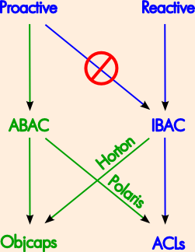
The Dilemma
For IBAC to be
effective reactively,
must stop using it
proactively.
ABAC better for proactive
control anyway.
How to get best of both?

Slide 3
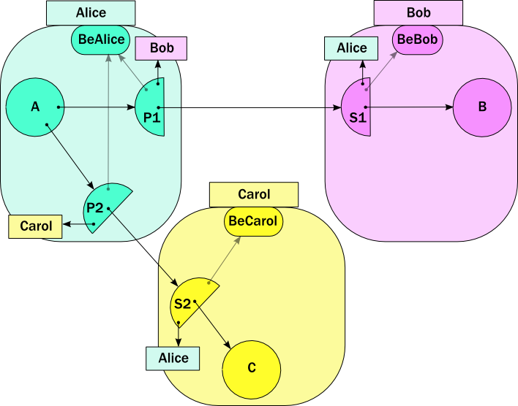

Slide 4
b.foo(c)

Slide 5
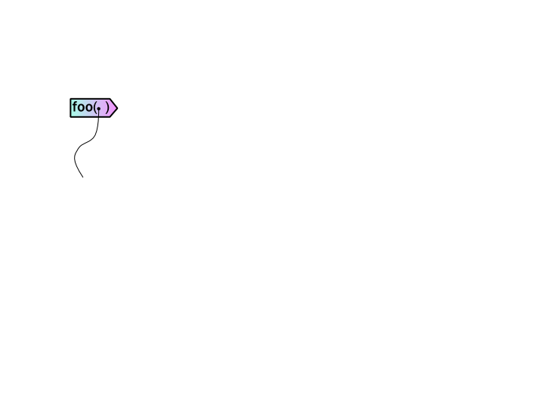

Slide 6
s2.intro(..)

Slide 7
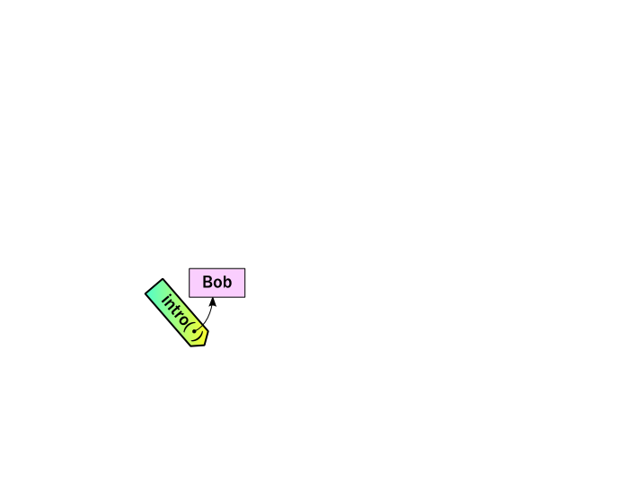
s2.intro(..)

Slide 8
s1.deliver(..)

Slide 9
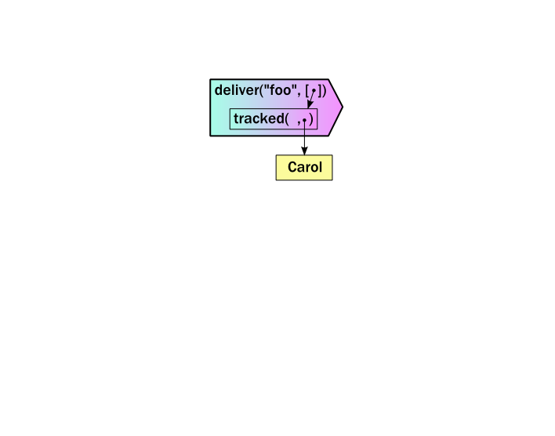

Slide 10
makeStub(..)
return gift
wrap(s3)

Slide 11
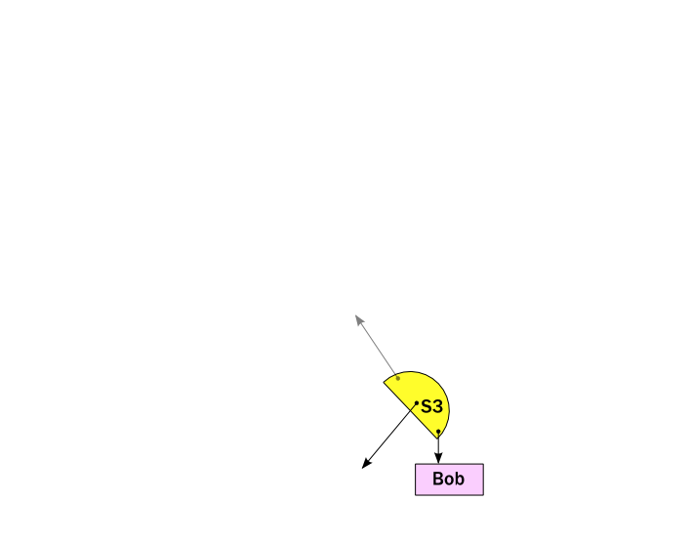
makeStub(..)

Slide 12
wrap(s3)

Slide 13
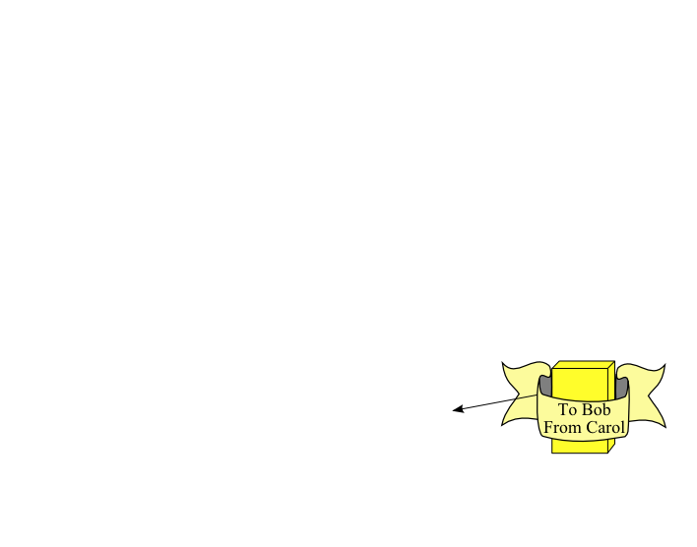
wrap(s3)

Slide 14
return gift

Slide 16
unwrap( )

Slide 17

unwrap( )

Slide 18
makeProxy(..)

Slide 19
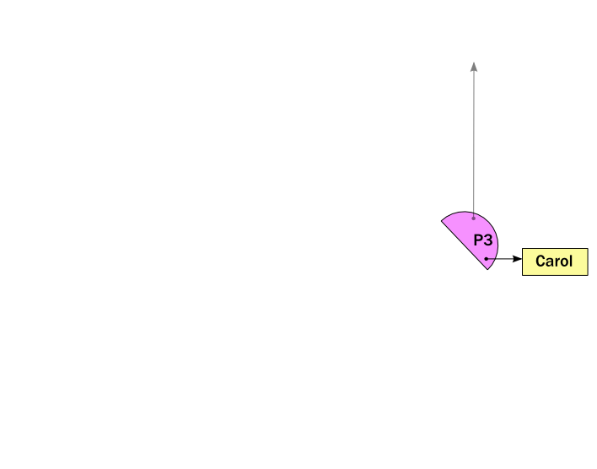
makeProxy(..)

Slide 20
E.call(..)

Slide 21
