Slide 1
Horton’s Who Done It?
Higher-Order Responsibility Tracking of Objects in Networks

Slide 2
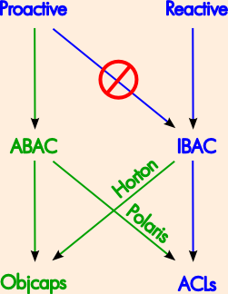
The Dilemma
For IBAC to be
effective reactively,
must stop using it
proactively.
ABAC better for proactive
control anyway.
How to get best of both?

Slide 3
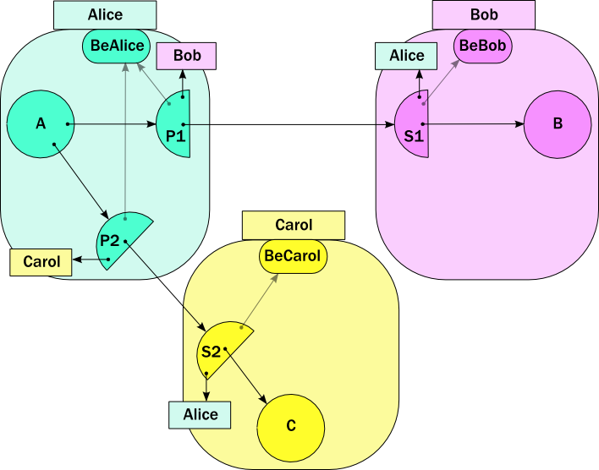
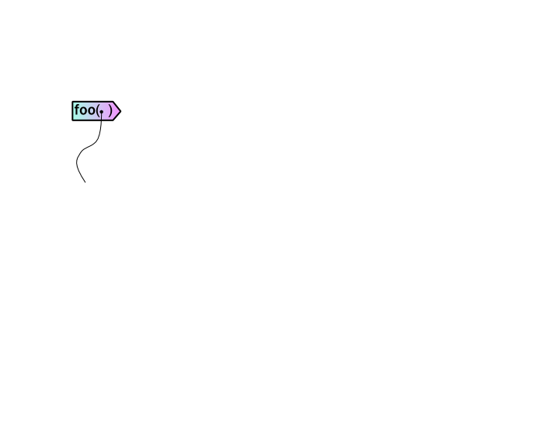
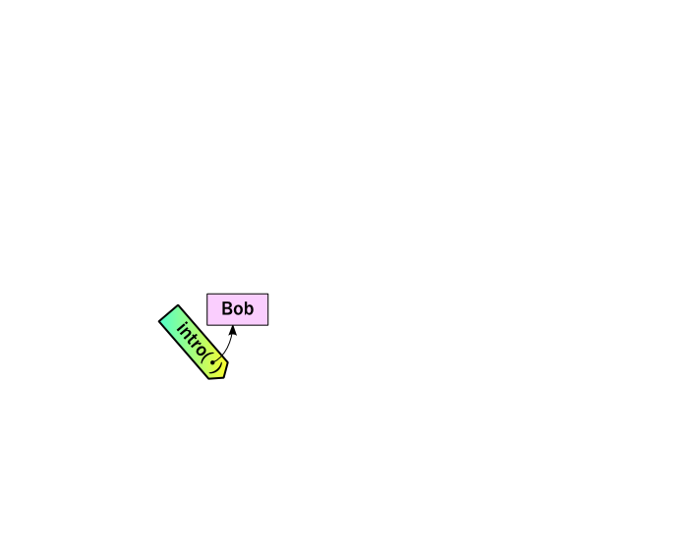
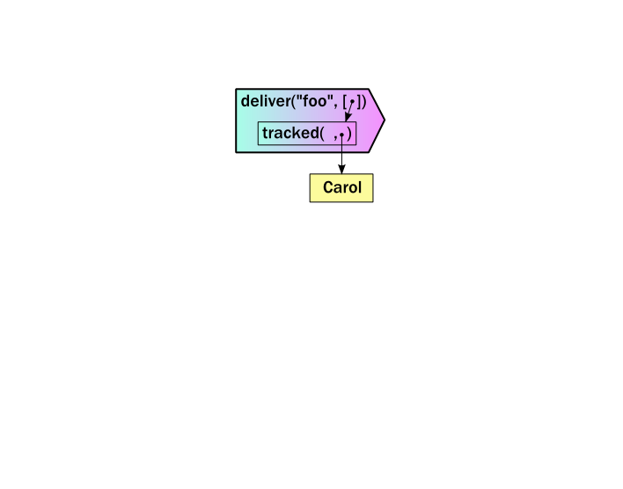

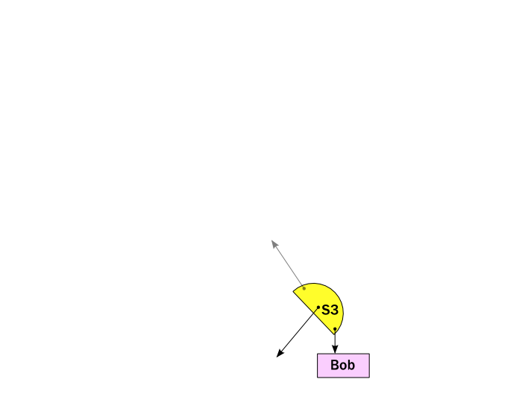
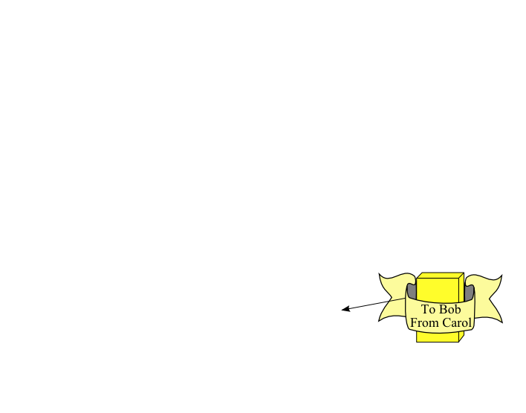
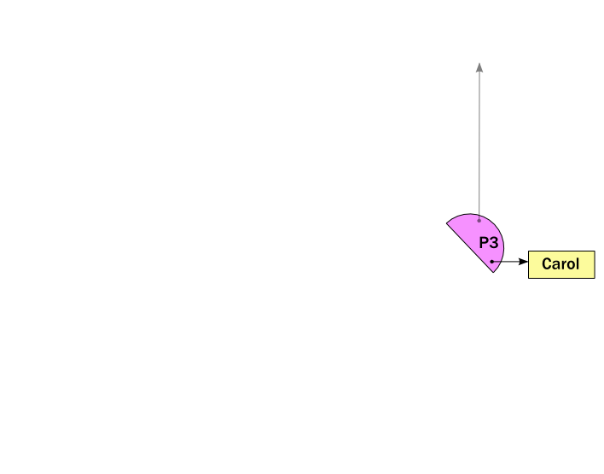
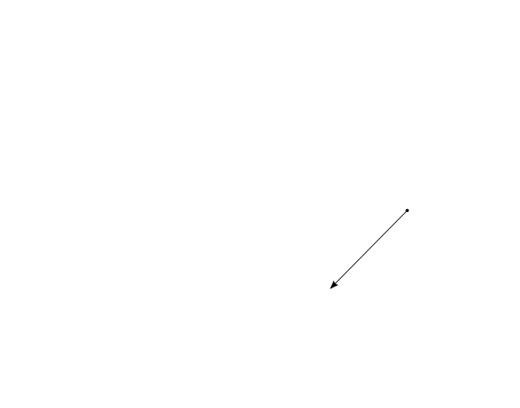
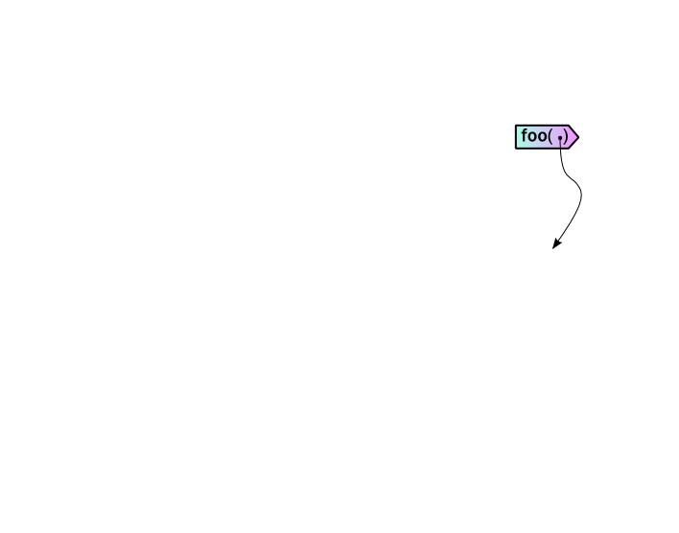
s2.intro(..)
s1.deliver(..)
unwrap( )
makeProxy(..)
E.call(..)
b.foo(c)
makeStub(..)
return gift
wrap(s3)

