Slide 1
Concurrency Among Strangers
Programming in E as Plan Coordination
by Mark S. Miller
Thursday September 1, 2005

Slide 2
Talk Overview
Research question
Approach for seeking answers
Progress to date & evaluation
Example & Demo (time permitting)

Slide 3
Research Question
Plan Coordination =
    plan composition (realize cooperative opportunities)
    + plan separation (avoid destructive interference)
Programmers express plans for machines to run
    Plan must handle all relevant contingencies
    Danger: explosive case analysis
OO works “in the small” – local, sequential, benign
    Abstraction reduces relevant cases
Can we support plan coordination at Internet scale?
    asynchronous, distributed, possibly malicious
    Existing separate solutions don’t compose well

Slide 4
Plan Coordination Challenges for Internet-scale distributed computing
Extend virtues of oo-languages …
  … among mutually suspicious objects
  … on mutually suspicious machines
  … without undue vulnerability.
Let objects interact asynchronously…
  … in partially predictable order
  … with distant machines
  … that may not be reachable.
Novelty mostly in integration, linguistic support

Slide 5
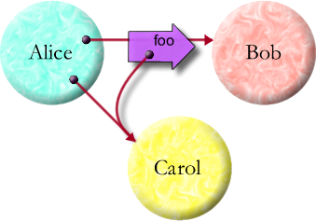
Extend virtues of oo-languages …
Alice says: bob.foo(carol)
abstraction & composition, rapid prototyping
precise semantics, compact familiar notation

Slide 6
… among mutually suspicious objects …
Object-capabilities: Reference Graph == Access Graph
Absolute encapsulation—causality only by messages
Only references permit causality
Graph limits what’s possible

Slide 7
… on mutually suspicious machines …
Object
Reference
Message
Vat/Process
Machine
Pluribus: cryptographic capability protocol
Kernel-E: safe mobile code

Slide 8
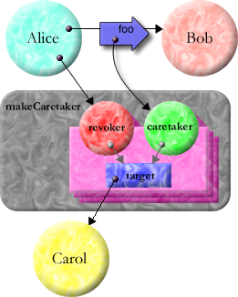
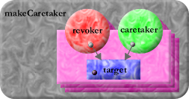
… without undue vulnerability.
Alice says: def [carol2, carol2revoker] := makeCaretaker(carol)
bob.foo(carol2)
def makeCaretaker(var target) :any {
def caretaker {
match [verb :String, args :any[]] {
E.call(target, verb, args)
} }
def revoker {
to revoke() :void {
target := null
} }
return [caretaker, revoker]
}

Slide 9
Let objects interact asynchronously …
delta
foxtrot
tango
bravo
zulu
charlie
Turns are isolated micro-transactions

Slide 10
… in partially predictable order …
A
x
B
z
Alice says:
y
Bob says:
z
carol <- w()
bob <- x(carol)
carol <- y()
carol <- z()
w
C
>FIFO, <Causal, enforced by protocol

Slide 11
… with distant machines …
def r3 := (x <- a()) <- c(y <- b())
Expands to...
def r1 := x <- a()
def r2 := y <- b()
def r3 := r1 <- c(r2)
Messages always move
towards arrowhead.
x
r1
c
r3
a
r2
X
y
b
Y

Slide 12
… that may not be reachable.
RESOLVED
UNRESOLVED
near
Near: “.” & “<-”
    local objects
Eventual: only “<-”
    promise or remote
    lock-free atomicity
Broken: complains
    Reify partition
    NaN-like contagion
EVENTUAL
local promise
resolve
VAT-CROSSING
remote promise
far
partition
broken
Unresolved Promises
    Results of “<-”
    pipeline messages
Off-line Caps (unshown)
    Reify right to reconnect

Slide 13



Example: Alice pays Bob
def payment := myPurse <- makePurse()
payment <- deposit(10, myPurse)
bob <- buy(..., payment)
when (payment) -> ... {
when (myPurse <- deposit(10, payment)) ... {
... # dispense value
}
}
buy
makePurse
deposit
deposit
mint
$0
$10
name
sealer
unsealer
$100
$200
$90
$210

Slide 14
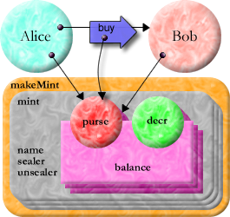
Distributed Secure Money in E
def makeMint(name :String) :any {
def [sealer, unsealer] := makeBrandPair(name)
def mint {
to makePurse(var balance :(int >= 0)) :any {
def decr(amount :(0..balance)) :void {
balance -= amount
}
def purse {
to getBalance() :int { return balance }
to makePurse() :any { return mint.makePurse(0) }
to getDecr() :any { return sealer.seal(decr) }
to deposit(amount :int, src) :void {
unsealer.unseal(src.getDecr())(amount)
balance += amount
} }
return purse
} }
return mint
}
No explicit crypto

Slide 15
Progress to Date
Capability-based Financial Instruments
      Miller, Morningstar, Frantz – Financial Crypto 2000
The Digital Path: Smart Contracts and the Third World
      Miller, Stiegler – Austrian Perspectives on the Internet Economy 2003
Paradigm Regained:
Abstraction mechanism for access control
      Miller, Shapiro – Proceedings ASIAN’03
The Structure of Authority:
Why security is not a separable concern
      Miller, Tulloh, Shapiro – 2nd Mozart/Oz Conference 2004
Institutions as Abstraction Boundaries
      Tulloh, Miller – Social Learning, Essays in honor of Don Lavoie (talk in 2002)
Concurrency Among Strangers:
Programming in E as Plan Coordination
      Miller, Tribble, Shapiro – Symposium on Trustworthy Global Computing 2005

Slide 16
Research Plan
Expand “Concurrency Among Strangers”
Finish design of Kernel-E
Convert Pluribus protocol to Data-E serialization
Analyze security, concurrency, failure properties
of Kernel-E, Pluribus, Kernel-E + Pluribus
Evaluate with an extended concrete example

