Slide 1
Desktops to Donuts: Object Caps Across Scales
Marc Stiegler
Visiting Scholar, HP

Slide 2
Object Caps Crossing Scales
Bundle Authority with Designation to achieve easy to use secure systems, from the object to the ecosystem:
Programming Objects: Sash in Emily
  Security is an emergent property of OO design
Desktop: Polaris, CapDesk
DarpaBrowser: Across the network
DonutLab: Full ecosystem
2 Views:
  User View
  Powerbox

Slide 3
Safe Bash Commands in Emily: Sash
Safe Bash Commands powerbox
  “-filepath” ->readOnly file reference
  “+filename” -> read/write file reference
  “*auth” -> special power
    *time -> read clock
  Stdin conveyed by default
  Forgery-resistant stdout conveyed by default (limits phishing)
User View
  sashcp -f1.txt +f2.txt
  sashls -dir1
  sashdeck 4000 *time

Slide 4
Sash Powerbox
open SashInterface
let authsCount = Array.length Sys.argv - 1 in
let auths = Array.make authsCount (Str "") in
for i = 1 to authsCount do
let arg = Sys.argv.(i) in
let argUnprefixed = String.sub arg 1 (String.length arg - 1) in
auths.(i-1) <- (match arg.[0] with
'-' -> FileArg (SysFile.make argUnprefixed File.ReadOnly)
| '+' -> FileArg (SysFile.make argUnprefixed File.Editable)
| '*' -> if argUnprefixed = "time" then
Auth Unix.time
else raise (Invalid_argument "bad * request")
| _ -> Str arg)
done;
let commandName = Sys.argv.( 0) in
let userOut message =
print_string ("Command " ^ commandName ^ ": " ^ message ^ "\n") in
CapMain.start stdin userOut (Array.to_list auths);

Slide 5
Sashcp
open SashInterface
let start userIn userOut authlist =
match authlist with
| FileArg fromFile :: FileArg outFile :: [] ->
outFile.File.setText(fromFile.File.getText())
| _ -> userOut "To use sashcp, an input file is required"

Slide 6
SashDeck Layout
The beginnings of defense in depth
Rapid authority attenuation
Fractal Authority Delegation
CapMain
(Stdin,
userOut,
read-clock)
Powerbox
(Full User Auth)
Deck
(No Auth)
Pseudo
RandGen
(NoAuth)

Slide 7
Mini-Benchmark
Card Deck Table Shuffle: 5000 decks, 5000 shuffles per deck, 2Ghz Pentium, WinXP, 1GB RAM
Language | Time (sec)
MSVS C++ | 52
Emily* | 54
GCJ Java | 98
*Emily using the MSVS C++ compiler as backend

Slide 8
CapDesk Demo
User View

Slide 9
CapDesk Powerbox
CapDesk
Powerbox 2
InitialFileAuths
RequestForOpenDialog
RequestForSaveAs
makeDropTarget
makeDragSource
RequestToLaunchSeparately
ReadAppResources
Endowments
PetWindowMaker
CapEdit
CapDesk
Kernel
CapDesk
Powerbox 1
CapDesk
File
Explorer
User
Doc
Click

Slide 10
DarpaBrowser Demo
User View

Slide 11
DarpaBrowser Powerbox
Renderer
Powerbox
RenderPanel
DOMTree
RequestPageJumpList
Embededs InStreams
Browser
Frame
Renderer
User
Link
Click

Slide 12
DarpaBrowser Part 2

Slide 13
DarpaBrowser + Object Cap Lang
More powerful than AJAX
In demo, launch Browser from File Explorer
With POLA modularity, just as easy and secure to launch File Explorer from Browser
  Browser as desktop
  Desktop as file browser app
A new twist on desktop metaphor variations:
  Emacs: text editor as desktop
  Smalltalk: IDE as desktop
  Mac: File Explorer as desktop
  Has the time finally come for the browser as desktop?

Slide 14
Why Has the Browser Not Taken Over?
The Impossible Choice of Full Authority or Puny Authority
Like Users faced with a Security Dialog Box (surrender all control, or do not get work done), programmers have had no good choices
The tradeoff is obsolete
Do not fight with one hand tied behind your back
Break forth!

Slide 15
Conclusions
Object-caps enable easy to use, easy to understand, secure cooperation at many scales
The ability to cooperate securely is the ability to cooperate on more projects with more people
  Cooperation without security fails tragically at large scale (wikipedia)
What can object-caps do for you?

Slide 16
Backup Slides

Slide 17
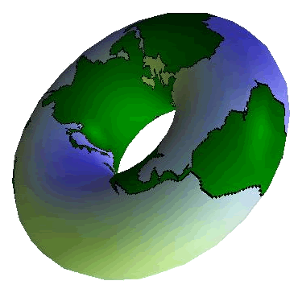
DonutLab

Slide 18

Basic Layout and Operation
Firewall
Sensitive
Assets
Sensitive
Assets
Server
Sensitive
Assets
Server
DoughBit
Kiosk
DoughBit
Sensitive
Assets
Server
Kiosk
DoughBit
DoughBot
Server
DoughBit
“Membership”
Mint
Dough
Changer

Slide 19
Interesting Features
Full Decentralization
  No PlanetLab Central
  No DNS “Root Server”
Agoric Resource allocation
  No Sustainable DDOS attacks
Persistence
  What goes down must come up
Secure Cooperation
  Servers Behind Firewalls
Ease of Use
  No passwords or certificates, 1 hour HelloWorld
(MSRP, PlanetLab SpamBot Account: $21,600)

Slide 20
SliverServer Powerbox
DonutApp
Powerbox
selfPersist
RevocableForwarders
SliverServer
DonutApp
App
Owner
Other Authorities

Slide 21
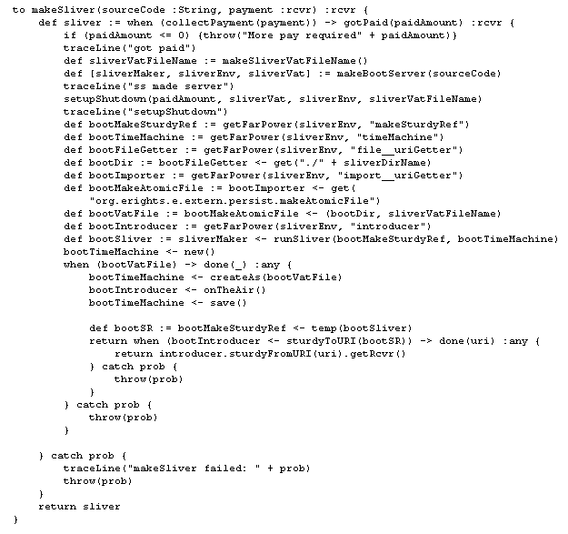
Object-Cap Security Review, A Taste

