Slide 1
The Structure of Authority
Why security is not a separable concern
Mark S. Miller, Bill Tulloh, Jonathan Shapiro
Virus-Safe Computing Project
Hewlett Packard Laboratories
Johns Hopkins University
George Mason University

Slide 2
Hopes
Common Ancestors: Actors, Concurrent Prolog
  Lambda Calculus, Logic Variables, Stateful Processes
Oz & E: Similar Philosophies
  Multi-paradigm, Explicit state, Hemi-transparent distribution
  Built for adoption & use, not sterile purity
  Oz: Constraints, Larger community, More engineering
  E: Security, Defensive correctness
Oz-E .. Oz-4: Union of paradigms
  Oz with Security Oz without Insecurity
  How to add a subtractive paradigm?
  Search the most constrained choices early!

Slide 3
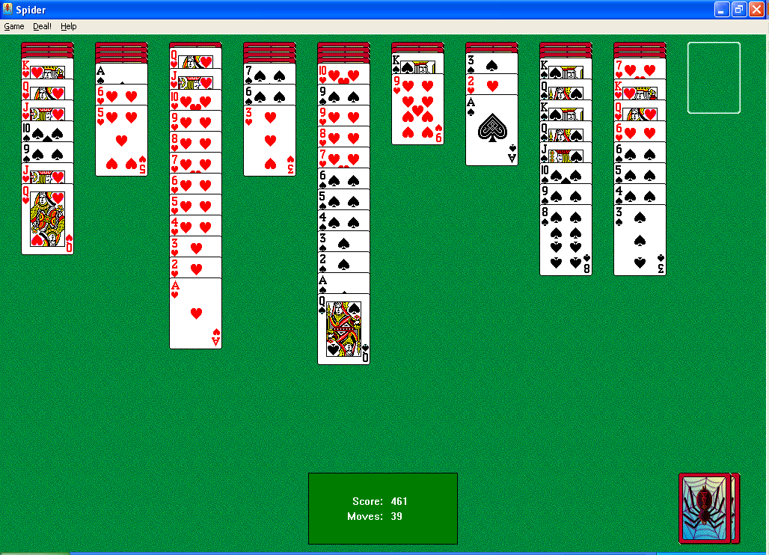
A Very Powerful Program
This program can delete any file you can.
Notes:
The problem with computer security is that there’s this very powerful program. This program can delete any file that you can. This program can scan your email for interesting tidbits and sell them on eBay to the highest bidder. And many of your employees run this program for several hours every day. What is this dangerous program?
CLICK
Solitaire, and every program. The only rights Solitaire needs to do its job are the rights to draw in its window, to receive UI events directed at it, and to write into a file you specify in order to save your score. Instead, Solitaire runs with all of your authority.
While Solitaire itself probably doesn’t abuse its excess authority, it could. If Solitaire became corrupted by a virus, the virus could do anything Solitaire may do. This is the lever viruses use to shake the world.
If Solitaire had only the rights needed to do its job, a corrupted Solitaire might be annoying, but not a threat.
So why do you grant Solitaire the authority to destroy your life?

Slide 4
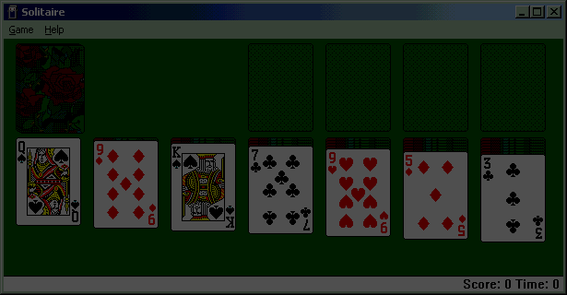
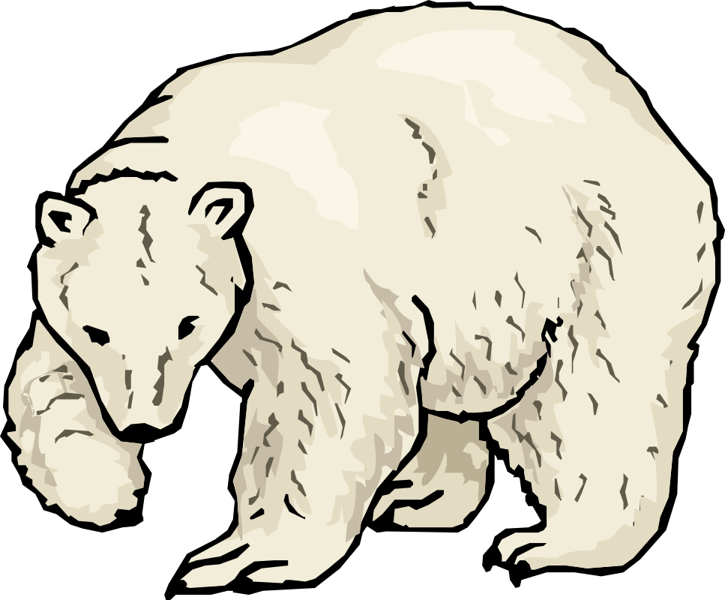
Functionality vs. Security?
Integratable
Applications:
User’s Authority
E, CapDesk, Polaris
Usable Least Authority
Unusable
“Sandboxing”
Firewalls
Applets:
No Authority
Isolated
Dangerous
Safe
Notes:
When you run Solitaire, why do you grant it the authority to destroy your life? Well, let’s examine your alternatives.
CLICK
Well, you can run Solitaire as an application, allowing all the functionality and integration our application frameworks have been built to for. The price is trusting it with all your authority, which is very dangerous.
CLICK
You could run it as an applet, but then it becomes isolated and mostly useless. A Solitaire applet has so little authority it could not even offer to save its score into a file you specify.
CLICK
With sandboxing ala Java WebStart, you could trade away your safety piecemeal for functionality, but only by suffering a torrent of annoying security dialog boxes that are the antithesis of usability.
CLICK
Firewalls are often suggested. They impose a terrible cost on cooperating between organizations, while still leaving us in danger.
CLICK
What we’re doing, with E and CapDesk, is making it practical to grant Least Authority. We are building a system that is safer, more functional, and easier to use. With E and CapDesk, your normal means of operating Solitaire would naturally give it the least authority it needs to do its job.
CLICK
We are enabling users and programmers to practice the Principle of Least Authority, or POLA, as a natural part of what they do.

Slide 5
A Tale of Two Copies
$ cp foo.txt bar.txt
vs.
$ cat < foo.txt > bar.txt
Bundle permission with designation
Remove ambient authority
Let “knowledge of” shape “access to”
Notes:
How much authority is least? Consider these two Unix shell commands for copying a file. Under Unix, both cp and cat, like Solitaire, actually run with all of your authority. But how much authority do they actually needs to do their jobs?
In both examples, you are using names to tell the programs which files to copy. These filenames are names in your namespace of files.
In the 1st example, you tell “cp” the names themselves – the text strings “foo.txt” and “bar.txt”. “cp” then uses these names to open these files. In order for cp to do its job, it must share access to your namespace, and it must be able to read and write any file that you may read or write. Its least authority is still most of your authority.
By contrast, in the cat example, you are still using names in order to tell cat which files to copy. But you aren’t communicating the names to cat. Instead, your shell opens your foo.txt and bar.txt, and gives cat the resulting file descriptors. Rather than giving cat the names of the files, cat is directly given access to the files. It’s least authority is what you’d expect – the right to read your foo.txt and the right to write your bar.txt. It isn’t even told what your name is for these files.
Although cat is actually given all your authority, for this example at least, it doesn’t need any authority beyond what you’re explicitly giving it.
CLICK
In both cases, the parameters designate what files you wish the program to operate on. The parameters provide “knowledge of”.
CLICK
Why provide a program with knowledge of something it has no access to? Why provide a program with access to something it has no knowledge of? The essence of usable POLA flows from having these acts of designation also be the acts of authorization.

Slide 6
Separation Principles
  Information hiding: “Need to know”
  POLA: “Need to do”
Modularity & Security each need both.
Modularity is not a separable concern.
Notes:
Stepwise refinement. Simon’s watchmakers.
Let locality of knowledge shape localization of authority
Dynamics of “knows about” from acts of designation
Provide “access to” when providing “knowledge of”

Slide 7

The Access Matrix
Who might endanger what?
 | Assets at risk
 | /etc/passwd | Alan’s stuff | Barb’s stuff | Doug’s stuff
Kernel + ~root = TCB
~alan
~barb
~doug
risk = ∑exploitability of flaws
flaws
Org principle: “separation of duties”
Get the yellow out!
Notes:
How can we see what kind of a difference does POLA make?
A traditional formalism for comparing access control paradigms is Butler Lampson’s access matrix.

Slide 8
Barb runs Excel
What might endanger what?
 | Barb’s assets at risk “to Barb”
 | email addrs | pgp ring | killer.xls | internet access
Desktop
Mozilla
Excel
Eudora+PGP

Slide 9
Demo Trojan Spreadsheet

Slide 10
Let Knowledge Shape Access
“Knows about” has a fractal structure.
    People know people. Organs know organs. Cells know cells.
    Abstraction & modularity at every level of composition.
Make access rights similarly self-similar!
Notes:
Stepwise refinement. Simon’s watchmakers.
Let locality of knowledge shape localization of authority
Dynamics of “knows about” from acts of designation
Provide “access to” when providing “knowledge of”

Slide 11
Barb runs Excel
What might endanger what?
 | Barb’s assets at risk “to Barb”
 | email addrs | pgp ring | killer.xls | internet access
Desktop
Mozilla
Excel
Eudora+PGP

Slide 12
The Access Matrix
Who might endanger what?
 | Assets at risk
 | /etc/passwd | Alan’s stuff | Barb’s stuff | Doug’s stuff
Kernel + ~root = TCB
~alan
~barb
~doug
Notes:
How can we see what kind of a difference does POLA make?
A traditional formalism for comparing access control paradigms is Butler Lampson’s access matrix.

Slide 13
The Access Matrix, Reloaded
Who might endanger what?
 | Assets at risk
 | /etc/passwd | Alan’s stuff | Barb’s stuff | Doug’s stuff
Kernel + ~root = TCB
~alan | POLArized:
~barb |  |  | legacy user
~doug |  |  | POLArized:

Slide 14
Doug Runs Legacy Apps
What might endanger what?
 | Doug’s assets at risk “to Doug”
 | email addrs | pgp ring | killer.xls | internet access
E + CapDesk = Doug’s TCB
DarpaBrowser
Excel |  |  | Polaris
CapMail

Slide 15
Demo Polaris

Slide 16
Doug runs Caplets on CapDesk
What might endanger what?
 | Doug’s assets at risk “to Doug”
 | email addrs | pgp ring | killer.xls | internet access
E + CapDesk = Doug’s TCB
DarpaBrowser
Excel |  |  | Polaris
CapMail

Slide 17
Demo CapDesk

Slide 18
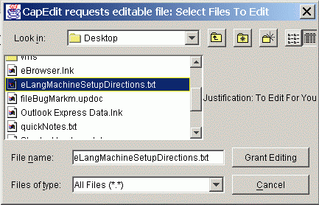
CapDesk/Polaris: Usable POLA
Double click launch
File Explorer
Open dialog
Drag/Drop
Etc...
Moral:
Bundle permission with designation
Notes:
Those of you who saw Marc Stiegler’s talk on the SkyNet Virus know that the same principle applies at the desktop.
Our modern user interface frameworks represent billions of dollars of investment in vast engines of designations – explorer windows, right button menus, drag/drop – ever more elaborate ways for you to say “This thing should perform some operation on that thing.” A conventional file open dialog box operates like our cp example -- it conveys to the program the name of the file, which the program then uses to open the file. Such programs still need all your authority to work.
Under CapDesk, you still use a file open dialog box to pick the name of the file you wish the program to use. But, like our cat example, the program is given, not the name of the file, bit the right to open this one file.
CLICK
The act of designation you had to perform anyway, to give the program knowledge of what file you wished it to operate on, now also carries the permission to operate on what you designated.

Slide 19
Doug runs CapMail
What might endanger what?
 | Doug’s assets at risk “to Doug”
 | email addrs | pgp ring | killer.xls | internet access
E + CapDesk = Doug’s TCB
DarpaBrowser
Excel |  |  | Polaris
CapMail

Slide 20
CapMail’s main() imports modules
 | Doug’s assets at risk to his CapMail
 | email addrs | pgp ring | killer.xls | internet access
CapMail’s main() = CapMail’s TCB
address book
gpg plugin | Tamed Library
smtp / pop stacks

Slide 21
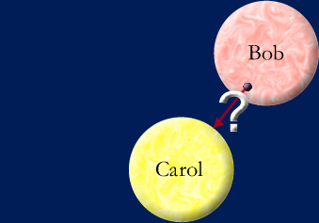
How do I designate thee?
by Introduction
  ref to Carol
  ref to Bob
  decides to share
by Parenthood
by Endowment
by Initial Conditions
How might object Bob come to know of object Carol?

Slide 22
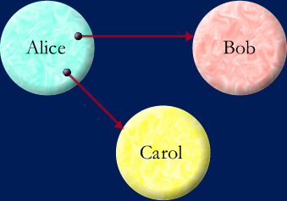
How do I designate thee?
Alice says: bob.foo(carol)
by Introduction
  ref to Carol
  ref to Bob
  decides to share
by Parenthood
by Endowment
by Initial Conditions

Slide 23
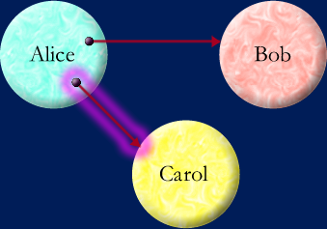
How do I designate thee?
Alice says: bob.foo(carol)
by Introduction
  ref to Carol
  ref to Bob
  decides to share
by Parenthood
by Endowment
by Initial Conditions

Slide 24
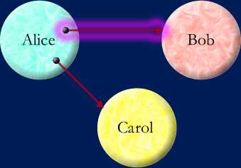
How do I designate thee?
Alice says: bob.foo(carol)
by Introduction
  ref to Carol
  ref to Bob
  decides to share
by Parenthood
by Endowment
by Initial Conditions

Slide 25
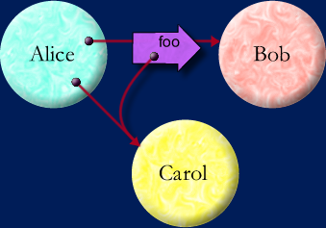
How do I designate thee?
Alice says: bob.foo(carol)
by Introduction
  ref to Carol
  ref to Bob
  decides to share
by Parenthood
by Endowment
by Initial Conditions
Think in names. Speak in references.

Slide 26
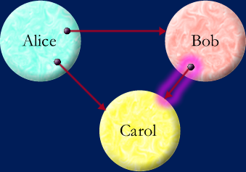
How do I designate thee?
Alice says: bob.foo(carol)
by Introduction
  ref to Carol
  ref to Bob
  decides to share
by Parenthood
by Endowment
by Initial Conditions

Slide 27
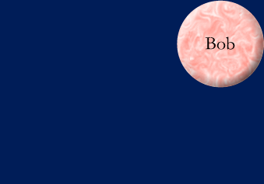
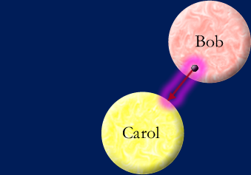
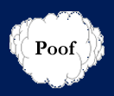
How do I designate thee?
Bob says: def carol { ... }
by Introduction
  ref to Carol
  ref to Bob
  decides to share
by Parenthood
by Endowment
by Initial Conditions

Slide 28
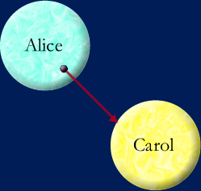
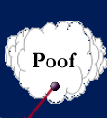
How do I designate thee?
Alice says: def bob { ... carol ... }
by Introduction
  ref to Carol
  ref to Bob
  decides to share
by Parenthood
by Endowment
by Initial Conditions

Slide 29
How do I designate thee?
Alice says: import bob(... carol ...)
by Introduction
  ref to Carol
  ref to Bob
  decides to share
by Parenthood
by Endowment
by Initial Conditions

Slide 30
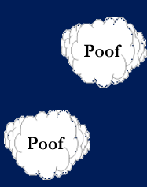
How do I designate thee?
At t₀:
by Introduction
  ref to Carol
  ref to Bob
  decides to share
by Parenthood
by Endowment
by Initial Conditions

Slide 31
What are Object-Capabilities?
Reference Graph == Access Graph
by Introduction
  ref to Carol
  ref to Bob
  decides to share
by Parenthood
by Endowment
by Initial Conditions
Absolute encapsulation—causality only by messages
Only references permit causality

Slide 32
Not Discretionary!
Alice says: bob.foo(carol)
by Introduction
  ref to Carol
  ref to Bob
  decides to share
by Parenthood
by Endowment
by Initial Conditions
Overlooked requirement. Enables confinement.
Only connectivity begets connectivity.

Slide 33
CapMail’s main() imports modules
 | Doug’s assets at risk to his CapMail
 | email addrs | pgp ring | killer.xls | internet access
CapMail’s main() = CapMail’s TCB
address book
gpg plugin | Tamed Library
smtp / pop stacks

Slide 34

Least Authority is Fractal!
 | Assets at risk
 | /etc/passwd | Alan’s stuff | Barb’s stuff | Doug’s stuff
Kernel + ~root = TCB
~alan
~barb |  |  | legacy user
~doug
polarized Excel
tamed gpg
Recursively reduce target area

Slide 35

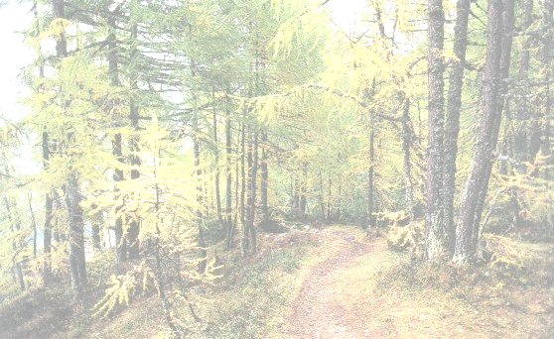
Roadmap, in Hindsight
What about
Security?
Scheme
W7 E
Message Passing, Encapsulation
Objects
Lexical Nesting
Object-Capabilities
D.Correctness
Memory Safety, GC, Eval / Loading
Safe Loading
Safe Reflection
Virus Safe
Computing
Mutable Static State
Static Native “Devices”
Shared State Concurrency
Unprincipled Libraries
What about
Security?
Oak, pre.NET, Squeak , Oz
No problemo
ClassLoaders as Principals
Stack Introspection
Security Managers Signed Applets
Java, .NET

Slide 36
Detour is Non-Object Causality
Scheme W7 E
Message Passing, Encapsulation Lexical Nesting
D.Correctness
Objects
Object-Capabilities
Memory Safety, GC, Eval / Loading Safe Loading
Safe Reflection
Virus Safe
Computing
Mutable Static State
Static Native “Devices”
Shared State Concurrency
Unprincipled Libraries
What about
Security?
Squeak-E, Oz-E
No problemo
ClassLoaders as Principals
Stack Introspection
Security Managers Signed Applets
Java, .NET

Slide 37
Security is Just Extreme Modularity
Good software engineering
    Responsibility driven design
    Omit needless coupling
    assert(..) preconditions
Information hiding
    Designation, need to know
    Dynamics of knowledge
Lexical naming
    Think names, speak refs
    Avoid global variables
Abstraction
    Procedural, data, control, ...
    Patterns and frameworks
    Say what you mean
Capability discipline
    Authority driven design
    Omit needless vulnerability
    Validate inputs
Principle of Least Authority
    Permission, need to do
    Dynamics of authorization
No global name spaces
    Think names, speak refs
    Forbid mutable static state
Abstraction
    ... and access abstractions
    Patterns of safe cooperation
    Mean only what you say

Slide 38
Not Quite: Defensive Correctness
Server Sam has clients Claire & Clem
    Claire and Clem’s correctness depend on Sam’s correctness
    Claire and Clem “rely on” / “are vulnerable to” Sam
Traditional Correctness:
    Sam’s service specified with pre- and post- conditions
    Sam relies on Claire => Clem relies on Claire
Defensive Correctness: No unchecked pre-conditions
    Sam can give Clem good service despite arbitrary Claire
    Better modularity of correctness arguments
Correctness is not a separable concern!

Slide 39
Our Logo
The POLA Bear

Slide 40
POLA all the way down

Slide 41
Bibliography
E in a Walnut skyhunter.com/marcs/ewalnut.html
Download E from erights.org and try it! (It’s open source.)
Paradigm Regained (HPL-2003-222) erights.org/talks/asian03/
A Security Kernel Based on the Lambda-Calculus mumble.net/jar/pubs/secureos/
Capability-based Financial Instruments (“the Ode”)
erights.org/elib/capability/ode/index.html
Intro to Capability-based Security
skyhunter.com/marcs/capabilityIntro/index.html
Statements of Consensus
erights.org/elib/capability/consensus-9feb01.html
Web Calculus www.waterken.com/dev/Web/Calculus/
Web sites: erights.org , combex.com , eros-os.org ,
cap-lore.com/CapTheory , www.waterken.com

Slide 42

Thank You

