Slide 1
Coroutines in SilkRPC
Cooperative tasks using C++20 coroutines
Notes:
Welcome to this talk about using C++ coroutines in SilkRPC, I’m going to use these slides just to help myself discussing the topic

Slide 2
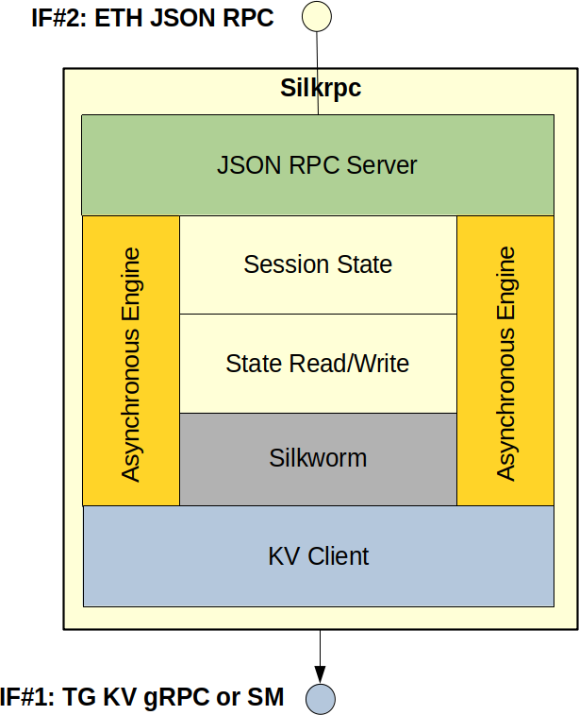
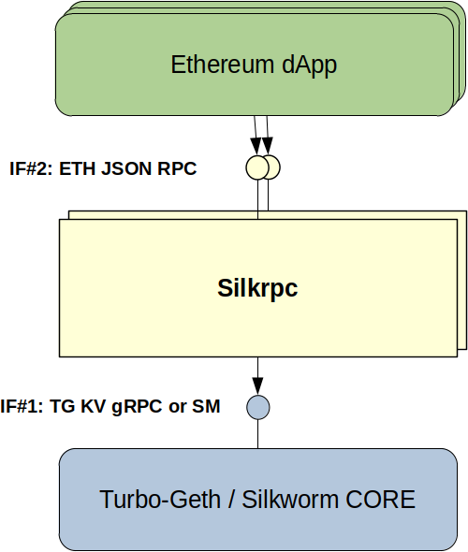
SilkRPC Overview
SilkRPC is an implementation of Turbo-Geth RPC Daemon written in C++
Notes:
First of all, what’s SilkRPC? <1>
In the picture on the left, you can see the context diagram for SilkRPC, which is a component with two interfaces:
IF#1 at the bottom is the gRPC Key-Value (KV) interface exposed by Turbo-Geth Core and used by SilkRPC for accessing the node state in read/write
IF#2 at the top is the well-known Ethereum JSON RPC. Implementing IF#2 using IF#1 is basically the main responsibility of SilkRPC. Which are the main requirements for SilkRPC? I’ll be quite generic and inaccurate here, but obviously we want: scalability, performance, ease to upgrade and maintain. It turns out that, in terms of its main uses case (implementing JSON RPC API using internal KV API), SilkRPC is mostly a message-passing application. Our current design is based on an execution flow guaranteed by a cooperative engine handling I/O operations asynchronously.
So we decided to explore the usage of C++ coroutines for implementing such an engine as an alternative to the classic callback+state approach.

Slide 3
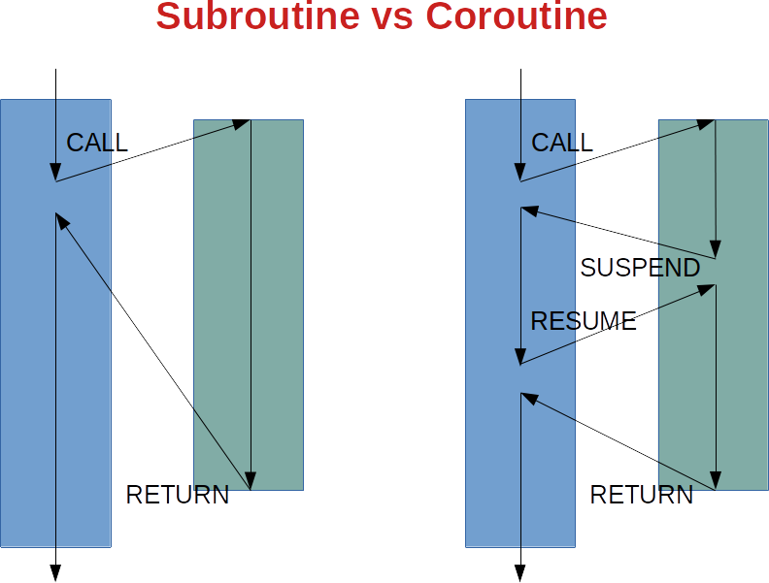
Coroutines: Overview
“Design of a Separable Transition-Diagram Compiler” (Conway, 1963)
Coroutines are a generalization of subroutines (Knuth, TAOCP, 1968)
 | subroutine | coroutine
call | ✓ | ✓
return | ✓ | ✓
suspend | ❌ | ✓
resume | ❌ | ✓
destroy | ❌ | ✓
act. frame | stack | heap
Notes:
The term was firstly introduced in paper <1>, which described a COBOL compiler using coroutines, i.e. separability of modules communicating with input/output operations and transferring control each other, for improved performance.
Knuth defined them as <2> and indeed they are <CLICK>, as you can see in the picture: subroutines are functions supporting CALL and RETURN operations, coroutines have also SUSPEND and RESUME. <3> So a coroutine starts with an ordinary function call [there are some differences], executes some code but then can reach a suspension point and return the control back to the caller, then it can be resumed (by the same caller or another) restarting from the last suspension point having its internal state restored and so on until it completes. Another important difference is in the activation frame, which is on the heap for coroutines.

Slide 4
C++ Coroutines: Hello World
generator<char> hello() {
for (char ch: "Hello world!\n")
co_yield ch;
}
int main(int argc, char* argv[]) {
for (char ch: hello())
std::cout << ch;
return 0;
}
https://godbolt.org/z/zTG184
Taken from CppCon 2018: G. Nishanov “Memory Latency Troubles You? Nano-coroutines to the Rescue! (Using Coroutines TS, of Course)”
Notes:
This is the classic “Hello world” program written in C++ using coroutines: the main looks quite familiar, no strange code there, just one for-each on a function returning a character iterator (sort of) and then print on standard output.
But what about the hello function, which is a coroutine as we’ll see later, you can spot two unusual things:
1) <CLICK> the return value is a generator thing, we have to understand what it is
2) <CLICK> the keyword co_yield is used to suspend the hello coroutine and give control back to the caller returning a result
Let’s see if it really works as expected: <CLICK>
It’s really a lot of code just for “Hello world”, that’s because of the generator type which is required for specifying the behavior of hello coroutine.
In order to understand more, now we need a bit of theory...

Slide 5
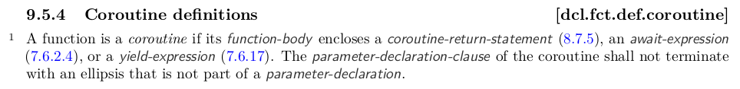
C++ Coroutines: N4868
co_await
co_yield
co_return
coroutine_handle<>
coroutine_traits<>
noop_coroutine_handle
suspend_always
suspend_never
promise_type
awaitable/awaiter
Notes:
So, coroutines in C++ language: they were present in the original design of C++ from Stroustrup, in a task library which however wasn’t supported by most post-1989 language implementations. Flash forward to nowadays, they’ve been added in C++20 standard version and I think in this case the standard itself does a good job at describing what a coroutine is in C++
<1>
So coroutines support in C++20 is made up of three keywords
<2>
some predefined types in the C++ Standard Library
<3>
and a couple of interfaces that your coroutine auxiliary types must implement. They’re not typed interfaces, they’re templatized interfaces through template specializations.

Slide 6
C++ Coroutines: Awaitables
co_await <expr>
A type that supports the co_await operator is called an Awaitable type.
THIS IS PSEUDO-CODE TO EXPLAIN WHAT THE COMPILER GENERATES
template<typename P, typename T>
decltype(auto) get_awaitable(P& promise, T&& expr)
{
if constexpr (has_any_await_transform_member_v<P>)
return promise.await_transform(static_cast<T&&>(expr));
else
return static_cast<T&&>(expr);
}
template<typename Awaitable>
decltype(auto) get_awaiter(Awaitable&& awaitable)
{
if constexpr (has_member_operator_co_await_v<Awaitable>)
return static_cast<Awaitable&&>(awaitable).operator co_await();
else if constexpr (has_non_member_operator_co_await_v<Awaitable&&>)
return operator co_await(static_cast<Awaitable&&>(awaitable));
else
return static_cast<Awaitable&&>(awaitable);
}
An Awaiter type is a type that implements the three special methods that are called as part of a co_await expression:
await_ready()
await_suspend(...)
await_resume()
Taken from post “C++ Coroutines: Understanding operator co_await” appeared in L. Baker’s blog Asymmetric Transfer
Notes:
What does the compiler generate for a co_await expression? First of all, some definitions: <1> Note that whether or not the co_await operator can be applied to a type can depend on the context in which the co_await expression appears. The promise_type used for a coroutine can alter the meaning of a co_await expression within its own coroutine via its await_transform method.
If the promise type, P, has a member named await_transform then <expr> is first passed into a call to promise.await_transform(<expr>) to obtain the Awaitable value, awaitable. Otherwise, if the promise type does not have an await_transform member, then we use the result of evaluating <expr> directly as the Awaitable object, awaitable.
Then, if the Awaitable object, awaitable, has an applicable operator co_await() overload then this is called to obtain the Awaiter object. Otherwise the object itself, awaitable, is used as the awaiter object.

Slide 7
C++ Coroutines: Awaiters
co_await <expr>
THIS IS PSEUDO-CODE TO EXPLAIN WHAT THE COMPILER GENERATES
{
auto&& value = <expr>;
auto&& awaitable = get_awaitable(promise, static_cast<decltype(value)>(value));
auto&& awaiter = get_awaiter(static_cast<decltype(awaitable)>(awaitable));
if (!awaiter.await_ready()) {
using handle_t = std::experimental::coroutine_handle<P>;
using await_suspend_result_t = decltype(awaiter.await_suspend(handle_t::from_promise(p)));
<suspend-coroutine>
if constexpr (std::is_void_v<await_suspend_result_t>) {
awaiter.await_suspend(handle_t::from_promise(p));
<return-to-caller-or-resumer>
} else {
static_assert(std::is_same_v<await_suspend_result_t, bool>, "await_suspend() must return 'void' or 'bool'.");
if (awaiter.await_suspend(handle_t::from_promise(p))) {
<return-to-caller-or-resumer>
}
}
<resume-point>
}
return awaiter.await_resume();
}
Taken from post “C++ Coroutines: Understanding operator co_await” appeared in L. Baker’s blog Asymmetric Transfer
Notes:
What’s the meaning of the Awaiter? It is used to control the semantics of the co_await expression. The behavior is roughly the following one:
- await_ready is called to check if the coroutine result is already available because it’s synchronous, if so the coroutine is not suspended and the result is returned at the end
- the void-returning version of await_suspend just transfers execution back to the caller/resumer of the coroutine when the call to await_suspend returns, whereas the bool-returning version allows the awaiter object to conditionally resume the coroutine immediately without returning to the caller/resumer
- the current coroutine is considered suspended after the <suspend-coroutine> operation completes. The first point at which you can observe the suspended coroutine is inside the call to await_suspend(). Once the coroutine is suspended it is then able to be resumed or destroyed.
- it is responsibility of the await_suspend() method to schedule the coroutine for resumption (or destruction) at some point in the future once the operation has completed. Note that returning false from await_suspend() counts as scheduling the coroutine for immediate resumption on the current thread.
- when the suspended coroutine is eventually resumed then the execution resumes at the <resume-point>; the return value of the await_resume method becomes the result of the co_await expression
- if an exception throws out of await_suspend, the coroutine is automatically resumed and the exception propagates out of the co_await expression
- if an exception throws out of await_resume, it propagates out of the co_await expression directly

Slide 8
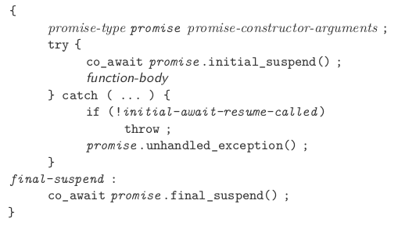
C++ Coroutines: Promise
struct promise_type {
/* ... */
auto get_return_object() { ... }
auto initial_suspend() { ... }
auto final_suspend() { ... }
void set_exception() { … }
void unhandled_exception() { ... }
/* alternatives */
void return_void() { … }
void return_value() { … }
/* just for changing co_await behavior */
auto await_transform() { … }
/* just for generators */
auto yield_value(V value) { … }
};
Notes:
The Promise object defines and controls the behaviour of the coroutine itself by implementing methods that are called at specific points during execution of the coroutine.
<1>
When/if co_return is called within the function body, the return_void or return_value method is called and then the final suspend point is reached.
How the compiler chooses the promise type?
The type of the promise object is determined from the signature of the coroutine by using the std::coroutine_traits class. The default definition of coroutine_traits template defines the promise_type by looking for a nested promise_type type definition defined on the return-type.

Slide 9
C++ Coroutines: Handle
namespace std {
template<typename Promise = void>
struct coroutine_handle;
template<> struct coroutine_handle<void> {
constexpr coroutine_handle();
constexpr void* address() const noexcept;
static constexpr coroutine_handle from_address(void* addr);
constexpr explicit operator bool() const noexcept;
bool done() const;
void resume();
void destroy();
};
}
namespace std {
template<typename Promise>
struct coroutine_handle : coroutine_handle<> {
using coroutine_handle<>::coroutine_handle;
static constexpr coroutine_handle from_address(void* addr);
Promise& promise() const;
static coroutine_handle from_promise(Promise& promise);
};
}
How to obtain the coroutine_handle:
  passed to await_suspend in co_await <expr>
  coroutine_handle<Promise>::from_promise()
Notes:
When you call a coroutine function, a coroutine frame is created. In order to resume the associated coroutine or destroy it you need some way to identify or refer to that particular coroutine frame. The mechanism provided by the C++ for this is the coroutine_handle type. Basically it is a template wrapper type around the memory pointer to the activation frame, as the address/from_address methods suggest.
There is one type-erased specialization (on the left) that can refer to any kind of coroutine; the other one is for coroutines with a known promise type. Note that the typed one derives from the type-erased one.
// Doesn't allow access to the promise object.
// Constructs to the null handle.
// Convert to/from a void* for passing into C-style interop functions.
// Query if the handle is non-null.
// Query if the coroutine is suspended at the final_suspend point.
// Undefined behaviour if coroutine is not currently suspended.
// Resume/Destroy the suspended coroutine
// Template argument must exactly match coroutine's promise type.
// Access to the coroutine's promise object.
// You can reconstruct the coroutine handle from the promise object.

Slide 10
C++ Coroutines: Advanced
Customizing the co_await / co_yield behavior
  await_transform / yield_value in promise_type
Memory allocators
  avoid extra-heap allocations
Symmetric Transfer
  await_suspend returns coroutine_handle<>
  prevent stack overflow in some scenarios
  tail call optimization
Notes:
I just mention some advanced topics that I’ve read about, but never experimented with:
<1>
This means customizing the behavior in the specific context of one coroutine: every co_await/co_yield expression in the coroutine body becomes a call to the await_transform/yield_value methods of the promise_type.
<2>
It is possible to overload operator new and delete in the promise_type to exploit the coroutine activation frame (in the heap) as memory area and avoid other heap allocations.
<3>
Recent addition: allows to pass execution control from one coroutine directly to another, resuming the latter after suspension of the former.

Slide 11
C++ Coroutines: Usages
Generators
Asynchronous Tasks
generator<char> hello() {
for (char ch: “Hello world!\n”)
co_yield ch;
}
int main(int argc, char* argv[]) {
for (char ch: hello())
std::cout << ch;
return 0;
}
task<int> sleepy() {
std::cout << “Going to sleep...\n”;
co_await sleep_for(1ms);
std::cout << “Woke up\n”;
co_return 42;
}
int main(int argc, char* argv[]) {
std::cout << sleepy().get();
return 0;
}
Taken from CppCon 2018: G. Nishanov “Memory Latency Troubles You? Nano-coroutines to the Rescue! (Using Coroutines TS, of Course)”
Notes:
Coroutines have basically two different use cases: 1) generators [when you need to produce multiple return values upon suspension points] and 2) asynchronous tasks [when you want to perform asynchronous operations before hitting suspension points and resume the coroutine when the asynchronous result is available and the processing can continue], and also a mix of the two cases. We’ve already seen a simple example of the former in the Hello World program <1>, for the task case the calling code looks something like this <2>.
Please note that neither generator nor task are part of the C++20 standard library: you have to craft your own version of them, maybe with your custom behavior.
In the next years coroutine libraries implementing general higher-level awaitable primitives will appear, hopefully leading the way for inclusion of such types within the C++ standard library.

Slide 12
SilkRPC Coroutines Options
Using cppcoro library https://github.com/lewissbaker/cppcoro
Using concurrencpp library https://github.com/David-Haim/concurrencpp
Implementing custom coroutines https://github.com/canepat/cplusplus2a-bench/blob/master/coroutines/src/scheduler_example.cpp
Using Asio C++20 coroutines http://think-async.com/Asio/
Notes:
These are the options that I’ve evaluated and explored for SilkRPC coroutines:
<1>
<2>
<3>
<4>

Slide 13
SilkRPC Coroutines Choice
HP: Asio as asynchronous networking library
cppcoro is really cool BUT issue#131
concurrencpp suffers the same problem
Custom coroutine types also require double adaptation (i.e. gRPC callback wrapper + custom Asio completion type both compatible with my own coroutines)
Asio C++20 coroutines
Notes:
Unfortunately both cppcoro and concurrencpp cannot be used out-of-the-box because of adaption issues with Asio awaitables. So just to summarize, in the end the choice was between:
- either adapting my custom coroutine types, used for wrapping around gRPC asynchronous API which lack native coroutine support, to work with Asio coroutine and completion types, i.e. double adaptation;
- or using Asio coroutine types throughout all SilkRPC, making asio::awaitable work with custom wrappers for gRPC asynchronous API, i.e. single adaptation
I’ve chosen the second approach: <CLICK>, so the problem becomes: how to write a thin wrapper around the gRPC Callback API to plug it into the Asio asynchronous completion types

Slide 14
Asio Coroutines Example
Simple (not so simple because of issue#752) example of using Asio C++20 coroutines with an asynchronous callback API
  Boost Asio 1.74.0
  GCC 10.2
  Opts: -std=c++20 -fcoroutines
https://godbolt.org/z/vf1fM5
Notes:
<1> <CLICK> Here I won’t enter into all the details, it’s a dirty example, sorry for that, just want to show the basic idea:
- async_api simulates an asynchronous callback API: this is the gRPC side, sort of, at one side
- on the other side, we want to be able to use such interface using Asio coroutines by means of asio::use_awaitable completion token, which is done at line 93 of the f() coroutine
[one word about Asio completion tokens: Asio support a sophisticated approach allowing you to choose at the call site which async mechanism you want to use, i.e. coroutines, futures, callback and changes parameters/return value accordingly via heavy template specialization]
- in the middle, in order to perform the adaptation, you need to define a functor async_func using Asio async_initiate and Asio handler semantics to reach the goal. It’s quite tricky to make it work.

Slide 15
SilkRPC Coroutines
void kv_seek(RemoteClient& kv_client, const std::string& table_name, const silkworm::Bytes& key) {
std::cout << "KV Tx OPEN -> table_name: " << table_name << "\n" << std::flush;
auto cursor_id = kv_client.open_cursor(table_name);
std::cout << "KV Tx OPEN <- cursor: " << cursor_id << "\n" << std::flush;
std::cout << "KV Tx SEEK -> cursor: " << cursor_id << " key: " << seek_key << "\n" << std::flush;
auto kv_pair = kv_client.seek(cursor_id, key);
std::cout << "KV Tx SEEK <- key: " << kv_pair.key << " value: " << kv_pair.value << "\n" << std::flush;
std::cout << "KV Tx CLOSE -> cursor: " << cursor_id << "\n" << std::flush;
kv_client.close_cursor(cursor_id);
}
asio::awaitable<void> kv_seek(RemoteClient& kv_client, const std::string& table_name, const silkworm::Bytes& key) {
std::cout << "KV Tx OPEN -> table_name: " << table_name << "\n" << std::flush;
auto cursor_id = co_await kv_client.open_cursor(table_name);
std::cout << "KV Tx OPEN <- cursor: " << cursor_id << "\n" << std::flush;
std::cout << "KV Tx SEEK -> cursor: " << cursor_id << " key: " << seek_key << "\n" << std::flush;
auto kv_pair = co_await kv_client.seek(cursor_id, key);
std::cout << "KV Tx SEEK <- key: " << kv_pair.key << " value: " << kv_pair.value << "\n" << std::flush;
std::cout << "KV Tx CLOSE -> cursor: " << cursor_id << "\n" << std::flush;
co_await kv_client.close_cursor(cursor_id);
co_return;
}
SilkRPC main
Notes:
First of all, just a preview of the similarities and the differences between using synchronous versus coroutine-based asynchronous code accessing the KV interface:
this is the synchronous version, just consider that the RemoteClient class not shown here is a simple class using gRPC generated stubs;
<CLICK>
and this is the coroutine-based asynchronous version… they look quite similar, right? Just some coroutine keywords put here and there, but in this case the code is fully asynchronous.
Now let’s take a final look at the complete coroutine engine within SilkRPC <1>

Slide 16
References
C++ Standard [First C++23 working draft after the release of the C++20 IS] https://github.com/cplusplus/draft/releases/tag/n4868
CppCon 2015: G. Nishanov “C++ Coroutines: A negative overhead abstraction” https://www.youtube.com/watch?v=_fu0gx-xseY&t=2329s&ab_channel=CppCon
CppCon 2016: G. Nishanov “C++ Coroutines: Under the covers” https://www.youtube.com/watch?v=8C8NnE1Dg4A&ab_channel=CppCon
CppCon 2017: G. Nishanov “Naked coroutines live (with networking)” https://www.youtube.com/watch?v=UL3TtTgt3oU&ab_channel=CppCon
CppCon 2018: G. Nishanov “Memory Latency Troubles You? Nano-coroutines to the Rescue! (Using Coroutines TS, of Course)” https://www.youtube.com/watch?v=j9tlJAqMV7U&t=114s&ab_channel=CppCon
Lewiss Baker’s “Asymmetric Transfer” blog https://lewissbaker.github.io/
Raymond Chen’s “The Old Thing” blog (some posts about C++ coroutines) https://devblogs.microsoft.com/oldnewthing/20191209-00/?p=103195
Notes:
Finally this is the reference material I’ve been watching and reading for learning C++ coroutines, especially the presentations from Gor Nishanov, who was the proposer of the Coroutine TS in the standardization process, are really amazing and the blog from Lewiss Baker, that goes deep in explaining promise type, awaitable/awaiters and so on.
OK that’s all, do you have any questions? I don’t know if I will be able to answer, but let’s see

