Slide 1


DELTA TEAM
12/16/2023

Slide 2
DELTA Team Introduction
Adriana Rodriguez
Erik Hernandez
Somsak Bounchareune
Taib Elbaroudi

Slide 3
A Brief Description of Willson Financial Case Study
Willson Financial is owned by Jake and Ned Willson, and is located in a small town in New Mexico. They currently have 2 employees: June Santos (Part Time Compliance Manager) and Phoenix Two Star (Office Employee). Their clientele mostly consists of ranchers, farmers, and retirees. Both Jake and Ned have their CFA license and have registered their company with the SEC. June was hired to ensure that the company stringently follows all regulations required by the SEC.
The company's list of clients has grown in the past year, and they are now taking steps to reevaluate their client list and assets, as well as the billing process. The database the DELTA team has designed allows for reports to be run to review the number of clients added in the past 6 months, average amount of assets for the entire client list, and the number of clients who have more than 10 transactions per month. The main decision that they are looking to make is possibly changing the billing structure, from a monthly fee to a flat fee (pay per service done).

Slide 4
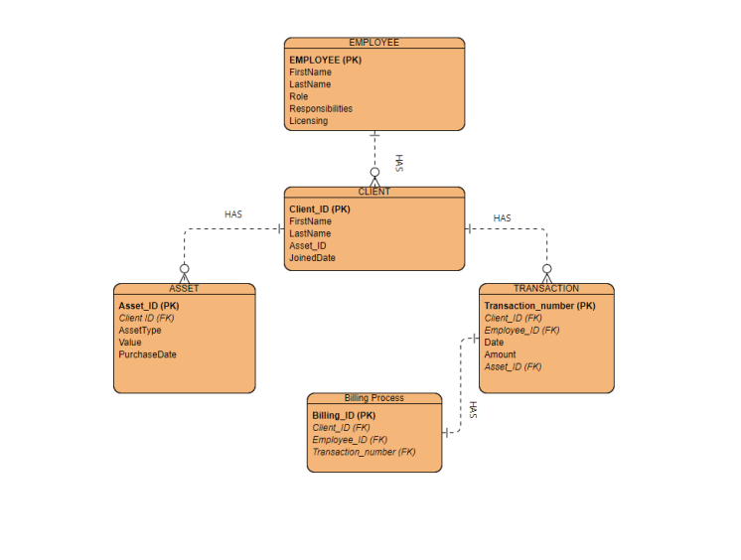
Finalized Entity Relationship Diagram

Slide 5
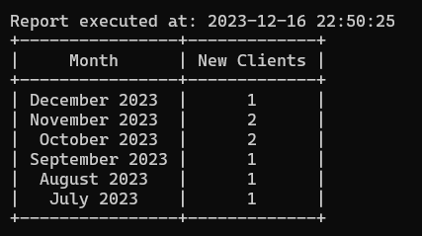
Report 1: Number of Clients Added Monthly
This report is designed to give the company an idea of how many clients are added monthly, and more specifically to see how many have been added for each of the past 6 months.
Report Result:

Slide 6
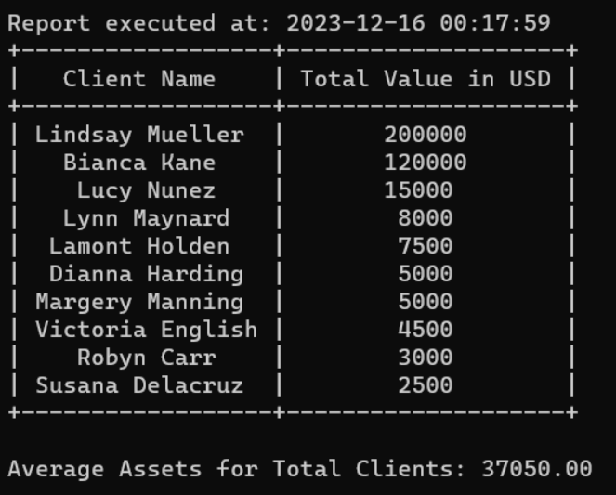
Report 2: Average Amount of Assets Per Client
This report is designed to show the average amount of assets in (currency in U.S. dollars) per client, and more specifically for the entire client list.
Report Result:

Slide 7
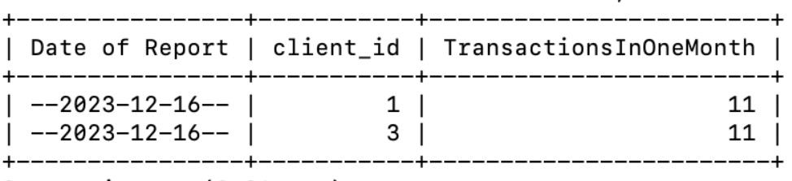
Report 3: High Transaction Frequency
This report is designed to show the number of clients who have a high transaction frequency, specifically more than 10 transactions per month.
Report Result:

Slide 8
Assumptions
1. Clientele and Business Location:
The current clientele consists mainly of ranchers, farmers, and retirees in a small town in New Mexico.
Expanding to other cities/states may lead to diversification in clientele.
2. Financial Licensing and Data Handling:
Staff handling financial data require proper financial licensing, while specific roles like Phoenix Two Star might not handle financial data directly.
3. Tracking and Changes in Billing:
Billing structure currently in place that charges clients a monthly fee.
The system tracks new client additions, average client assets, and clients with high transaction volumes over six months.
These assessments might prompt changes in the billing process at Willson Financial.

Slide 9
Assumptions (continued...)
4. Investment Goals and Compliance:
Clients should have well-defined investment goals, guiding tailored investment strategies.
All transactions must comply with SEC regulations and undergo compliance review by June Santos.
5. Company Operations and Client Reporting:
Willson Financial regularly reviews its client list and maintains up-to-date SEC registration.
Clients receive regular performance reports to evaluate portfolio performance and discuss investment strategies
6. Roles, Compliance, and Client Services:
Each employee has clearly defined roles.
Compliance with SEC regulations is mandatory in all transactions.
Regular client list reviews and performance reports are part of Willson Financials' operations.

