Slide 1
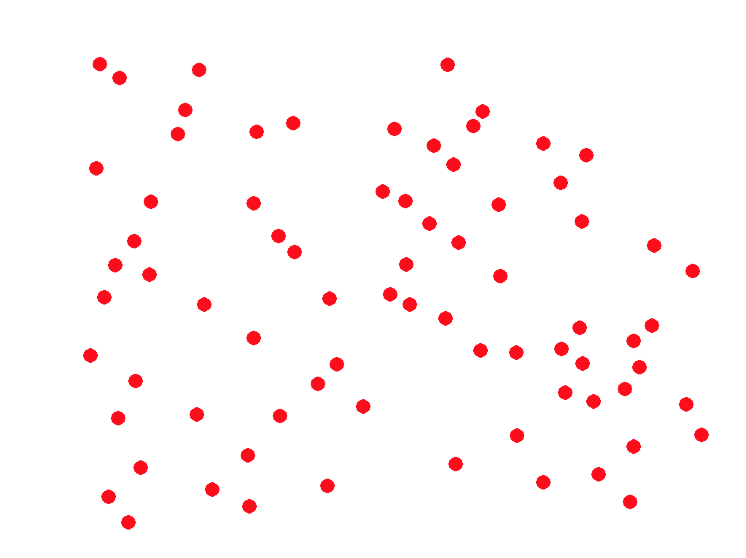






3.
2.
number
1.
$$number y_{t−1}$$
$$trial t$$
$$number y_{t−2}$$
magnitude
$$magnitude m_{t−2}$$
$$magnitude m_{t}$$
$$magnitude m_{t−1}$$

