Slide 1
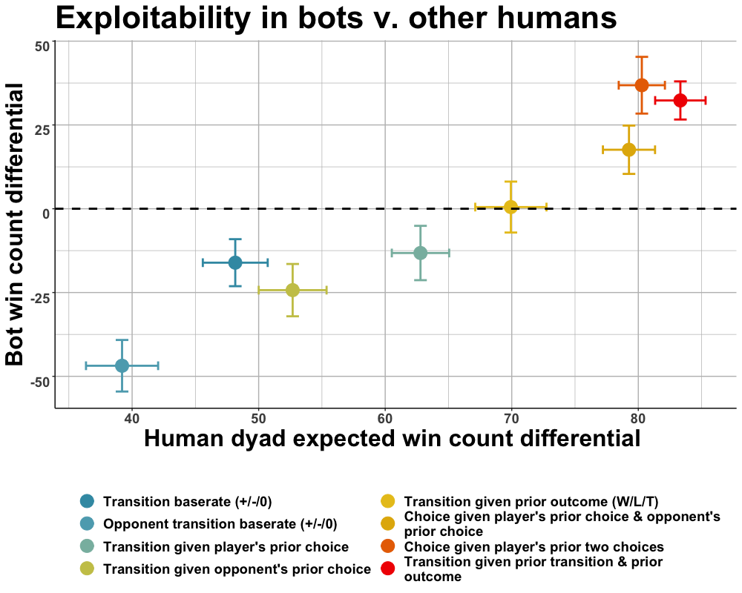
$$Reported in Brockbank \& Vul (2020)$$

