Slide 1
Pascal Compiler
Erik Ford
Principles of Translation
Fall 2019

Slide 2
Overview
Parsing techniques
System components and architecture
Known issues and remaining work
Demonstration

Slide 3
Parsing Techniques
Lexical Analysis – regular expressions
Syntax Analysis – LL(1) parsing
Semantic Analysis – static type checking
Intermediate Code Generation – syntax directed definitions
Final Code Generation - MIPS

Slide 4
System Components and Architecture
Built in Java
Main driver class
I/O module
Class for each phase of compilation
Custom data structures

Slide 5
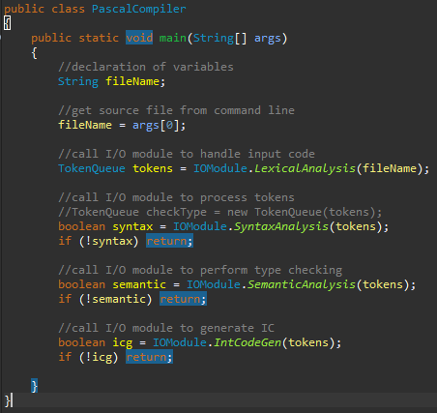
PascalCompiler.JAVA
Main driver program
Calls IOModule for each major phase of compilation
Exits early if any errors are detected

Slide 6
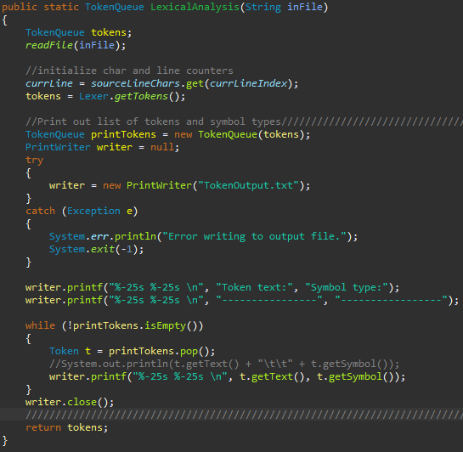
IOModule.JAVA
Handles all standard I/O between system, user, and files
Has methods for each phase of compilation
Includes input handling for initial source file

Slide 7
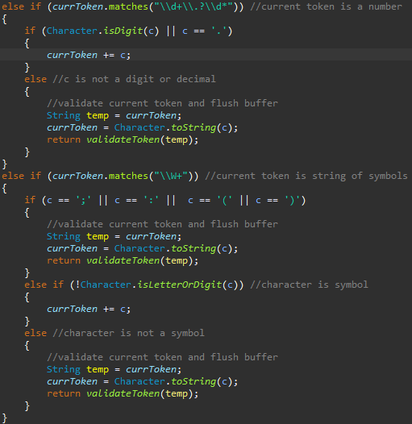
Lexer.java
Performs tokenization of source program
Uses regular expressions
Builds tokens through buffer character by character
Returns TokenQueue object to IOModule

Slide 8


Token.JAVA / TokenQueue.java
Token.java
Data structure representing token
Has fields text, symbol, and next
Basic get/set methods for each field
TokenQueue.java
Standard FIFO queue of Token objects
Implements basic queue functions

Slide 9
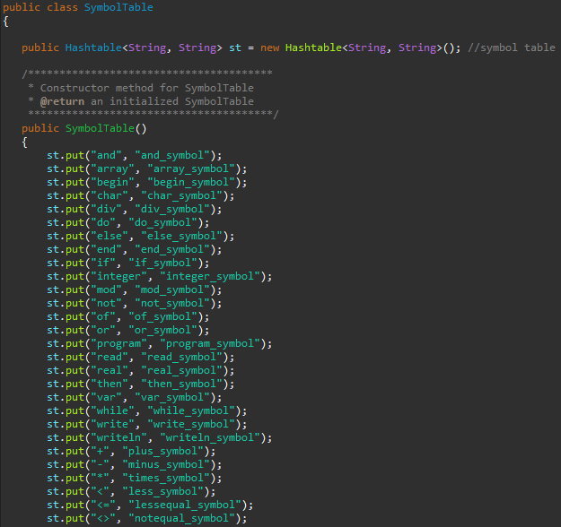
SymbolTable.java
Initialized with all reserved symbols
Implemented as HashTable<String,String>
Provides basic get and put functions

Slide 10
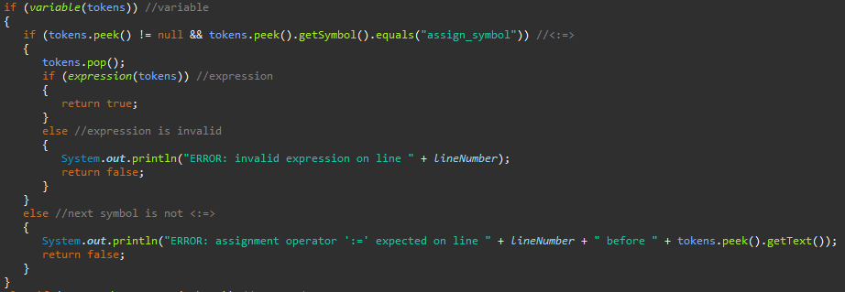
Parser.Java
Performs syntax analysis
Has a method for each nonterminal of grammar
Uses single lookahead symbol
Returns true on success to IOModule
Gives error messages if detected

Slide 11
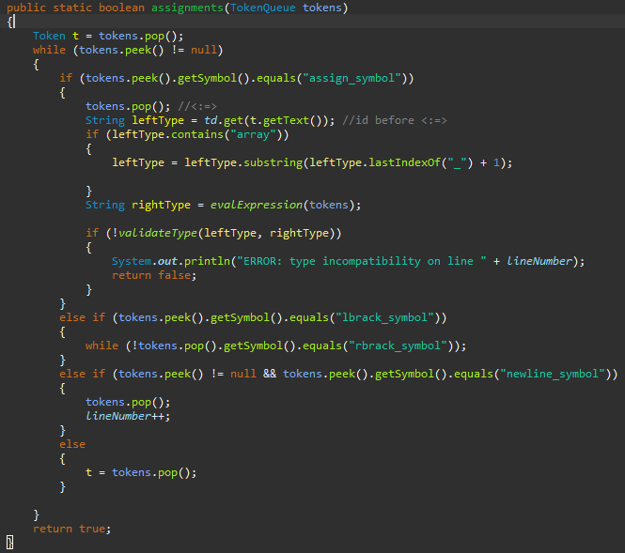
TypeChecKer.Java
Performs semantic analysis and type checking
Looks at declarations and adds to TypeDictionary
References TypeDictionary to determine type compatibility
Gives error messages if detected

Slide 12
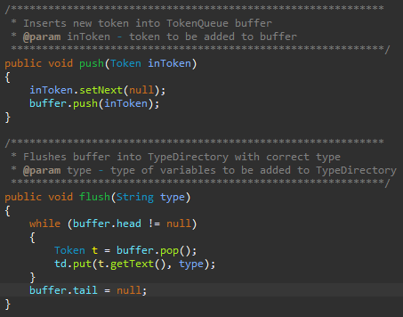
TypeDictionary.Java
Second symbol table used for type checking
Implemented as HashTable<String,String>
Utilizes TokenQueue during variable declarations
Provides get operation for TypeChecker

Slide 13

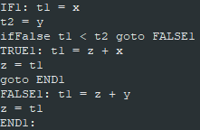

IntermediateCodeGenerator.JAva
Generates intermediate code (3AC)
Stored in text file
3AC used as input to FinalCodeGenerator
Similar process to syntax analysis

Slide 14
Remaining Work
Minor bug fixes for IntermediateCodeGenerator
Expression as array index
Checking for temp variable limit
Implementation of FinalCodeGenerator
Convert 3AC into MIPS assembly code
Creating read, write, writeln functions

Slide 15
Demonstration

