Slide 1

Maximizing Caloric Expenditure: A Comparative Study of Cardio Exercises
Erik Painter
Cleveland State University

Slide 2
Motivation
Caloric expenditure during exercise is a critical aspect of health and fitness
Investigate factors influencing caloric expenditure during exercise
Understanding these factors can inform and contribute to more effective workouts
To identify key factors influencing caloric expenditure, assess their impact using statistical analysis, and draw implications for future research and practice

Slide 3
Research Question
Do various types of cardio exercises produce differential effects on caloric expenditure?

Slide 4
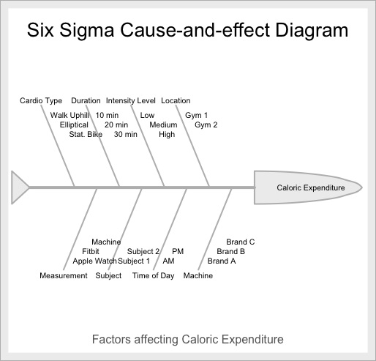
Cause Effect Diagram

Slide 5
Design
A 3x3 Replicated Latin Square Design will be used
Allows for controlling of potential confounding variables and reduces variability
Best for simultaneous blocking with a limited number of experimental units
Very efficient!

Slide 6
Design Cont.
This design involves 3 factors, 1 treatment and 2 blocking, with 3 levels for each factor
4 replicates -> 2 subjects, AM & PM sessions
Multiple replications of the Latin Square are conducted to increase the power of our test
Each replicate comes from the same 3x3 Latin Square

Slide 7
Standard 3x3 Latin Square
 | 1 | 2 | 3
1 | A | B | C
2 | B | C | A
3 | C | A | B

Slide 8
Permuting Rows & Columns
Random real numbers between [0,1] were generated for each row and column
Rows and columns were reordered based on these real numbers in descending order

Slide 9
Assigning Treatments
Similar to row and column permutations
Random real numbers between [0,1] were generated for each treatment level (T1, T2, T3)
Treatments were sorted based on these numbers in descending order (Highest went to A, Lowest to C)

Slide 10
Final Latin Square
 | Low | Medium | High
10 Min | A | C | B
20 Min | B | A | C
30 Min | C | B | A
A = Walking Uphill, B = Elliptical, C = Stationary Bike

Slide 11
Experimental Order
Randomizing order in which participants would perform experiment
Each factor combination was randomized for each replication
Result was 4 randomized lists of length 9
Each list had rows in random order for each unique combination of factors

Slide 12
Duration | Intensity | TRT | Cal. Burned
10 | Low | A
10 | Medium | C
10 | High | B
20 | Low | B
20 | Medium | A
20 | High | C
30 | Low | C
30 | Medium | B
30 | High | A

Slide 13
Sample Size
Experimental design with 3 treatment levels
Significance level set at 0.10 & power set at 80%
Estimated standard deviation from pilot data
Effect size chosen at 50, which indicates significant difference in caloric expenditure

Slide 14
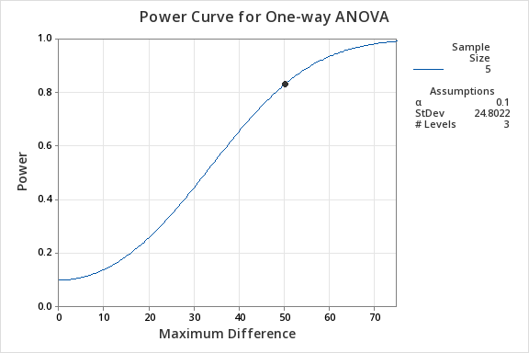

Slide 15
Scope of Analysis
Comparison of caloric expenditure across various cardio exercises, durations, and intensity levels within the experimental constraints
Analysis confined to the participants of the experiment due to convenience sampling
Low generalizability

Slide 16
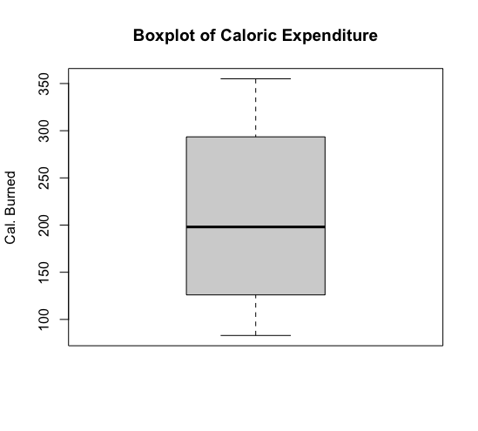
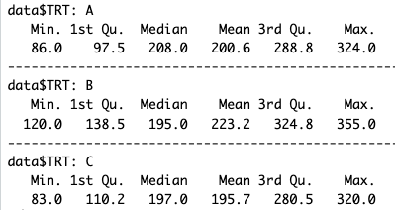
Exp. Data Analysis

Slide 17
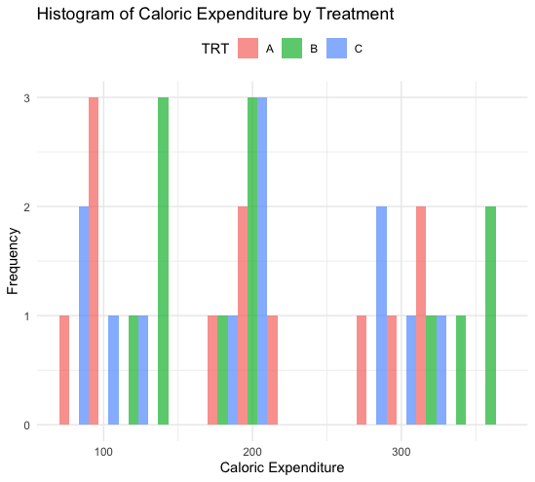
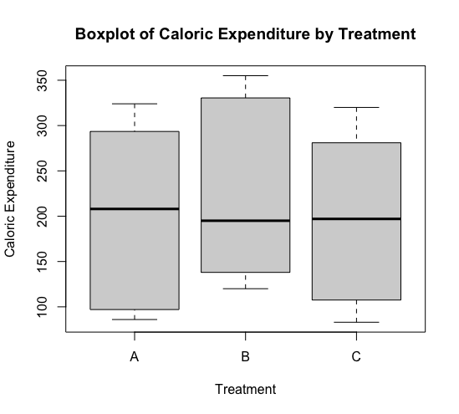
Exp. Data Analysis

Slide 18
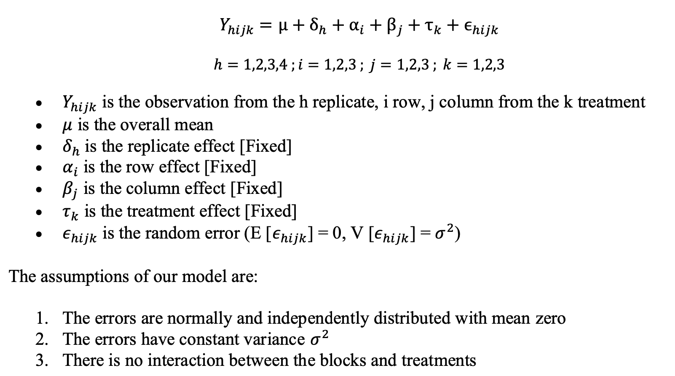
Model

Slide 19
Estimation Methods
Estimating Treatment Effects:
MS for treatment factor is estimated by calculating variance among treatment level means (variability among treatment levels)
’Treatment Effect’ comes from deviation from overall mean
Estimating Blocking Factor Effects:
MS for blocking is estimated by calculating the variance among the block means (variability among blocks)
‘Row/Column Block Effect’ comes from deviation from overall mean
ANOVA:
Analyze the variation in caloric expenditure across different treatments and blocking factor levels
We are not interested in blocking factor level effects, but can be important for analyzing certain aspects of the experiment
Post-hoc Tests:
Conduct post-hoc tests (such as Tukey's HSD test) to determine which specific treatment levels differ significantly from each other in terms of mean caloric expenditure

Slide 20
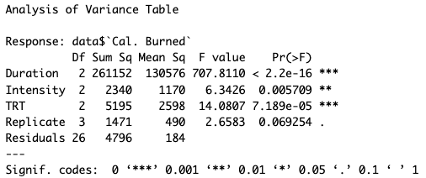
ANOVA

Slide 21
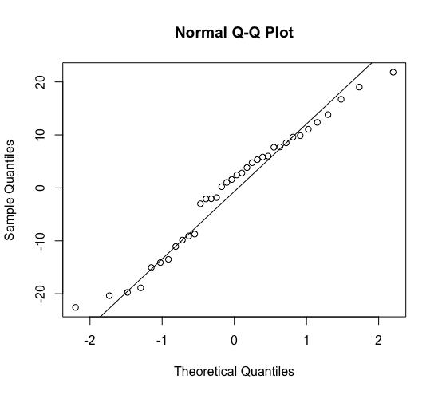
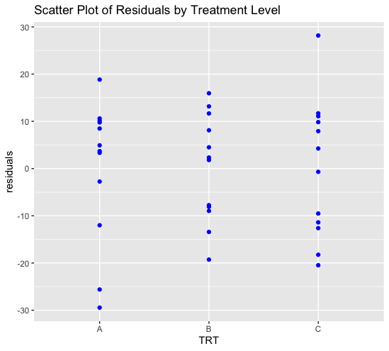
Residuals

Slide 22
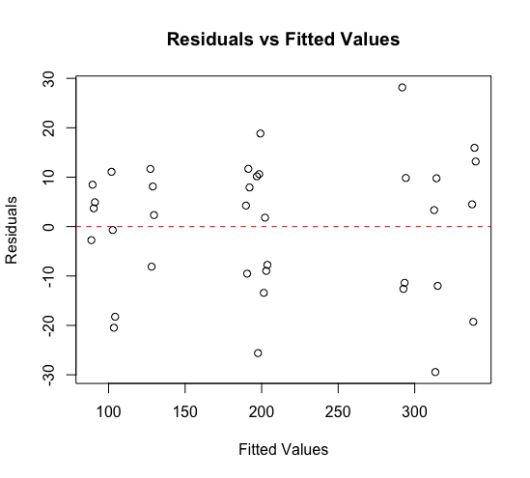
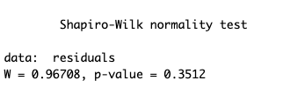

Residuals Cont.

Slide 23
Multiple Comparison
Tukey’s HSD test
Controls for family-wise error rate
Identifies any difference between two means that is greater than the expected standard error

Slide 24
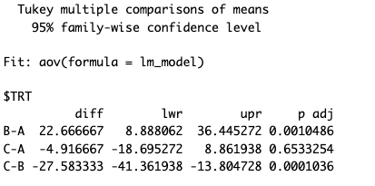
Tukey’s Test Results

Slide 25
Overall Results
Treatment B significantly increases caloric expenditure compared to Treatments A and C
Treatment B emerges as the most effective in maximizing caloric expenditure
Findings inform personalized exercise plans for enhanced weight management and overall health

Slide 26
Implications
Low generalizability
Small sample size reduces statistical power
Many factors not included affect caloric expenditure
No baseline screening of subjects
Given our sample size calculation, max detectable difference is much higher than our results detectable difference

Slide 27
Replicated Comparison
3 different types of replicated Latin Square Designs
Each requires a different model
Our design has highest d.f. for error
Repeated vs. Replicated?

Slide 28
Further Questions
Future experiments could explore caloric expenditure more comprehensively with factorial designs
A 2^k factorial design can efficiently screen influential factors for further investigation
Treatment Level B shows promise in maximizing caloric expenditure, how does it compare to other exercises
Absence of residual issues enhances confidence in study validity
Acknowledgment of study limitations highlights the need for future research to delve deeper into caloric expenditure during exercise

Slide 29
Any Questions?

