Slide 1
Naïve Bayes
1 TODO 2017

Slide 2
Agenda
Theory Naïve Bayes (technology agnostic)
Naïve Bayes in Knime
Naïve Bayes in Spark
Discussion about training and scoring using different environments

Slide 3
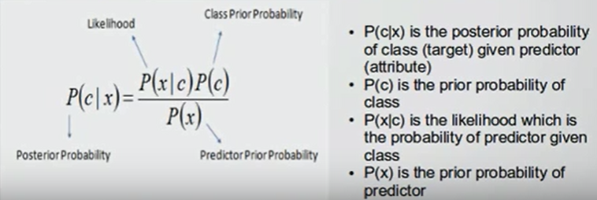
How it works
See: https://www.youtube.com/watch?v=XcwH9JGfZOU

Slide 4
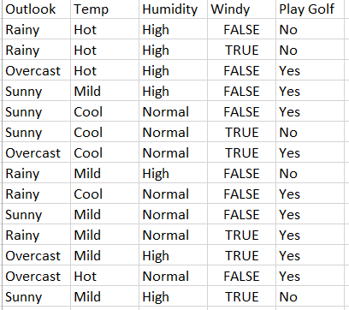
Historical observations – Person X playing golf
Question:
Will person X will play golf if it is: Rainy, Mild temperature, Normal Humidity, Not windy

Slide 5

How it works
See: https://www.youtube.com/watch?v=XcwH9JGfZOU
What is the probability that on a sunny day he will play golf?

Slide 6
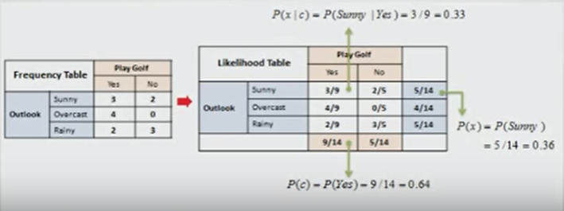
Calulate the probability that X will play golf it is Sunny

Slide 7
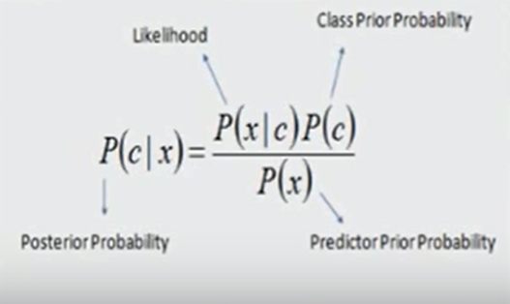
Probability of playing golf on a sunny day

Slide 8
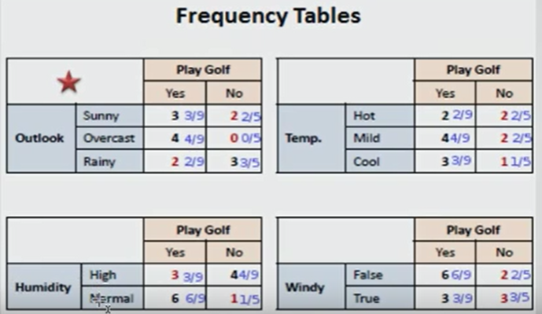
Calculate the freq. Table for each attribute

Slide 9
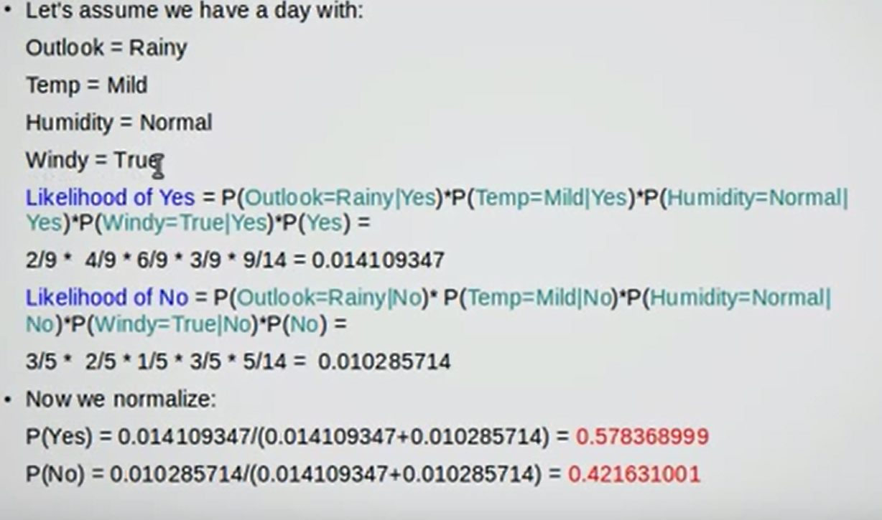

Slide 10
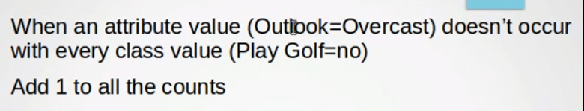
How to deal with zero values

Slide 11
Naïve Bayes in Knime
https://www.knime.org/downloads/overview

Slide 12
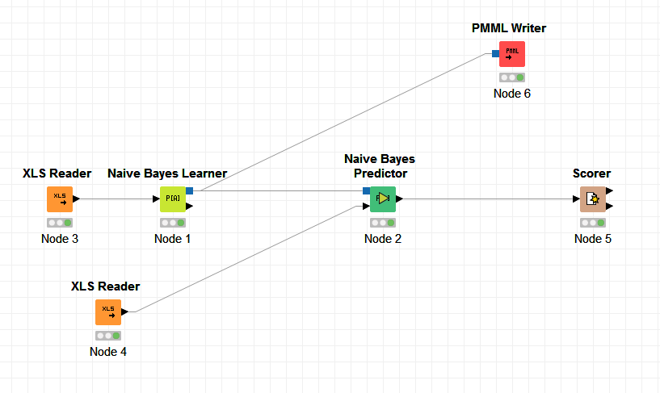
Lets run this in Knime (Demo)
You can download Knime from: https://www.knime.org/downloads/overview
You can get the training and test data from Github: https://github.com/erik121212/naivebayes/tree/master/spark-core/naive-bayes/src/main/resources/knimedata

Slide 13
Naïve Bayes in Spark

Slide 14
Machine Learning Library (MLlib)
Common learning algorithms
Classification,
Regression
Clustering
Collaborative filtering
Dimensionality reduction

Slide 15
Features of Naive Bayes
Features
Simple multiclass classification
Training is done in a single pass
assumption of independence between every pair of features

Slide 16
MLlib - Data Types
Underlying data types for the ML algorithms
Local vector
Labeled point
Local matrix
Distributed matrix

Slide 17
Labeled point
A labeled point is a local vector, either dense or sparse, associated with a label/response
Example
// Create a labeled point with a positive label and a dense feature vector.
val pos = LabeledPoint(1.0, Vectors.dense(1.0, 0.0, 3.0))

Slide 18
Spark Example
// Load and parse the data file.
val data = MLUtils.loadLibSVMFile(sc, <some file>)
// Split data into training (60%) and test (40%).
val Array(training, test) = data.randomSplit(Array(0.6, 0.4))
val model = NaiveBayes.train(training, lambda = 1.0, modelType = "multinomial")
val predictionAndLabel = test.map(p => (model.predict(p.features), p.label))
val accuracy = 1.0 * predictionAndLabel.filter(x => x._1 == x._2).count() / test.count()

Slide 19
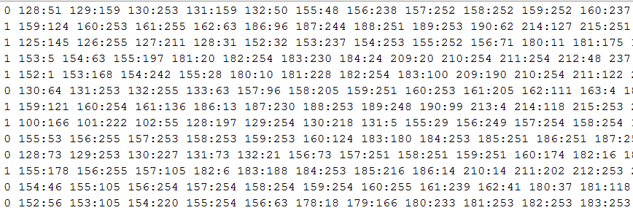
A data file…

Slide 20
val pos = LabeledPoint(1.0, Vectors.dense(1.0, 0.0, 3.0))
Q: How do we transfer “Rainy”, “Mild”, “Normal”, True into a LabelPoint
A: Each unique value gets it own Feature
e.g.
“Sunny” → LabeledPoint(1.0, Vectors.dense(1.0, 0.0, 0.0))
“Overcast” → LabeledPoint(1.0, Vectors.dense(0.0, 1.0, 0.0))
“Rainy” → LabeledPoint(1.0, Vectors.dense(0.0, 0.0, 1.0))

Slide 21
Demo
Analyze and run the following code from Github: https://github.com/erik121212/naivebayes

Slide 22
Discussion
1: Inspect the properties of the member variable
2: How can we do one-hot encoding?
e.g. https://spark.apache.org/docs/2.0.2/ml-features.html#onehotencoder
3: How can we get the model to save to a file? And is it the same as generated by Knime?
4: …

