Slide 1
Naïve Bayes
1 TODO 2017

Slide 2
Agenda
Theory Naïve Bayes
Naïve Bayes in Knime
Naïve Bayes in Spark
Discussion about training data on the fly

Slide 3
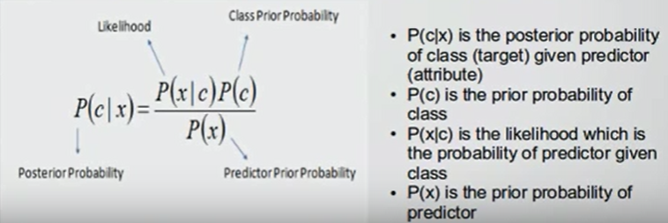
How it works
See: https://www.youtube.com/watch?v=XcwH9JGfZOU

Slide 4
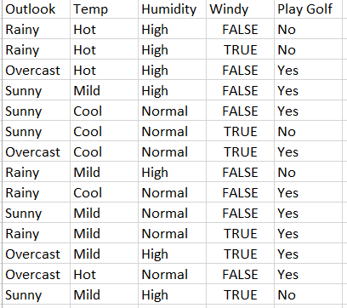
Historical observations – Person X playing golf
Question:
Will person X will play golf if it is: Rainy, Mild temperature, Normal Humidity, Not windy

Slide 5

How it works
See: https://www.youtube.com/watch?v=XcwH9JGfZOU

Slide 6
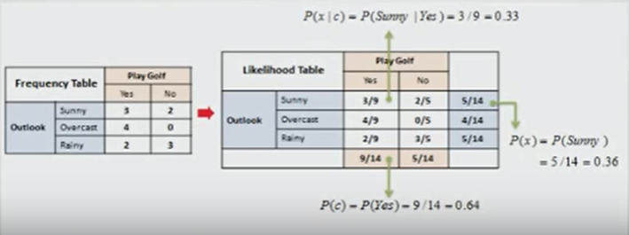
Calulate the probability that X will play golf it is Sunny

Slide 7
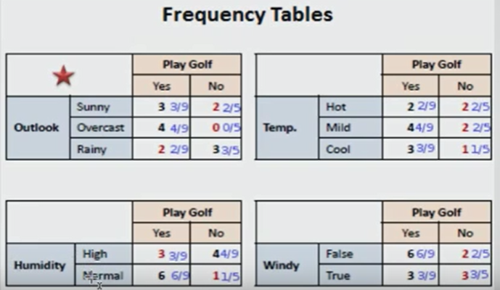
Calculate the freq. Table for each attribute

Slide 8
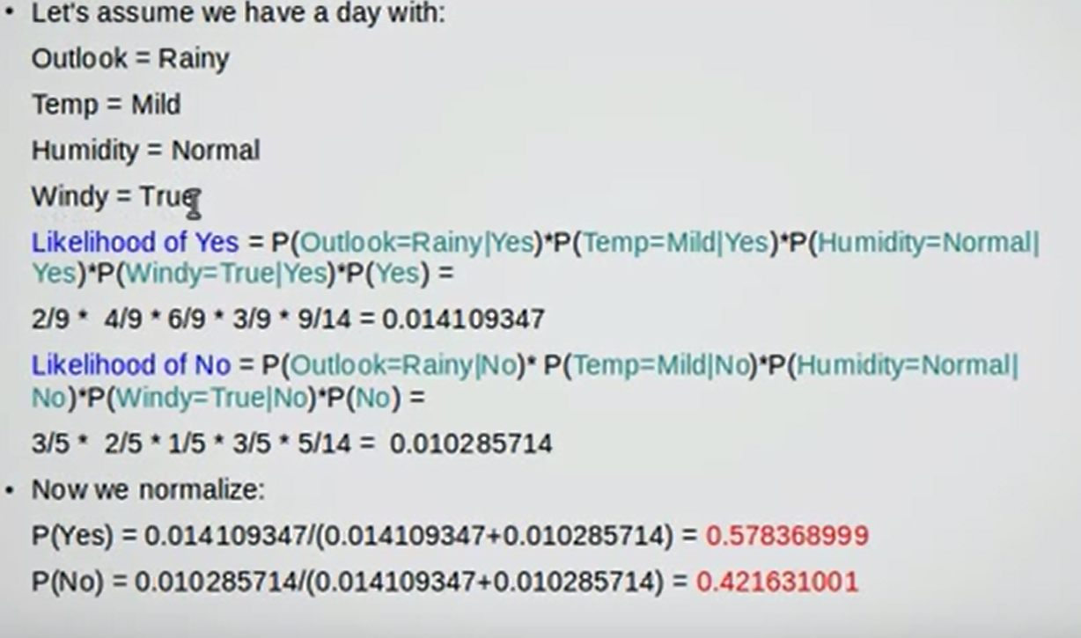

Slide 9
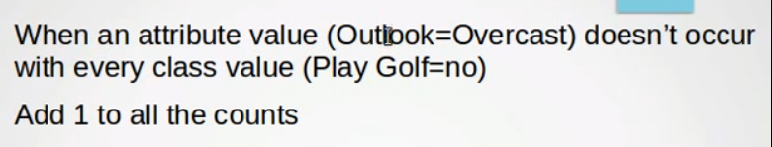
How to deal with zero values
https://www.knime.org/downloads/overview

Slide 10
Naïve Bayes in Knime

Slide 11
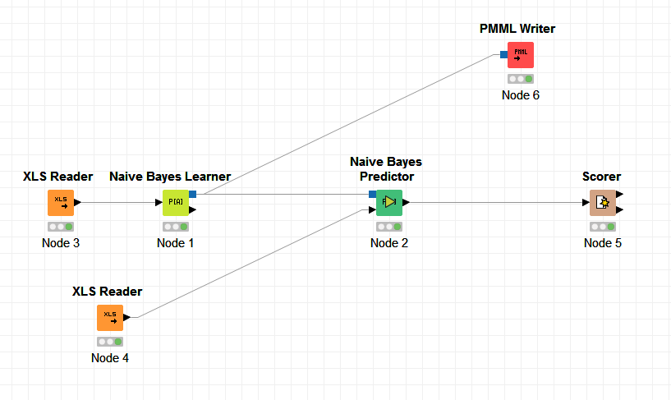
Lets run this in Knime (Demo)
You can download Knime from: https://www.knime.org/downloads/overview
You can get the training and test data from Github: https://github.com/erik121212/naivebayes/tree/master/spark-core/naive-bayes/src/main/resources/knimedata

Slide 12
Naïve Bayes in Spark

Slide 13
Machine Learning Library (MLlib)
Common learning algorithms
Classification,
Regression
Clustering
Collaborative filtering
Dimensionality reduction

Slide 14
Features of Naive Bayes
Features
Simple multiclass classification
Training is done in a single pass
assumption of independence between every pair of features

Slide 15
MLlib - Data Types
Underlying data types for the ML algorithms
Local vector
Labeled point
Local matrix
Distributed matrix

Slide 16
Labeled point
A labeled point is a local vector, either dense or sparse, associated with a label/response
Example
// Create a labeled point with a positive label and a dense feature vector.
val pos = LabeledPoint(1.0, Vectors.dense(1.0, 0.0, 3.0))

Slide 17
Spark Example
// Load and parse the data file.
val data = MLUtils.loadLibSVMFile(sc, <some file>)
// Split data into training (60%) and test (40%).
val Array(training, test) = data.randomSplit(Array(0.6, 0.4))
val model = NaiveBayes.train(training, lambda = 1.0, modelType = "multinomial")
val predictionAndLabel = test.map(p => (model.predict(p.features), p.label))
val accuracy = 1.0 * predictionAndLabel.filter(x => x._1 == x._2).count() / test.count()

Slide 18
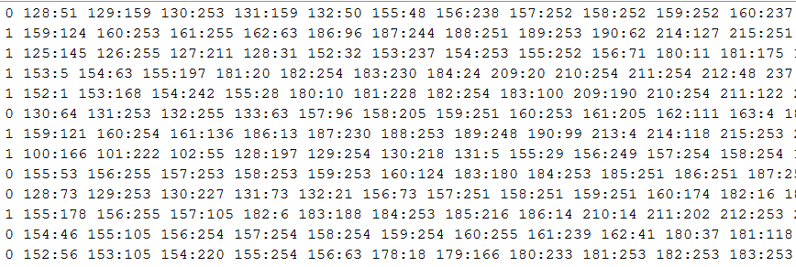
A data file…

Slide 19
val pos = LabeledPoint(1.0, Vectors.dense(1.0, 0.0, 3.0))
Q: How do we transfer “Rainy”, “Mild”, “Normal”, True into a LabelPoint
A: Each unique value gets it own Feature
e.g.
“Sunny” → LabeledPoint(1.0, Vectors.dense(1.0, 0.0, 0.0))
“Overcast” → LabeledPoint(1.0, Vectors.dense(0.0, 1.0, 0.0))
“Rainy” → LabeledPoint(1.0, Vectors.dense(0.0, 0.0, 1.0))

Slide 20
Demo
Analyze and run the following code from Github: https://github.com/erik121212/naivebayes

Slide 21
Online machine learning in Flink

Slide 22
Discussion
Suppose we get Business Events in Flink, how do we get the data in the right format to Spark to have it trained?

