Slide 1
Quiet Corners
Developed by:
Steven Bewerse, Erik Hendrickson and Michael Ware

Slide 2
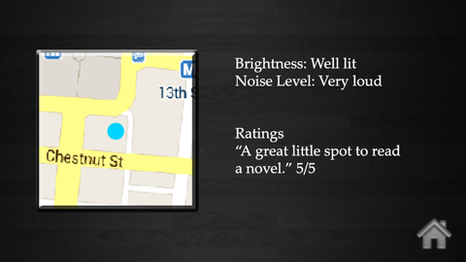
Vision and Scope
Quiet Corners is a humanitarian application used to log and rate quiet areas to study
Logs GPS Location, Pictures, Wireless Information, Sound Rating and Light Rating
Other users can view and rate locations or add their own
Initially released for just Android and just the USF area, but plenty of room to expand

Slide 3
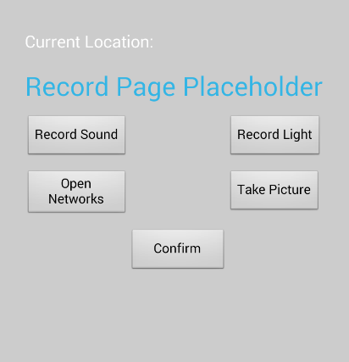
Features List
Create New Corners: users will be able to create their own Quiet Corners submission that will be stored externally on a MySQL database with associated information
GPS Location: each submission will contain a GPS location by default using built in GPS sensors
Decibel Meter: each submission will have the submitter attach a rating of the ambient sound of the location. This reading will be taken using the internal recording devices or the user’s subjective rating

Slide 4
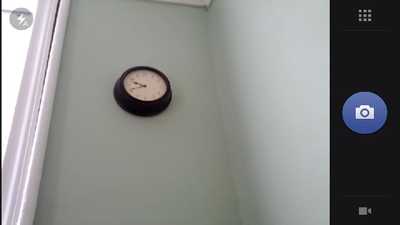
Features List
Lumen Meter: each submission will have the submitter attach a rating of the ambient light of the location. This reading will be taken using the internal light sensors of the phone and translated into a lighting rating. If the proper light sensors aren’t available, the submitter will be prompted for a subjective rating.
Wifi Information: each submission will have the submitter attach a rating of the wireless signal available at the location. This reading will be taken using the built in wireless tracking system. It will also be recorded if the wireless signal is password protected or not.
Picture of Corner: each submission will have the submitter attach a picture of the location using the internal camera.

Slide 5
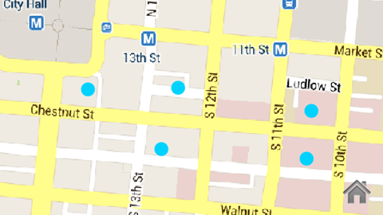
Features List
Corner Comments and Additional Information: each submission gives the submitter a chance to add any relevant text information. The comments/information can refer to an overall rating from the submitter or perhaps information like wireless passwords. (Internal Keyboard)
Rating: all submissions will have overall ratings averaged from all users who use the location. This rating will be given using a button interface in the application, rating between one and five stars.
Quiet Corner Locator: users can search for other user’s submissions using the corner locator. The locator will use internal GPS sensors to view the user’s current location and then compare it to the submission locations stored in the MySQL database.

Slide 6
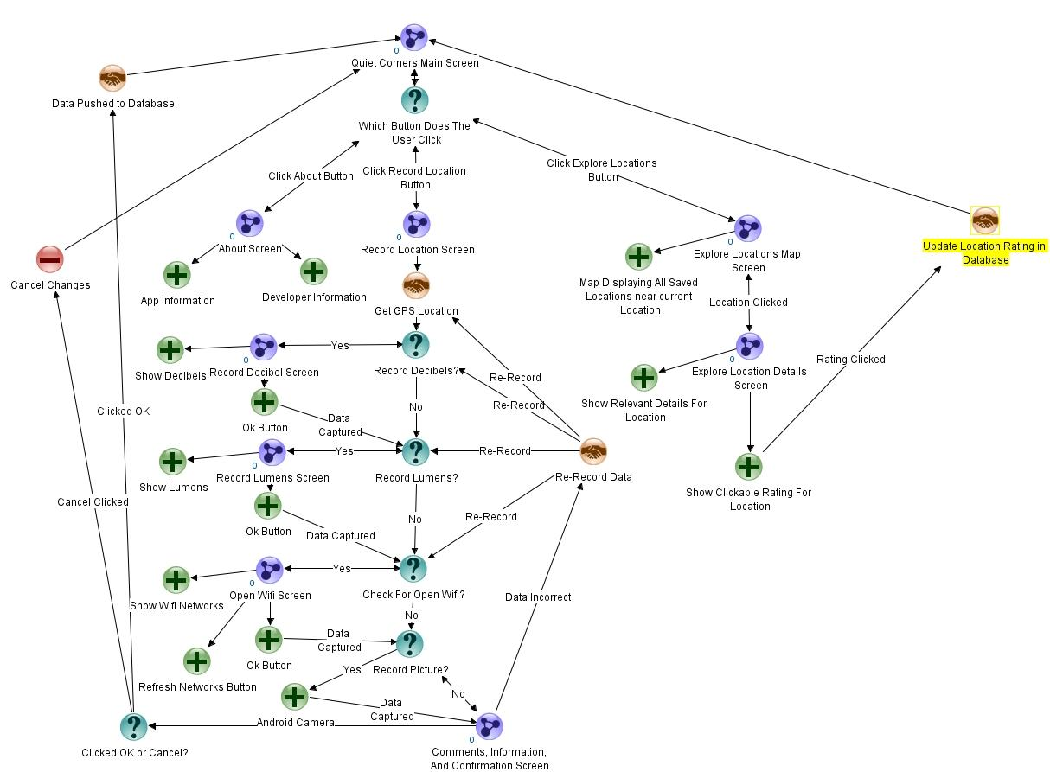
Dialogue Map

Slide 7
Conclusion
Much time and effort has been put into gauging the interest in an app like Quiet Corners, and the general consensus is one of excitement. We hope you take are proposal into consideration, and thank you for time.

