Slide 1
Quiet Corners
Developed by:
Steven Bewerse, Erik Hendrickson and Michael Ware

Slide 2
Vision and Scope
Quiet Corners is a humanitarian application used to log and rate quiet areas to study
Logs GPS Location, Pictures, Wireless Information, Sound Rating and Light Rating
Other users can view and rate locations or add their own
Initially released for just Android and just the USF area, but plenty of room to expand

Slide 3
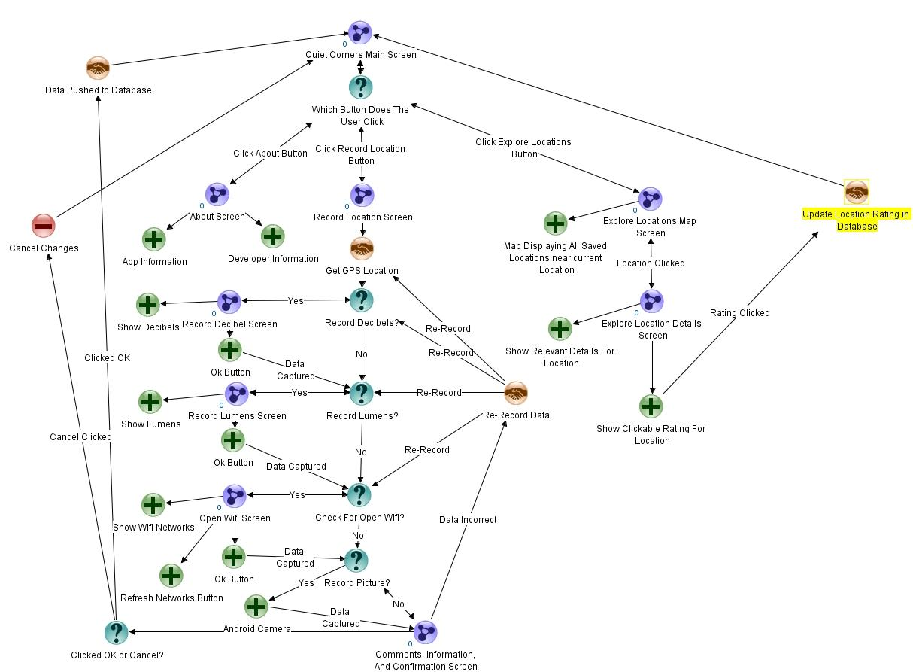
Dialogue Map

Slide 4
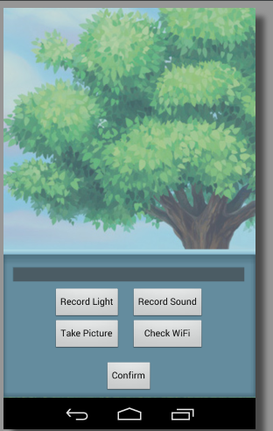
Feature: Create New Corner
Create your own Corners
Record relevant information into a Corner class using other features
View and rate your corner submission
Push your Corner to PHP server
PHP server parses the Corner and uploads into MySQL Database

Slide 5
Feature: Database
Everything that is saved through the database goes to a php front end.
The php server will get the intent of the query and any relevant data from the query string or post data
This is an example of a query

Slide 6
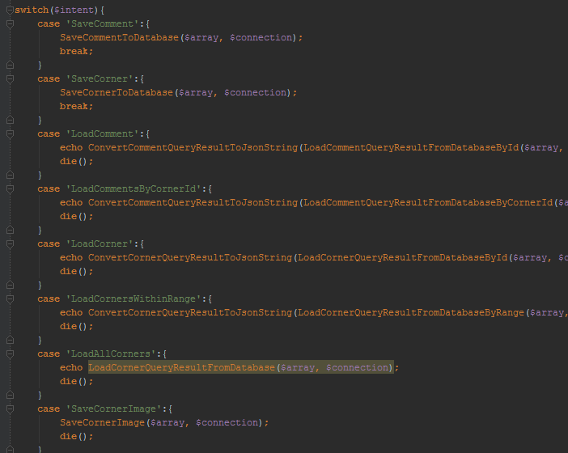
Feature: Database
This is the intent list in php, contains all functions for queries to and from database

Slide 7
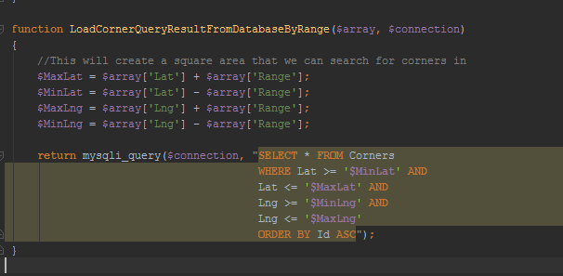
Feature: Database
This is a typical function written in php
This one loads all corners within a given range and location

Slide 8
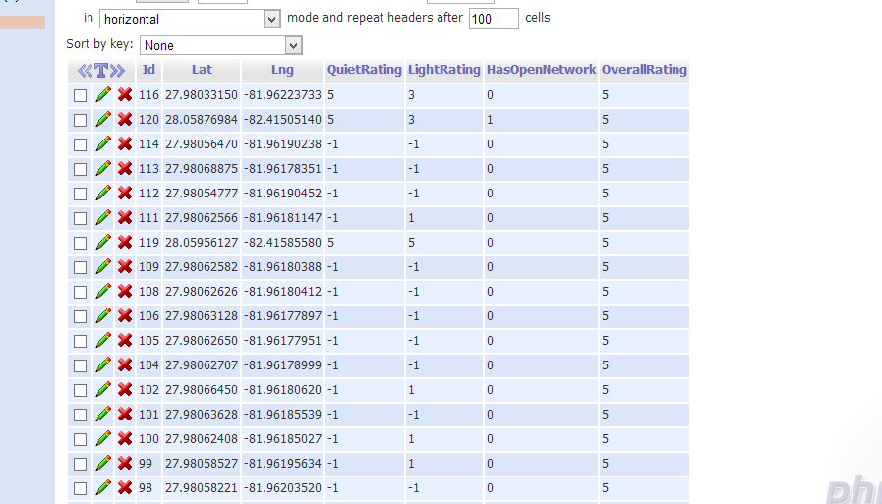
Feature: Database
Corners: consist of integer Id, 2 doubles for latitude and longitude, 3 integers for rating, and one boolean

Slide 9
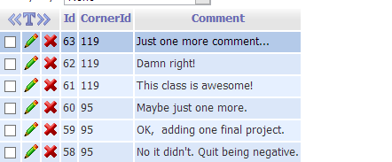
Feature: Database
Comments: 2 integer Ids, one string

Slide 10
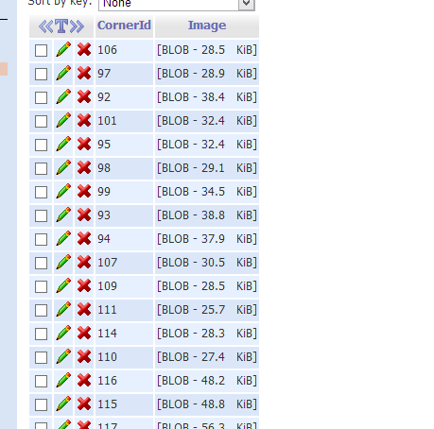
Feature: Database
Image consists of integer Id and Blob
Talk about BLOB

Slide 11
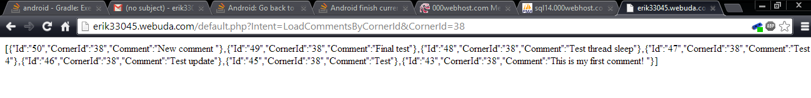
Feature: Database
This is a JSON data source return by PHP to android through HTTP Get

Slide 12
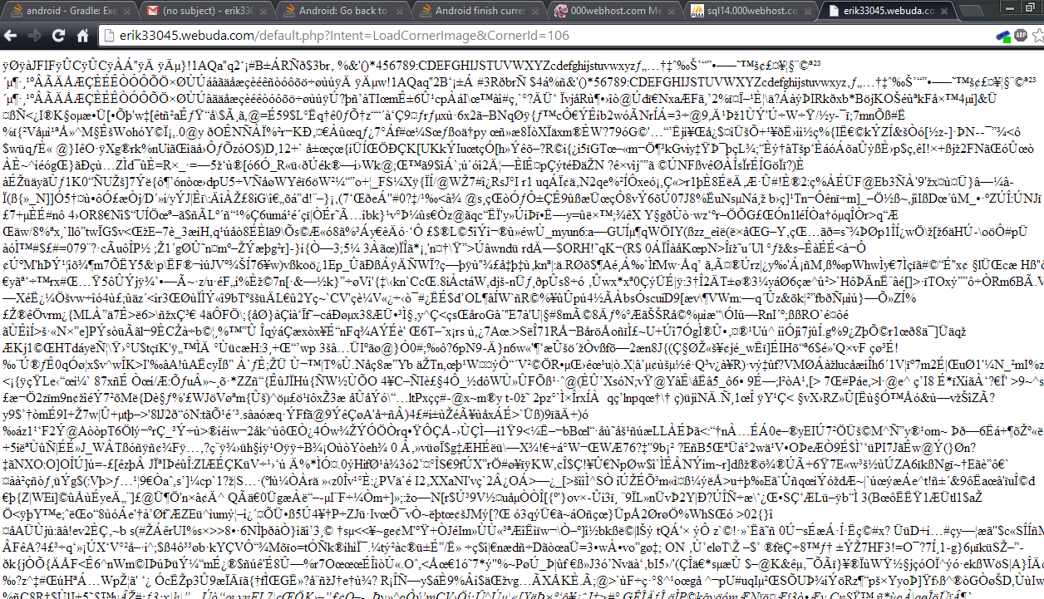
Feature: Database
This is the return data when we fetch an image from the database through HTTP Get

Slide 13
Feature: GPS Location
We use the built in Android class regarding location to pull the current GPS coordinates
This entails creating a listener event to find when the location is found or changed
When this event happens, we record the latitude and longitude to the corner’s internal properties

Slide 14
Feature: Sound Rating
Uses the microphone to record amplitude.
On button press, it will record a sample sound clip, and calculate amplitude.
The amplitude is converted into a 5-stcar scale.
Once finished, saves the rating to the Corner Information.

Slide 15
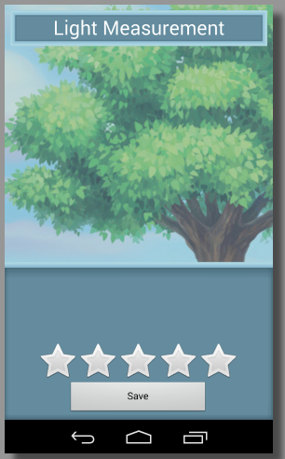
Feature: Light Rating
Use internal light sensors to rate the ambient lumen measurements
View rating bar that updates as the light changes and converts lumens to a 5-star scale
Rate manually if light sensors are unavailable
Send back light rating to be saved in Corner information

Slide 16
Feature: Wifi Information
Scans for local wifi points.
If wifi is turned on, it will interpret each wifi point.
Retrieves info from available wifi points and determines if they are open.
If the wifi point is open, it will store it as a boolean to the Corner information.

Slide 17
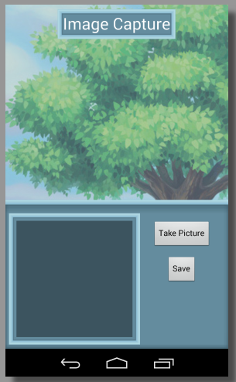
Feature: Picture of Corner
Use internal camera application to take a picture of the corner
View the picture preview
Convert to byte array
Send back byte array to be saved in Corner information

Slide 18
Feature: Comments
On the location details page, the user has the ability to add a comment for a corner.
A notification is displayed which has an input of a text box.
When then the user clicks save, we pass the text and the Corner Id to mySQL and store them
We then reload the comments, including the newly added one.

Slide 19
Feature: Explore Corners
The user clicks on the explore button which opens a map fragment activity
The map has a listener which waits for the current fine location
After location has been found, current position is passed to database to pull any corner Ids within about a 3 mile radius
These Ids are placed on markers which are clickable.
When a marker is clicked, we query the database for all info about a corner.
This then leads to the location details page which shows all properties for a corner including comments and the image.

Slide 20
Demonstration

