Slide 1
Pyum Project Advanced Python Dr. Tindell Spring 2014
Erik Hendrickson
Vi Tran
Mark Brophy
James Robe
Jason Maynard
Greg Alway

Slide 2
Overview
Vision and scope – Robe
Diabetes – Maynard
User interface – Tran
Driver - Brophy
Algorithms – Alway
Django / Webserver – Hendrickson
Demo - All

Slide 3
Vision and Scope
Vision
Say something about the vision here
Scope
Say something about the scope of the project here
Project goals?
Talk about how it is scalable to other needs like heart disease
Robe

Slide 4
Our Team
James Robe (Vision/Scope)
Jason Maynard (Diabetes / Reporting)
Erik Hendrickson (Django/Web Server)
Vi Tran (User Interface)
Mark Brophy (Driver)
Greg Alway (BMI / Calorie algorithms)

Slide 5

Type II Diabetes
Type I vs. Type II
Type I
Total lack of insulin
Only 5% of people have this
“juvenile” diabetes
Type II – Insulin imbalance
Adult onset
Body doesn’t use insulin properly
Does not produce enough insulin
Does not use it properly
Blood glucose levels too high “hyperglycemia”
Insulin helps move glucose from blood to cells

Slide 6
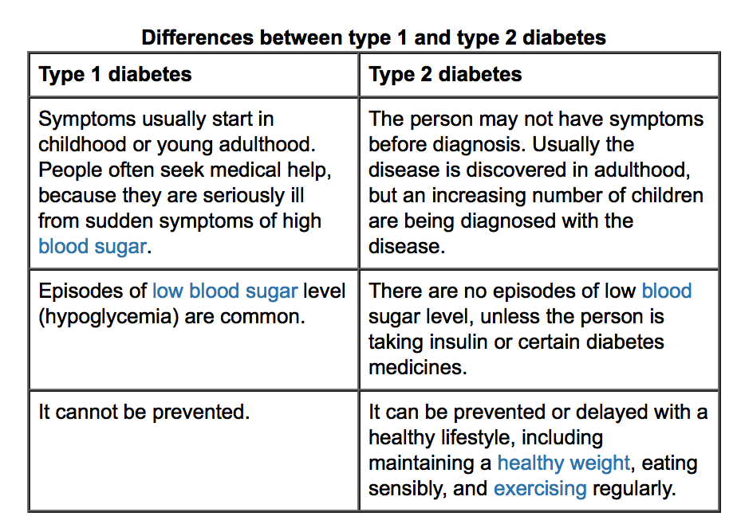
Type 1 vs. Type 2
“Eating sensibly”

Slide 7
Type II “Friendly” diet
The idea is to manage blood glucose
Carbohydrates
Simple (glucose)
Complex (starches)
Carbohydrate counting
Count carbs
Distribute over meals
Grains and starchy foods:
whole grain breads, such as whole wheat or rye
whole grain, high-fiber cereal
cooked cereal such as oatmeal, grits, hominy or cream of wheat
rice, pasta, dal, tortillas
cooked beans and peas, such as pinto beans or black-eyed peas
potatoes, green peas, corn, lima beans, sweet potatoes, winter squash
low-fat crackers, snack chips, pretzels and light popcorn
Non-starchy vegetables: spinach, carrots, lettuce, greens, cabbage, bok choy green beans, broccoli, cauliflower, tomatoes, vegetable juice, salsa, onion, cucumber, beets, okra, mushrooms, peppers,
Protein:
chicken or turkey without the skin fish such as tuna, salmon, cod or catfish other seafood such as shrimp, clams, oysters, crab or mussels lean cuts of beef and pork such as sirloin or pork loin tofu, eggs, low-fat cheese

Slide 8
Type II “Friendly” criteria
Carbohydrate counting
One carb = 15g per serving
Target 3 – 4 carbs per each meal (45 – 65 g per meal)*
1 – 2 carbs for snacks
No more than 400mg of sodium per serving
Healthy diabetic eating includes
Limiting foods that are high in sugar
Eating smaller portions, spread out over the day
Being careful about when and how many carbohydrates you eat
Eating a variety of whole-grain foods, fruits and vegetables every day
Eating less fat
Limiting your use of alcohol
Using less salt
* Check with health care provider for individual goals

Slide 9
Diabetes Implementation
Screenshot of UI here

Slide 10
User Interface
Tran

Slide 11
Driver Program
Brophy

Slide 12
Calorie Requirements
Basal Metabolic Rate (BMR) –
Number of calories burned at rest
Calculated using height, weight, age and gender
Male:
BMR = 66 + (6.23 * weight) + (12.7 * height) - (6.8 * age)
Female:
BMR = 655 + (4.35 * weight) + (4.7 * height) - (4.7 * age)

Slide 13
Calorie Requirements (cont.)
Harris Benedict Equation
Uses BMR and user’s activity level to determine total daily energy expenditure in calories
Sedentary (little or no exercise):
Calories = BMR * 1.2
Lightly active (light exercise 1-3 days/week)
Calories = BMR * 1.375
Moderately active (moderate exercise 3-5 days/week)
Calories = BMR * 1.55
Very Active (hard exercise 5-7 days/week)
Calories = BMR * 1.75
Extra Active(very hard exercise twice per day)
Calories = BMR * 1.9

Slide 14
Calorie Requirements (cont.)
User can select whether to maintain weight, or gain or lose ½, 1, or 2 pounds per week.
1 pound of fat ≈ 3500 calories
To gain or lose weight, add or subtract calories from daily energy expenditure
½ ppw = 250 calorie deficit/surplus per day
1 ppw = 500 calorie deficit/surplus per day
2 ppw = 1000 calories deficit/surplus per day

Slide 15
Django / Webserver
Hendrickson

Slide 16
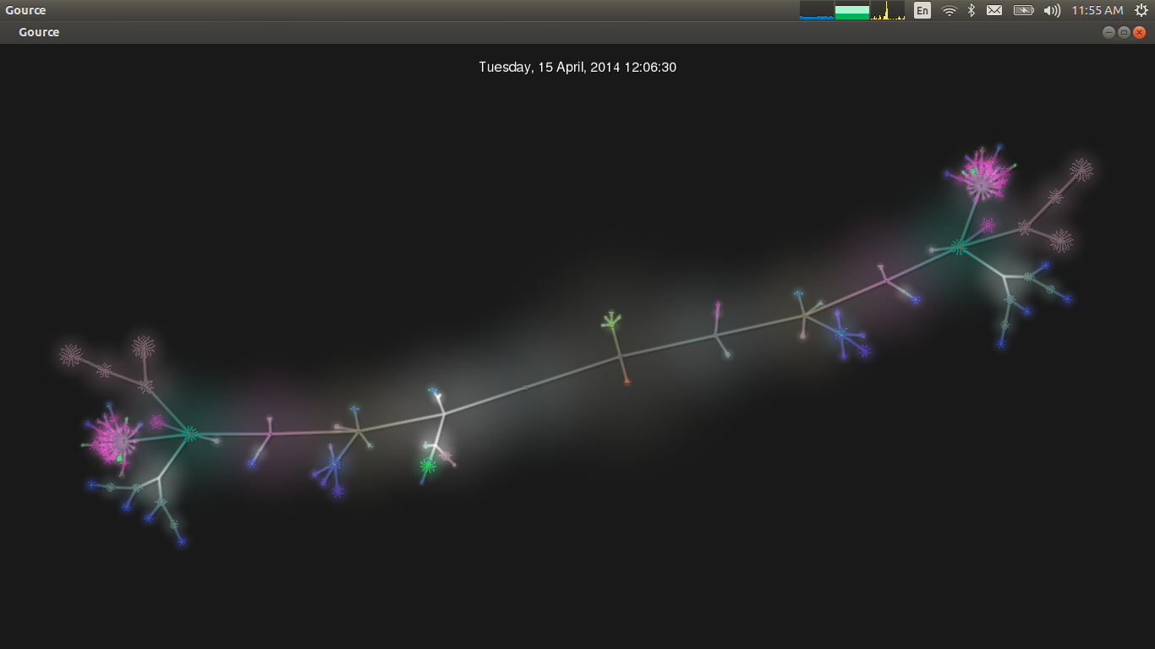
Demo
Maybe show the awesome graphic / video here ?
Hendrickson

Slide 17
Summary
Tell ‘em what we told ‘em
Robe

