Slide 1

ReFrameWork and GitHub Quickstart

Slide 2
ReFrameWork simplified
Initialization
Error
Success
Error
Get Transaction Data
End
No More
Exception
Next
Success
Process

Slide 3
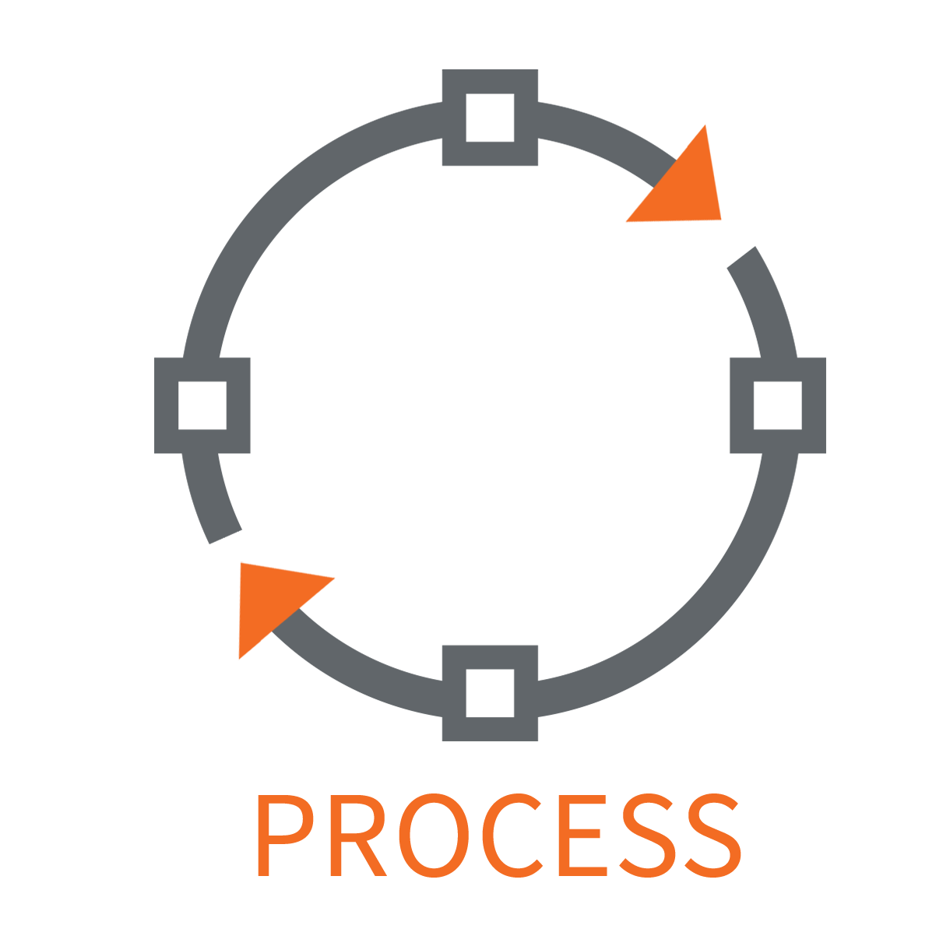
Main components of ReFrameWork
TransactionData
TransactionNumber
1
TransactionItem
2
TransactionItem
Get TransactionItem
3
TransactionItem
4
TransactionItem
5
TransactionItem
6
TransactionItem
7
TransactionItem
8
TransactionItem
9
TransactionItem

Slide 4
Initialization
Read the Configuration file located in the Data folder.
Get the TransactionData. It can be a DataTable, Excel file, or array etc.
Open and initialize applications.
In our example we will get a list of the filepaths of the PDFs that we want to process using Directory.GetFiles(Config("PathToFiles").ToString).
TransactionData must be type String[], a string array.
TransactionItem must be type String.
Example: https://github.com/erika-bot/Sample

Slide 5
Example
List of Filepaths
TransactionNumber
1
Filepath
2
Filepath
Get a File
3
Filepath
4
Filepath
5
Filepath
6
Filepath
7
Filepath
8
Filepath
9
Filepath

Slide 6
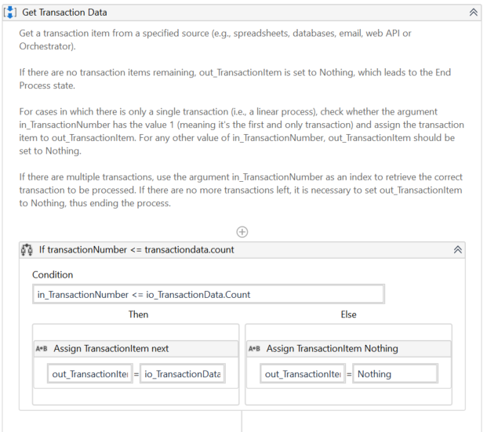
Get Transaction Data
This condition needs to be added to the Get Transaction Data workflow to assign the next TransactionItem. If there are no more items, out_TransactionItem should be set to Nothing.

Slide 7

Code hosting
Version control
Collaboration
Easy to use with UiPath Studio

Slide 8
Getting started
Create a repository in GitHub
Clone the repository to local machine
Add new a project or add changes
Commit and push
https://docs.uipath.com/studio/docs/managing-projects-git

Slide 9
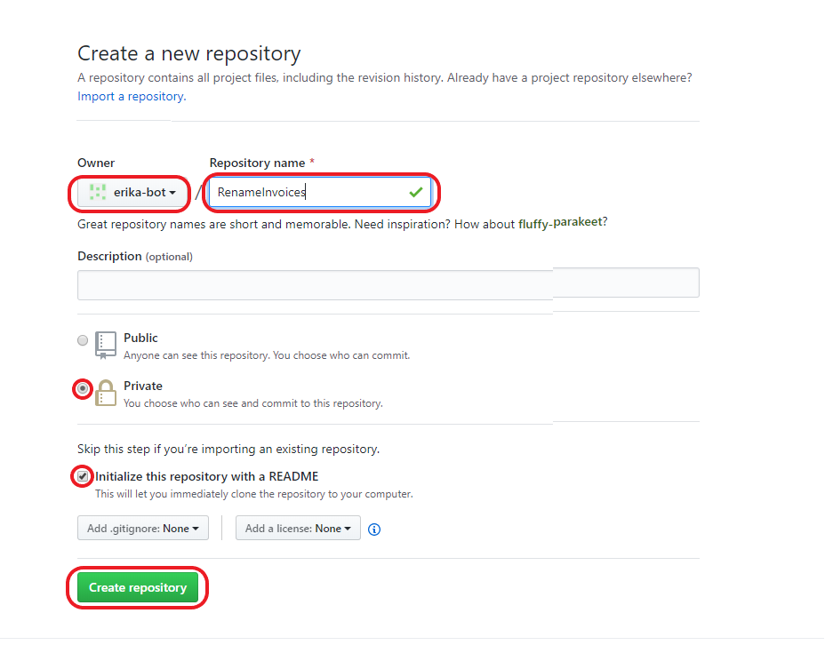
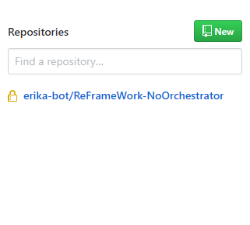
Create a repository in GitHub
When you do this, you will select the name of your organization. Not erika-bot.

Slide 10
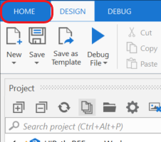
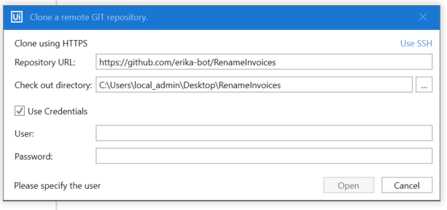
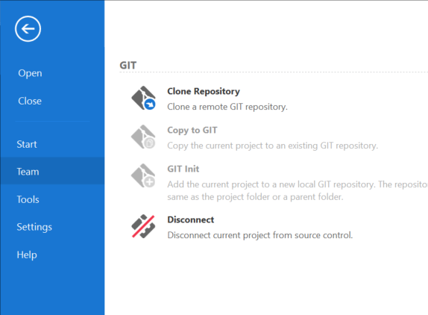
Clone the repository to local machine
1
Url of repository in GitHub.
Path to destination folder. This one will be created if not already there.
3
GitHub username or email.
2
GitHub password.

Slide 11
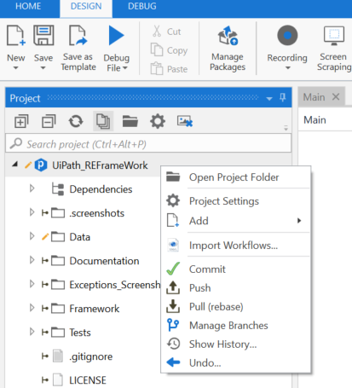
Git functions in UiPath
Right click on a folder or file in Project to see Git functions.
Commit – Saves the changes you made to your local repository.
Push – Syncs the remote repository to your local repository. You must commit before you push your changes.
Pull – In case your copy is not up to date, you pull first, which syncs you local repository to the remote one.
Undo – Restores your project to the last commit. All changes made after your last commit is removed.

Slide 12
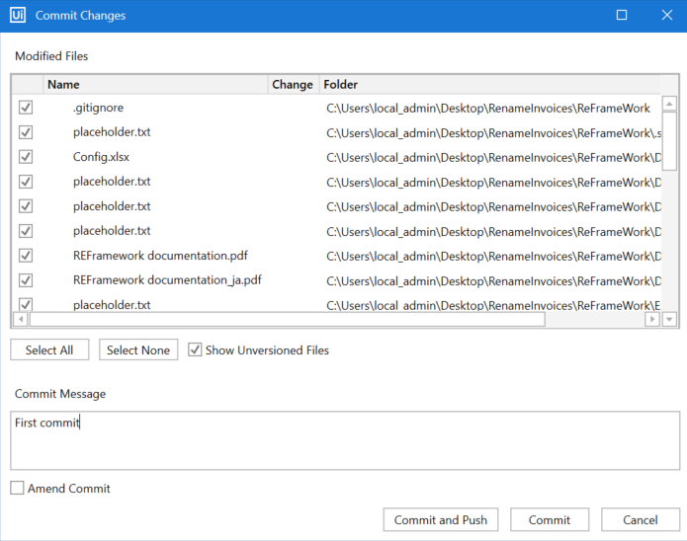
Commit or commit and push
Enter a message that describes the changes that were made.
Commit and push will save the changes and sync the remote repository to the new version.
Commit will only save changes to your local repository and not save to GitHub repository.
1.
2.
or
3.

Slide 13
More information
https://rogerdudler.github.io/git-guide/
https://github.com/UiPath/ReFrameWork

