Slide 1

Real Estate Insights Across the 50 States
Presented by:
Alexia, Devi, Erika and Kevin

Slide 2
Our Goal: A Comprehensive Guide for Post-Education Homebuying
Assisting individuals in making informed decisions regarding their future home purchase after completing their education.
Average annual salary by state based on household size
The average cost of homes per square foot
General averages of homes by state and major cities
Individuals will be equipped with the necessary knowledge to assess the financial possibilities and preferences for their future home, aligning their choices with their personal and financial goals.

Slide 3
Data Sources
Excel File from Rockethome.com:
Contains house prices variations by state in 2023.
CSV File from Justice.gov:
Contains annual salary data based on family size by state for the period between April 1st and May 14, 2023.
CSV File from Zillow Economics Data:
Provides data on major cities within states and their corresponding average house prices.
CSV File from Fred Economic Research:
Contains information on average home prices and square footage.

Slide 4


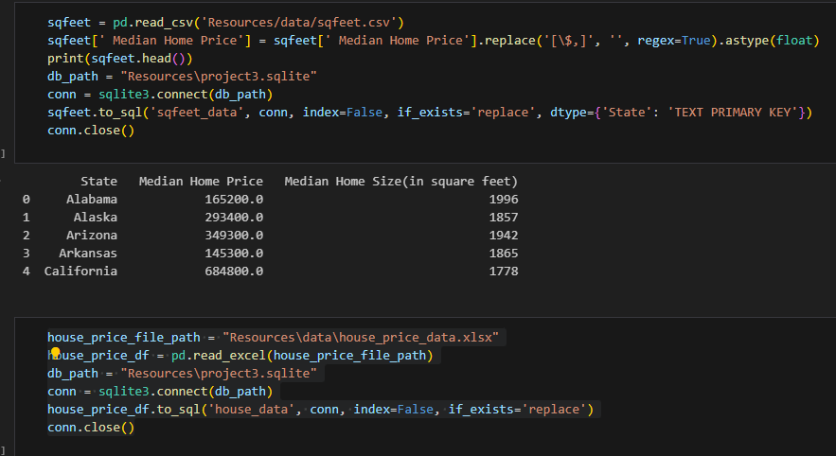
Real_estate.ipynb
Project3.sqlite

Slide 5
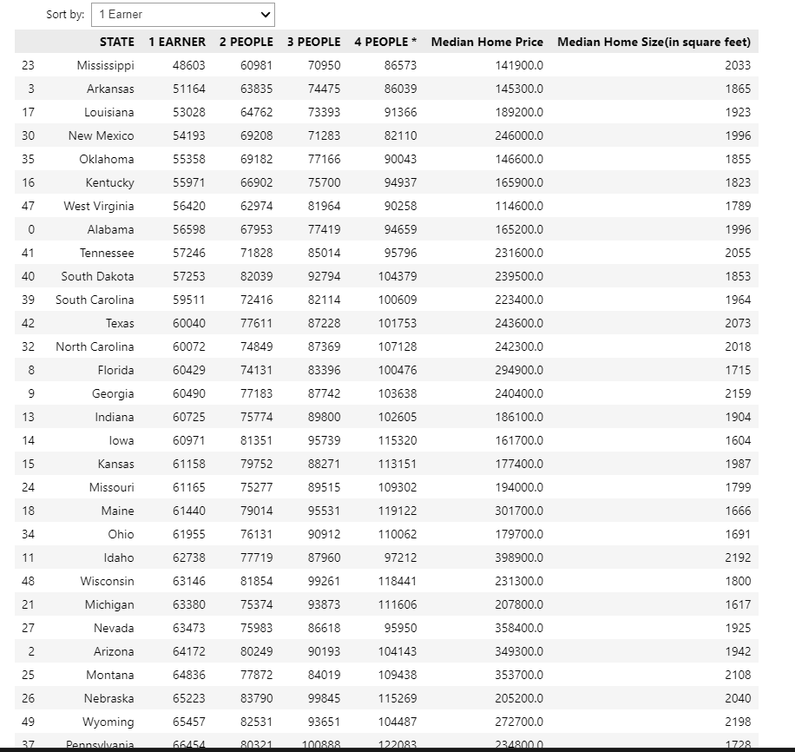
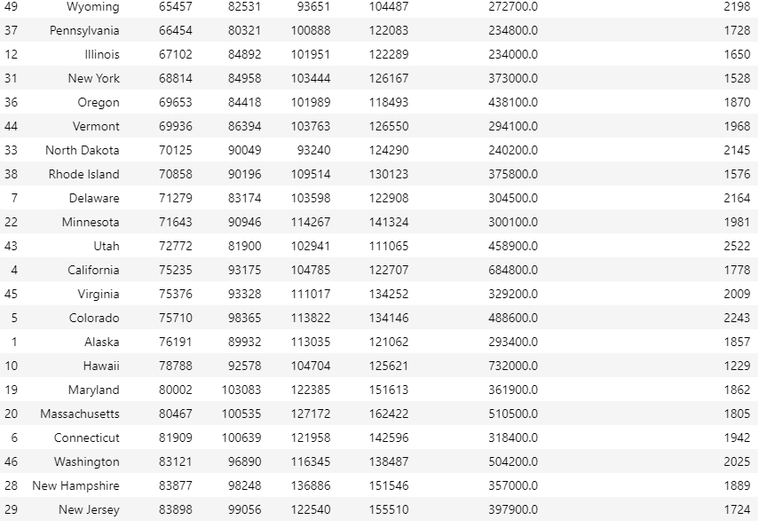
Data Merge

Slide 6
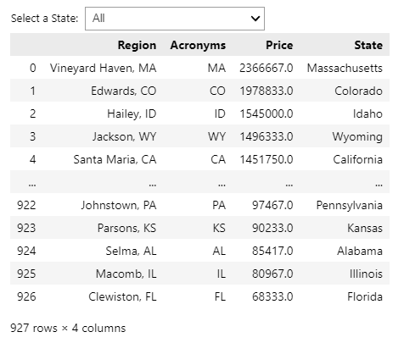
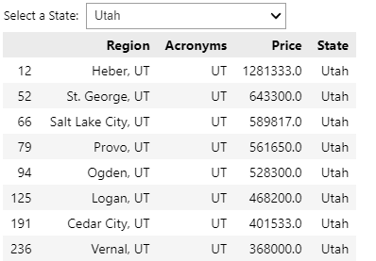
Data Merge Part 2

Slide 7
G U E S S
Which states has the highest median house price?

Slide 8
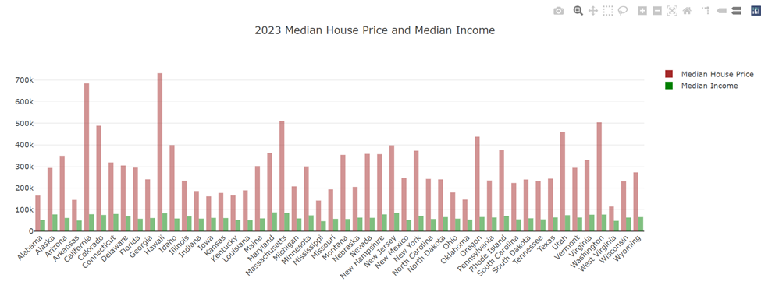
Hawaii tops the list at $732,000, followed by California at $684,800.
West Virginia is at the bottom of the list with median house price at $114,600.
Data source : Rocket Homes

Slide 9
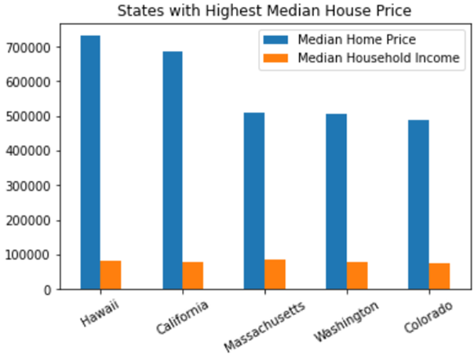
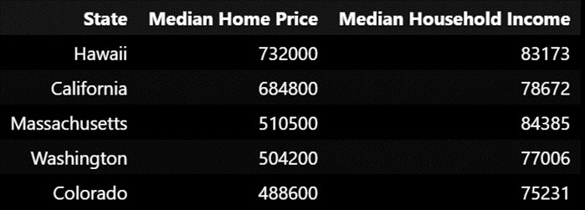
The median house price in Hawaii and California is almost 9x the median household income.
In Massachusetts, Washington and Colorado, the median house price is around 6x the median income.
Though Hawaii and Massachusetts have almost same median household income, Massachusetts seems affordable than Hawaii.
Similarly Washington seems affordable than California.

Slide 10
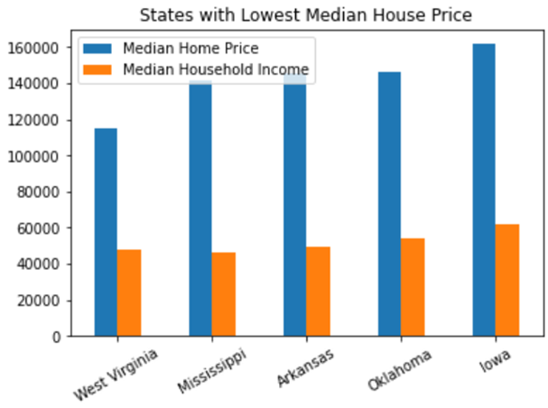
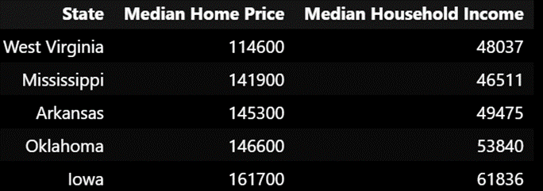
In West Virginia, Mississippi, Arkansas, Oklahoma and Iowa, the median house price is about 3x the median household income.
Among these states we also notice that there is less variation in the house prices.

Slide 11
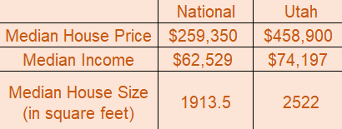
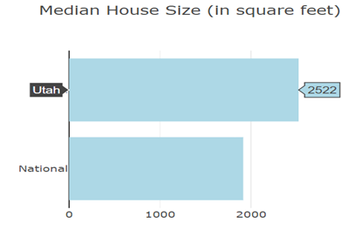
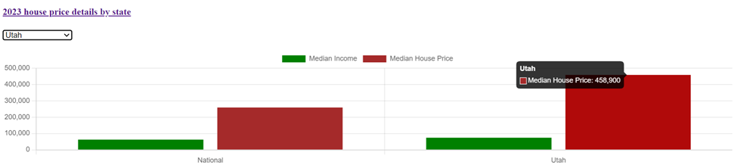
Comparing Utah with National Median
Utah ranks 6th, next to Colorado with median house price of $458,900.
The median house price in Utah is 6x the median household income and almost 2x the median house price at National level.
Data source : Rocket Homes

Slide 12
Cities
01.
Data on cities in the U.S.

Slide 13
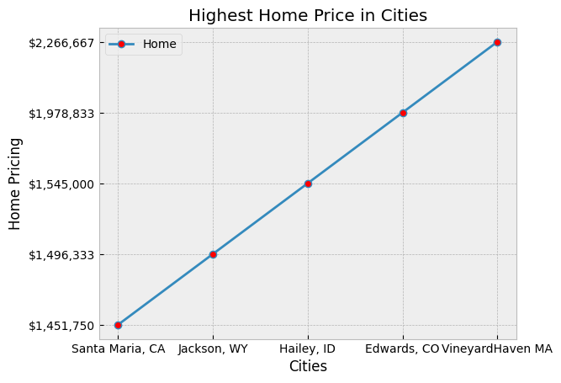
Highest City Prices
01.
Highest City:
Starting with the highest we have Vineyard Haven, MA.
Then Edwards CO, Hailey ID, Jackson WY, and Santa Maria CA.
To display this data you can see a line graph to the right.

Slide 14
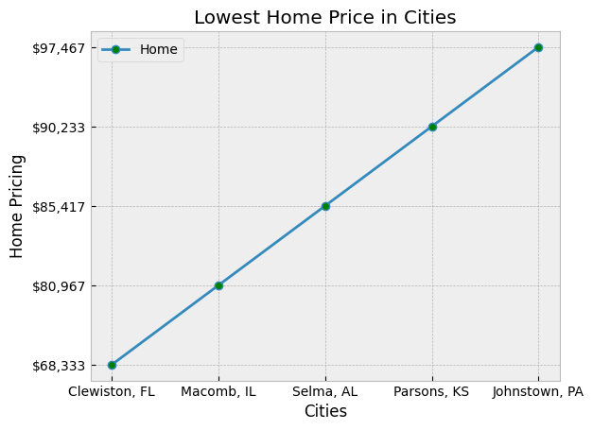
Lowest
City Prices
Starting with the lowest we have Clewiston FL, followed by Macomb IL, Selma AL, Parsons KS, and Johnstown PA.
To display this data you can see the line graph to the right.

Slide 15
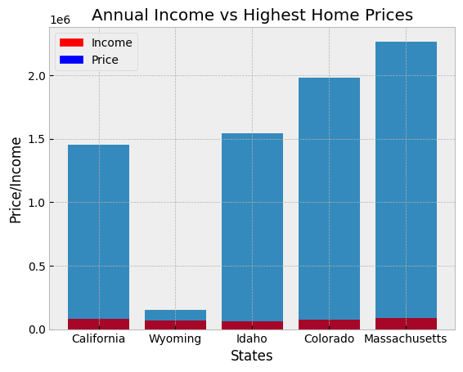
Highest Prices with Annual Income
Here you can see the huge
difference between the highest city home price and the annual income for that state. Surprisingly there is a huge gap between the two.
Sadly ⅘ look impossible to afford based on overall income for the state. Interesting enough some are not the most popular states yet have a high home price.

Slide 16
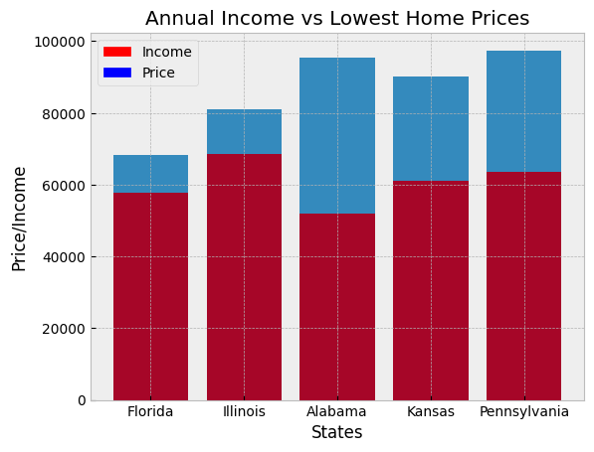
Lowest Prices with Annual Income
In this graph we can see the very close numbers between the lowest house prices and annual income for the state the city is in. This graph is very different from the previous one. As we can see there is a better chance of being able to afford these homes based on prices and overall income.
Illinois and Florida being the closest with the very low gap in between.

Slide 17
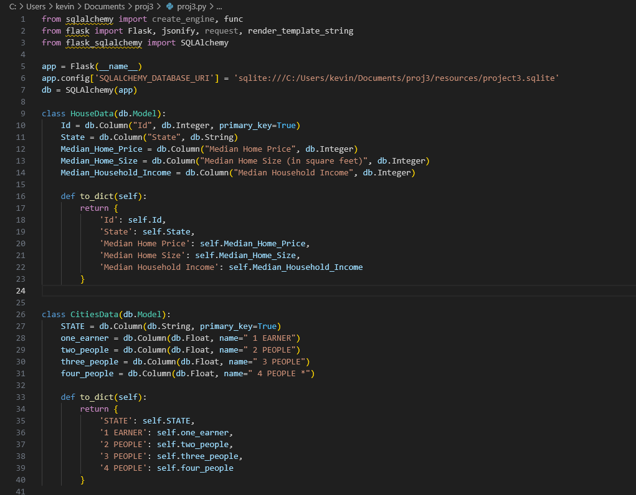
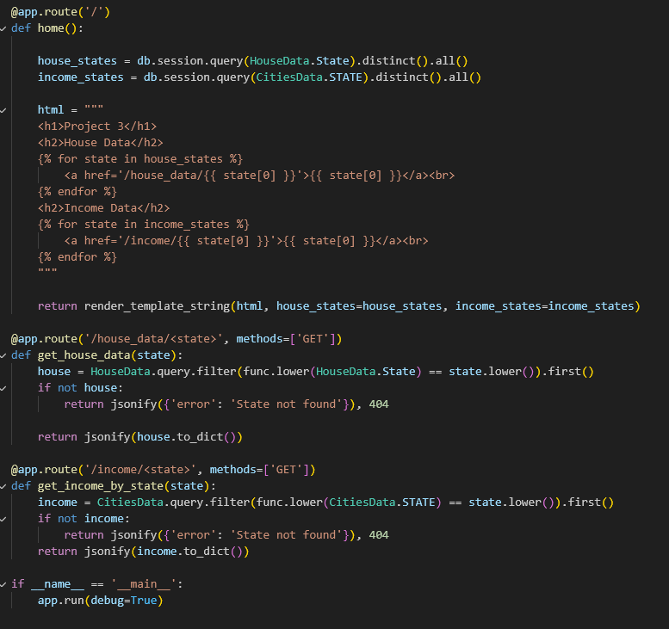
Flask API and Endpoints

Slide 18
Conclusion
MY RECENT SALES
In conclusion, our data-driven analysis has shed light on the critical factors that aspiring homeowners should consider when making informed decisions about purchasing a home after completing their education in the United States. By exploring the average annual salary data correlated with household size and examining the average cost of homes per square foot, we've provided valuable insights into the varying dynamics of the real estate market across different states.

Slide 19
MY RECENT SALES
Thank You!

