Slide 1
Finding alternative cities to live in the Northwest US
Erika Navara
IBM Applied Data Science Capstone Project

Slide 2
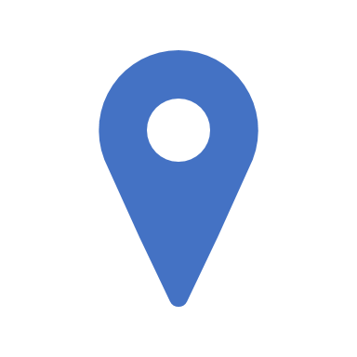
Business Problem
Seattle is the fastest growing city in the US, causing sense of crowding and displacement for existing residents, compelling some to seek alternative places to live in the Northwest US.
Washington State alone has 211 cities and there are over 650 cities in the Northwest. With so many cities to choose from,
How can prospective Northwest home buyers find similar cities to live in?

Slide 3
Data
Wikipedia. List of cities in Washington, Oregon, Idaho state
Mapquest API. City location data
Foursquare API. Top venues and their categories for each city

Slide 4
Methodology
k-means clustering algorithm to identify patterns in the data
top 5 venue categories for each city’s vector profile for clustering
clusters most meaningful and interesting with k=6

Slide 5
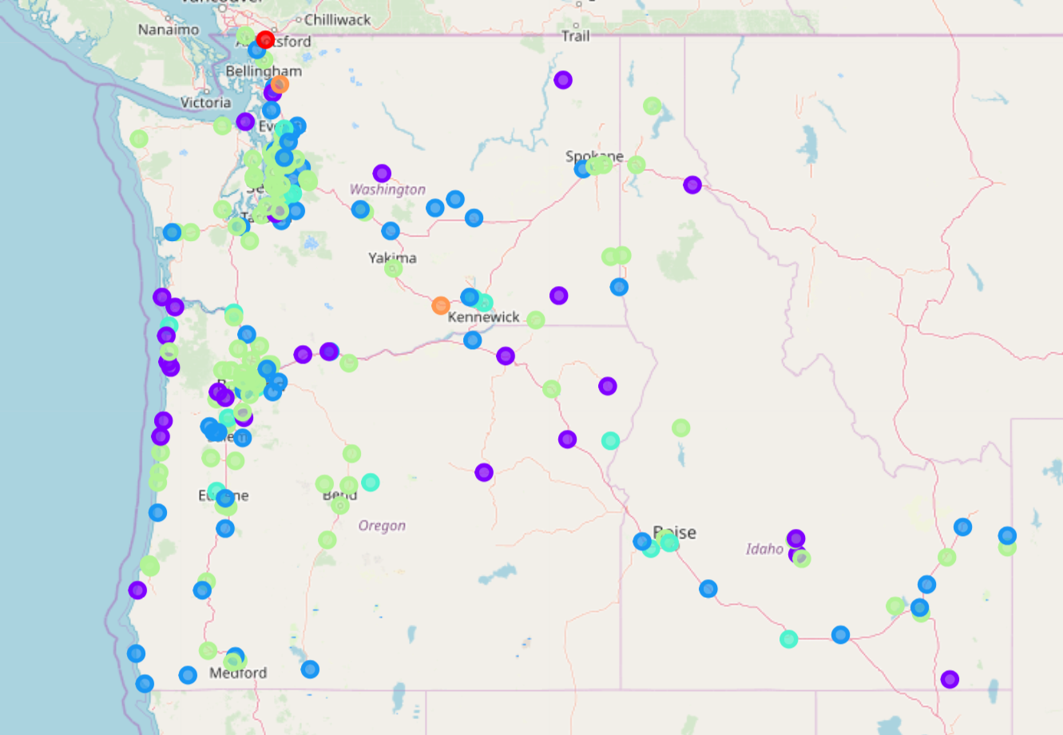
Results/Discussion
Clusters
2 outliers. Due to unique venue types and combinations.
Coffee cities. Coffee + diverse venue offerings typical of large urban centers.
Restaurant cities. Pizza places reign supreme.
Fast food cities. Bedroom communities situated between larger cities.
Vacation destinations. Accommodations, restaurants and night life.

Slide 6
Conclusion
653 total cities in Washington, Oregon, and Idaho states
593 cities with Foursquare API data representing 5935 venues
180 cities with > 10 venues in Foursquare representing 4272 venues and 309 unique categories

