Slide 1




Frito lay workforce case study
Presented by Erika DuPond

Slide 2


Introduction
Frito-Lay has given us the task to analyze their workforce trends to help retain employees and gain insight on salary predictions.
The dataset has 38 variables with 870 entries. The variables include age, gender, attrition, monthly salary, job role, department, number of years in company, stock option levels, marital status, and other descriptors of employees.
Analysis was done with Rstudio and R.
Notes:
DDSAnalytics is an analytics company that specializes in talent management solutions for Fortune 100 companies. Talent management is defined as the iterative process of developing and retaining employees. It may include workforce planning, employee training programs, identifying high-potential employees and reducing/preventing voluntary employee turnover (attrition). To gain a competitive edge over its competition, DDSAnalytics is planning to leverage data science for talent management. The executive leadership has identified predicting employee turnover as its first application of data science for talent management. Before the business green lights the project, they have tasked your data science team to conduct an analysis of existing employee data.

Slide 3

Objectives
Attrition
Monthly Income
Which variables correlate the most with those who have stayed or left the company?
Is there a model to predict future attritions?
Which variables correlate the most with monthly income?
Is there an accurate regression model for monthly income across the company?

Slide 4
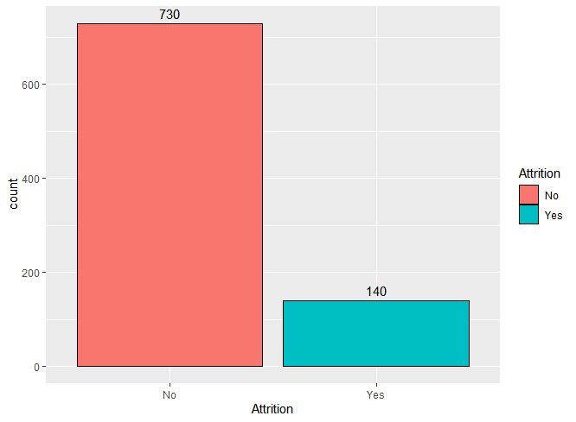
Variables for attrition
16% “Yes” Attrition

Slide 5
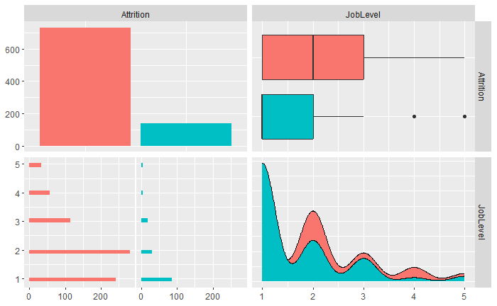

Variables for attrition
Using ggpairs() function in R, I was able to test out and plot variables versus Attrition to see how the “Yes” and “No” differed.
As you can see on the Job Level, there is a spike in level “2” for the “Yes” while “No” has a spike in level “1”.

Slide 6
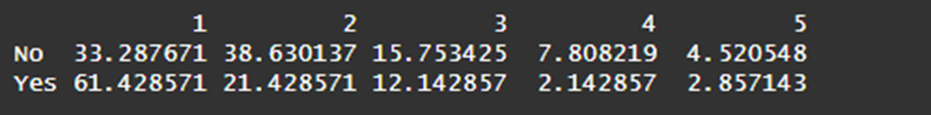
Variables for attrition
This example on the left is a prop.table() function of Attrition vs. Job Level.
By using the prop.table() function too, I was able to see by a ratio standpoint, how the Attrition values differed between each type of variable and therefor which variable could be the best indicator for Attrition.

Slide 7
Attrition Classification Model
Using the Naïve Bayes model, I inputted Attrition verses different dataset variables and tested different variable iterations based on which produced the most unique Attrition ratios.
Finally, I settled on making a naïve bayes model based on Marital Status, Over Time, and Work Life Balance.
To find a high specificity and sensitivity for cross-validating the training and test sets, I wrote a loop to find the best threshold which ended up being 0.17.

Slide 8

Attrition Classification Model
Using those model factors, I was able to cross validate the model by printing the confusion matrix.
My sensitivity (true negative) was 0.75 and my specificity (true positive) was 0.65 with a 74% accuracy.

Slide 9

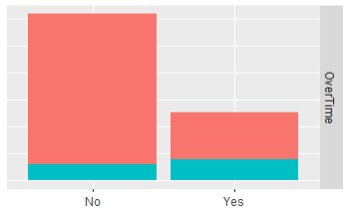
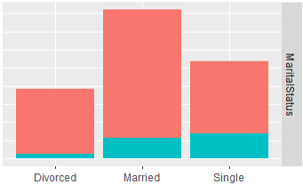
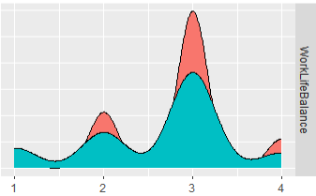
Best variables to predict attrition

Slide 10
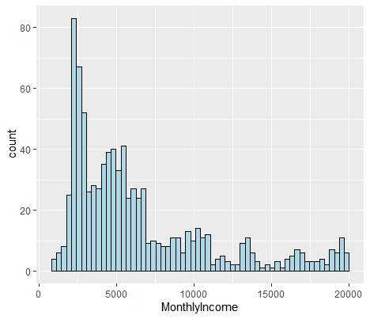
Monthly Income

Slide 11
Monthly Income Regression Model
Using the linear regression function, I inputted Monthly Income versus Job Level. My goal was to get a root mean squared error (RMSE) of less than 3000 per my cross-validation method.
I first tested the model with “Years Working in Company”, however when I tested with “Job Level” it ended up with a much smaller RMSE.
The RMSE I got with “Job Level” was 1476.2

Slide 12
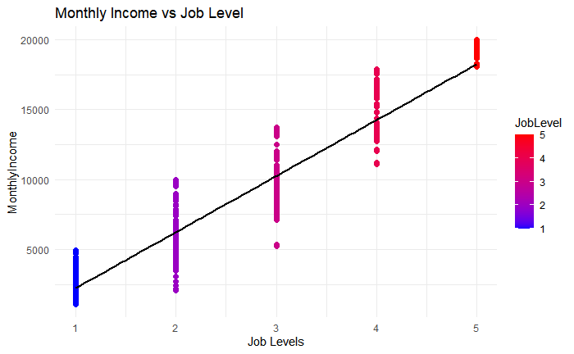

Slide 13

Recommendations
1. Frequent surveys of employees’ work-life balance and working relationship with their team
2. Reduce overtime by fostering a more collaborative team environment so workload can be shared.
3. Observe work forecast closely to hire more people when there is too much workload for the headcount
4. Reward those who work overtime with overtime pay or a monetary award

Slide 14


Thank
You

