Slide 1

BigBrother
Probably the best brother in the wolrd!
Surveilence on the GO
Ease of use
Easy to install
Timetravelling

Slide 2
Features
Connect, disconnect and reconnect.
Connect to TWO servers.
Motion detection. Adjusting video stream.
Intuitive user experience.
Painless server installation.
Mobile! Grabbing coffe on duty? Yes, you can!
Open Source

Slide 3
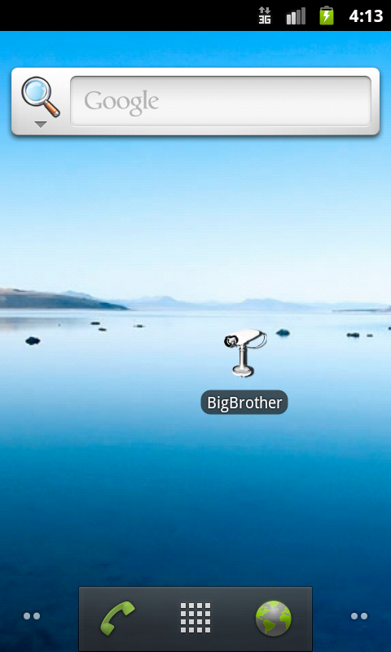
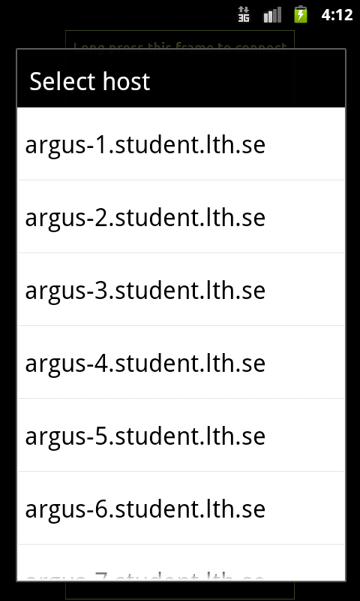
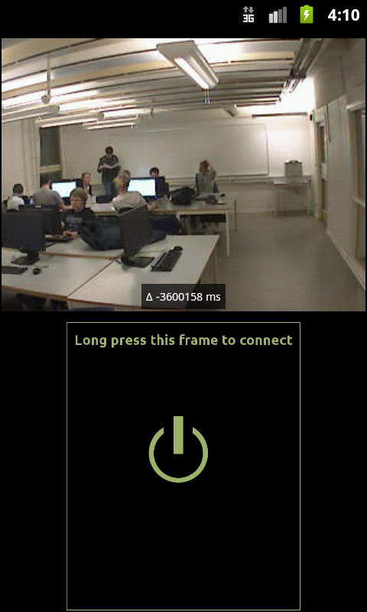
User Interface

Slide 4
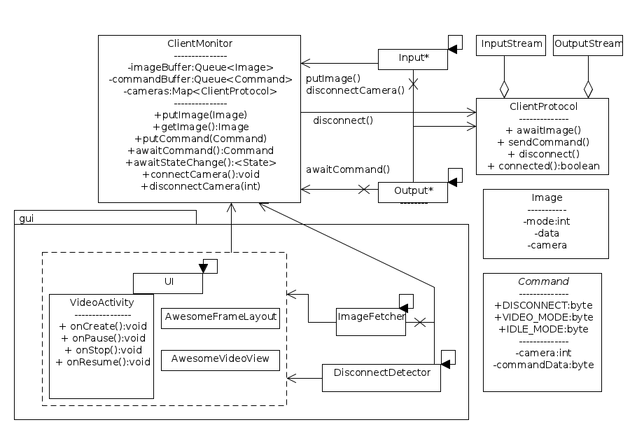
Client Internals

Slide 5
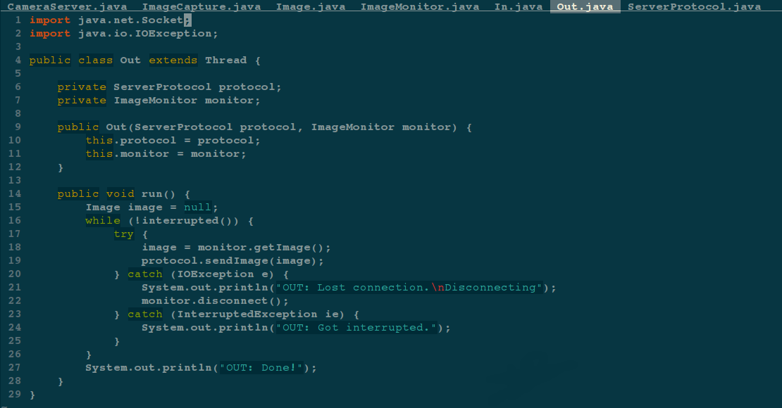
Server has no UI

Slide 6
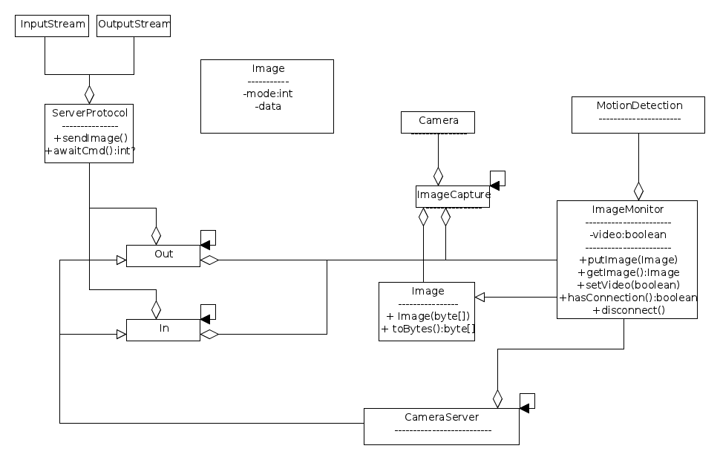
Server Internals

Slide 7
Oupps!
Time coordination on server
Server crash due to incorrect J2C compiler
Very slow emulator

Slide 8
Our, now vast, experiance
Cross compilation might cause uexpected and undocumented problems.
Java networking is very easy!
Android development. API, tools.
Git version control
Rooted newly gained knowlegde in concurrent programming.

Slide 9
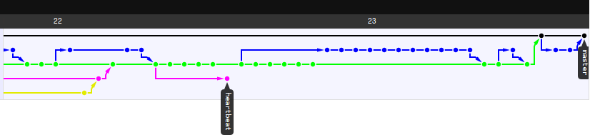
Git repo network graph

