Slide 1
Clinical Notes Extraction and Evaluation
Erika Fox, Peining Yang, Nancy Huang, Yaze Gao
Notes:
Yaze

Slide 2


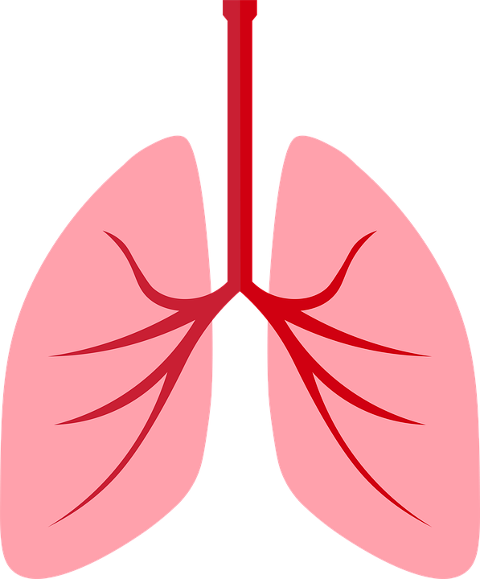
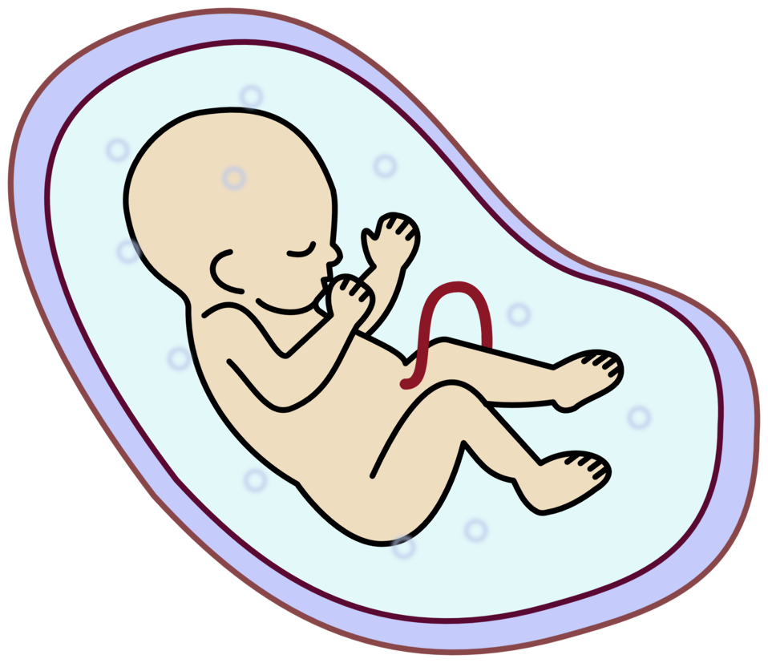

About 45 others
Notes:
Yaze
This is Jane, she is a practicing medical student at Duke.
Graduation is finally in sight, but she still has some work to do
She has to see different symptoms (such as heart murmur) on patients under each category duke has access to.
Besides OBGYN，there are 45 other categories.
Moreover, she has to get familiar with clinical notes.

Slide 3
Electronic Health Records (EHR)
What is EHR?
EHR is a digital version of a patient's’ paper chart
Duke & EHR
Create an application
Notes:
Yaze
More specifically, she needs to get familiar with the electronic health records which is the data the medical school has to represent every student. It is also called EHR.
EHR is a digital version of a patient’s paper chart which contains the medical and treatment histories of patients.
Before EHR is adopted，there is no thorough system for documenting clinical notes. In 2009, EHR becomes more popular in medical community under President Obama’s American Recovery and Reinvestment Act. This is significant because we can conduct analysis on clinical notes easier than before. In 2018, Duke becomes the pioneer that let students contributes information on EHR.
Duke Health cooperates with Duke OIT to create an application that can access the records of medical students’ training in medical decision and usage of EHR.

Slide 4
Problem
Accuracy
Practicality
Students self-reporting their own requirements leaves room for mistakes and dishonesty
Not realistic for the medical school to sift through medical notes of all students to check if they have reached all the specialties
Notes:
Peining
Since Duke uses medical student’s clinical notes as a way to gauge the progress in their academic career, this can lead to some issues if there isn’t a system in place.

Slide 5
Goal
Create a program that takes in a particular student’s clinical notes from EHR (Electronic Health Records) and returns a summary of which specialty requirements that student has met and which specialty requirements they still need
Notes:
Peining

Slide 6
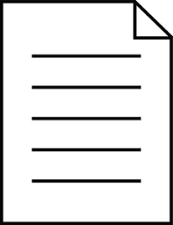
Feature Extraction
 | Subjective | Objective | Assessment | Plan | Diagnosis
Note #1
Note #2
Physical Exam
Subjective
Objective
Data:
unit of observation is a single encounter
(one EHR)
Assessment
Plan
Diagnosis: ____
Notes:
Erika

Slide 7
Pipeline
✅
Extraction
Classification (Next Step)
Extract important components (SOAP, physical exams and diagnoses) from the notes
Use processed data to assign each note to a diagnosis code.
✅
✅
Labelling
Entity Detection
Create a hierarchy for specialty labels
Extracting medical terminology and handle negation cases.
Notes:
Peining
Briefly explain hierarchy & specialty mapping in Labelling.

Slide 8
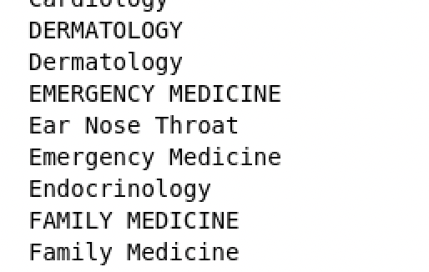
Hierarchy & Specialty Mapping
We created specialty assignments by condensing three fields from the raw data: ‘title’, ‘admission_service’, and ‘specialty’ (in order)
From there, this type of grouping was necessary:
And then this type:
Example:
The field OBGYN includes
Gynecology
Labor and Delivery
Obstetrics
Reproductive Endocrinology and Infertility
…
Notes:
Used three vars to create specialty values because of lots of missing values. If an observation had values in more than one of the three, we would prioritize based on the order shown here. Once this was done we did some cleaning (shown on left) and did more specialty grouping (right) with instructions from our client

Slide 9
SOAP Structure
Subjective
Patient medical / social history, chief complaints, etc.
History of Present Illness: XXX is a X-year old female established patient. Starting 3 weeks ago she began having problems with xxx.
Objective
Physical exam results / Vitals
Vitals: DD/MM/YYYY Weight:
xxx kg Height: xxx cm BP: xxx Body mass index is xxx kg/m².
General Appearance: Pleasant young woman. No murmur. Patient has audible wheezing. Normal gait.
A student note of a patient encounter
Assessment
Clinical assessment and diagnosis
Assessment/Plan: #asthma; Take 1 tablet (100 mg total) once daily; I recommended she try one half of 100 mg tablet first to see if this is enough. If not she can increase to a full tablet.
Medical student’s treatment plan (contains # of diagnoses)
Plan
Notes:
Emphasize why were doing separation- highlight most important pieces

Slide 10
Keyword Detection and Extraction
Detection
We used Regular Expressions incorporating business logic to detect SOAP components.
Our Regex expressions were designed to minimize false positives to optimize extraction
Extraction
Our code does not assume components are in order
Our code does assume that the end of a section is when a new section starts or the note ends (why false positives are such an issue)
Notes:
Erika

Slide 11
Detection Rates
Subjective (96.54%) Subjective Interval Hx:/ Interval Events:/ Interval History History of Present Illness Hospital Day:/ Hosp Day FIRST_NAME_FULL | Objective (96.33%) Objective Examination/Exam Current Vital Signs Vitals | Assessment (94.35%) Plan (96.32%) Assessment/Plan Plan and Assessment Assessment and Recommendations Assessments and Plans Assessment &amp; Plan Assessment/Coordination of Care Assessment and Plan are grouped together (66.28%)
Physical Exam Constitutional (94.5%)
Constitutional
General Appearance
Appearance
Diagnosis Codes (49%)
Any hashtag (#) that is not followed by a number or special character
Extraction rate (with filtered data): 88.11% (17,508 notes)
Notes:
Erika

Slide 12
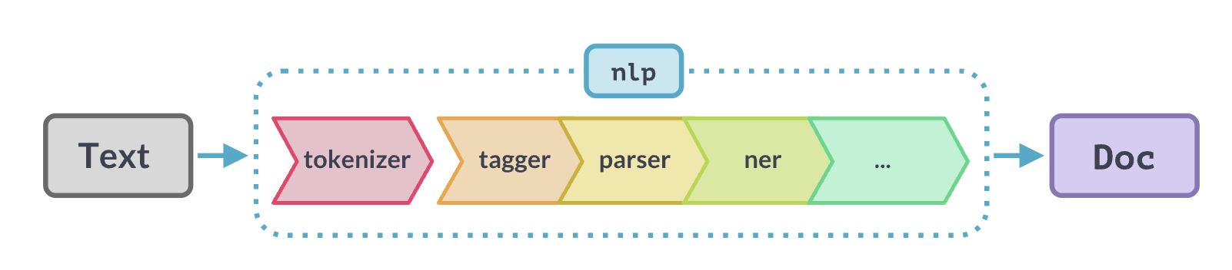
Detecting Presence/Absence of Symptoms/Diseases
Approach: a SpaCy NER model pre-trained on biomedical corpus
Source: https://spacy.io/usage/linguistic-features
Tokenization: breaking a text into meaningful units known as tokens.
Lemmatization: identifying the root or stem of a word, e.g., runs, ran, running, all stem from the word "run".
Named Entity Recognition (NER): detecting and labeling "entities" in a document. In our case, this task will identify the presence/absence of a disease or a symptom
Notes:
Nancy

Slide 13
Detection Model Pipeline
Original Text
Lungs are clear, no rales or wheezing. Mild erythema.
Tokenize and Lemmatize Notes
lung be clear, no rale or wheeze. mild erythema.
Detect diseases and symptoms
lung be clear, no rale or wheeze. mild erythema.
DISEASE
DISEASE
Add customized
Patterns
lung be clear, no rale or wheeze. mild erythema.
DISEASE
DISEASE
DISEASE
Detect negations
lung be clear, no rale or wheeze. mild erythema.
NEG
ENTITY
NEG
ENTITY
DISEASE
Notes:
Nancy

Slide 14
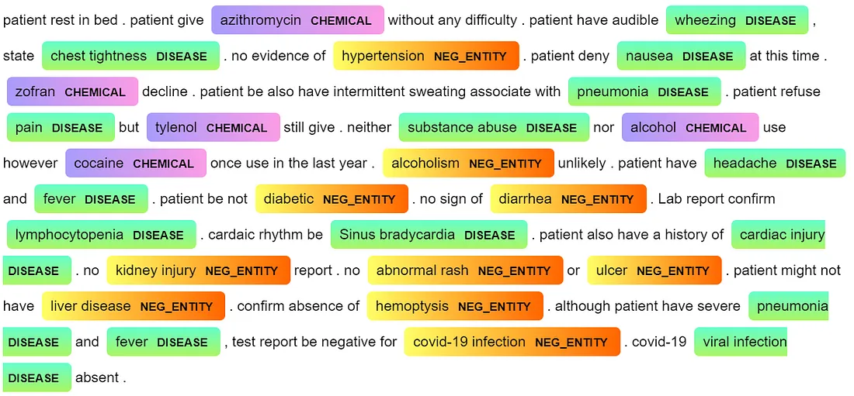
Model Results
Source: https://medium.com/@MansiKukreja/clinical-text-negation-handling-using-negspacy-and-scispacy-233ce69ab2ac
Notes:
Talk about errors

Slide 15

Now What?
The features we have created will make it possible for us to generate summaries for every student automatically. We are confident in these features for 83.3% of notes that we determined to have the SOAP structure.
 | Murmur (Heart) | Tachycardic (Cardiac) | #asthma
Note #1 | 1 | 0 | 0
Note #2 | 0 | 1 | 0
Student 1 Academic Report
Completed
Heart murmur
Tachycardic
Incomplete
Asthma
Student 1
 | Murmur (Heart) | Tachycardic (Cardiac) | #asthma
Note #1 | 0 | 0 | 0
Note #2 | 0 | 1 | 1
Student 2 Academic Report
Completed
Asthma
Tachycardic
Incomplete
Heart murmur
Student 2
Notes:
Peining
Negation cases
“No murmur” as column

Slide 16
Predictions
Previously we mentioned that only 49% of the notes contain the helpful ‘#’ marked diagnosis codes. Modeling, using the notes that do have these codes as the training set, could allow us to generate our own codes for the student summary reports.
 | Tightness (Chest) | Cough | Difficulty (Sleep) | Loss of Taste
Note #1 | 1 | 1 | 1 | 0
Note #2 | 1 | 0 | 1 | 0
Note #2 | 1 | 1 | 0 | 1
Predicted ICD-9 medical codes
#asthma
#anxiety
#covid19
Notes:
Peining
While you may have noticed that modeling is not a big part of our project, our hard work has made it more realistic, and here is an example of how it can help us

Slide 17
THANK YOU!
QUESTIONS?

