Slide 1





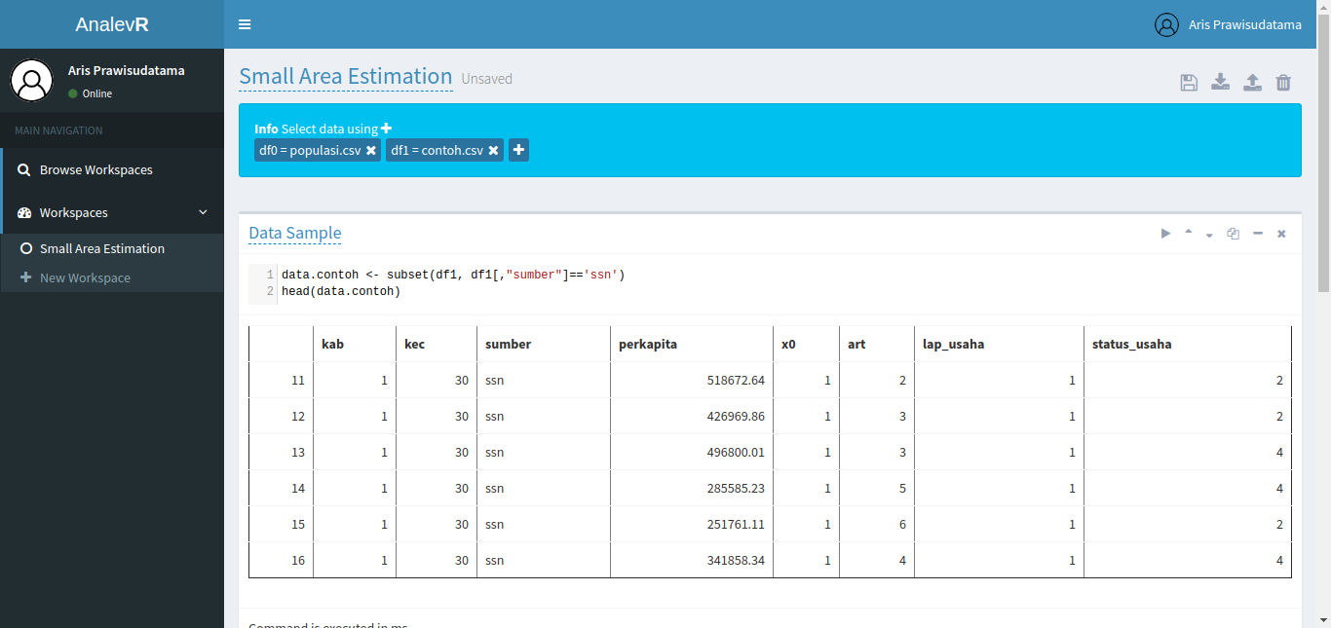












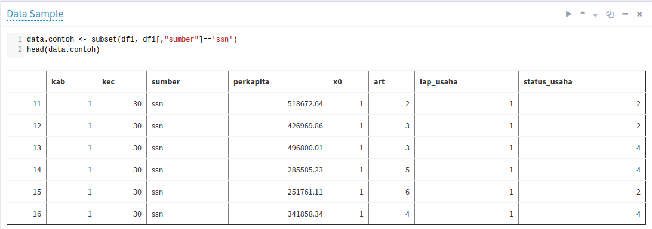



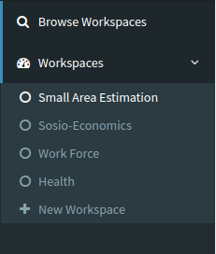
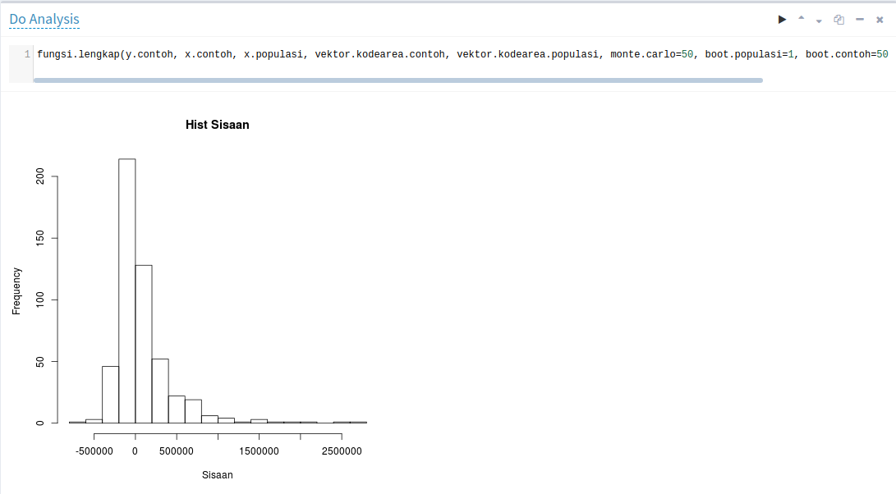









Analev R
AN INTERACTIVE R-BASED ANALYSIS ENVIRONMENT
For Utilizing BPS-Statistics Indonesia Data
Erika Siregar (erika@bps.go.id)^{1, 2}
Aris Prawisudatama (arisp@bps.go.id)¹
As Indonesia’s national statistical agency, BPS-Statistics Indonesia produces a massive amount of strategic data every year. However, these data are still underutilized by other parties (governments, researchers, etc.) due to technical limitations and raw data exclusivity and locality. Actually, numerous people outside BPS are capable of conducting analysis but unable to access the data.
To increase the data usefulness, we introduce AnalevR, an online R-based analysis environment that allows anyone to perform analyses and create visualization without having to own the original raw data. It uses a notebook-like interface where users can type commands and the output appears below it.
http://s.bps.go.id/analev-r
Problem: Underutilization of Data
Without AnalevR
Result
Barrier
Money
Government
User
Buy Data
Open in Own
Analysis Application
Select
Single Dataset
Make
Analysis
Visualize
Result
Bureaucracy
Researcher
Without AnalevR, user must buy the raw data and go through a series of bureaucratic process to ge the data
BPS – Statistics
Indonesia
Produce
Many Data
Capable Make
Analysis
Long Waiting Time
Business Process Changes
Academics
Several data-acquiring issues cause data underutilization problem at BPS – Statistics Indonesia
Introducing: AnalevR
Architecture
Data Selector
Data
Preview
Req
Python
Web Server
Req
R Session
Create
Workspace
Multi Workspaces
Data Analysis and
Visualization
Resp
Resp
Open
Workspace
User
Open Browser
Select
Multiple Dataset
Make
Analysis
Visualize
Result
User
Workspace
Data catalog
R Object
HTML Object
BPS – Statistics Indonesia
CS Department, Old Dominion University
Browse and Clone
Workspace
Save
Workspace
Share
Workspace
MySQL
Database
R Processor
With AnalevR, the user just simply open the website, select the data, and conduct analysis using R code
2018

