Slide 1




































DIGITAL ACADEMIC RESEARCH POSTER TEMPLATE
Subtitle for Digital Academic Research Poster (16:9)
Your names and the names of the people who contributed to this presentation
Introduction
Data Analysis
Conclusion
Mauris orci mi, varius id diam id, egestas auctor enim. Praesent ut massa nibh. Duis purus neque, facilisis cursus ultrices vel, ullamcorper ac augue. Donec semper lorem vitae urna pulvinar, in congue massa aliquet sed nibh sit amet, faucibus.
Mauris orci mi, varius id diam id, egestas auctor enim. Praesent ut massa nibh. Duis purus neque, facilisis cursus ultrices vel, [See Figure A] massa tristique:
Sed in risus nibh. In nisl quam, aliquet sed nibh sitamet, faucibus placerat dui.
Fusce quis augue scelerisque, luctus rum sed, ut dolor. pulvinar urna in eros posuere.
in elementum orci dignissim. Proin semper ipsum finibus quam tempor, vitae consectetur.
Mauris orci mi, varius id diam id, egestas auctor enim. Praesent ut massa nibh. Duis purus neque, facilisis cursus ultrices vel, ullamcorper ac augue. Donec semper lorem vitae urna pulvinar, in congue massa:
Sed Risus Nibh: CiIn nisl quam, aliquet sed nibh sitamet, faucibus placerat dui augue scelerisque.
Curabitur Accumsan Nulla: Fusce quis augue urna scelerisque, luctus rum sed, ut dolor in pul.
Elemenum Orci Dignissim: Proin semper ultrices vel, ullamcorper.
Methods
Mauris orci mi, varius id diam id, egestas auctor enim. Praesent ut massa nibh. Duis purus neque, facilisis cursus ultrices vamcorper ac augue. Donec semper lorem vitae urna:
MAURIS ORCI VARIUS ID DIAM
Sed in risus nibh. In nisl quam, aliquet sed nibh sitamet, faucibus placerat dui.
Fusce quis augue scelerisque, luctus rum sed, ut in pulvinar urna in eros posuere.
Results
Figure A: neqinue dignissim, and int aliquet nisl et umis.
Mauris orci mi, varius id diam id, egestas auctor enim. Praesent ut massa nibh. Duis purus neque, facilisis cursus ultrices vel, ullamcorper ac augue. Donec tristique quis augue scelerisque.
Graphic Elements
Figure B: neqinue dignissim, and int aliquet nisl eumis.
Chart Title
8.01 | 7.99 | 5.77 | 6.44
4.50 | 3.11 | 9.55 | 1.12
6.15 | 8.00 | 6.18 | 5.65
8.21 | 2.16 | 3.11* | 7.17
3.00 | 9.70 | 10.50 | 4.45
References
Phasellus nec lectus bibendum, posuere nibh id
Mauris orci mi, varius id diam id, egestas auctor enim
Duis vitae tincidunt tortor, vitae sollicitudin magna
Aenean et est sem. Phasellus nec lectus bibendum
*Unamcorper efficitur sed in nulla.
MAURIS ORCI MI VARIUS ID DIAM Egestas auctor enim. Praesent ut massa nibh. Duis purus neque, facilisis cursus ultrices vel, ullamcorper ac augue. Donec semper lorem.
Mauris orci mi, varius id diam, egestas auctor enim.
buffalo.edu

Slide 2
DIGITAL ACADEMIC RESEARCH POSTER TEMPLATE
Subtitle for Digital Academic Research Poster (16:9)
Your names and the names of the people who contributed to this presentation
Introduction
Data Analysis
Conclusion
Mauris orci mi, varius id diam id, egestas auctor enim. Praesent ut massa nibh. Duis purus neque, facilisis cursus ultrices vel, ullamcorper ac augue. Donec semper lorem vitae urna pulvinar, in congue massa aliquet sed nibh sit amet, faucibus.
Mauris orci mi, varius id diam id, egestas auctor enim. Praesent ut massa nibh. Duis purus neque, facilisis cursus ultrices vel, [See Figure A] massa tristique:
Sed in risus nibh. In nisl quam, aliquet sed nibh sitamet, faucibus placerat dui.
Fusce quis augue scelerisque, luctus rum sed, ut dolor. pulvinar urna in eros posuere.
in elementum orci dignissim. Proin semper ipsum finibus quam tempor, vitae consectetur.
Mauris orci mi, varius id diam id, egestas auctor enim. Praesent ut massa nibh. Duis purus neque, facilisis cursus ultrices vel, ullamcorper ac augue. Donec semper lorem vitae urna pulvinar, in congue massa:
Sed Risus Nibh: CiIn nisl quam, aliquet sed nibh sitamet, faucibus placerat dui augue scelerisque.
Curabitur Accumsan Nulla: Fusce quis augue urna scelerisque, luctus rum sed, ut dolor in pul.
Elemenum Orci Dignissim: Proin semper ultrices vel, ullamcorper.
Methods
Mauris orci mi, varius id diam id, egestas auctor enim. Praesent ut massa nibh. Duis purus neque, facilisis cursus ultrices vamcorper ac augue. Donec semper lorem vitae urna:
MAURIS ORCI VARIUS ID DIAM
Sed in risus nibh. In nisl quam, aliquet sed nibh sitamet, faucibus placerat dui.
Fusce quis augue scelerisque, luctus rum sed, ut in pulvinar urna in eros posuere.
Results
Figure A: neqinue dignissim, and int aliquet nisl et umis.
Mauris orci mi, varius id diam id, egestas auctor enim. Praesent ut massa nibh. Duis purus neque, facilisis cursus ultrices vel, ullamcorper ac augue. Donec tristique quis augue scelerisque.
Graphic Elements
Figure B: neqinue dignissim, and int aliquet nisl eumis.
Chart Title
8.01 | 7.99 | 5.77 | 6.44
4.50 | 3.11 | 9.55 | 1.12
6.15 | 8.00 | 6.18 | 5.65
8.21 | 2.16 | 3.11* | 7.17
3.00 | 9.70 | 10.50 | 4.45
References
Phasellus nec lectus bibendum, posuere nibh id
Mauris orci mi, varius id diam id, egestas auctor enim
Duis vitae tincidunt tortor, vitae sollicitudin magna
Aenean et est sem. Phasellus nec lectus bibendum
*Unamcorper efficitur sed in nulla.
MAURIS ORCI MI VARIUS ID DIAM Egestas auctor enim. Praesent ut massa nibh. Duis purus neque, facilisis cursus ultrices vel, ullamcorper ac augue. Donec semper lorem.
Mauris orci mi, varius id diam, egestas auctor enim.
buffalo.edu

Slide 3



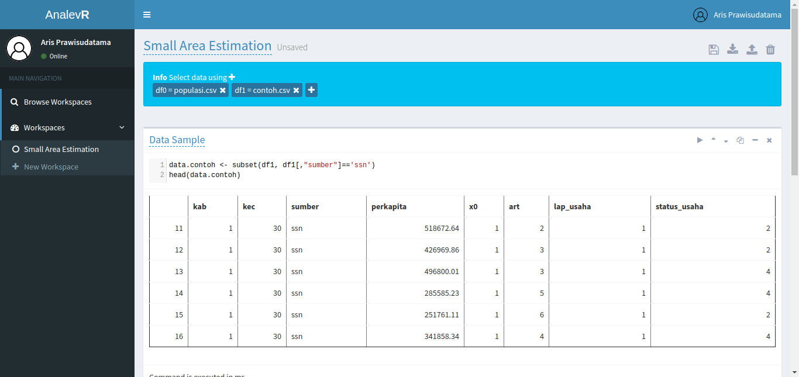
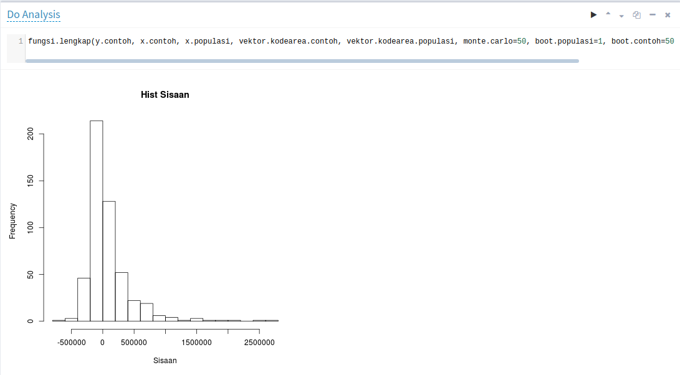
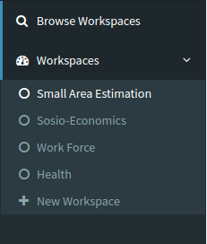
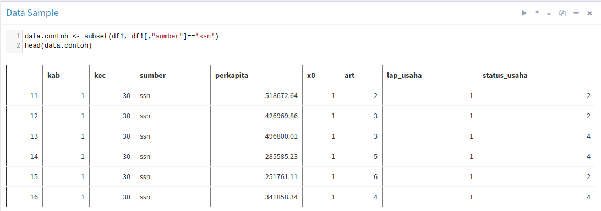
Analev R
AN INTERACTIVE R-BASED ANALYSIS ENVIRONMENT
For Utilizing BPS-Statistics Indonesia Data
Erika Siregar (erikaris1515@gmail.com)¹, Aris Prawisudatama (soedomoto@gmail.com)¹
BPS-Statistics Indonesia produces a massive amount of strategic data every year. To increase the data usefulness, we introduce AnalevR, an online R-based analysis environment that allows anyone to perform analyses and create visualization without having to own the original raw data. It uses a notebook-like interface where users can type commands and the output appears below it.
Data Selector – Data is provided by BPS – Statistics Indonesia
+
Python:
Flask
PyZMQ
SQLAlchemy
R:
RZmq
Xtable
Base64enc
Xlsx
XML
Plyr
Foreign
Ggplot2
Multi Workspaces – User can make workspaces up to 10
Data Analysis and Visualization
Live preview: https://simpeg.bps.go.id/analev-r
BPS – Statistics Indonesia
Data Filtering And Previewing – Preview data as visual table

Slide 4



























Analev R
AN INTERACTIVE R-BASED ANALYSIS ENVIRONMENT
For Utilizing BPS-Statistics Indonesia Data
Erika Siregar (erika@bps.go.id)^{1, 2}
Aris Prawisudatama (arisp@bps.go.id)¹
As Indonesia’s national statistical agency, BPS-Statistics Indonesia produces a massive amount of strategic data every year. However, these data are still underutilized by other parties (governments, researchers, etc.) due to technical limitations and raw data exclusivity and locality. Actually, numerous people outside BPS are capable of conducting analysis but unable to access the data.
To increase the data usefulness, we introduce AnalevR, an online R-based analysis environment that allows anyone to perform analyses and create visualization without having to own the original raw data. It uses a notebook-like interface where users can type commands and the output appears below it.
Problem
Without AnalevR
Result
Barrier
Money
Government
User
Buy Data
Open in Own
Analysis Application
Select
Single Dataset
Make
Analysis
Visualize
Result
Long Waiting Time
Without AnalevR, user must buy the raw data and go through a series of bureaucratic process to ge the data
BPS – Statistics
Indonesia
Produce
Many Data
Bureaucracy
Capable Make
Analysis
Researcher
Academics
Business Process Changes
Several data-acquiring issues cause data underutilization problem at BPS – Statistics Indonesia
With AnalevR
Architecture
Data Selector
Data
Preview
Req
Python
Web Server
Req
R Session
Create
Workspace
Multi Workspaces
Data Analysis and
Visualization
Resp
Resp
Open
Workspace
User
Open Browser
Select
Multiple Dataset
Make
Analysis
Visualize
Result
User
Workspace
Data catalog
R Object
HTML Object
BPS – Statistics Indonesia
CS Department, Old Dominion University
Browse and Clone
Workspace
Save
Workspace
Share
Workspace
MySQL
Database
R Processor
With AnalevR, the user just simply open the website, select the data, and conduct analysis using R code

