Slide 1
Viewing Morphology as an Inference Process
Krovetz, R.
In Proceedings of the 16th annual international ACM SIGIR conference on Research and development in information retrieval, pp. 191-202. ACM, 1993.
Corpus-Based Stemming Using Cooccurence of Word Variants
Xu, Jinxi, and W. Bruce Croft.
ACM Transactions on Information Systems (TOIS) 16.1 (1998): 61-81.
Presented by Erika Siregar
CS 834 - Introduction to Information Retrieval
Fall 2016
Old Dominion University
October 6, 2016

Slide 2
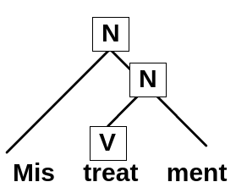
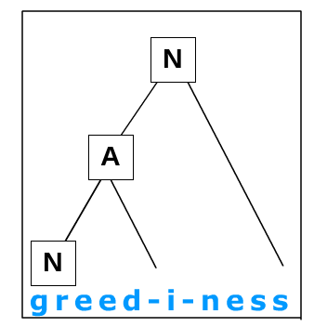
Morphology? What is this?
Internal structure of words.
Variations of words
term
stem
affixes
Figure from: http://davidbrett.uniss.it/morphology/treeDiagramTextInput/treeDiagramTextInput.html

Slide 3


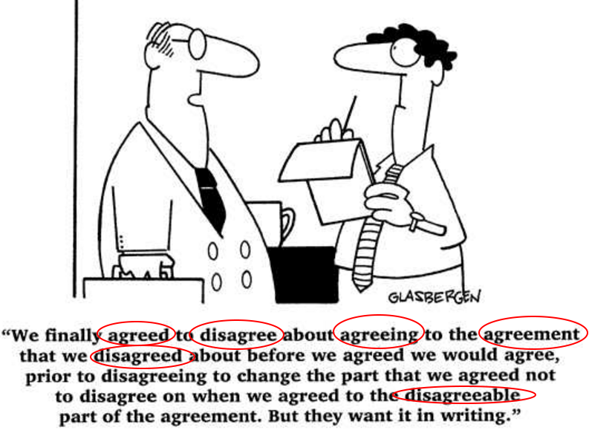
Why do we care?
Work, worked, working → V
Fast, faster, fastest → ADJ
A word could have many variants
Inflectional → same part-of-speech
Derivational → change the part-of-speech
Figure from http://kurdistantribune.com/2013/importance-of-morphology-english-language-as-prime-example/
Notes:
Stemmers attempt to reduce morphological variations of words to a common stem
usually involves removing suffixes
Imagine if there is no stemming, the words like distributed and distributing will be considered not related.

Slide 4

Again, why do we care?
Strong impact on the effectiveness of a retrieval system
Failed to process morphological variants
Inability to match query and documents
Poor retrieving result
Distribute
Distributed
Distributing
We need stemming!!!
Notes:
As we recall, the retrieval process rely on matching the words to find relevant documents.
Stemmers attempt to reduce morphological variations of words to a common stem
usually involves removing suffixes
Imagine if there is no stemming, the words like distributed and distributing will be considered not related.

Slide 5
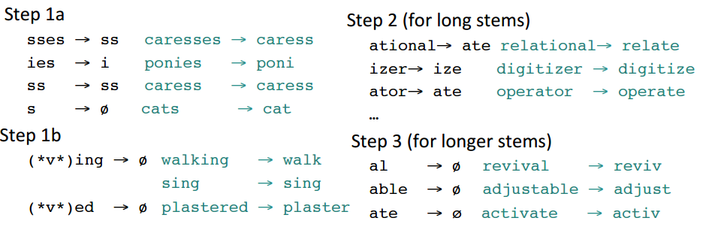
What is stemming?
Reducing word variants to their common stem
How do we stem?
Chop the affixes
Porter Stemmer
Algorithmic → replace ‘sses’ with ‘ss’
Removes the longest possible suffix
-ed, -eed, -edly, -eedly, -ing, -ingly
Cats → cat, lakes → lake
*Figure from: https://web.stanford.edu/class/cs124/lec/textprocessingboth.pdf
Notes:
Why do we care about morphology? Because we used stemmers
Rewrite the porter’s algorithm
Stemming = query expansion

Slide 6
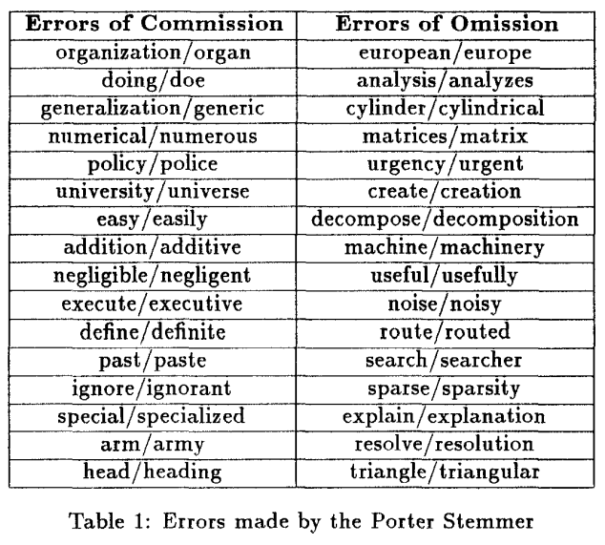
Why do we still have to analyze morphology?
Porter Algorithm produces stems not words
Iteration vs iter, general vs gener
Ignores the word meaning
Example: gravitation → force-of-gravity → not ‘seriousness’
Improper conflation
False positives (error of commission): supplies → supplie
False negatives (errror of omission): european → europe
Loss in precision
Word-sense disambiguation
*Table from Krovetz (1993)
Notes:
Word-sense disambiguation
removal of ambiguity by making something clear.

Slide 7
How to solve this?
Existed solution
Lovins: removes the longest-match suffix
Porter: iteratively removes suffix from predefined set.
Improve retrieval performance, not by words, but by meaning.
Word senses are strongly correlated with judgement of relevance
Krovetz devised a new algorithm
KSTEM is a part of Lemur Project.
Download: http://sourceforge.net/projects/lemur/
Notes:
Give example when sense in the query word does not match the sense the word in the documents.

Slide 8
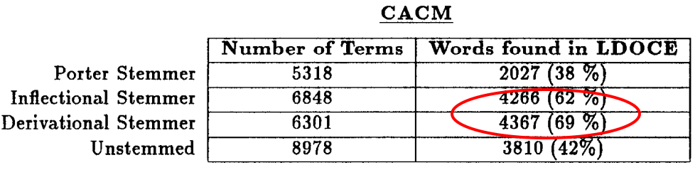
Krovetz Ideas
The stems to be words rather than truncated-words
Distribute, not distribut
Only conflate word-forms if their meanings were related.
Broad terms coverage.
Assumption: if the variant occured in the dictionary, it has different meaning from the root and should not be conflated
Need an algorithm for word-sense disambiguation
A better algorithm than Porter’s.
Table 1. A breakdown of vocabulary after being processed by different stemmers
*Table from Krovetz (1993)
Notes:
Lexicon = list of words (stems + affixes)

Slide 9
What did Krovetz do?
Hypothesis:
Retrieving documents on the basis of word senses (instead of words) will result in better performance
Unrelated senses will be more effective at separating relevant from nonrelevant documents.
Use a machine-readable dictionary
LDOCE (Longman Dictionary of Contemporary English)
It’s a hybrid algorithmic-dictionary-based method
Does this word exist in the dictionary?
Yes → take this word
No → remove suffix and check the dictionary again.
Carefully handle words ends with ‘-es’ and ‘-ed’
If word is in dictionary → found
Else replace ‘ing’, ‘es’, ‘d’ with ‘e’ → check dictionary
Else remove entire suffix → check dictionary

Slide 10
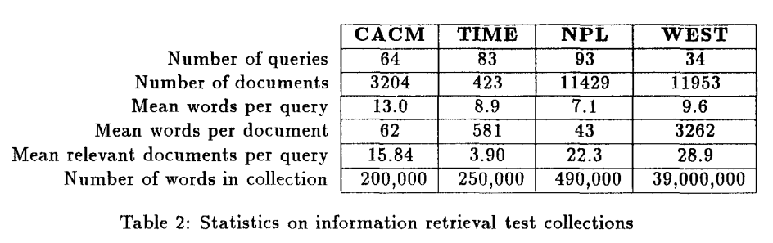
Krovetz Experiment
4 test collections
computer science (CACM)
newspaper stories (Time)
physics (NPL)
law (WEST).
*Table from Krovetz (1993)

Slide 11
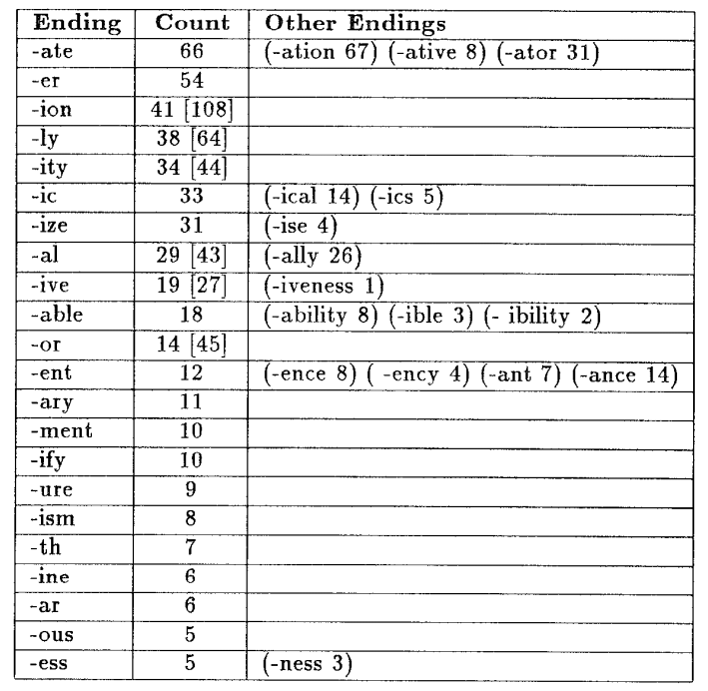
Krovetz Algorithm
Handling inflexional stemmer
Handling derivational stemmer
List various suffixes from Longman dictionary
List the words for each suffix
Count how many times each suffix occured in the document collections
Table 6: Frequencies for Derivational Endings in the NPL Collection
*Table from Krovetz (1993)

Slide 12
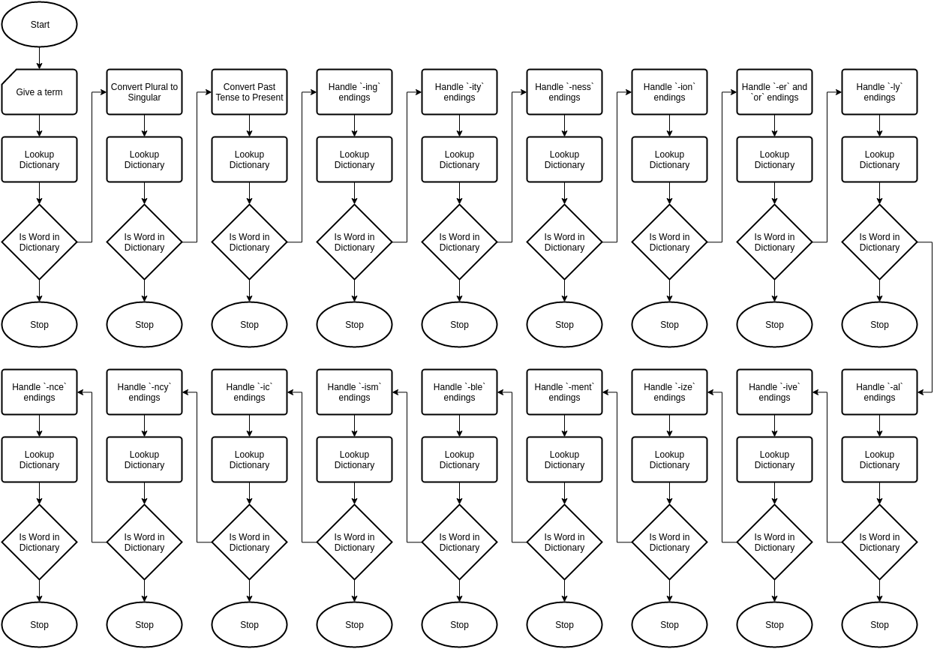
How does Krovetz work?
Notes:
Convert plural to singular
‘-ies’:
Remove ‘-s’ → check dictionary:
Found → root
Else → replace ‘-ies’ with ‘-y’
‘-es’
Remove ‘-es’ → check dictionary
Found → root
Else → remove ‘-es’ → check dictionary
Not found: root ends with ‘-e’
‘-s’
End with ‘-ous’, ‘-ss’?
Yes: this is the root.
No: remove ‘-s’
Convert past tense to present tense
Remove ‘-ing’
Remove the ending → check dictionary
Found → it is the root
Not found → check double letter
Controlling vs control.
Identify all words that:
End with ‘e’
Still in dictionary after the ‘e’ is removed.
229 words end with ‘e’ → 60 are the exceptions
Use part-of-speech:
If it’s a plural noun → use the exception form
E.g: suited → suit ; suites → suite

Slide 13
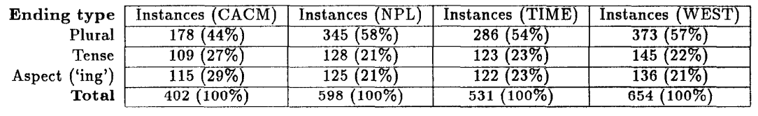
Statistics on Inflectional Endings
Table from Krovetz (1993)
Table from Krovetz (1993)
*Table from Krovetz (1993)

Slide 14
Krovetz’s weaknesses
Heavily relied on dictionary
lexicon to be created in advance
Dictionary is incomplete
Cannot handle words outside of the lexicon
Spelling errors → fail to conflate terms with its root
Conservative in conflation
‘Stocks’ and ‘bonds’ appear in the dictionary
They will not be in the same group with ‘stock’ and ‘bond’
Not efficient for large documents
Jinxi Xu and Bruce Croft come up with
“Corpus-Based Stemming”

Slide 15


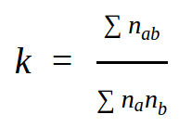
The idea ...
“Word forms that should be conflated for a given corpus will cooccur in documents from that corpus.”
Conducted a class refinement.
Formula:
n_{a} = occurences of a in the corpus
n_{b} = occurences of b in the corpus
n_{ab} =
Win = size of the text window = 100 words
em = expected mutual information
Notes:
Put definition of em

Slide 16
Xu and Croft’s Experiment
Document Collection:
WEST legal documents
TREC experiments
WSJ (Wall Street Journal)
ISM Collection → Spanish Corpus
Baseline stemmers:
Porter
KSTEM
Trigram matching algorithm
Create the initial equivalence classes

Slide 17
Xu and Croft’s Algorithm
Less expansion
= faster retrieval
= better retrieval effectiveness
Collect all unique word forms in the corpus
Discards numbers, stopwords, and proper nouns.
Use a stemmer (Porter, Krovetz) to create initial equivalence class.
Calculate em score for every word pairs in the equivalence class.
Crete connected component graph
Mapping the class into a graph based on the em score.
Find the optimal partition
Stemming
Increase recall
Decrease precision
Optimal partition = partition that maximizes the formula
δ = the precision’s harm of a & b.
Achieve the best trade-off
Higher em score
a & b are more related
Good conflation
Improve recall
em(a, b) - δ
Notes:
What is partition? All possiblities that we can do to split a large conflation.
Aggressive stemmer → over-stemming → large equivalence classes (conflation)
Do an optimal partition to solve this over-stemming problem.

Slide 18
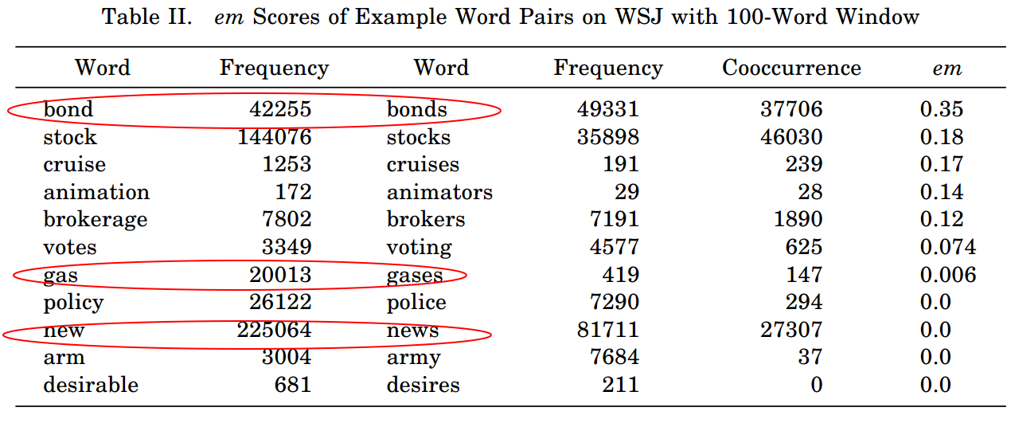
em Scores Example
Gases → hot gases, medical gases
Gas → natural gas, gasoline
*Table from Xu and Croft (1998)

Slide 19
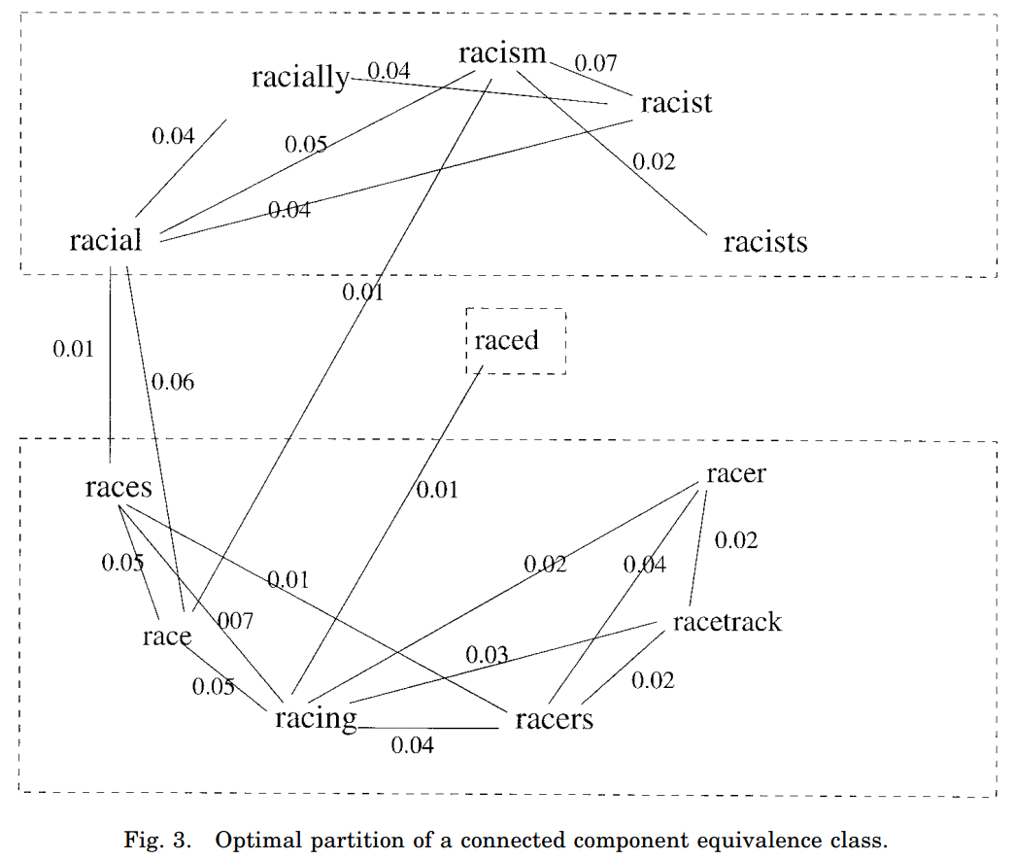
Win = 100 words
Em threshold = 0.01
δ = 0.01
Do the query expansion:
Query words
Equivalence classes
*Figure from Xu and Croft (1998)
Notes:
Race has 2 distinct meanings:
Related to human
Related to competition

Slide 20
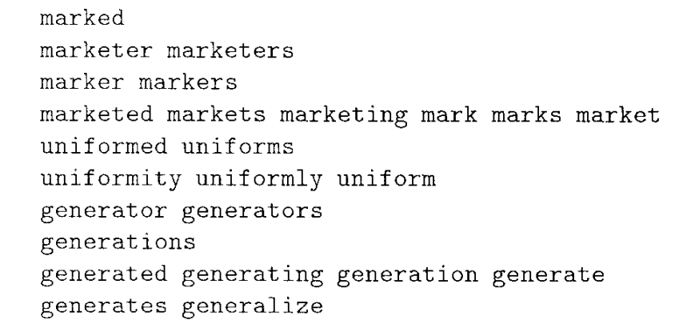
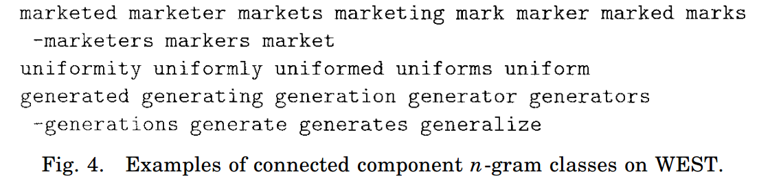
How did they test the experiment?
Optimal Partition Algorithm vs The Baseline Stemmers
Porter
KSTEM
Trigram Matching Algorithm
computer and company
t-test
Optimal partition is better than both Porter and KSTEM
P-value = 0.02
Optimal partition is better than KSTEM
P-value = 0.01
*Figure from Xu and Croft (1998)

Slide 21
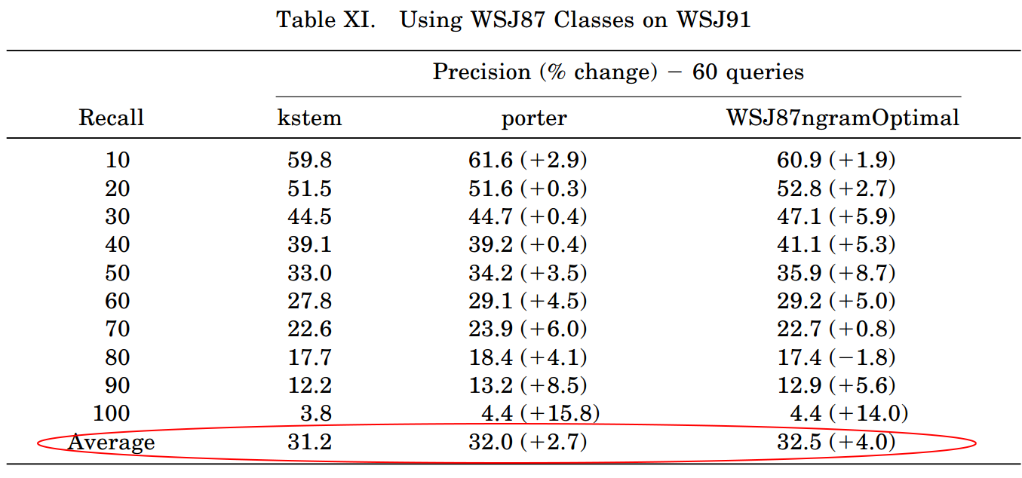
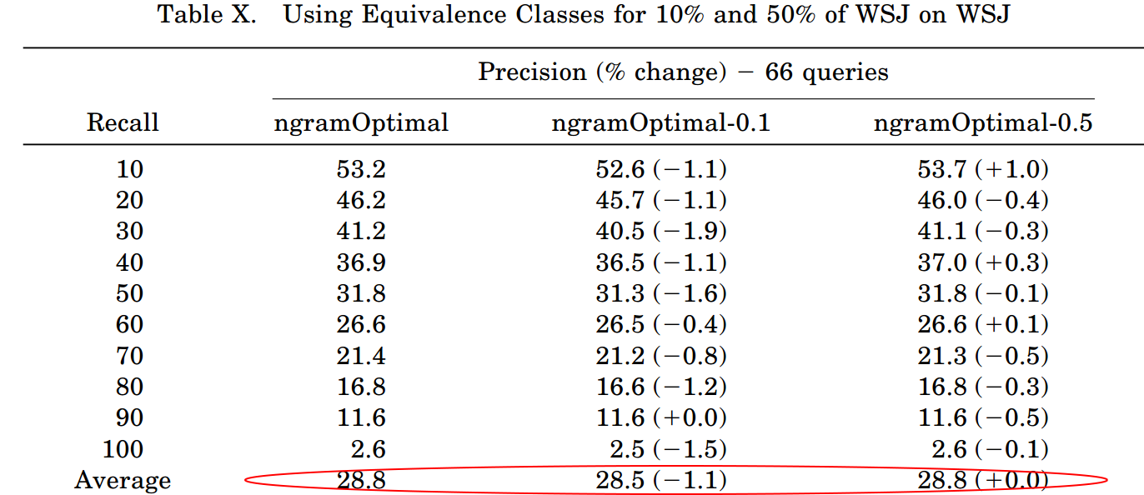
Conclusion
Krovetz Stemmer heavily depends on dictionary which brings some drawbacks:
Incompleteness
Over stemming
Corpus-based algorithm comes up to refine both Porter and Krovetz stemmer
Adding the cooccurence of word variants in the calculation
Partition the large equivalence class into smaller conflations.
Better retrieval results
Other benefits:
Scalability → generate equivalence classes based on part of the corpus
Portability → port equivalence classes from one corpus to other corpora
Efficiency → smaller equivalence classes, more efficient retrieval process
*Table from Xu and Croft (1998)
Notes:
Choose 50% of WSJ to generate the equivalence classes for the whole corpus

Slide 22
References:
[1] Krovetz, Robert. "Viewing morphology as an inference process." Proceedings of the 16th annual international ACM SIGIR conference on Research and development in information retrieval. ACM, 1993.
[2] Xu, Jinxi, and W. Bruce Croft. "Corpus-based stemming using cooccurrence of word variants." ACM Transactions on Information Systems (TOIS) 16.1 (1998): 61-81.
[3] Croft, Bruce., Metzler, Donald., and Strohman, Trevor. 2009. “Search Engines: Information Retrieval in Practice (1st ed.).” Addison-Wesley Publishing Company, USA.

Slide 23
Thank You
Notes:
Check:
Judul slide
References
Pastikan judul tiap slide nyambung dengan kontennya
Pastikan ada nomor slide
Check grammar dan typos
Check judul table dan figures
Kalo ada table dan gambar yang bukan diambil dari paper, cantumkan sumbernya.
Check Outline

