Slide 1
Cassandra - A Decentralized Structured Storage System Author : Avinash Lakshman and Prashant Malik
Venue : ACM SIGOPS Operating System Review
Year : 2010
Bigtable: A Distributed Storage System for Structured Data
Author : Fay Chang, Jeffrey Dean, et al.
Venue : 7th USENIX Symposium on Operating Systems Design and Implementation (OSDI)
Year : 2006
Presented by: Erika Siregar
CS 834 - Introduction to Information Retrieval
Fall 2016
Old Dominion University
September 15, 2016

Slide 2
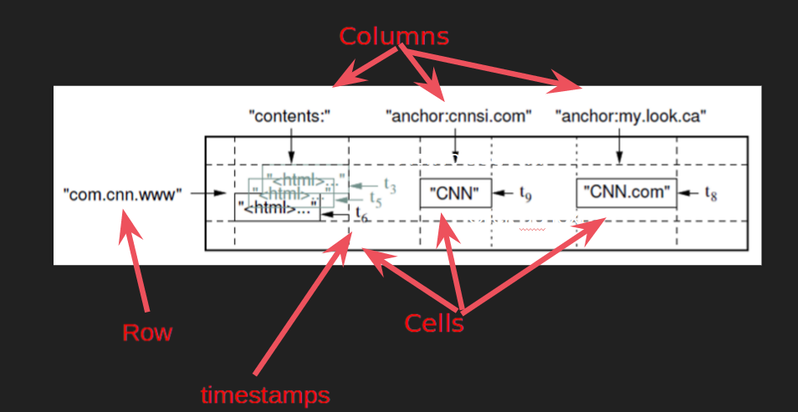
What is Bigtable?
A distributed multidimensional sorted map
Data is indexed using rows, columns, and timestamps <Row: string, Column: string, Timestamp: Int64> --> String
Bigtable does not support a full relational data model, but: provides clients with a dynamic control over data layout and format
Notes:
* it means, you can access any cell in the bigtable by giving the row key, column key, and timestamp.

Slide 3
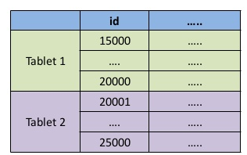
Data Model : Row
Row keys are arbitrary strings
Row is the unit of transactional consistency
Every read or write of data under a single row is atomic
Data is maintained in lexicographical order by row key
Rows with consecutive keys (Row Range) are grouped together as “tablets”
Unit of distribution and load-balancing
For example, in Webtable : pages in the same domain are grouped together into contiguous rows by reversing the hostname components of the URLs.
Data for maps.google.com/index.html --> stored under: com.google.maps/index.html
A more efficient host and domain analysis

Slide 4
Data Model : Column
Column keys are grouped into sets called “column families” --> basic unit of access control
Privacy setting --> add, read, view, etc.
All columns in a family are in the same type
Column key is named using the following syntax: family:qualifier
Family names: printable
Qualifier : arbitrary strings
A table may have unbound number of columns, but the column families:
should be small in small numbers (± hundreds)
Rarely change
Notes:
* in our example about webtables : family name = anchor ; quallifier : the referring site. --> the cell content = link text.

Slide 5
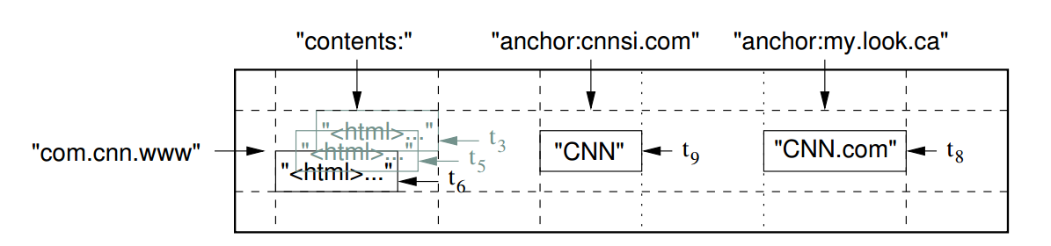
Data Model : Timestamp
Versioning --> each cell contain multiple versions of the same data.
Each version is indexed by timestamp
Can be assigned by :
Bigtable --> real time in microseconds.
client applications
Data are stored in decreasing timestamp order --> from the newest to the oldest.
Garbage-collection mechanism:
Keep the latest n updates
Keep the updates since time t

Slide 6
Building Blocks
Use Google File System (GFS) to store log and data files.
Using Google SSTable file format.
A cluster management system
Scheduling jobs
Managing resources and shared machines
Dealing with machine failures
Monitoring machine status
Chubby
Lock Service
Ensure that there is at most one active master at any time
Discover tablet servers and finalize tablet server deaths;

Slide 7
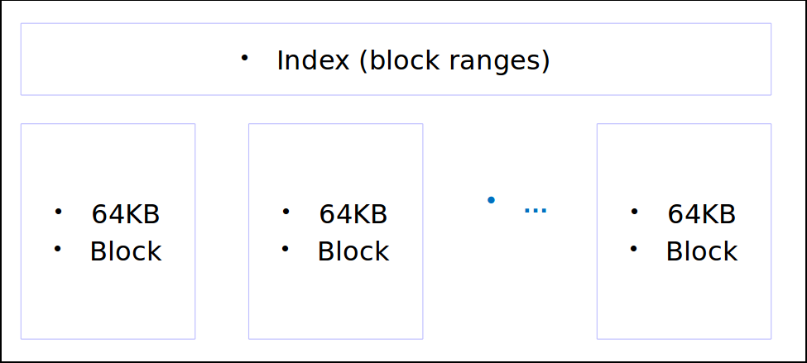
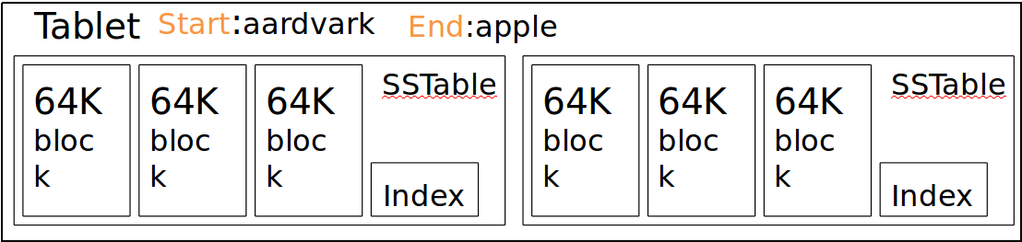
SSTable
Immutable
contains a sequence of blocks
A block index is used to locate blocks
This index is loaded into memory when the table is open.

Slide 8
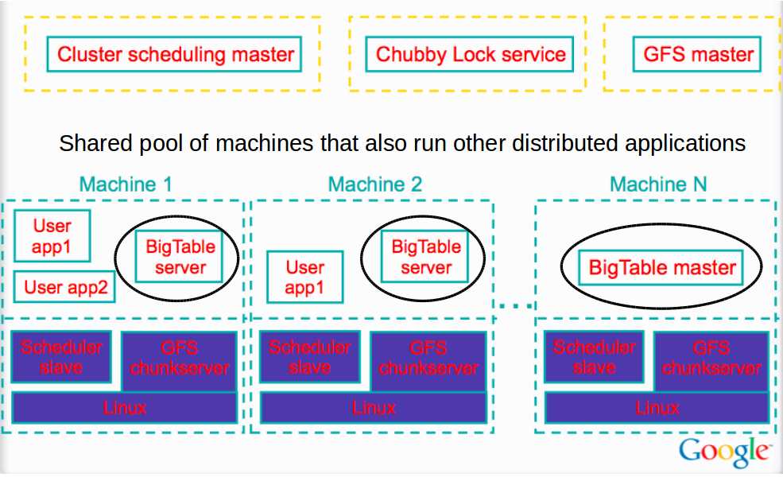
Bigtable Illustration
3 major components:
A library that is linked to every client
One master server
Many tablet servers
Master:
assigning tablets to tablet server
detecting the addition and expiration of tablet server
balancing tablet-server load --> split tablets that have grown too large
garbage collection of files in GFS
handling schema changes
Clients never communicate with the master
Notes:
Master assign tablets to tablet servers​
Tablet server manages reads and writes from it's tablets​
Clients communicate directly with tablet server​
Tablet server splits tablets that have grown too large​

Slide 9
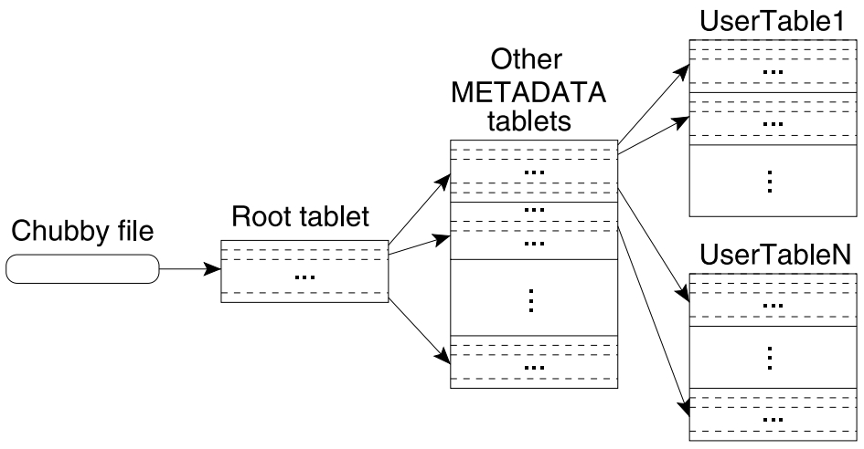
Tablet Location
Use a three-level hierarchy analogous :
A file stored in Chubby --> contains the location of the root tablet
The root tablet contains the locations of all of the tablets of a special METADATA table
Each METADATA tablet contains the location of a set of user tablets
given a row, how do clients find the right machine?

Slide 10
Tablet Assignment
Each tablet is assigned to one tablet server at a time
The master keeps track of:
The set of live tablet servers
The current assignment of tablets to tablet servers
How to keep track of tablet server?
Tablet server starts --> creates and acquires an exclusive lock in a specific Chubby directory
The master monitors this chubby directory to discover tablet servers.

Slide 11
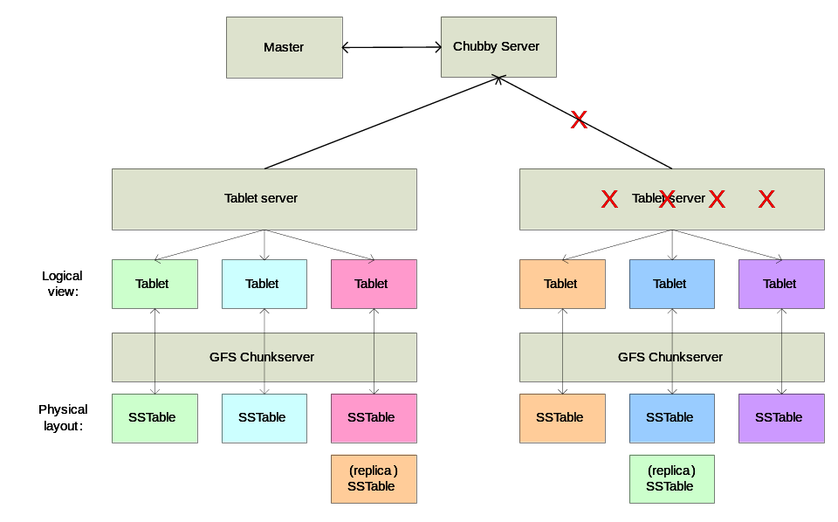
Tablet Server Failure
When network failure happens:
Tablet server loses its lock and stops serving its tablets.
A tablet server attempts to reacquire an exclusive lock
If the lock is no longer exists --> tablet server kills itself.

Slide 12
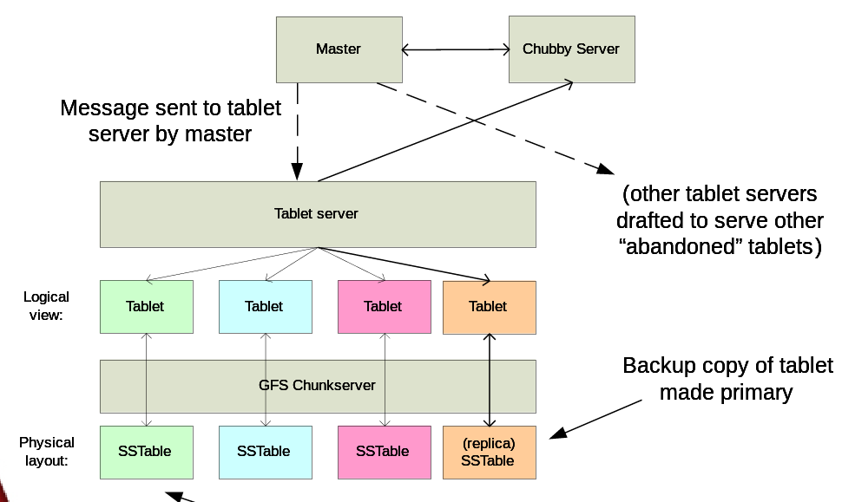
Tablet Server Failure

Slide 13
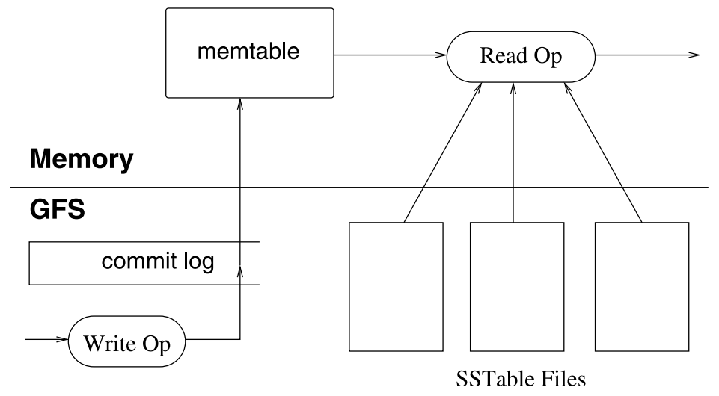
Tablet Serving
The persistent state of a tablet is stored in GFS
The recently committed ones are stored in memory in a sorted buffer called a memtable
Older updates are stored in a sequence of SSTables
Tablet Recovery:
Read metadata containing SSTABLES and redo points
Apply redo points

Slide 14
Compaction
Minor Compaction
Size of memtable increases
Convert the memtable into an SSTable
Reduce memory usage and log traffic
Merging Compaction
Number of SSTable increases
Bound the number of SSTable
Reads the contents of a few SSTables and the memtable, and writes out a new SSTable.
Major Compaction
Rewrites all SSTables into one new SSTable
Clean deletes

Slide 15
What is Cassandra?
Bigtable has inspired the creation of another distributed storage system called “Cassandra”
Distributed storage system
For managing very large amounts of structured data
Across many commodity servers → Designed to run on cheap commodity hardware
Providing highly available service with no single point of failure
run on top of hundreds nodes, spread across different data centers

Slide 16
Background Story
Facebook runs the largest social networking platform
Strict requirements on performance, reliability, efficiency, and scalability
Serves hundreds of millions users at peak times
Using tens of thousands of servers located in many data centers around the world
There are always a small but significant number of server and network components that are failing at any given time
So, Facebook developed CASSANDRA

Slide 17
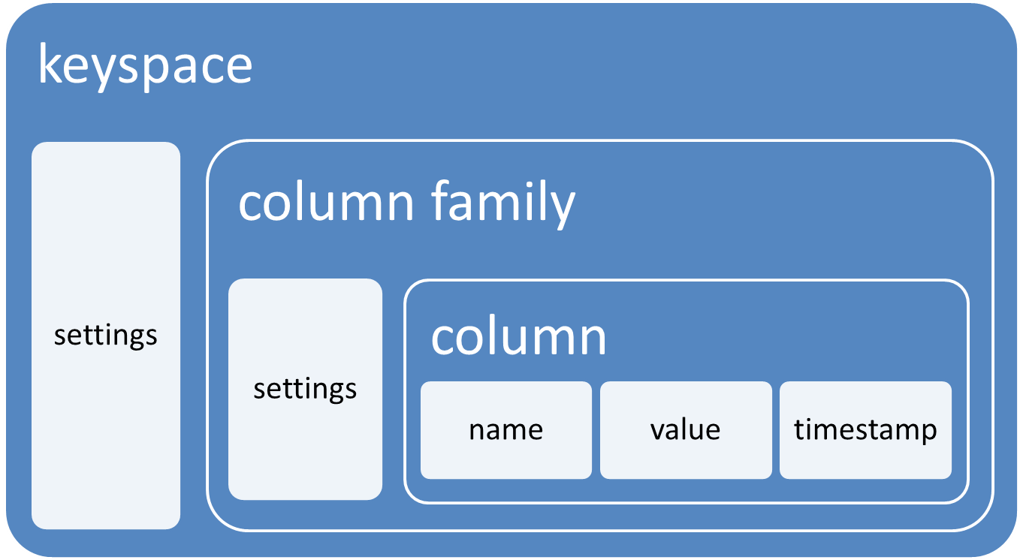
Data Model
Cassandra has a similar data model with Google Bigtable:
A table in Cassandra is a distributed multi dimensional map indexed by a key
The row key in a table is a string with no size restrictions
Every operation under a single row key is atomic
no matter how many columns are being read or written into
Columns are grouped together into sets called column families

Slide 18
Column Families
Cassandra exposes two kinds of columns families: Simple and Super column families
Simple column families are very similar with Bigtable column families
Super column families can be visualized as nested column family
Any column within a column family is accessed using the convention column family : column
Any column within a column family that is of type super is accessed using the convention column family : super column : column

Slide 19
System Architecture
Core distributed systems techniques:
Partitioning,
Replication,
Membership,
Failure handling
Scaling

Slide 20
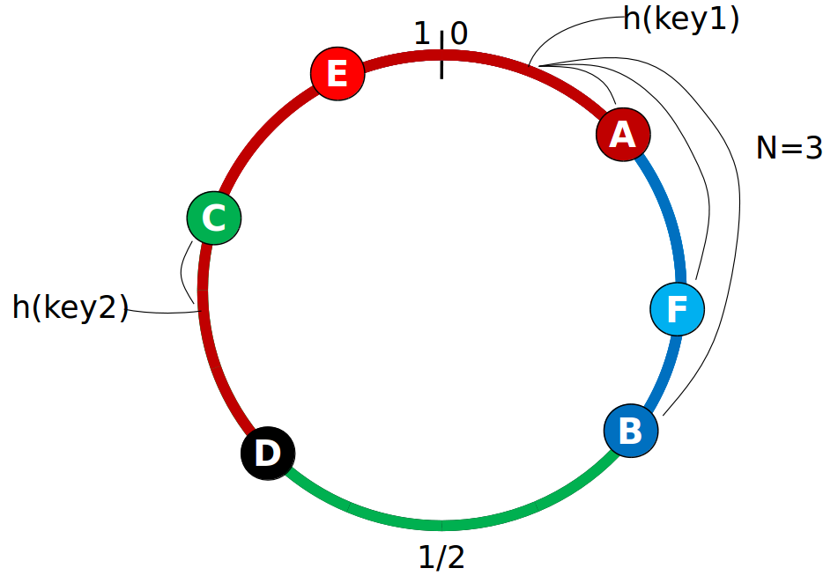
Partitioning & Replication
Partitioning:
Split the data into several different nodes
Nodes are structured in Ring Topology
Replication:
replicate the data into several nodes
How many nodes? depends on the replication factor (N)

Slide 21
Membership
Membership defines the state of a nodes in a cluster.
using a internodes communication protocol called “Gossip”.
inspired by real life rumour spreading.
Gossip also used to disseminate other system-related control state.
Illustration of Gossip:
Example – Node A wish to search for pattern in data
Round 1 – Node A searches locally and then gossips with node B.
Round 2 – Node A,B gossips with C and D.
Round 3 – Nodes A,B,C and D gossips with 4 other nodes ……

Slide 22
Failure Detection and Request Handling
Failure Detection:
determine if any other node in the system is up or down
uses a modified version of the Accrual Failure Detector
tracks “heartbeats” from other nodes
unreachable nodes will be assumed to be “down”.
Request Handling:
For reads :
Routes the requests to the closest replica, or
Routes the requests to all replicas and waits for a quorum of responses
For writes:
the system routes the requests to the replicas and waits for a quorum of replicas to acknowledge the completion of the writes

Slide 23
Local Persistence
The Cassandra system relies on the local file system for data persistence
Write operation involves a write into a commit log for durability and recoverability
Then the write into the in-memory data structure is performed
Read operation first queries the in-memory data structure before looking into the files on disk

Slide 24
Bigtable and Cassandra : Similarity
Cassandra’s data model, derived from Google’s BigTable
Distributed multidimensional sorted map
Row key
Column families
Timestamp
Using cluster concept
Bigtable : tablets
Cassandra : nodes
Inserts and updates are committed to a commit log
Data is compacted into SSTable
Cassandra is a daughter of Bigtable
http://www.planetcassandra.org/blog/cassandra-daughter-of-dynamo-and-bigtable/

Slide 25
Bigtable and Cassandra : Difference
Context | Bigtable | Cassandra
Replication | Handled by GFS | Chosen based on replication policy in configuration file
Partitioning | tablets server | nodes
Failure Detection | Using Chubby lock | Using gossip
Column Families | Only simple column families | There are simple and super column families (nested column families)
Read/Write Consistency | Directly into related tablets | one, all, or quorum consistency

Slide 26
References
Chang, F., Dean, J., Ghemawat, S., Hsieh, W.C., Wallach, D.A., Burrows, M., et al. (2006). Bigtable: a distributed storage system for structured data. OSDI '06: Proceedings of the 7th symposium on operating systems design and implementation (p. 205-218). USENIX Association.
Lakshman, A., Malik, P. (2010). Cassandra – A Decentralized Structured Storage System. ACM SIGOPS Operating Systems Review (p. 35-40)

