Slide 1

Selling Visibility in the AI Era
How to communicate WebMD Care Solutions for Answer Engine Optimization (AEO) and New Patient Search Behavior
March 3, 2026
Notes:
Today I’m going to walk you through what’s changing in patient search behavior. Specifically how AI is now influencing discovery and decision-making and how we pivot our messaging to position WebMD Care as an AI visibility solution.
So, this is about reframing what we already sell for how patients actually search in 2026.

Slide 2
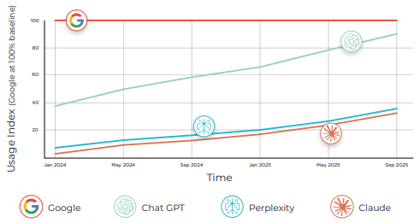
Beyond Google: Where the Market is Shifting
2
Google still dominates, but AI assistants are slicing the "search pie".
64.5%
21.5%
ChatGPT market share, the "entry point" for symptoms
Google Gemini, the "integrated" mobile experience
Rising challengers: Grok (3%), Perplexity (2%) and Claude (2%) capture high-intent "knowledge queries"
The volume: ChatGPT alone handles 1 billion interactions per day
Notes:
First, let’s talk about where the market is shifting.
Google still dominates traditional search, but the ‘search pie’ is no longer just Google.
AI assistants are becoming the entry point for health questions.
ChatGPT alone handles 1 billion interactions per day.
It holds 64.5% of AI assistant market share.
Gemini is integrated directly into mobile.
Perplexity, Claude, Grok — these are capturing high-intent knowledge queries.
The key shift is:
Patients aren’t starting with links.
They’re starting with answers.
So, of course, this changes how visibility works.

Slide 3
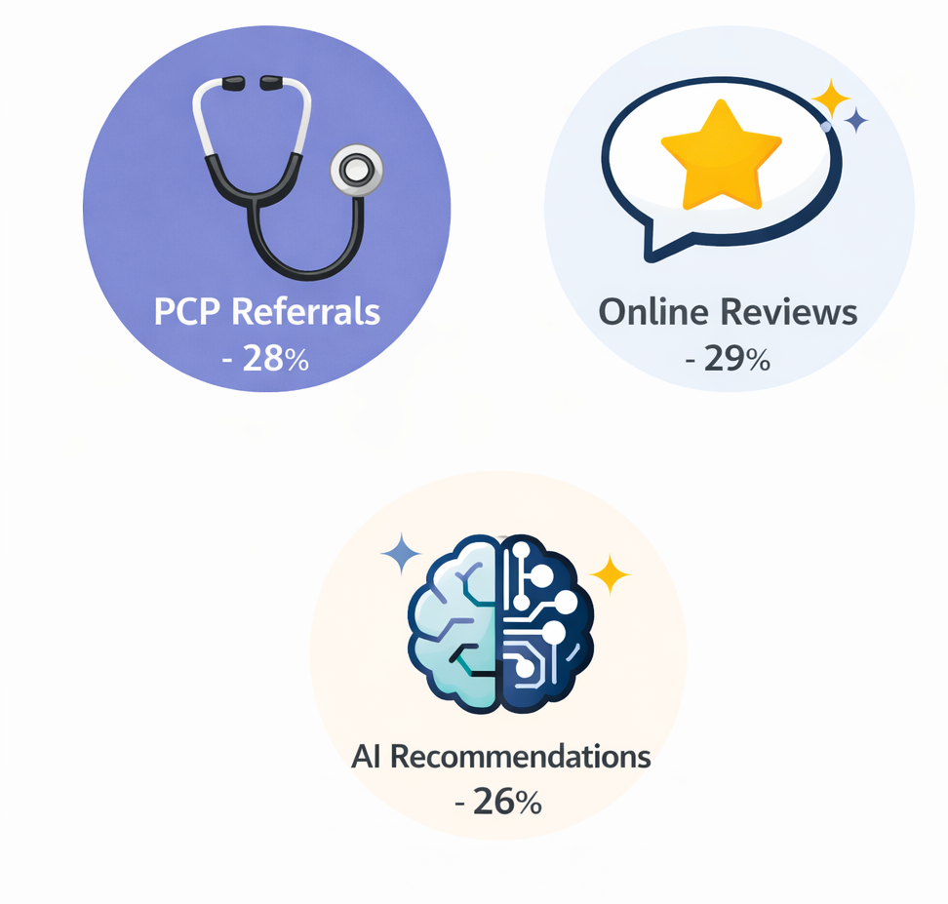
Health Searches & Referrals in 2026
3
40M
40 million people turn to ChatGPT daily for healthcare questions (OpenAI)
26%
of patients say AI recommendations directly influenced their choice of provider, nearly matching primary care referrals (28%) and online review sites (29%)
88%
of health-related searches now trigger an AI Overview
Notes:
OpenAI reports 40 million people use ChatGPT daily for healthcare questions.
More importantly:
26% of patients say AI recommendations directly influenced their provider choice.
That nearly matches:
Primary care referrals at 28%
And Review sites at 29%
And 88% of health searches now trigger AI Overviews.
So AI isn’t experimental anymore.
It’s sitting alongside referrals and reviews as a primary influence.

Slide 4
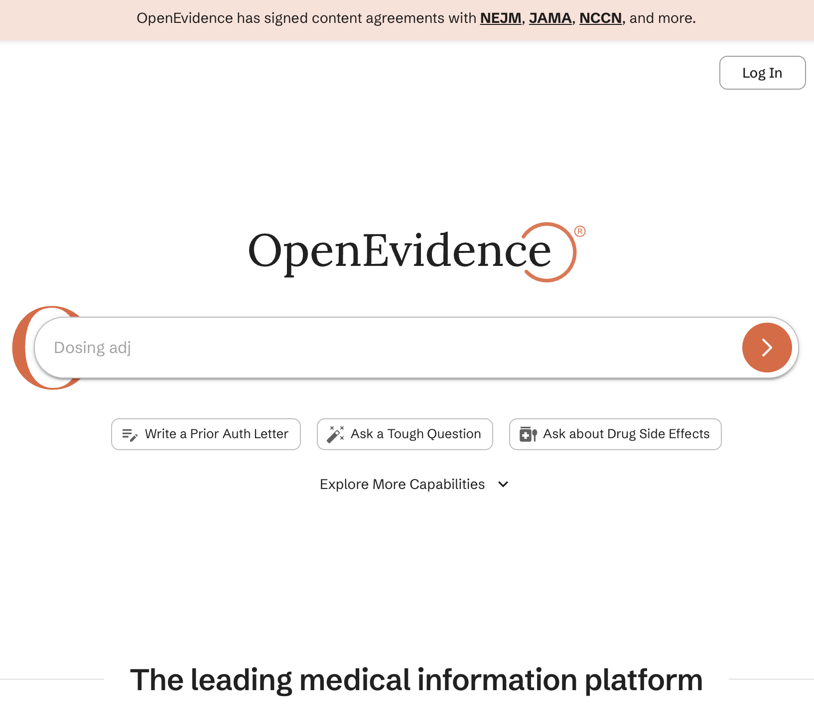
When AI Plays Doctor:
Health-Specific AI Search Tools
4
ChatGPT Health (OpenAI): launched Jan 2026; uses personal health data for specialist routing.
MedGemma (Google): clinical-grade AI that prioritizes medical authority.
40%
of US physicians use OpenEvidence for clinical evidence.
The Strategy: these models don't guess; they crawl trusted sources like WebMD to minimize clinical risk.
Notes:
There are now health-specific AI tools:
ChatGPT Health
MedGemma from Google
OpenEvidence, which is used by about 40% of US physicians
These models are built to minimize clinical risk.
And they don’t just guess.
They crawl trusted, authoritative medical sources, including WebMD.
So, here’s the important message for sales calls:
If a physician is not present in authoritative directories, the AI cannot safely recommend them.

Slide 5
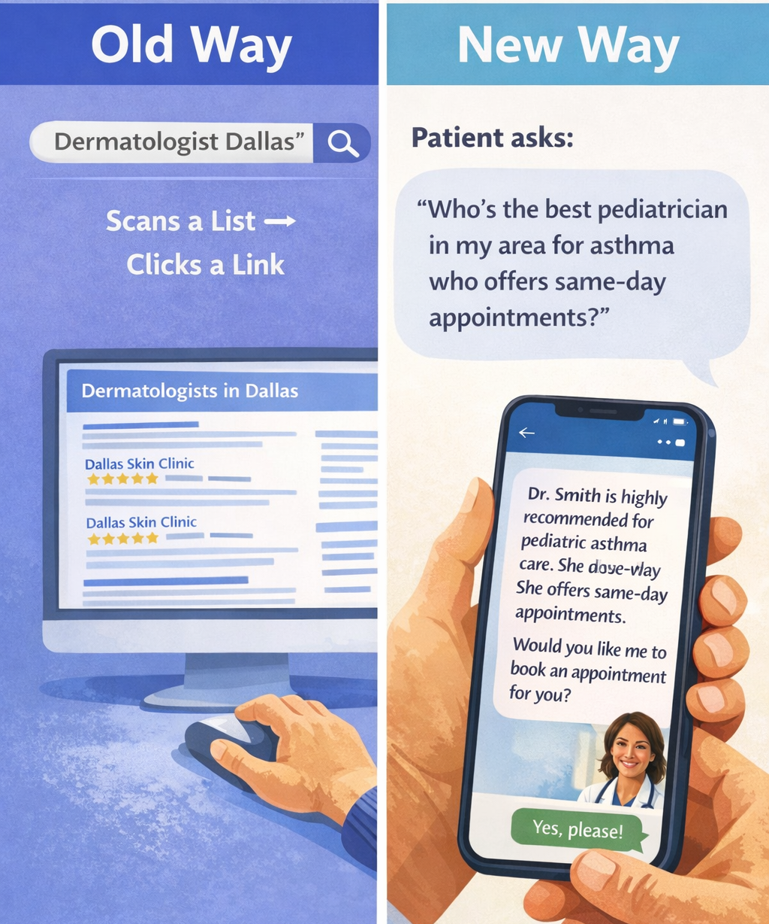
Why Patients Are Quitting Traditional Google
5
Old Way
Keywords
Patient types "Dermatologist Dallas," scans a list, then clicks a link.
New Way
Conversational
Patient asks "Who's the best pediatrician in my area for asthma who offers same-day appointments?"
The Difference: AI interprets intent and nuance. If a physician's data can't answer nuanced questions, they are invisible.
Notes:
So, here’s the behavioral shift.
The old way was when:
A patient types ‘Dermatologist Dallas.’ They scroll through and skim links. They click. Maybe they go back and scroll through more links and click again, and that could repeat.
Now, the new way is:
A patient opens and AI assistant like Gemini or ChatGPT and asks ‘Who’s the best pediatrician in my area for asthma who offers same-day appointments?’
AI interprets intent and nuance.
And it doesn’t just match keyword. It synthesizes.
If a physician’s information isn’t structured to answer these nuanced queries, the physician remains invisible.

Slide 6
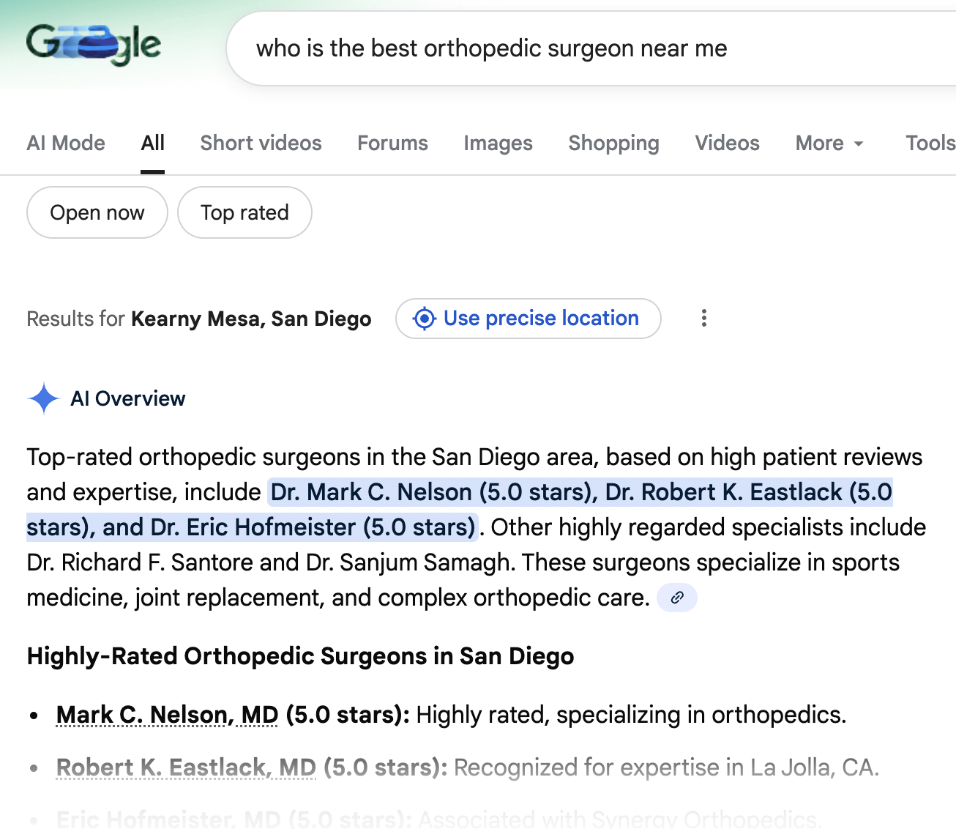
From Browsing Links to Getting Answers
6
Patients now get an answer before they see a practice website.
Visibility is no longer just ranking; it's being featured in the AI Overview.
Users rely on AI to summarize three things:
1
Provider Credentials: board certifications, years in practice
2
Real-Time Availability: Can I get in today?
3
Synthesized Patient Reviews: What's the consensus on this doctor?
Notes:
Patients now get answers before they ever see a website.
Visibility is no longer just ranking.
It’s being included in the AI synthesis.
AI summarizes three core signals:
Credentials
Real-time availability
Review consensus
If those signals are not structured and accessible, the AI chooses someone else.

Slide 7
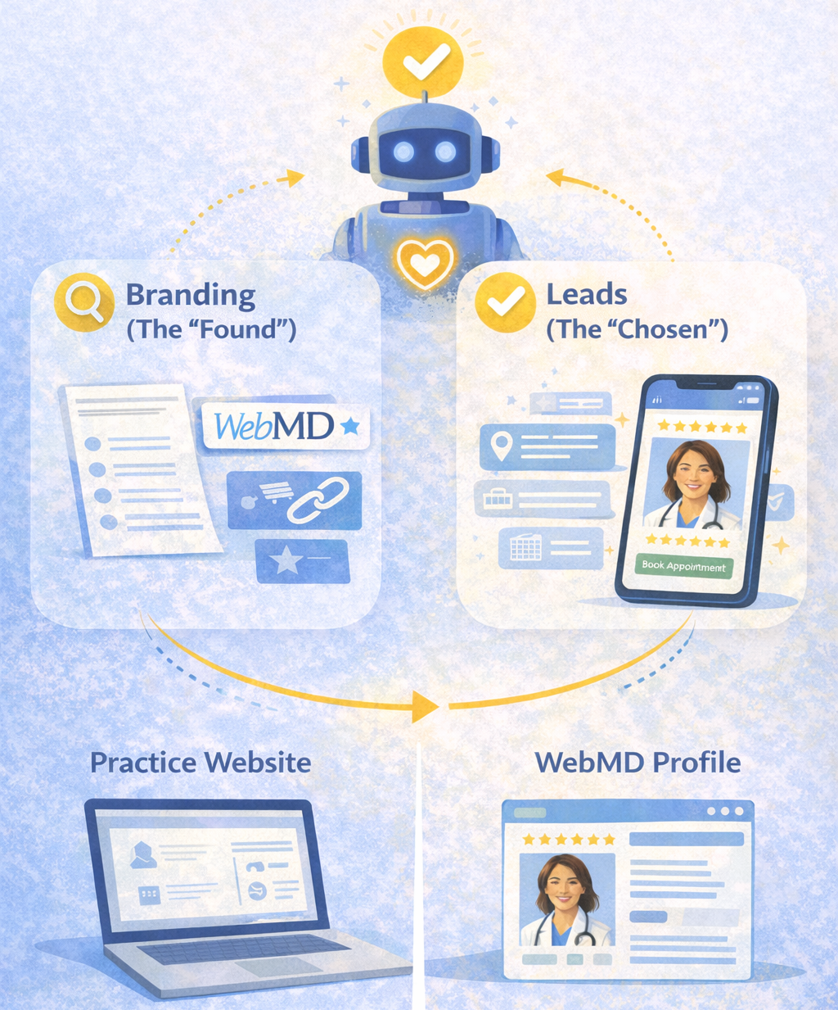
Branding vs. Leads in AI
7
AI search is about being Found AND Chosen
Branding: the "Found"
Leads: the "Chosen"
AI learns who you are through authority mentions, citations, and WebMD Featured Profiles.
Patients act on structured signals (availability, location, service tags).
The Pivot: A website builds a brochure; a WebMD profile builds long-term authority that AI models learn and trust.
Notes:
This is where we at WebMD Care pivot our positioning.
AI visibility is about being Found AND Chosen.
And this is exactly what WebMD Care Directories does - it provides both visibility and patient lead generation.
And today, being found means showing up in AI answers. And AI learns who a physician is through:
Authority mentions
Citations across other sites
And of course, that includes WebMD Featured Profiles because they provide that structured data AI looks for.
From there, the patient may book based on structured signals provided by the WebMD profile, like availability, location, and reviews being shown. So now, the physician is both found and chosen, thanks to the support of their Featured Profile.
One line you might use in your conversations with physicians is:
“A website builds a brochure.
While a WebMD profile builds long-term authority that AI models learn and trust.”
But most importantly, WebMD Profiles are no longer just about traffic. They create authority infrastructure, so that the physician can be referenced in AI answers.

Slide 8
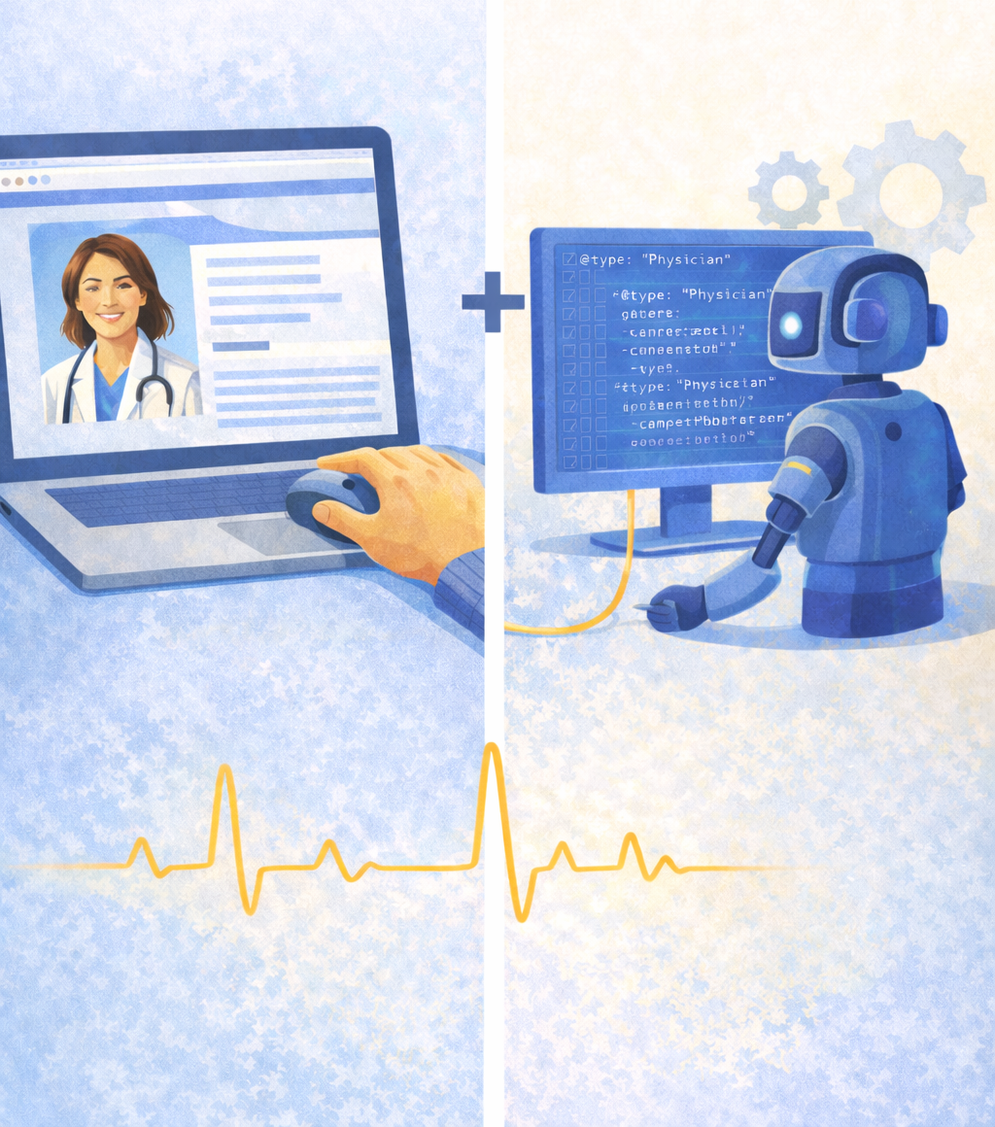
WebMD Profile: An AI “ID Card”
8
Schema Markup
Hidden code that acts as a digital ID. Structured data and schema make WebMD Care Profiles more likely to be cited by AI.
Expert-Level Content
AI Overviews favor deep, thorough data. We format credentials into "Knowledge Blocks" AI assistants easily digest.
THE SALES ARGUMENT
"Your website is for humans. Your WebMD profile is a Structured Data Feed for the machines."
Notes:
Think of a WebMD profile as an AI ID card.
So how does it work? This is where we get a little more technical.
WebMD Profiles offer structured data and schema, making it more likely to be cited by AI engines.
WebMD Profiles formats a physician’s credentials into “knowledge blocks” that AI can easily digest and reference.
AI models prefer this structured, clean, trusted data.
And here is a sales argument you might use:
“Your website is for humans. Your WebMD profile is a structured data feed for the machines.”
That line reframes the entire value proposition.

Slide 9
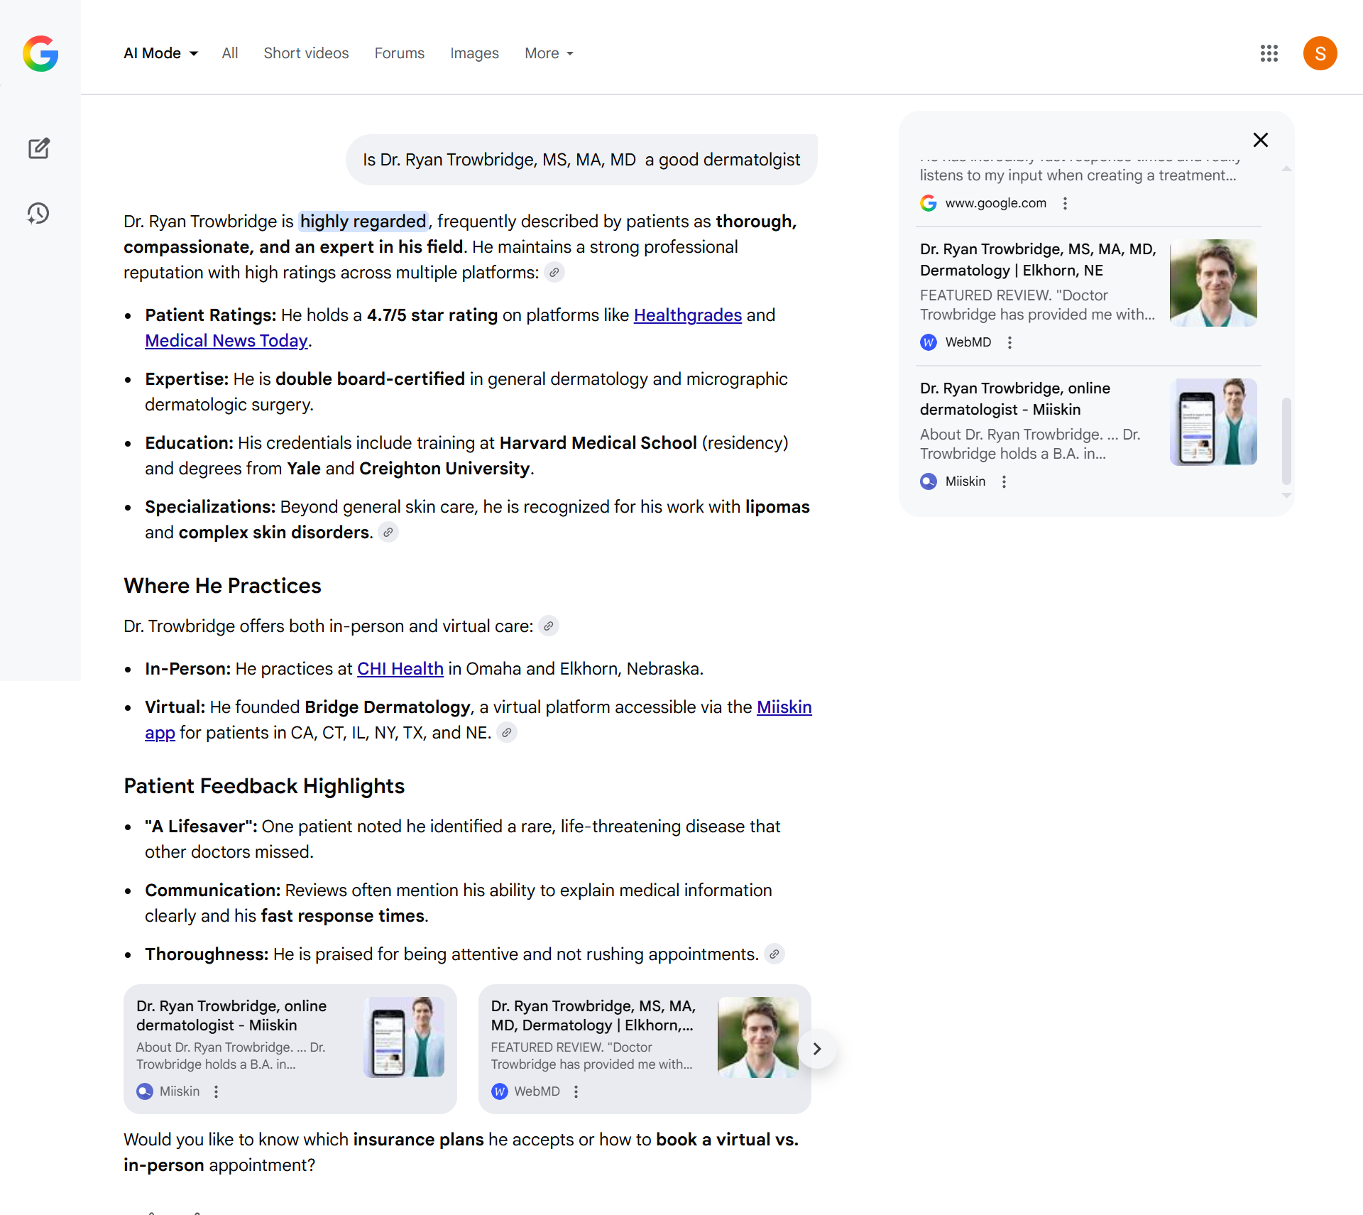
Reviews: The Data Food for AI
9
Why Patient Voice is a Ranking Signal
Sentiment over Stars
LLMs read review text to match physicians to specific user goals.
Review Velocity
AI is less likely to recommend a physician with no reviews in the last 90 days.
Risk Mitigation
AI is built to be "safe." Steady WebMD reviews signal you are Active & Verified.
Notes:
This is where reputation becomes strategic.
AI reads review text- not just star ratings.
It looks at:
Sentiment
Specific condition mentions
Freshness
Review velocity matters.
If a physician has no reviews in 90 days, AI confidence drops.
A steady stream of WebMD reviews signals that a physician is active, verified and safe to recommend.

Slide 10
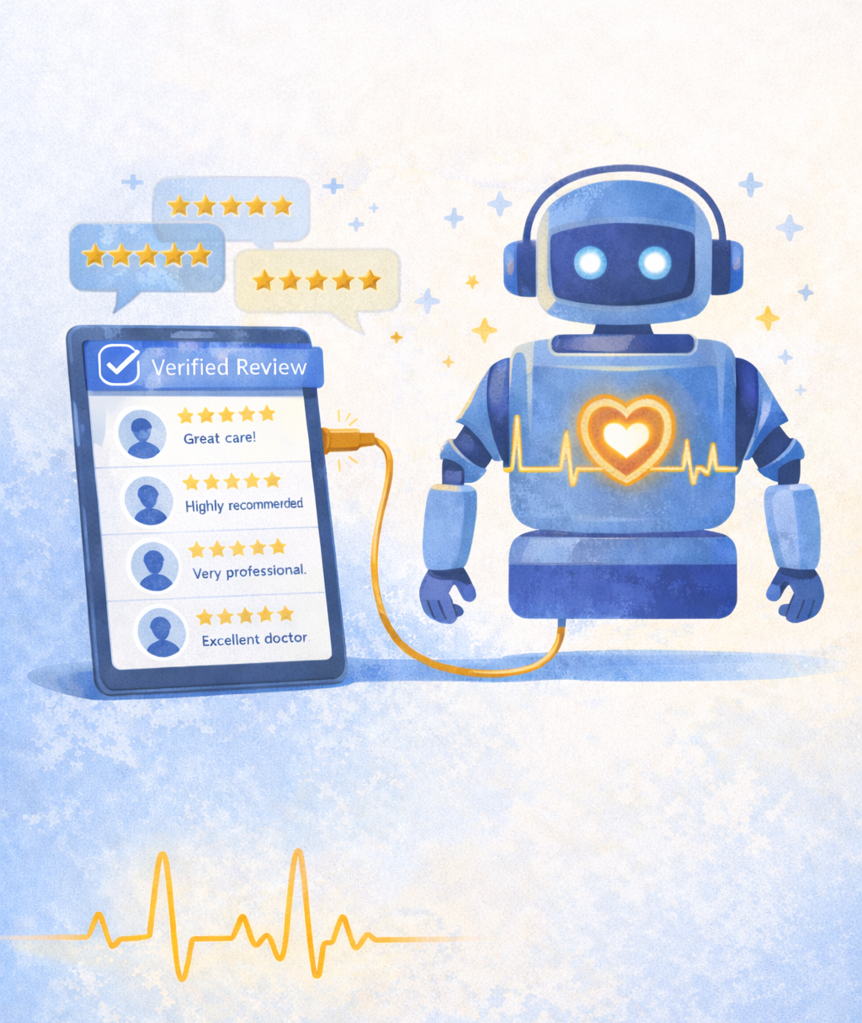
Reputation Management = AI Visibility
10
Feeding the Algorithm
A system, not a one-off
Our Reputation Management tools automate review collection to maintain your AI "heartbeat."
Authority over backlinks
In 2026, reputation and expertise matter more than old-school link building.
Engagement
Responding to reviews signals to AI that you are a reliable provider.
Notes:
Our reputation tools create a system, they’re not just a one-off.
We automate review collection to maintain what we can call the AI “heartbeat.”
In 2026, reputation and expertise signals matter more than backlinks.
And engagement — responding to reviews — tells AI:
This provider is active and accountable.

Slide 11

Handling the “I Already Have a Website” Objection
11
Objection: "I already have a website."
Rep: the shift
"Your website only works if a patient clicks your specific link. Right now, 40 million people every single day are bypassing search links and asking ChatGPT to choose a provider for them.
Rep: why WebMD
WebMD is a Verified Tier-1 Directory. When an AI synthesizes an answer, it cross-references your site with us. If you aren't on WebMD, the AI 'loses confidence' and recommends the competitor it can verify."
Notes:
How many of you have heard the “I already have a website” objection?
Depending on how many - okay, so what objections have you heard? (Erika to take notes)
For now, we’ll use this as an example to show how we might express the value of a WebMD Featured profile to a doctor who says they want more visibility.
I’m also sending out an Objection Handling One Sheet after this presentation for you to use to help you in your conversations with leads around AI search.

Slide 12


Live Demo
12
1
2
3
Open: ChatGPT or Gemini.
Ask: "Find me a [Specialty] near me who is highly rated for [Procedure]."
The Result: Note who the AI cites.
"See how the AI cited a medical directory to give this answer? My job is to make sure your WebMD data is the source for that next recommendation."
Notes:
Now we’re going to transition to a live demo. Let’s see this in action.
(Open ChatGPT.)
Run a local doctor query.
Highlight:
Structured formatting
Citations
How CTAs appear - now structured in ChatGPT
This is where the decision is happening now.

Slide 13
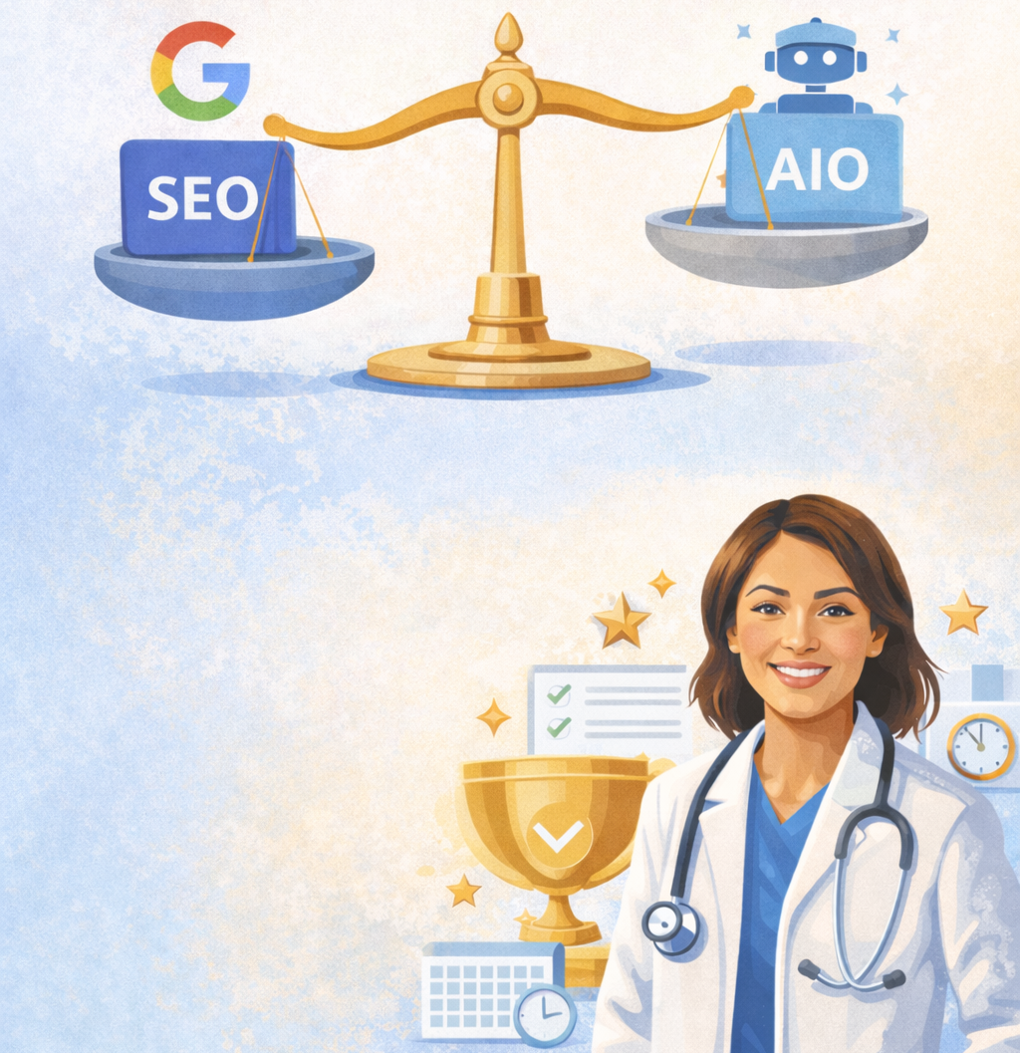
The New Visibility Advantage
13
Hybrid Search
Success requires balancing traditional Google SEO with Answer Engine Optimization (AEO).
The Winner
The physician with the most trusted, structured, and recent data signals.
Closing Stat
"One in four patients now asks an AI for a doctor recommendation by name. If the AI doesn't have the structured data from a platform like WebMD, it can't vouch for you, and it won't."
Notes:
Hybrid search is the future.
That’s both Traditional SEO and AI Optimization.
The winner is not the physician with the prettiest website.
It’s the physician with the most trusted, structured, recent data signals.
So here’s a line you might use in your sales calls:
“One in four patients now asks AI for a doctor recommendation by name. If the AI can’t verify you through a trusted directory like WebMD, it won’t vouch for you.”
That’s the opportunity we’re providing - to be known and trusted.

Slide 14
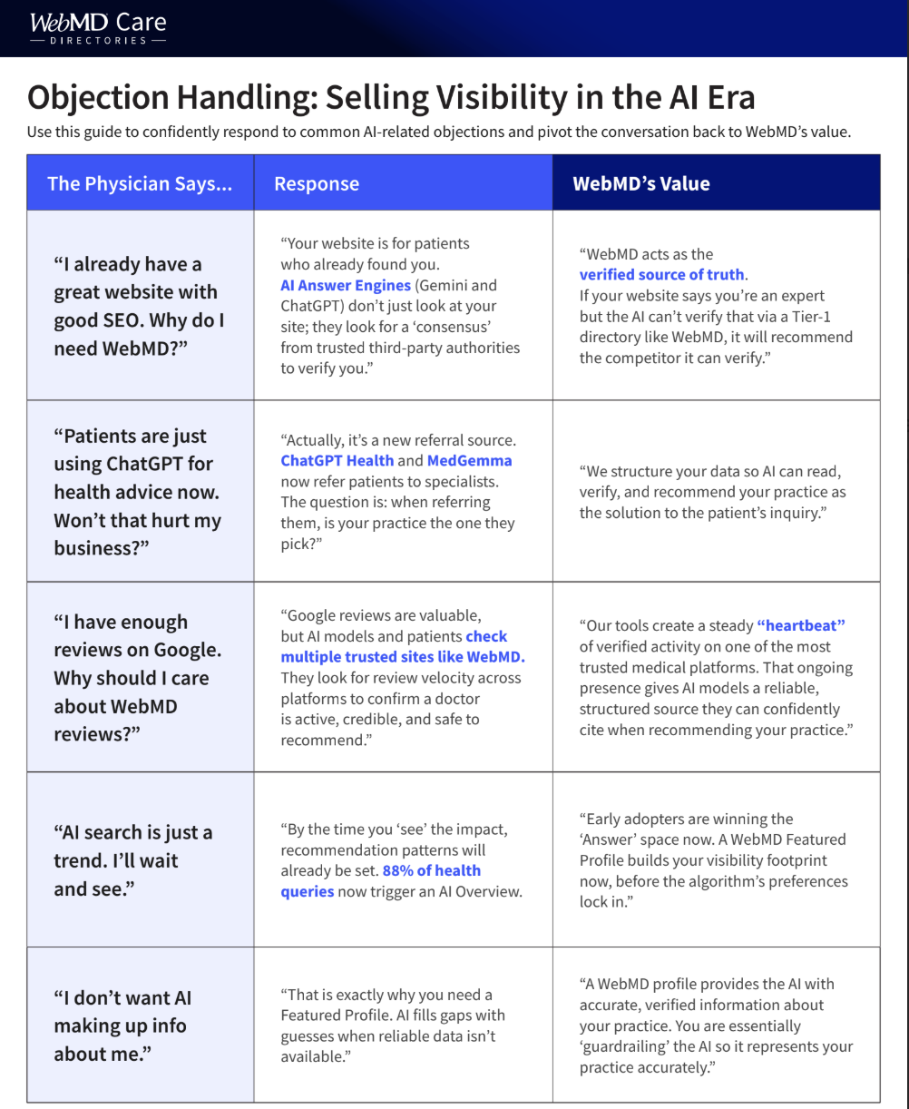
New Sales Resources
14
INTERNAL
Objection Handling: Selling Visibility in the AI Era
EXTERNAL
The AI Answer Era: How Physicians Win in 2026
Notes:
We have some very exciting sales resources.
To support you, I’m providing:
An Internal Objection Handling One Sheet, which is pictured here above.
A One Sheet you can send to physicians as a follow up or even on your calls called The AI Answer Era: How Physicians Win in 2026.
These are tools to help you translate this shift into confident sales conversations.
To sum all of this up:
Visibility used to mean ranking on page one.
Now it means being the answer.
WebMD helps doctors become the answer.

Slide 15

Notes:
Are there any questions?

