Slide 1

Uber vs lyft
Comparison Between Rivals in Boston, MA

Slide 2
Where do I find the Data Source ?
Find the data source from Kaggle, and they had a great source that predicts the cab prices for Uber vs. Lyft in Boston, MA.

Slide 3
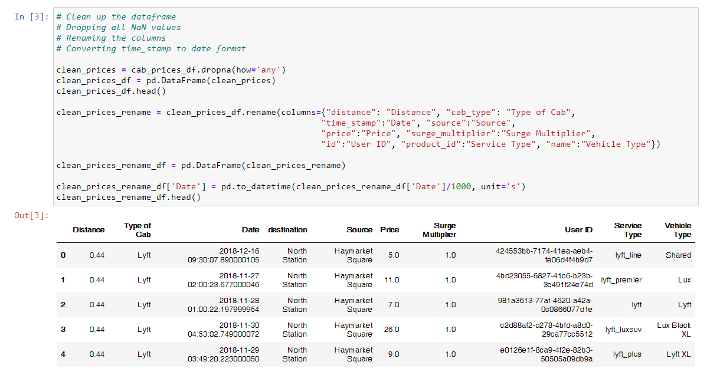
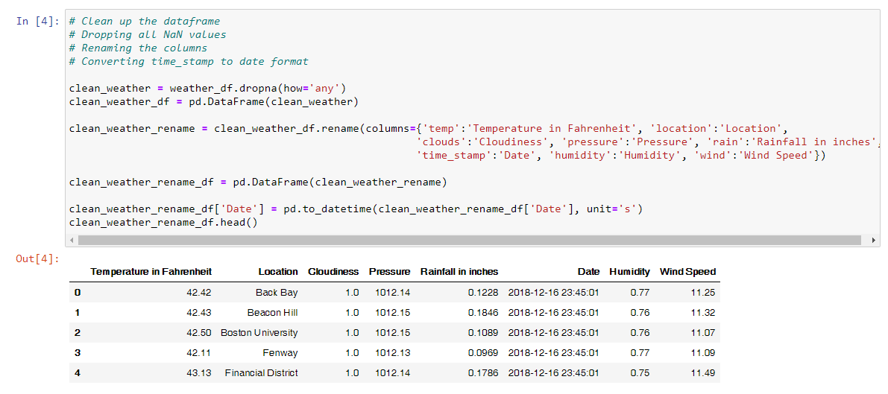
Cleaning up the data

Slide 4
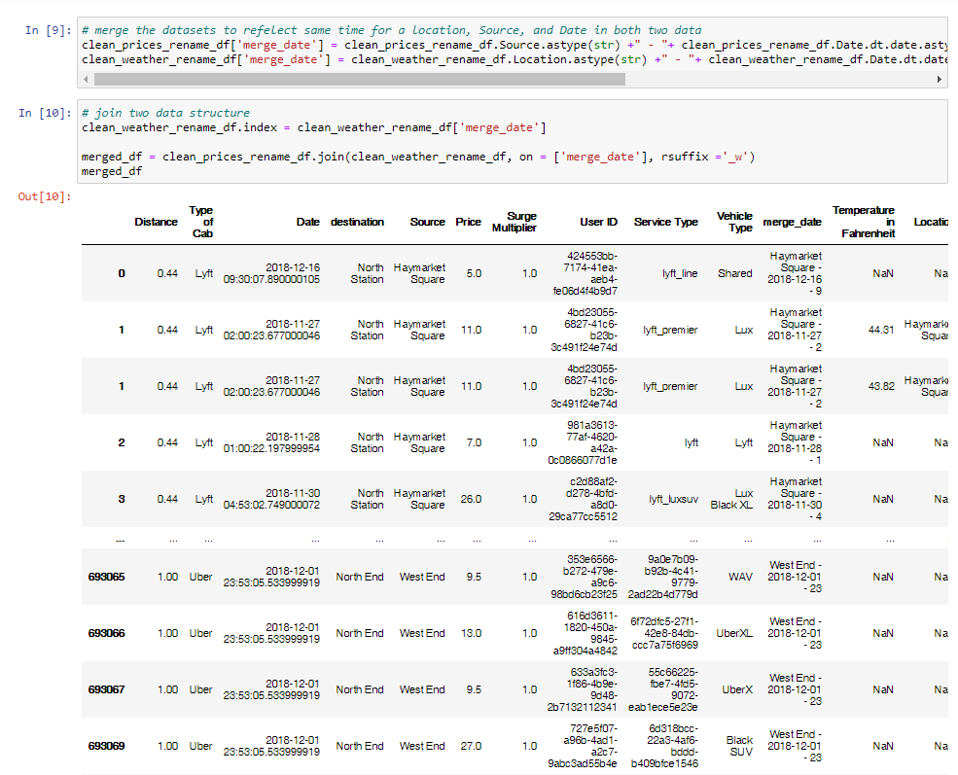
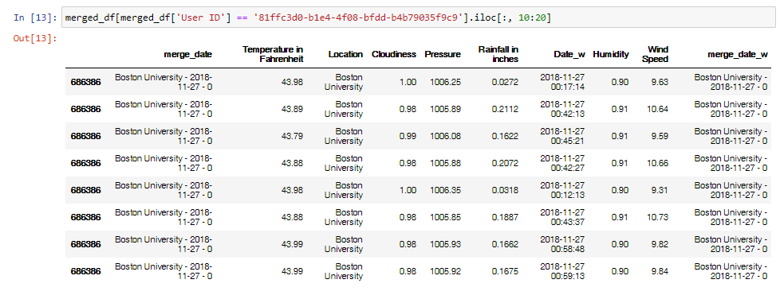
Merging data together

Slide 5
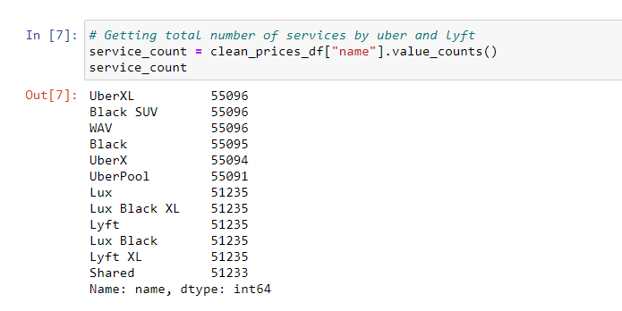
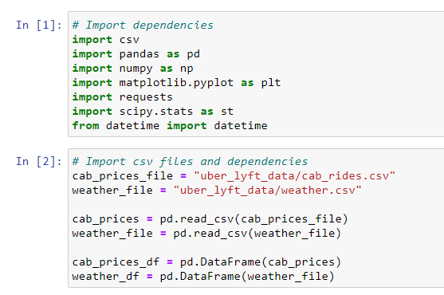
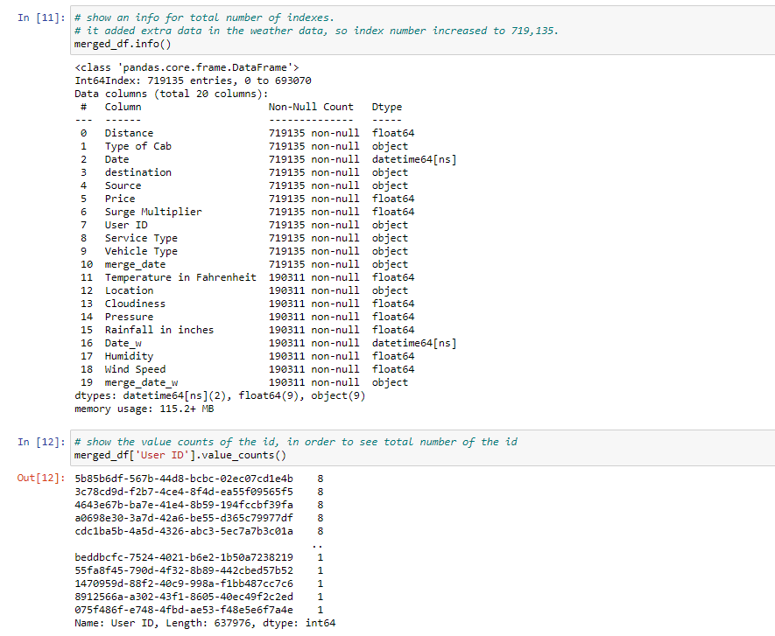
Importing and Finding Objects…
Importing the dependencies and files
Finding necessary services for Uber and Lyft
Finding the total values, after merging the data together

Slide 6
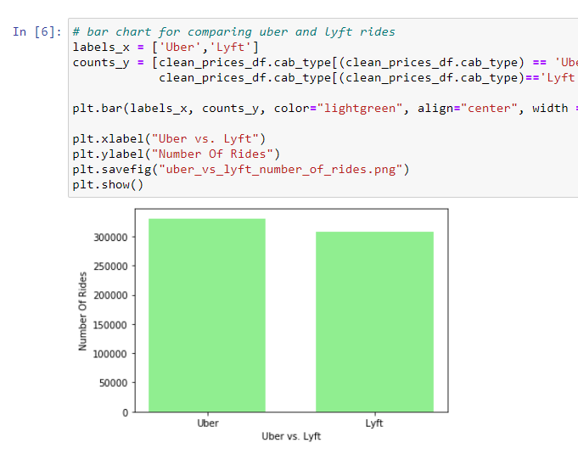
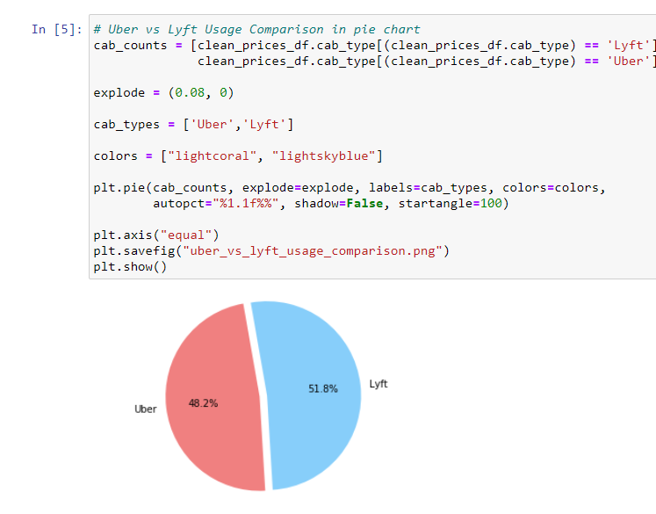
Questions: Is there more Uber users than Lyft users?
Yes, there are more rides with Uber than Lyft rides.
However, I find out that Lyft has silently more users than Uber users in percentages in the pie chart.

Slide 7
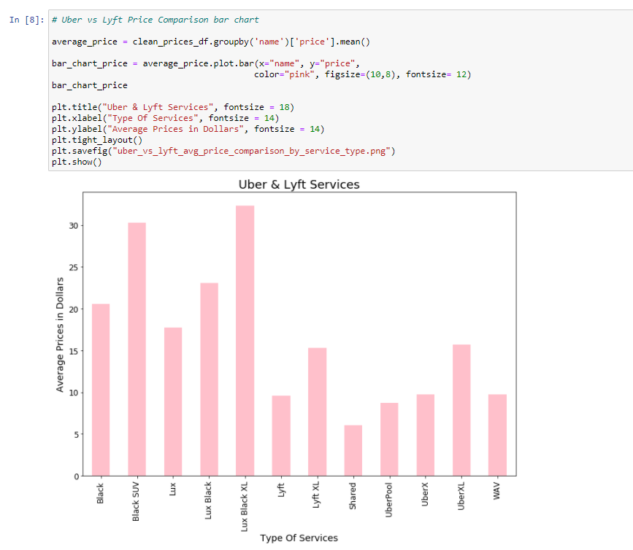
Questions: How many average prices are there in each Uber and Lyft services?
Lyft Rides
Lyft Shared has approx. 5-6 dollars in average prices.
Lyft Lux Black XL has slightly more than 30 dollars in average prices.
Lyft Shared has a lowest average prices in dollars, while Lyft Lux Black XL has the highest average prices in dollars.
Lyft Rides are in the red box.
Uber Rides are outside of the box.

Slide 8
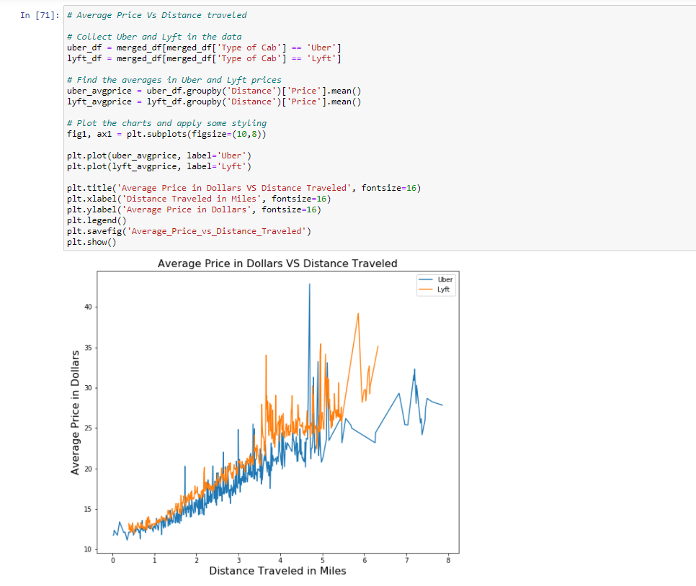
Questions: Are there any differences between average price of the data and distance traveled?
Lyft has the highest amount of average price than Uber as the distance increased.
Both average prices are increasing as the distance traveled increases.

Slide 9
Summary Analysis
Is there more Uber users than Lyft users?
Yes, there are more rides with Uber than Lyft rides.
However, I find out that Lyft has silently more users than Uber users in percentages in the pie chart.
How many average prices are there in each Uber and Lyft services?
Lyft Shared has approx. 5-6 dollars in average prices.
Lyft Lux Black XL has slightly more than 30 dollars in average prices.
Lyft Shared has a lowest average prices in dollars, while Lyft Lux Black XL has the highest average prices in dollars.
Lyft Rides are in the red box.
Uber Rides are outside of the box.
Questions: Are there any differences between average price of the data and distance traveled?
Lyft has the highest amount of average price than Uber as the distance increased.
Both average prices are increasing as the distance traveled increases.

Slide 10
Resources
https://www.kaggle.com/fivethirtyeight/uber-pickups-in-new-york-city
https://www.kaggle.com/ravi72munde/uber-lyft-cab-prices

