Slide 1

- Quick start
Erik Behrens, NIWA

Slide 2

Overview
What is PANGEO and what can it be used for?
Technical setup
Example
https://github.com/erikbehrens/pangeo_tutorial.git

Slide 3
What is PANGEO and what can it be used for?
Mainly US driven initiative
Tool packages which allow to analyse CMIP6 data ‘on the fly’
Pangeo is first and foremost a community promoting open, reproducible, and scalable science.
Pangeo project serves as a coordination point between scientists, software, and computing infrastructure.
The Pangeo software ecosystem involves open source tools such as xarray, iris, dask, jupyter, and many other packages. (Python)

Slide 4
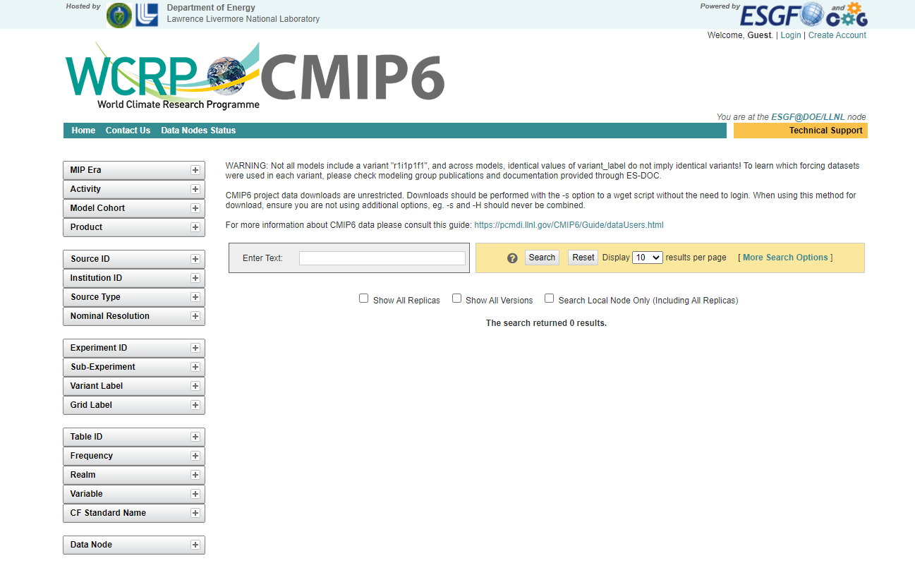
What is PANGEO and what can it be used for?
Mainly US driven initiative
Tool packages which allow to analyse CMIP6 data ‘on the fly’
You can interact with the CMIP6 via python interface
Options:
Pangeo Cloud (AWS, Google)
Pangeo (bring your own machine)

Slide 5
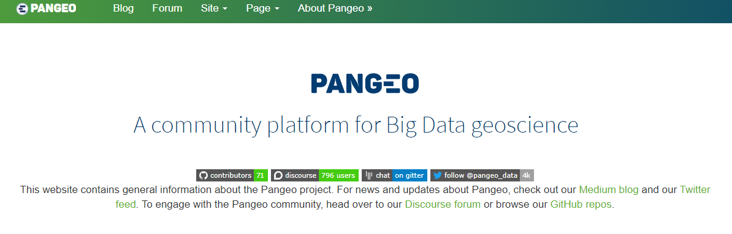
What is PANGEO and what can it be used for?
Mainly US driven initiative
Tool packages which allow to analyse CMIP6 data ‘on the fly’
You can interact with the CMIP6 via python interface
Options:
Pangeo Cloud (AWS, Google)
Pangeo (bring your own machine)
www.pangeo.io

Slide 6
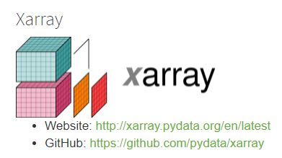


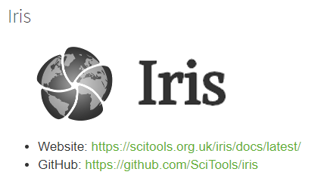
What is PANGEO and what can it be used for?
Mainly US driven initiative
Tool packages which allow to analyse CMIP6 data ‘on the fly’
You can interact with the CMIP6 via python interface
Options:
Pangeo Cloud (AWS, Google)
Pangeo (bring your own machine)

Slide 7
What is PANGEO and what can it be used for?
CMIP6 datastore
Mainly US driven initiative
Tool packages which allow to analyse CMIP6 data ‘on the fly’
You can interact with the CMIP6 via python interface
Options:
Pangeo Cloud (AWS, Google)
Pangeo (bring your own machine)
What data is available?
Analyse the data

Slide 8

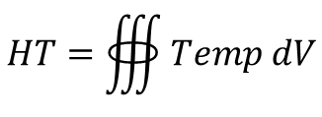
What is PANGEO and what can it be used for?
Mainly US driven initiative
Tool packages which allow to analyse CMIP6 data ‘on the fly’
You can interact with the CMIP6 via python interface
Options:
Pangeo Cloud (AWS, Google)
Pangeo (bring your own machine)
Dynamic data allocation
Lazy computation
1Gb
1Gb
1Gb
1Gb
1Gb
1Gb
1Gb
1Gb
1Gb
1Gb
1Gb
1Gb
1Gb
1Gb
1TB
20Gb
1Gb
1Gb
1Gb
1Gb
1Gb
1Gb
$$HT=∰{Temp dV}$$

Slide 9
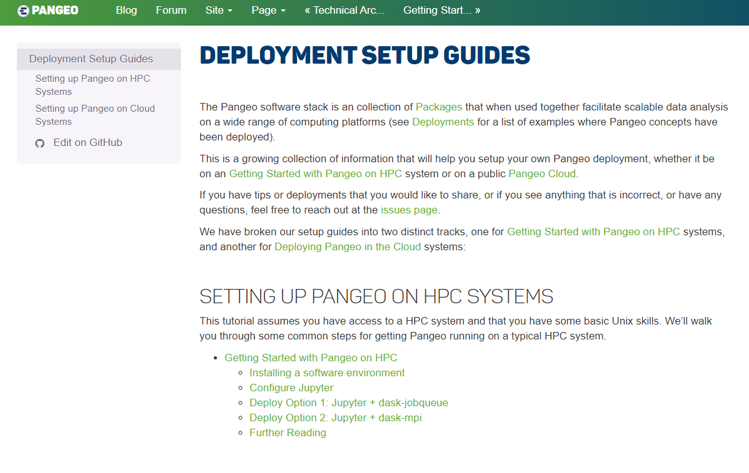
Technical setup
Setup python environment
Allocate resources
Get going

Slide 10
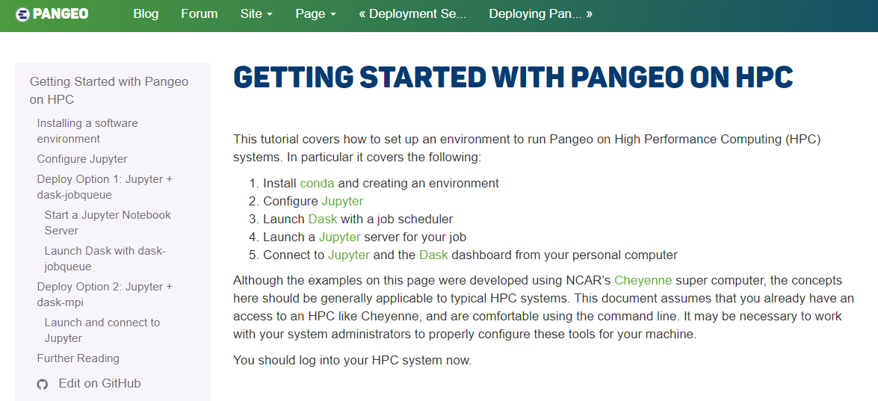
Technical setup
Setup python environment
Allocate resources
Get going
#create a python environment
module load Anaconda3
conda create -n pangeo -c conda-forge python dask jupyterlab dask-jobqueue ipywidgets xarray zarr numcodecs hvplot geoviews datashader jupyter-server-proxy widgetsnbextension dask-labextension gcsfs intake intake-esm
*NESI

Slide 11
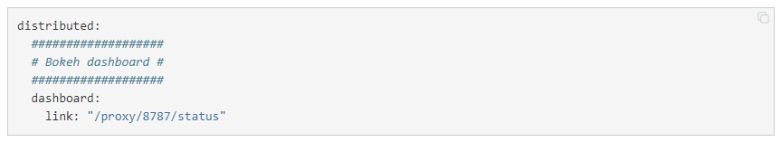
Technical setup
# configure dask
.config/dask/distributed.yaml
*NESI
Setup python environment
Allocate resources
Get going

Slide 12
Technical setup
Setup python environment
Allocate resources
Get going
# allocates CPUs and lets you work interactive
srun --x11 --account niwa02764 --job-name "dask" --cpus-per-task 4 --mem-per-cpu 30Gb --time 03:00:00 --pty bash
*NESI

Slide 13
Technical setup
Setup python environment
Allocate resources
Get going
# work interactively on reserved CPUs/node
# ssh –Y into allocated node/cpu or use the terminal
# where you run srun command
module load Anaconda3
source activate pangeo
#launch jupyter …
*NESI

Slide 14
Technical setup
Setup python environment
Allocate resources
Get going
… python example
*NESI

Slide 15
Thanks you …
Questions?

