Slide 1
OMSBA 5305 DTC May, Jarrod Vierela, Michael Hales, Chris Erik Campbell

Slide 2
Introduction

Slide 3
Data Set & Info.
Federal Reserve Bank of St. Louis Indexed Aggregate Weekly Hours of All Employees
(private employers & Indexed to 2007 = 100
Frequency :Monthly & Seasonally Adjusted
Dates:Mar 2006 –MAR 2023
N =205,
Variable Total = 2
Month/Year
Average Weekly Hours All Employees (AWHAE) Indexed to 2007 (100)
source https://fred.stlouisfed.org
Libraries & Packages
tidyverse
stats
forecast
readxl

Slide 4
“20k Foot Picture” Research Question /Design
Investigate state tax revenue sources.
Compare and contrast Washington state tax revenue to other state tax revenue.

Slide 5
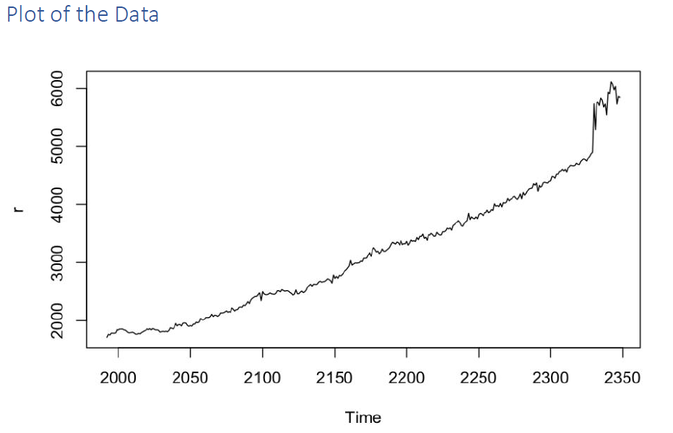
Plot 1-Raw
Trends
Seasonality
Plot to Demonstrate Stationary

Slide 6
“ Estimated ACF & PACF
a. Plot + describe/rationale how works, “Both ACF and PACF plots are decaying and fail to cut at a finite value. This suggests the process has both an AR and an MA component.
b. Q-Test to verify white-noise.
c. Histogram of residuals with a normal distribution

Slide 7
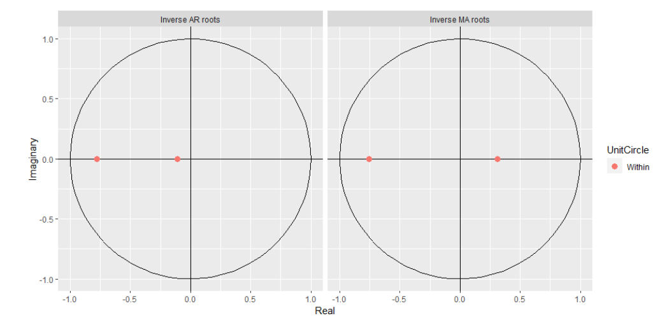
Model Selection and Validation
Results– table in accordance with Table 8.2 (text pp. 214)
Inverted roots of AR and MA terms. The visualization of inverted roots shows that all of the inverse roots lie within the unit circle, confirming that the model is both stationary and invertible.

Slide 8
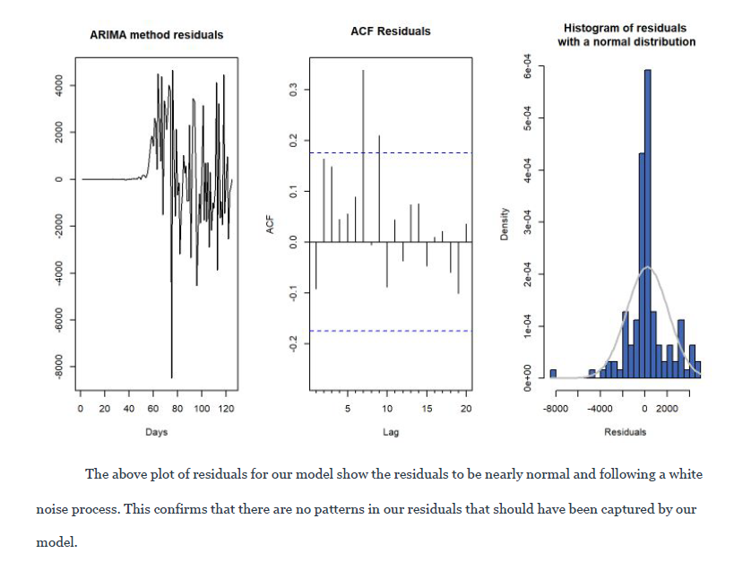
TBD
“The plots above of residuals for our model show the residuals to be nearly normal and following a white noise process? This is indicative that there are no patterns in our residuals that should have been captured by our model.”
6 month (h = 6) forecast.
Plot multistep of forecasts and CI bands for each specification and comment on preferred model.

Slide 9
“ Major Tax Sources & Revenue - EC
Visualizations?
Per capita, 2020 for major C codes and T01 and any other variable of interest

Slide 10
“ Major Tax Sources & Revenue – EC Continued
Visualizations?
Per capita, 2020 for major C codes and T01 and any other variable of interest

Slide 11
“ Major Tax Sources & Revenue – EC Continued
Visualizations?
Per capita, 2020 for major C codes and T01 and any other variable of interest

Slide 12
“ Major Tax Sources & Revenue – EC Continued
Visualizations?
Per capita, 2020 for major C codes and T01 and any other variable of interest

Slide 13
“ Major Tax Sources & Revenue – EC Continued
Visualizations?
Per capita, 2020 for major C codes and T01 and any other variable of interest

Slide 14
“ Major Tax Sources & Revenue – EC Continued
Visualizations?
Per capita, 2020 for major C codes and T01 and any other variable of interest

Slide 15
“ Major Tax Sources & Revenue – EC Continued
Visualizations?
Per capita, 2020 for major C codes and T01 and any other variable of interest

Slide 16
“ Washington State Tax Sources– JT
Visualizations?
Per capita, 2020 for major C codes and T01 and any other variable of interest

Slide 17
“ Washington State Tax Sources– JT Continued
Visualizations?
Per capita, 2020 for major C codes and T01 and any other variable of interest

Slide 18
“ Washington State Tax Sources vs. Other States with Similar Tax Sources? – JT?
Visualizations?
Per capita, 2020 for major C codes and T01 and any other variable of interest

Slide 19
Wa
Visualizations?

Slide 20
GDP per capita 2000-2020 - EC
Visualizations?

Slide 21
References/ Questions
Zhang, H, M. (2018, SEP 1). “Analysis and Prediction of Employee Turnover Characteristics based on Machine learning”. Hunan University. Retrieved OCT 22, 2022, from https://www.researchgate.net/publication/329959522_Analysis_and_Prediction_of_Employee_Turnover_Characteristics_based_on_Machine_Learning
Questions:
ecampbell@seattleu.edu
campbell.erik@gmail.com
206-225-9878

