Slide 1
ICF
Image Classification Framework
An MLSP Project by Erik Deinzer

Slide 2
Overview
Project Overview
Model
Framework
Results
Training Progress

Slide 3
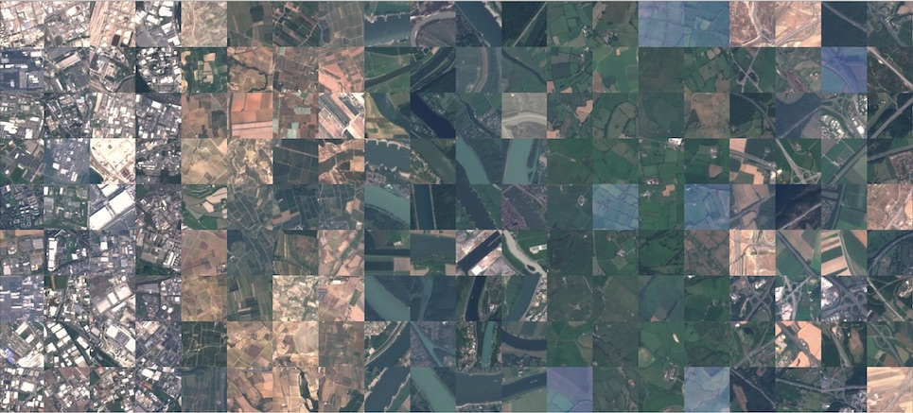
Project Overview
Objective: Classify satellite images into 10 land use classes
Dataset: EuroSAT
  27k Images (64x64, RGB, 640mx640m)
Hardware: 1 NVIDIA A100-SXM4-40GB
Approach: ResNet-18 with FFN
EuroSAT Patches [1]

Slide 4
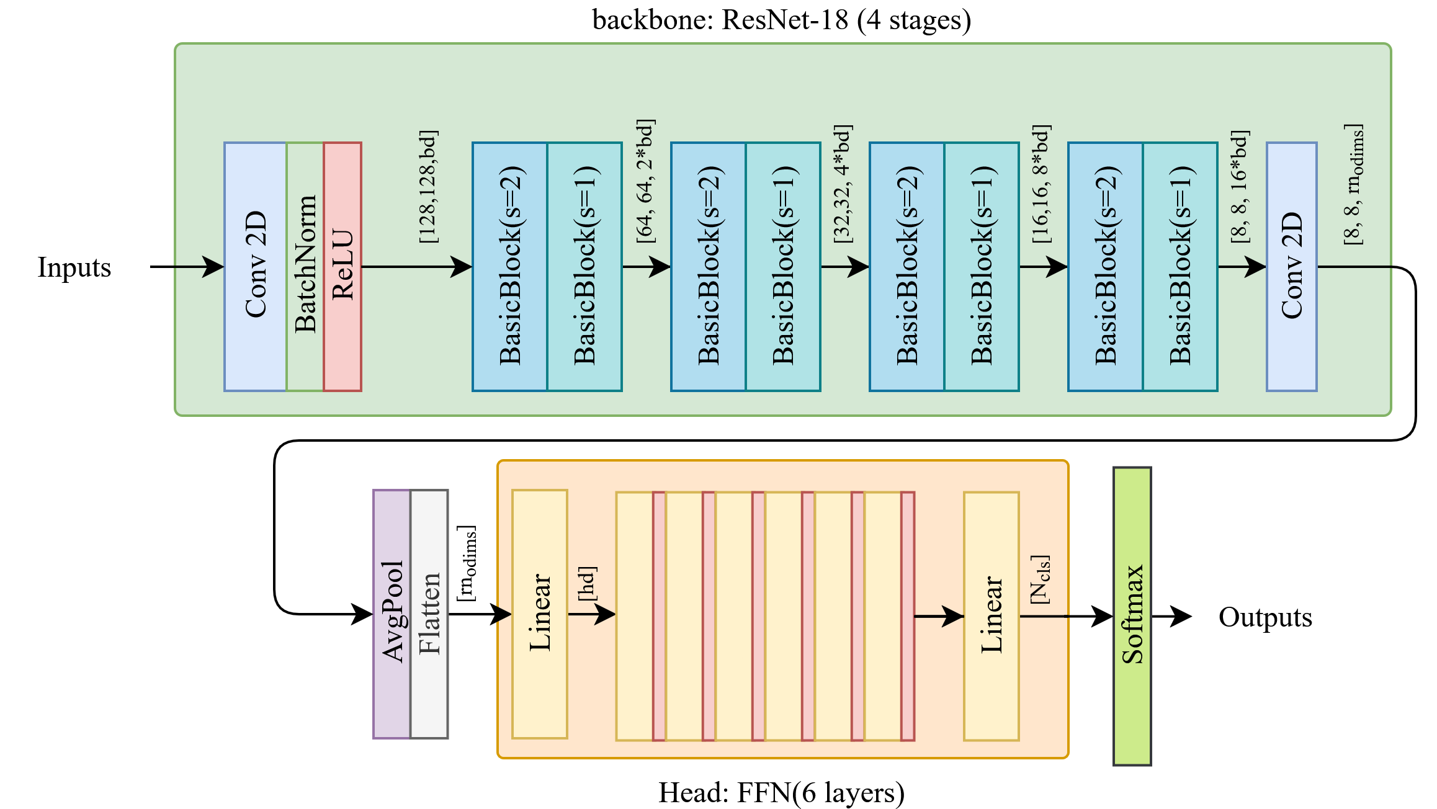
Model
Backbone: ResNet-18 (1.58M P)
Baseline:
  BB + AvgPool + Softmax
Own Idea:
  BB + FFN-Head(4.5M P)
Features:
  Dropout
  Transfer-Learning (ImageNet-Tiny)
  Augmentations
  Early Stopping
  Checkpoint logging

Slide 5
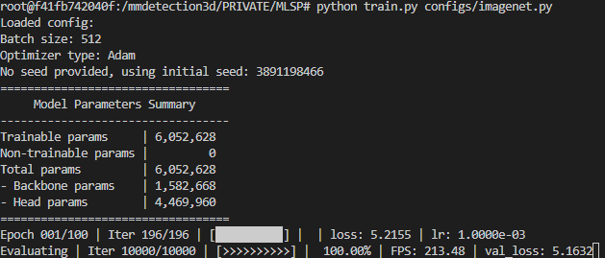
Config-based Framework
Define Model architecture by simple config dict
Architecture similar to mmdetection/mmdetection3d
Registries register both custom modules and most of PyTorch, allowing high modularity and extendability

Slide 6
Results
Model | PT | Aug | mAP | F1 | FPS
Baseline | - | + | 98.31 | 91.76 | 270
RN-T + FFN | - | - | 97.95 | 92.44 | 255
RN-T + FFN | - | + | 98.36 | 93.55 | 255
RN-T + FFN | + | - | 98.78 | 95.34 | 255
RN-T + FFN | + | + | 98.85 | 95.53 | 255
RN-L + FFN | - | - | 98.49 | 94.22 | 230
RN-L + FFN | + | + | 98.81 | 95.86 | 230
Model and Baseline achieve SOTA performances
With >250 FPS both models qualify as RT-suitable for most cases
In Transfer Learning, top-performances on the Pretraining aren‘t necessary for performance boosts
RN-T: 1.58M P, base_dims=12, odims=64
RN-L: 11.4M P, base_dims=32, odims=512
Model | Aug | mAP | F1 | FPS
RN-T + FFN | + | 35.62 | 34.37 | 255
RN-L + FFN | + | 34.17 | 32.89 | 230
Training on ImageNet

Slide 7
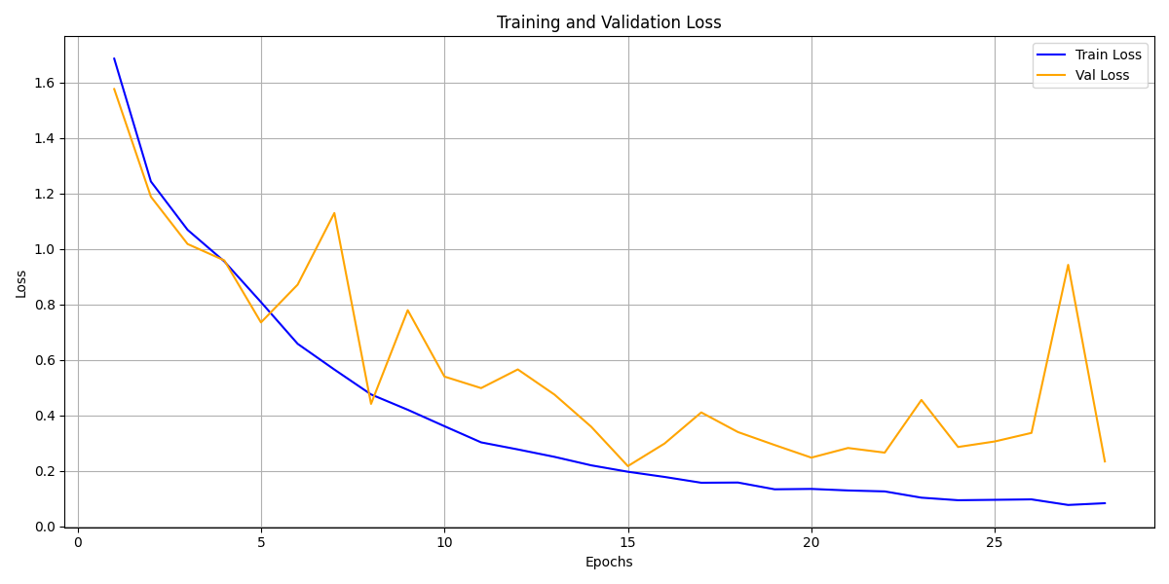
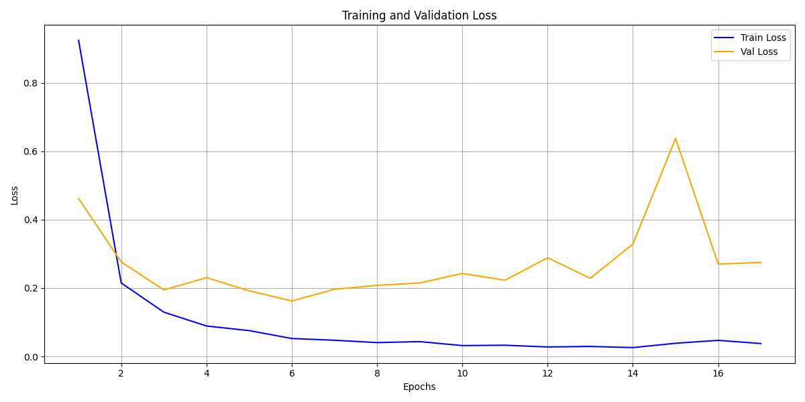
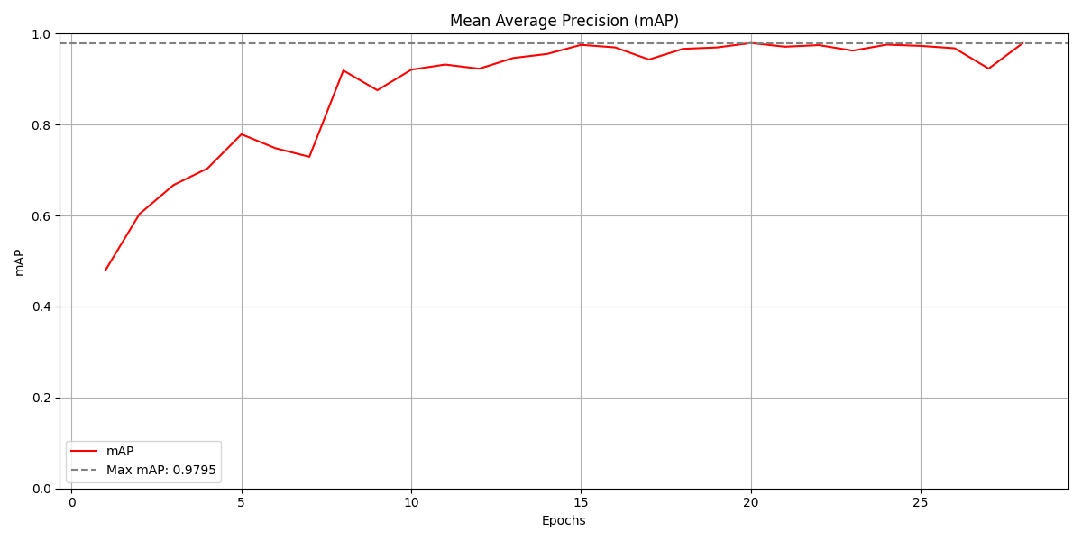
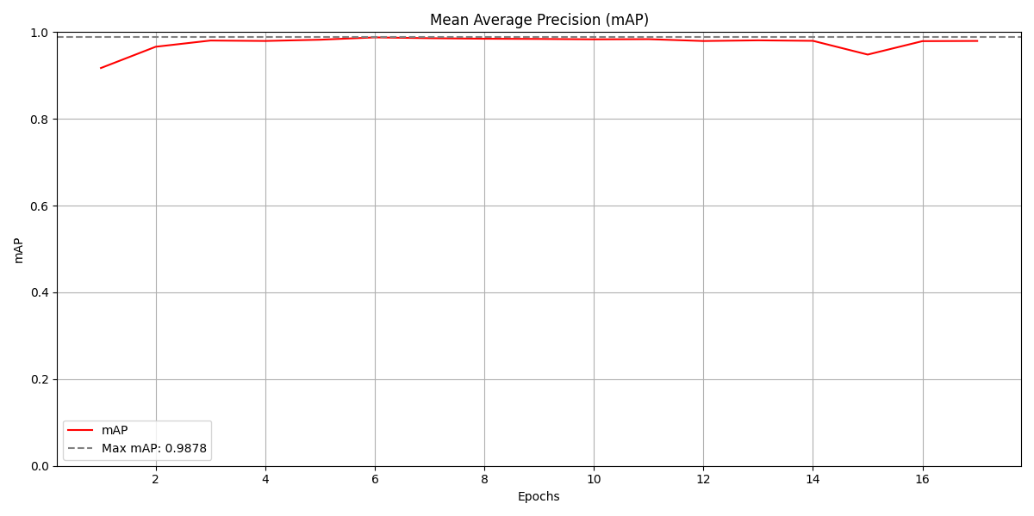
Training Progress
ResNet-18 + FFN
ResNet-18 + FFN + Pretraining

Slide 8
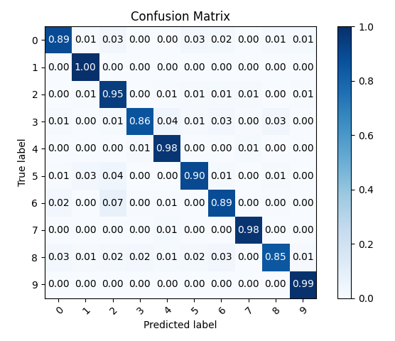

Confusion Matrices
ResNet-18 + FFN
ResNet-18 + FFN + Pretraining

Slide 9
Thank you for your Interest!

Slide 10
References
[1] https://github.com/phelber/eurosat

Slide 11
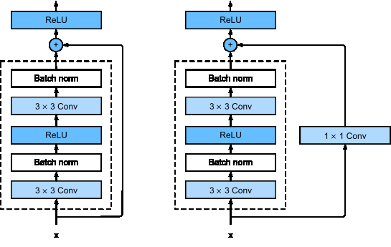
Backup: Basic Block

