Slide 1
Why do opinion polls often get it wrong?
Open Forum, Monday 8 October
Erik Gahner Larsen

Slide 2
Do polls get it wrong?

Slide 3
My argument:
Most polls are doing just fine.
The way they are covered in the media is less fine…

Slide 4
Two issues with the coverage:
1) Percentage forecasts
2) The selection of opinion polls

Slide 5
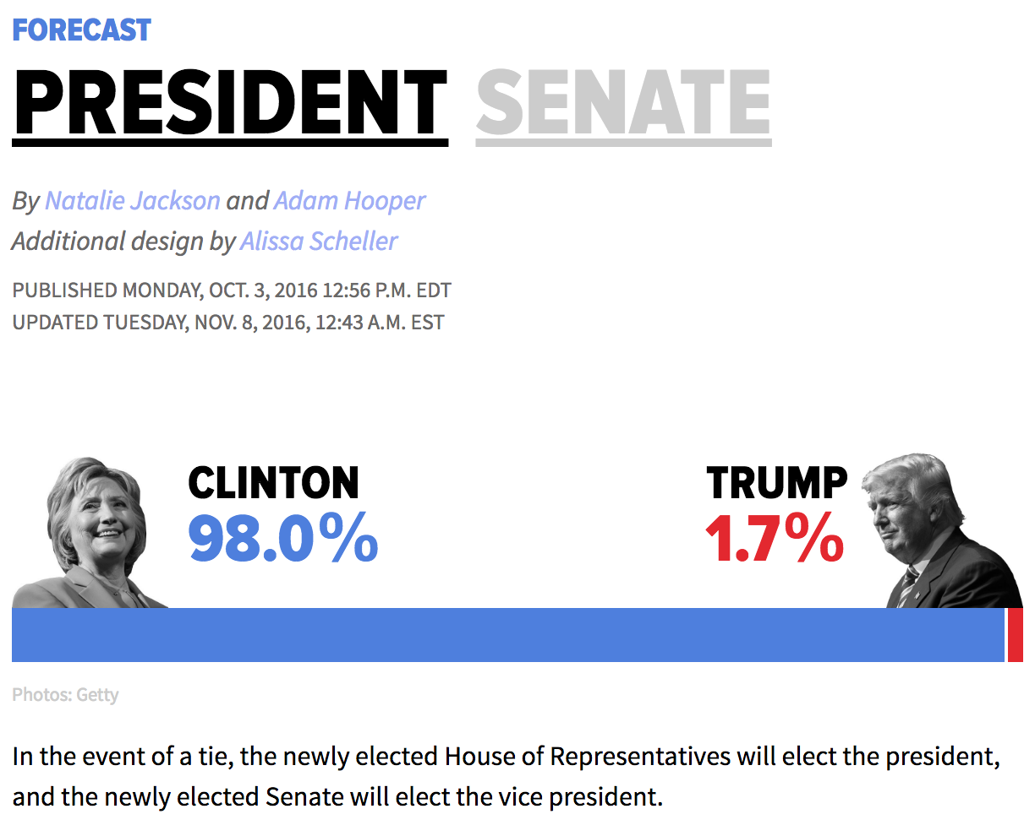
Notes:
http://elections.huffingtonpost.com/2016/forecast/president

Slide 6
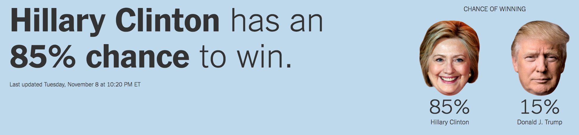
Notes:
https://www.nytimes.com/interactive/2016/upshot/presidential-polls-forecast.html

Slide 7
What is 85%?
5/6 ≈ 83%
(roll of the dice)

Slide 8
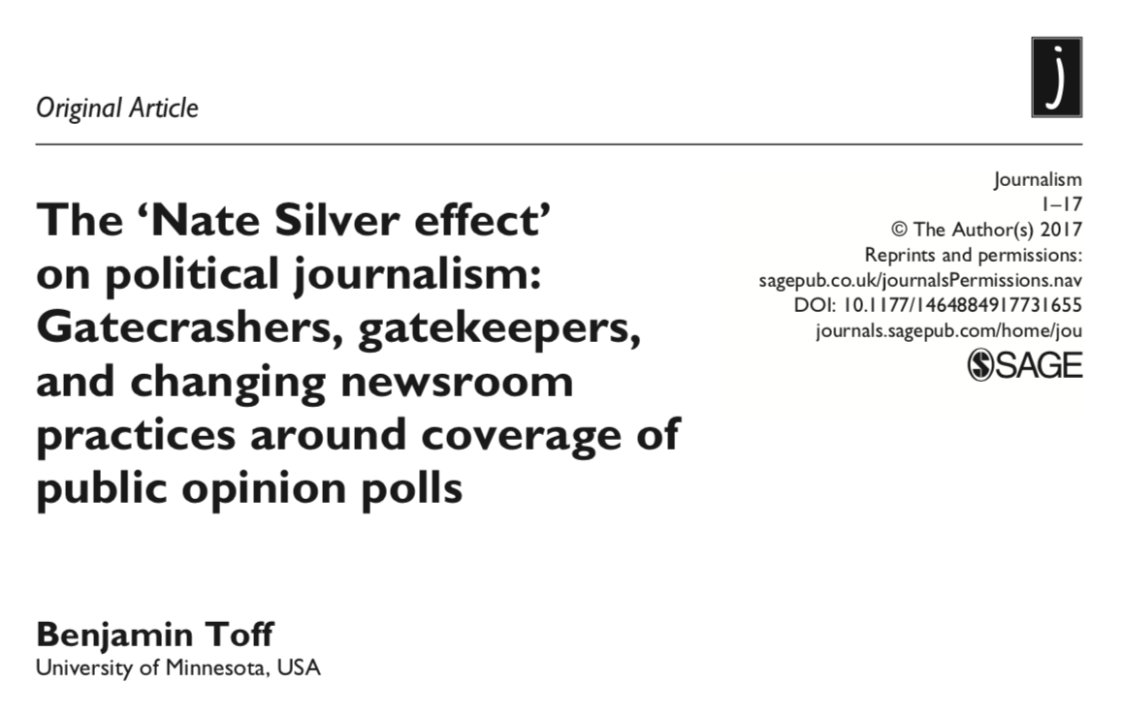
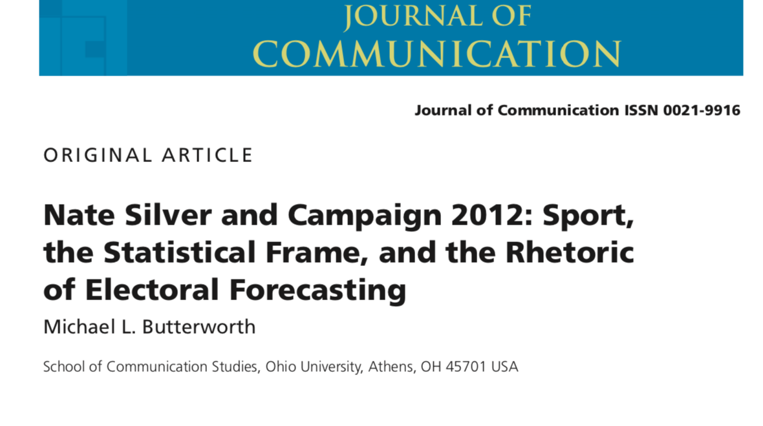

Slide 9
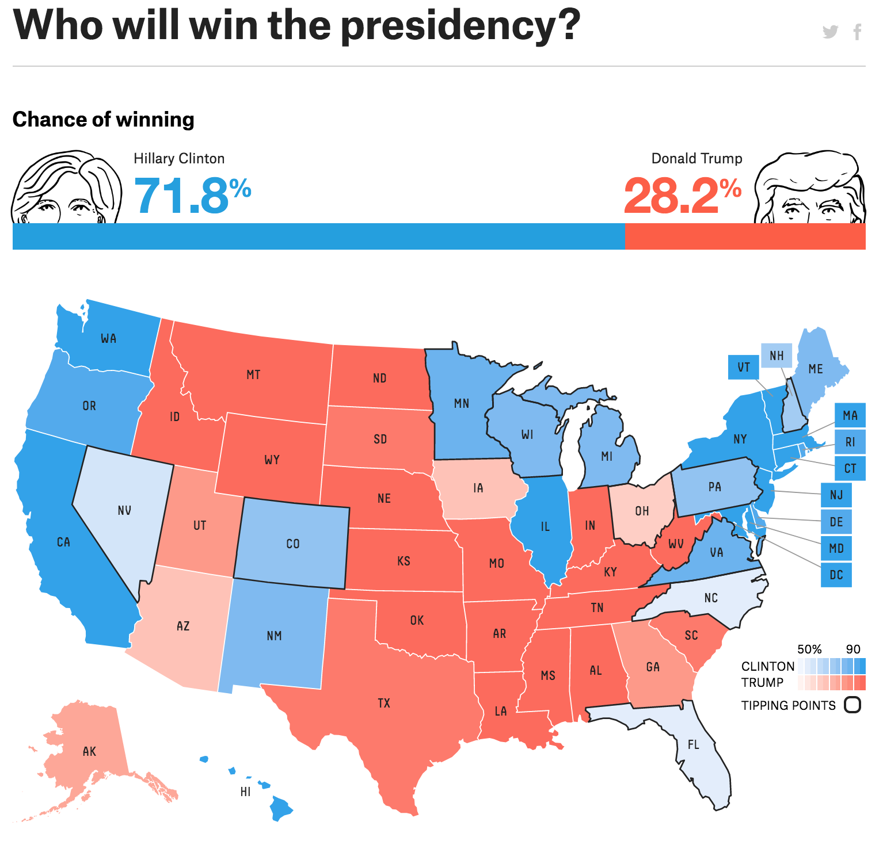
Notes:
https://projects.fivethirtyeight.com/2016-election-forecast/#plus

Slide 10
Be critical when you see predictions in percentages!
“75% chance for Y”

Slide 11
What could a 75% chance for a Leave vote look like?
53% support Leave
47% support Remain

Slide 12
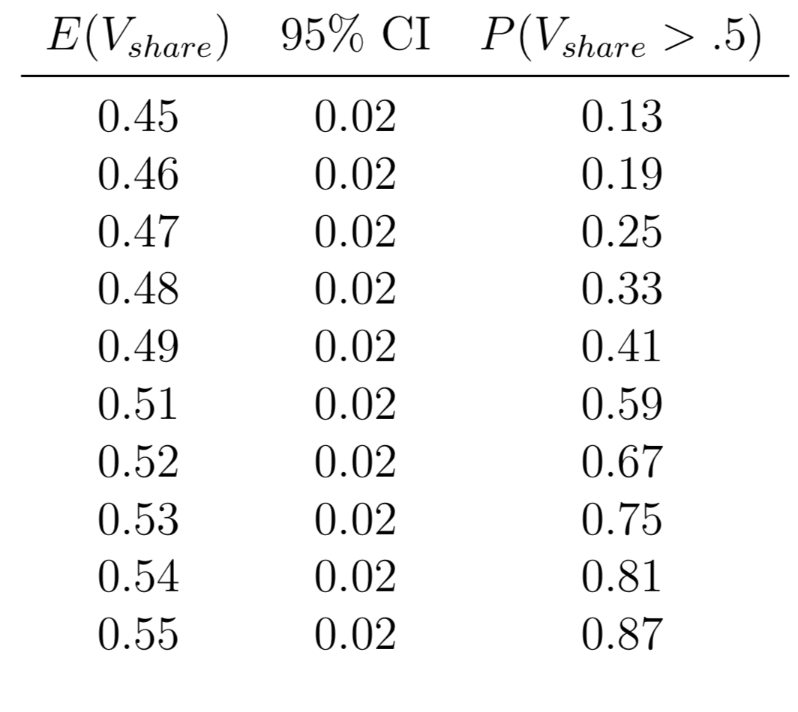

Slide 13
Do people perceive the probability of a win as greater when presented with a percentage forecast?

Slide 14
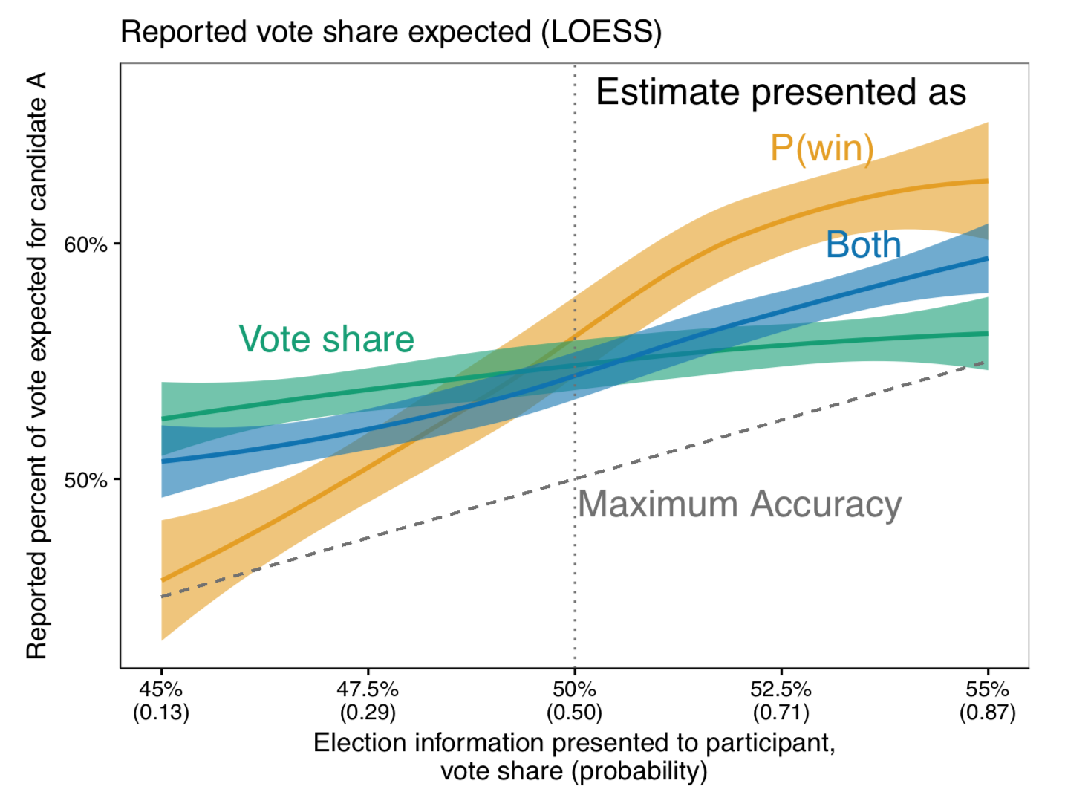

Slide 15
Second problem:
The selection of polls being covered

Slide 16
What is going on in most polls?
Nothing.

Slide 18
Most polls show little to no change over short periods of time!
Why do we see so many stories about change?

Slide 19
Media outlets select “outlier” polls and write about changes (even when there is no change!)

Slide 22
So there are problems with the coverage? What about the polls themselves? Are they wrong?

Slide 23
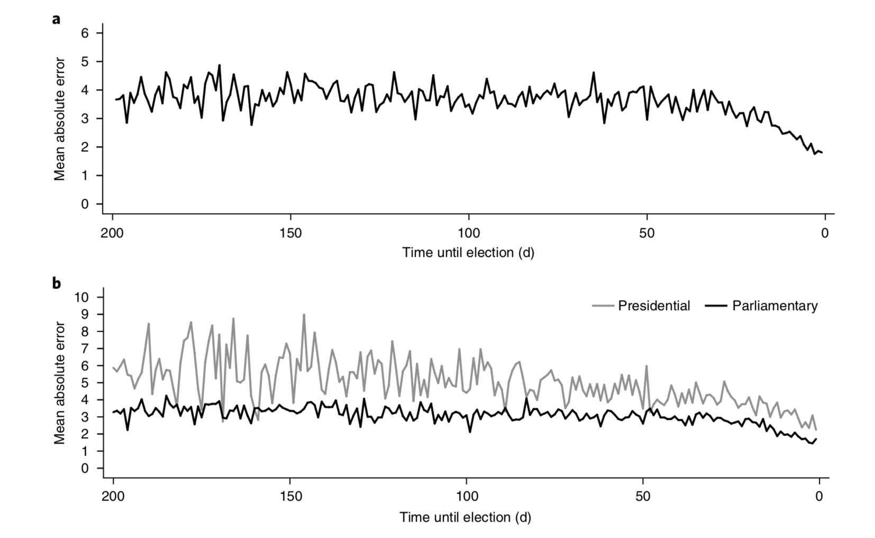

Slide 24
But are polls more likely to be wrong today?

Slide 25
But are polls more likely to be wrong today?
NOPE

Slide 26
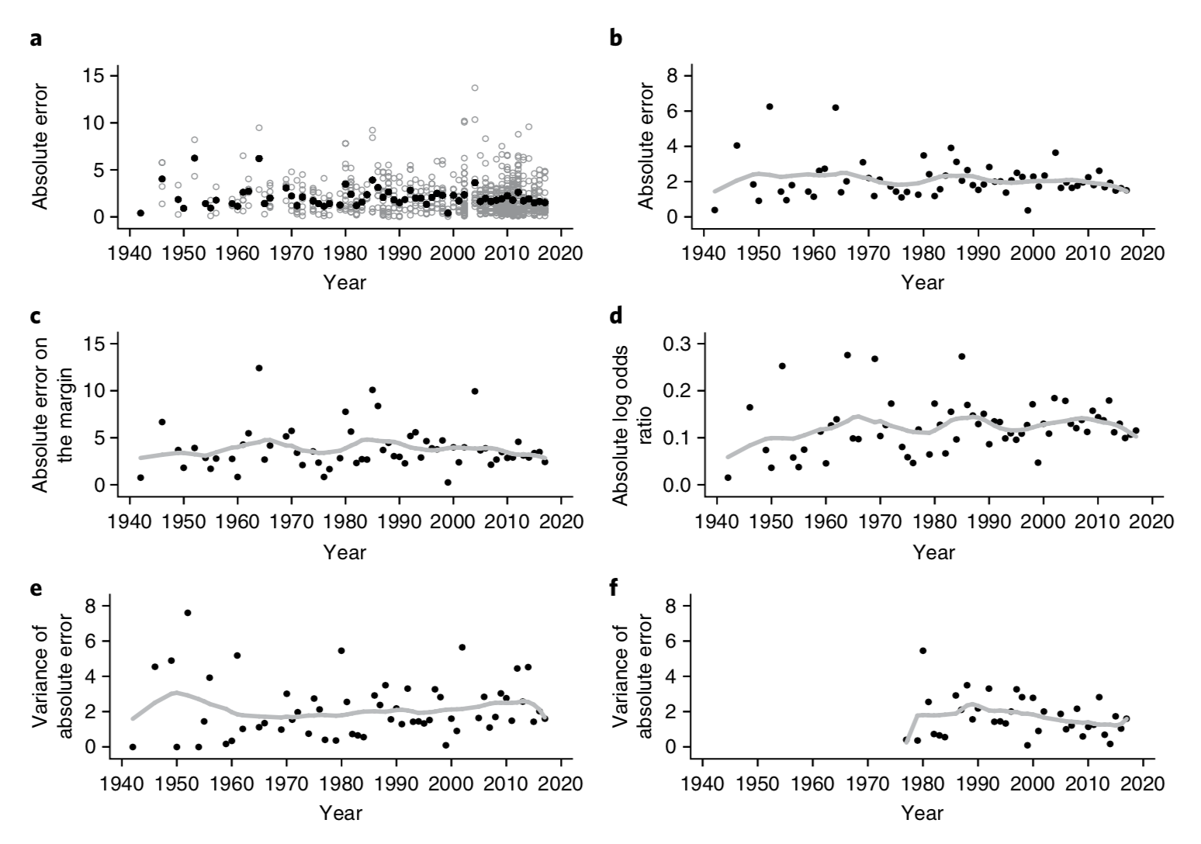

Slide 27
We remember the bad polls and forget the good polls!

Slide 28
Polls are not perfect, but…
What is the alternative?

Slide 29
How can we make sure journalists cover polls in a good way?

Slide 30
What are the effects of opinion polls?
Are opinion polls self-fulfilling prophecies?

Slide 31
Should we forbid opinion polls during election campaigns?

Slide 32
Questions?

