Slide 1
Thesis Update #8
May 6, 2019
James Erik Groving Meade

Slide 2
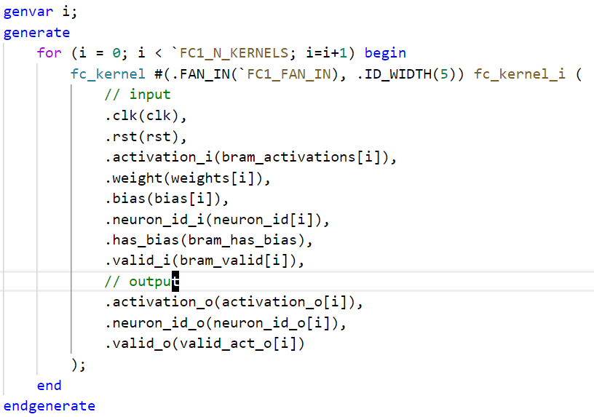
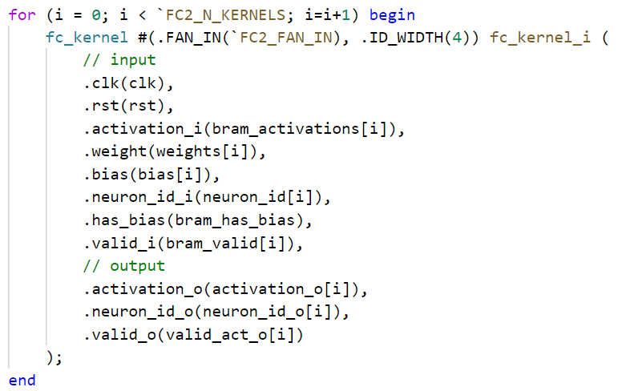
Work Completed Since
Went through many redesigns of the proposed architecture, but settled on a solution, scheduler and general layer layout complete
Modules for scheduler and kernel are parameterized so that every layer uses the same modules, just with different parameters, example for fc1 and fc2 on right

Slide 3
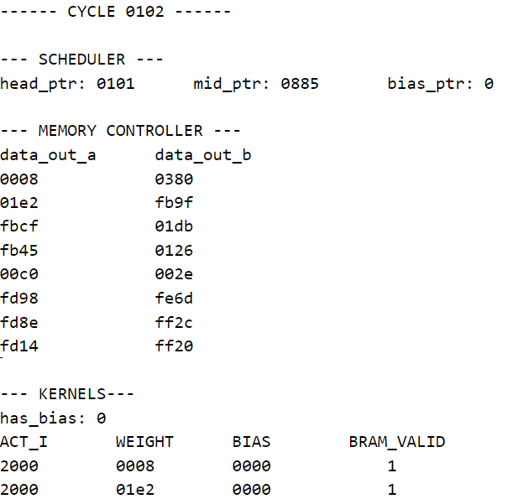
Testbenches
Testbenches for the scheduler and FC1 layer have been written and are passing
Cycle information is printed out during simulation for ease of debugging
Example to the right

Slide 4
Testing
Using Vivado’s TCL console to launching simulations and output to a simulation result file
Uses the BRAM loaded with coefficients for the layers
Activations loaded from testbench, next will use testbench on the network top module where activations will be loaded from BRAM
Wrote a python script which reads the binarized coefficient files used for the weight BRAMs and computes a forward pass to verify the results from the testbench

Slide 5
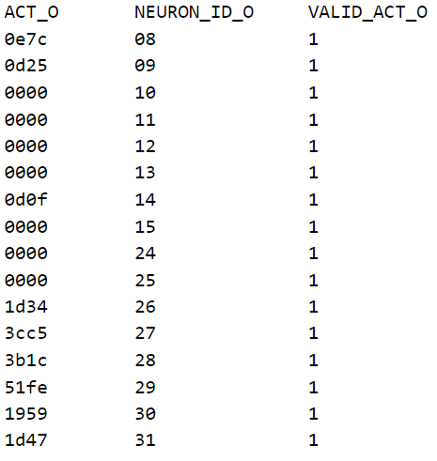
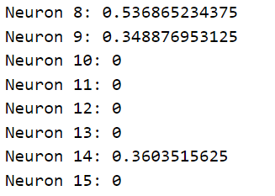
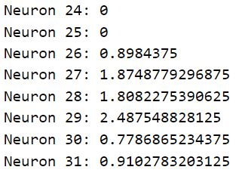
FC1 Testbench Comparison of Results
Python Test Script Output
FPGA Testbench Output
Q3.13 to decimal
0e7c – 0.453
0d25 – 0.411
0d0f – 0.408
1d34 – 0.913
3cc5 – 1.899
3b1c – 1.847
51fe – 2.562
1959 – 0.792
1d47 – 0.915

Slide 6
Analysis
Results show that the overall results tend to be pretty good with Q3.13
FC1 performs 392 MACs for each neuron, rounding error accumulates for each MAC, but end result is pretty close to the floating point values of the python script

Slide 7
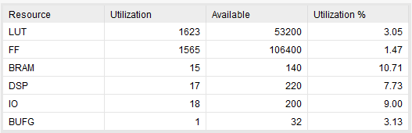
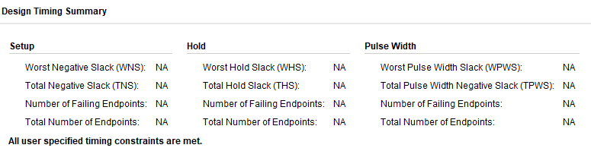
Resource Usage
Resource usage for the FC1 and FC2
Since focusing on fully connected to work on training later, probably will have one more FC0 layer, using 14x14 pooled input image with 392 (8 * 7 * 7) neurons, feeding into FC1

Slide 8
Next Steps
Create and test testbench for the full network, working on logic for the BRAMs used to store activations in between layers
Verify on FPGA using randomized data after testbench passes
Start on backward pass

