Slide 1
Thesis Update #12
June 13, 2019
James Erik Groving Meade

Slide 2
Demo!
Inference-only
2. Training with small dataset and frequent stat updates shown
3. Training speed with total disregard for results, only used to show performance with regard to how fast training occurs

Slide 3
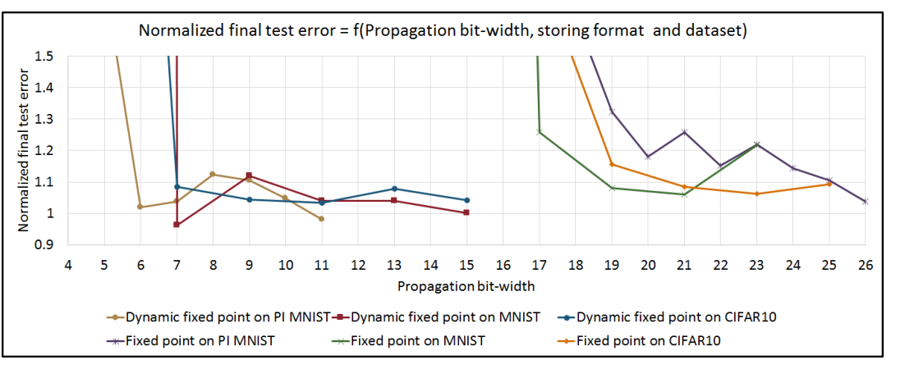
What’s going on, if the gradients calculated are correct, why isn’t it training to perfection!
This reminded me of a paper I read back in February
The below graph was a part of it, more on this later in the meeting

Slide 4
Updates
Implemented a softmax layer to compute a proper loss
Gradient checking in python script verifies that the gradients were indeed correct
Precision issues
Created memory map through DDR SDRAM between ARM and FPGA
Wrote C programs to perform various functions on the FPGA
Created custom PetaLinux image with the bitstream. Put the MNIST dataset and a few C programs the SD card.

Slide 5
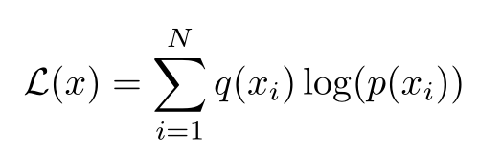
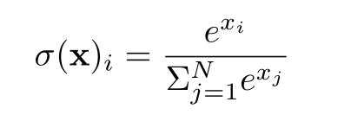
Softmax Layer
Why?
Needed to calculate using an actual loss function for gradients, otherwise unable to learn properly
Softmax is one of the best loss functions for training neural networks
Mathematically:

Slide 6
Softmax Layer Structure
Pipelined for the 10 output neurons
Convert to float
Perform e^{x}
Convert back to fixed
Sum all e^{x}
Divider core
Derivative is quite simple for softmax. It is just the output of the softmax for non-label neurons, and output minus 1 for the label neuron

Slide 7
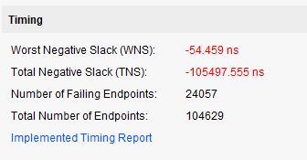
Also… don’t set the divider IP core to 1 cycle

Slide 8
Verification of Softmax
… I found out that SystemVerilog/Verilog can print out floating point, so it’s quite quick to visually verify now.

Slide 9
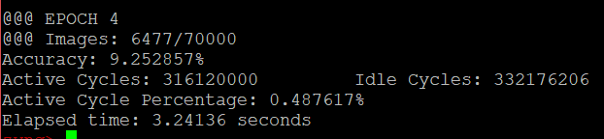
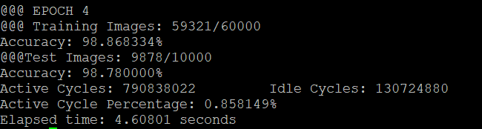
FPGA Clock Frequency
FPGA being at 50 MHz, should I try to get it back to 100 MHz?
No, DDR transmission is the bottle neck, as observed by the active cycle percentage
Also, active cycle percentage is ~2x for training compared to inference.
This is because training is ~2x more cycles, so roughly ~2x more time to load the next image
Inference
Training

Slide 10
Timing/Results
Faster than CPU by a lot
GPU
Faster for batch size of 1, but I discovered the GPU doesn’t parallelize by single input, it parallelizes by batch. So Batch size of 10 is roughly 10x faster than 1. Not entirely linear, but batch size of 200 is

Slide 11
Results
Will I be able to

Slide 12
Exam Date
Thesis hand-in is on Friday, June 28, I fly to the US on Wednesday, July 10.
We have tentatively scheduled the exam for July 8, 2019.

