Slide 1
Thesis Update #11
June 3, 2019
James Erik Groving Meade

Slide 2
Hardware Model Update Overview
Implemented and verified backpropagation architecture for all layers
Implemented and verified weight update phase for all layers
Implemented a state machine for each layer to allow “looping” through the states, i.e:
Forward – wait for gradients to be ready – backward – update weights – forward – ….

Slide 3
Differences in backpropagation for previous layers
Fc0 and fc1 both need to know the input and output activation of the neuron, fc2 only needed the input activations so a bit more data needed to be rerouted to back prop module
To backprop neuron gradients for fc0 in fc1, need to sum reduce 16 values in a cycle
Added a 5-stage pipelined addition reduction module
16 – 8 – 4 – 2 – 1 – Write to output (5 stages)

Slide 4
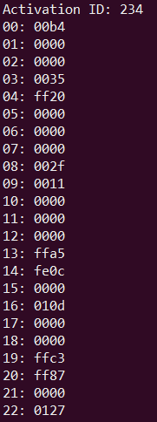
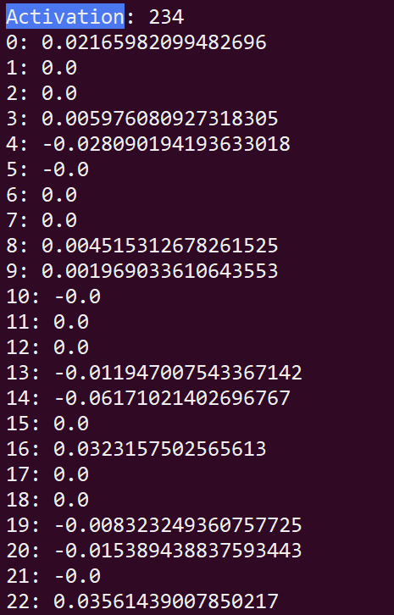
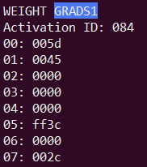
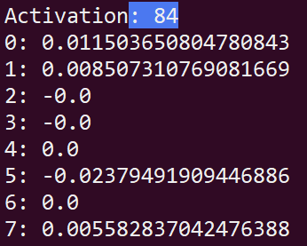
Verification of BP for FC0 and FC1 layers
There are 76,832 gradients for FC0 and 6,664 for FC1… I’ll just randomly choose a few gradients for this ppt. I do have all 80,000+ gradients available if other gradients want to be checked
weight₂₃₄ for neurons 0-22 in layer 0. Signs all align, value checked for neuron 0, 14, 22
0.0219
weight₈₄ for neurons 0-7 in layer 1
-0.06104
0.03601

Slide 5
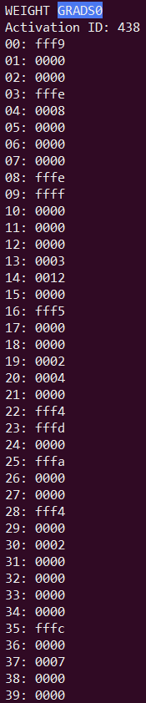
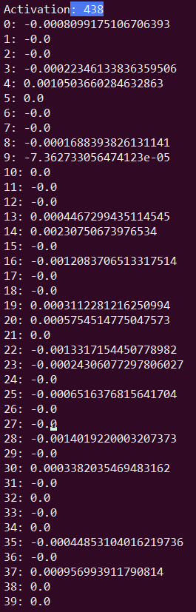
Vanishing Gradient Problem
Add one propagates through the layers, the gradients of the weights becomes less and less. See the gradients for weight₄₃₈ of layer 0 neurons on the right
Current learning rate is 0.125, which is quite high, 3 right bit shifts. For some of the gradients, this means that the change to the actual weight will be 0 in the update phase

Slide 6
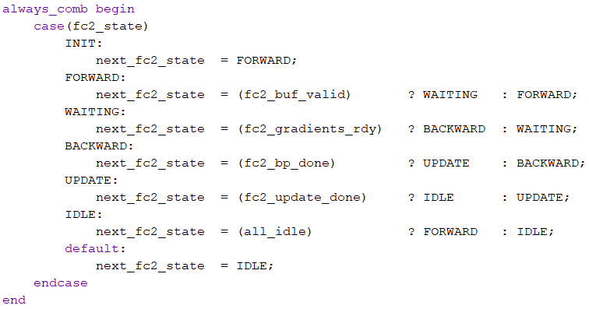
Layer States Currently designed to train constantly over provided input

Slide 7
Update Architecture
Idea – Iterate a pointer over the BRAM, updating weights as you go
Two cycles for each pointer iteration
Cycle 1
Read weight_{old} from weight BRAM
Read gradient from weight gradient BRAM
Cycle 2
weight_{new} = weight_{old} + gradient * learning_rate (0.125 in demo, right shift of 3)
Write weight_{new} to weight BRAM
Increment pointer

Slide 8
Simple Functional Test of the Training Cycle
Current input data is still random, but let’s assume it is a ‘0’. Since the loss function is not implemented, we can set the loss gradients to be negative for 0 (if neuron 0’s output increases, loss decreases), and positive for the others
This could be actually be used for the training process down the road since it isn’t so far off from what loss functions are doing
Otherwise, I can implement loss function using sigmoid: tanh(x)=2σ(2⋅x)−1
Tanh is supported with a CORDIC core
Might just be better to set positive gradients for wrong labels and negative for correct for sake of time

Slide 9
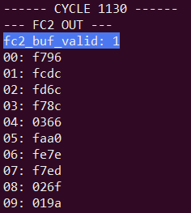
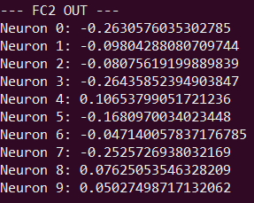
Simple Functional Test of the Training Cycle
Initial Output (Hex simulated and Python script verified)
Out is totally “wrong”, neuron 0 has the 2nd most negative output
Only converted a few hex numbers to decimal because they have been verified before
-0.26294
-0.09814
0.10620

Slide 10
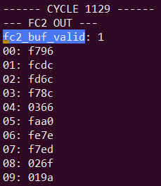
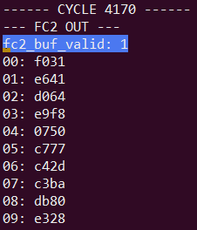
Epoch 1
Observation: 1 training cycle takes 3141 cycles

Slide 11
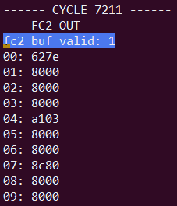
Epoch 2
After 2 epochs, neuron 0 is now the maximum output, also, many of the other neurons are now the lowest possible value, 0x8000. Note, the learning rate is rather high.

Slide 12
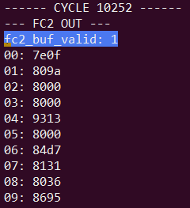
Epoch 3

Slide 13
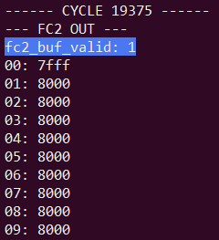
Epoch 6
After 6 epochs, neuron 0 is now the highest possible number, and all the other neurons are the lowest possible number. This training simulation also inadvertently tested my saturation checking.

Slide 14
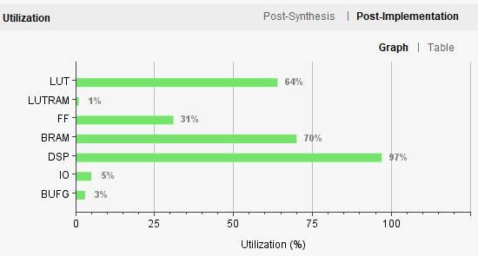
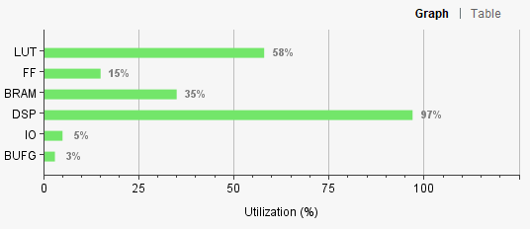
Resource Usage
With weight gradient BRAM
Last week: without weight gradient BRAM

Slide 15
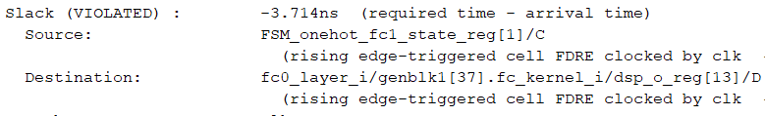
Timing
Previously non-violating regions are now causing slack violations, I believe it is due to the density of resource usage, 7.148 ns on routing.
Haven’t looked into it at all yet though to be honest, would need to investigate, I see it involves the fc1_state register, so it may have been a problem linked to states

Slide 16
Going forward
Report writing
Now that training is working, want to define an actual loss function (or just constant gradients based on label) that can be used with labels for the MNIST images. I estimate that I will be able to put about 100-200 images on the FPGA in BRAM
The backward pass logic has increased resource usage and has resulted in some negative slack, if I have the time I will try to fix this
Ideally, the loss function or signed gradients, although sub-optimal for training, will still be able to realize decent training results, this could allow for a demo

Slide 17
Exam Date
Thesis hand-in is on Friday, June 28, I fly to the US on Wednesday, July 10.
We have tentatively scheduled the exam for July 8, 2019.

